Slide 1
Data Processing Pipeline: From 3D BraTS to Model Input
Harsh Gupta (23U01011) & Mayank Verma (23U01063)

Slide 2
Is the Data 3D or 2D?
The data is 100% processed and trained as 3D.
The model (specifically our ResNet3D backbone) takes in a full 3D chunk of the brain and outputs a full 3D prediction.
It never slices the brain into 2D layers during the mathematical training or inference.

Slide 3
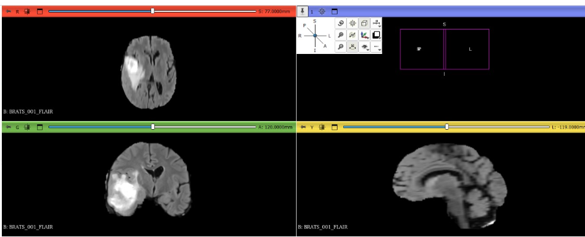
The only reason we saw "2D images" is because a standard computer monitor is flat
To show what the Model did, our scripts take the final 3D block that the given Input→ cut a single flat slice right out of the middle → and save it as a PNG picture.

Slide 4
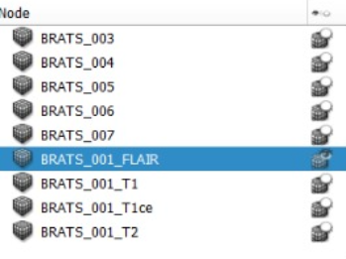
Anatomy of a Patient: The BRATS\001
The dataset provides one master file that contains 4 distinct layers (modalities).

Slide 5
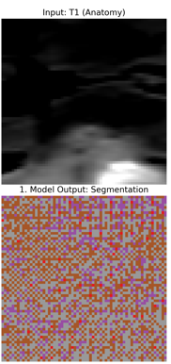
The 4 Modalities in BRATS\001:
T1 (Channel 1):
The Anatomy scan.
It shows the healthy structures clearly so the Model knows what a normal brain looks like.

Slide 6
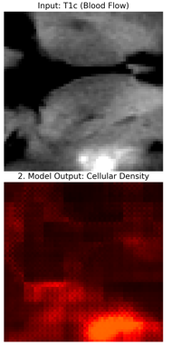
The 4 Modalities in BRATS\001:
T1ce (Channel 2):
The Contrast scan.
A special dye was injected into the patient.
This dye "lights up" the aggressive, blood-rich core of the tumor.

Slide 7
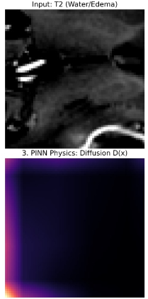
The 4 Modalities in BRATS\001:
T2 (Channel 3):
Specifically highlights different types of fluid.
Helping distinguish the solid tumor from cystic (liquid-filled) pockets.

Slide 8
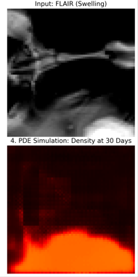
The 4 Modalities in BRATS\001:
FLAIR (Channel 0):
Used to see Edema (swelling).
Fluid glows bright,
making it easy to see where the tumor is pushing against the brain.

Slide 9
The Step-by-Step Processing "Factory"
Before the model sees the data, it goes through a "Machine Learning Factory"
Here is the exact journey of Patient BRATS\001:
Step 1: Loading & Stacking
Step 2: Spatial Calibration (Orientationd & Spacingd)
Step 3: Intensity Normalization (NormalizeIntensityd)
Step 4: Brain Extraction (CropForegroundd)
Step 5: Final 3D Shaping (The "Passport Photo" Step)

Slide 10
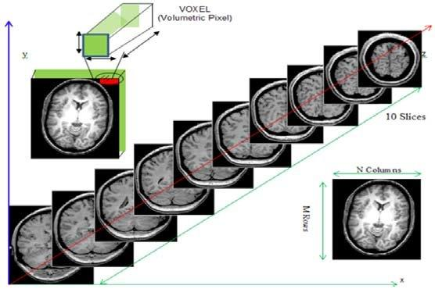
Step 1: Loading & Stacking
Action: The 4-channel NIfTI file is loaded into memory.
Result: A massive 4-dimensional matrix of numbers.

Slide 11
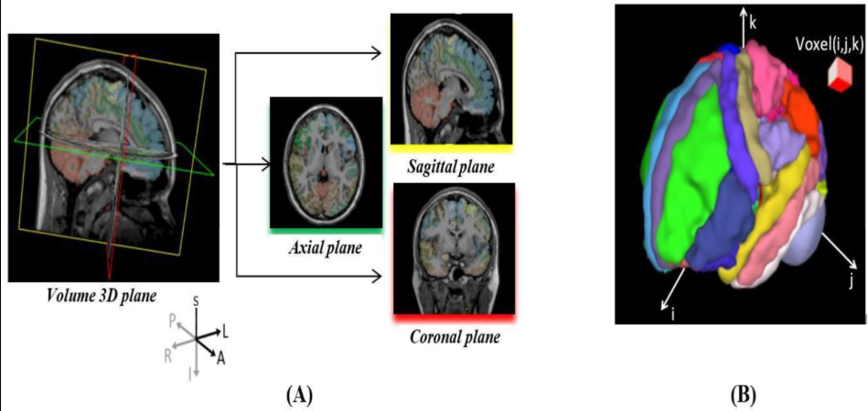
Step 2: Spatial Calibration (Orientation & Spacing)
We force the brain into RAS Orientation (Right-Anterior-Superior).
Spacing: We resample the pixels so 1 pixel = exactly 1mm of physical space.
Why? → To ensure "Up" is always up and "Left" is always left, regardless of how the patient was lying in the MRI machine.

Slide 12
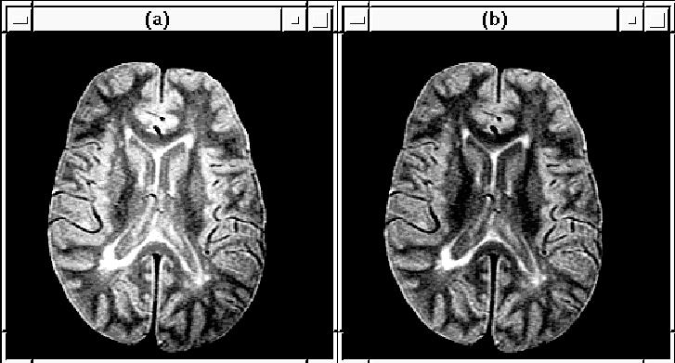
Step 3: Intensity Normalization (NormalizeIntensity)
Action: We adjust the brightness of all 4 channels.
Result: The Model sees "normalized" values instead of raw house-dependent brightness. This allows the Model to work on any hospital's MRI machine.

Slide 13
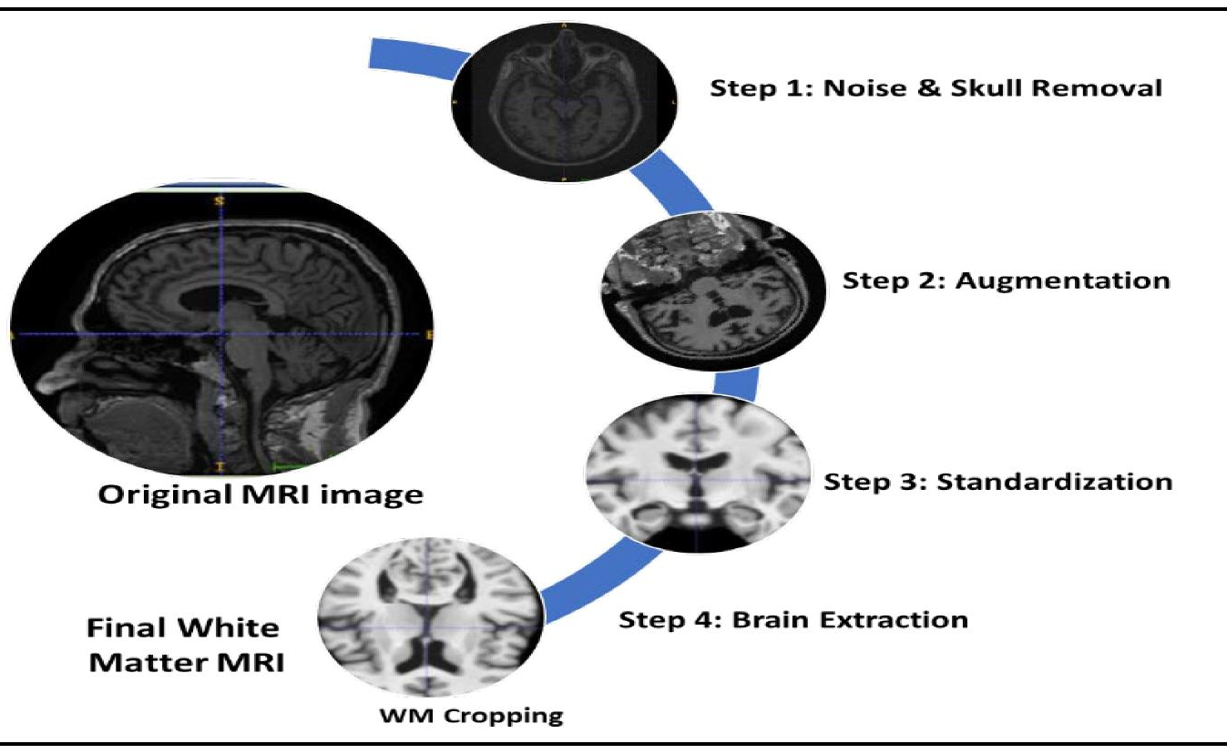
Step 4: Brain Extraction (CropForeground)
Action: We delete the empty black space (the air) around the head.
Result: We focus 100% of the AI's power only on the brain tissue.

Slide 14
Step 5: Final 3D Shaping (The "Passport Photo“ Step)
The Concept: Imagine you need a passport photo. No matter how the original picture was taken, the final version must be exactly 2x2 inches and centered perfectly. We do the same for the brain.
The Action: We use three sub-steps to get the brain into a perfect 64x64x64 voxel cube:
1. Cropping (CropForeground): We zoom in and cut off the empty black air around the head.
2. Padding (Spatial Pad): If the brain is smaller than our target cube, we add "blank space" (zeros) around it so it doesn't look stretched.
3. Final Cut (Spatial Crop): We use a mathematical "cookie cutter" to trim the data into a perfect cube.
Why? A Neural Network is like a specialized machine that only accepts one specific size of input. If the size is even 1 pixel off, the math breaks. Final shaping ensures every patient's brain "fits" into the AI's eyes perfectly.

Slide 15
Summary for Review
The model doesn't just look at one image ; it analyses a 4-channel 3D hyper-cube.
It sees the anatomy, the contrast-dye regions, and the swelling all at once, allowing it to mathematically predict exactly where the cancer cells are most dense!

