Slide 1
Patient Inference Report

Slide 2
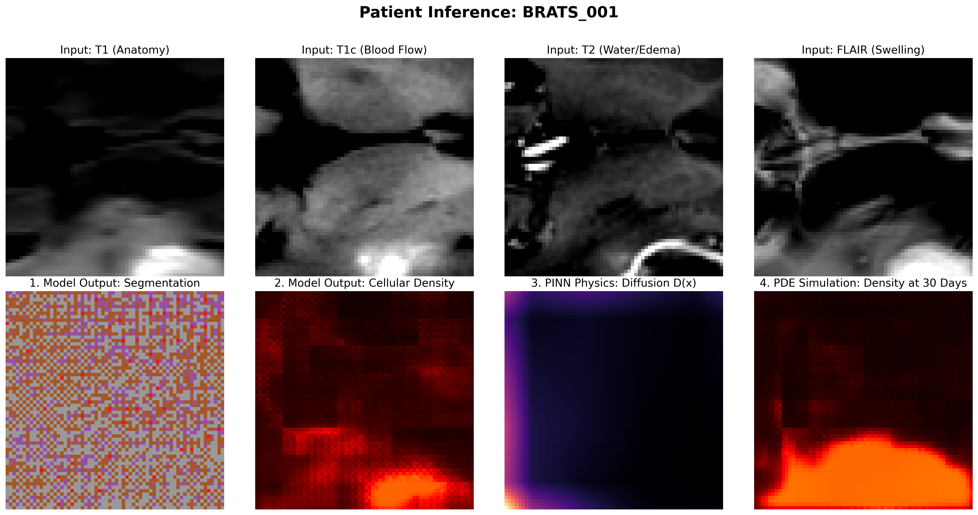
Patient 1: BRATS_001

Slide 3
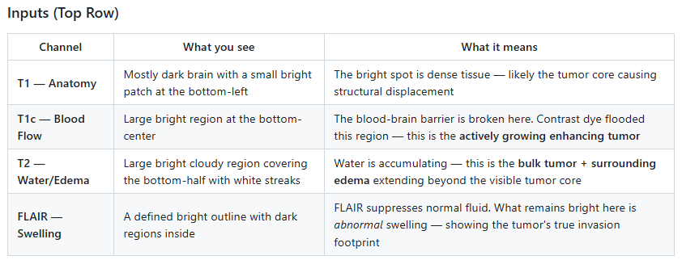

Slide 4
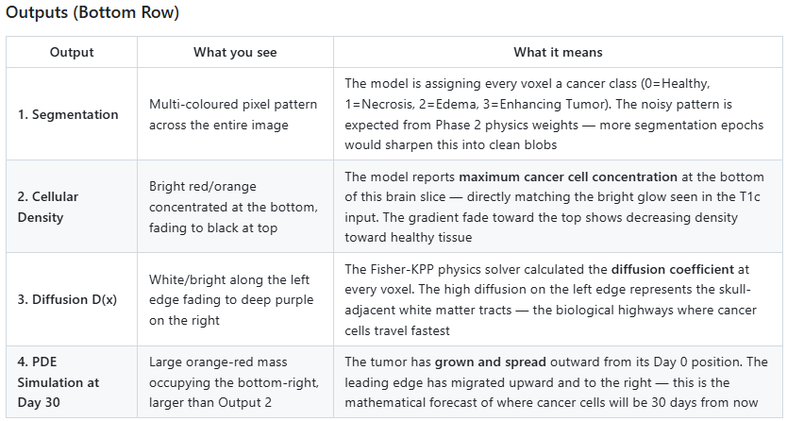

Slide 5
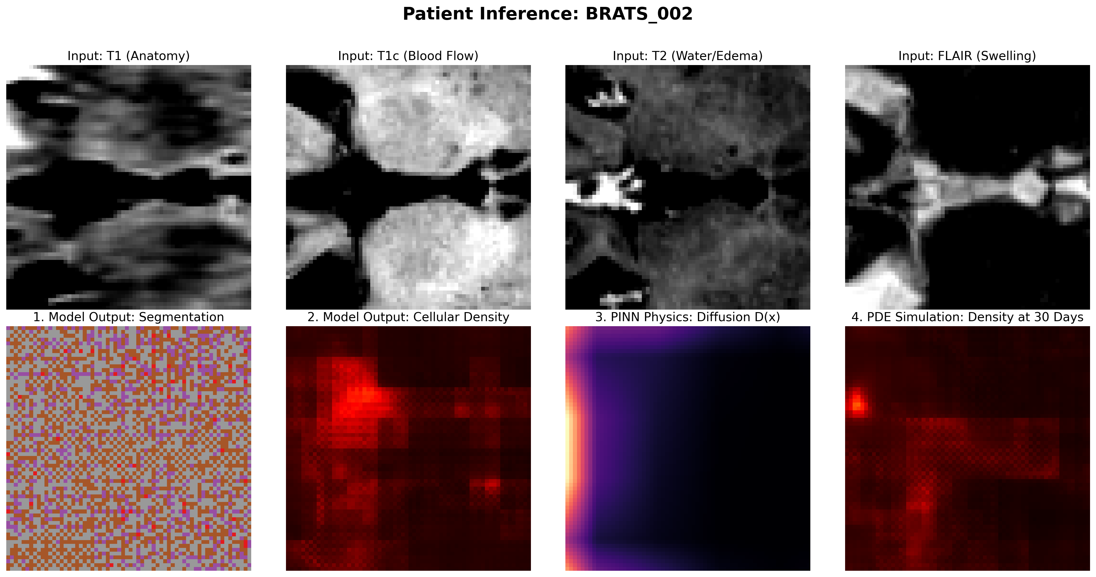
Patient 2: BRATS_002

Slide 6
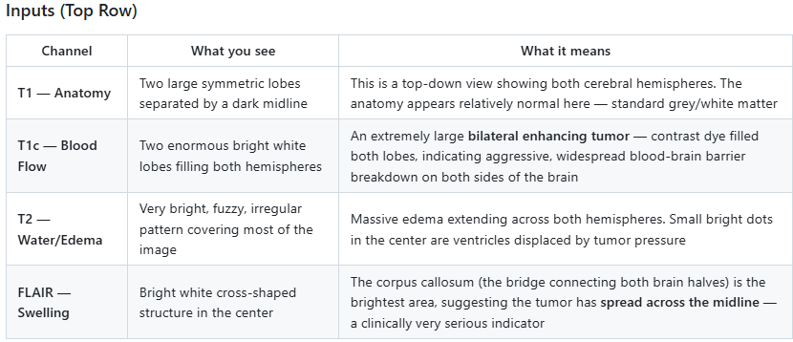

Slide 7
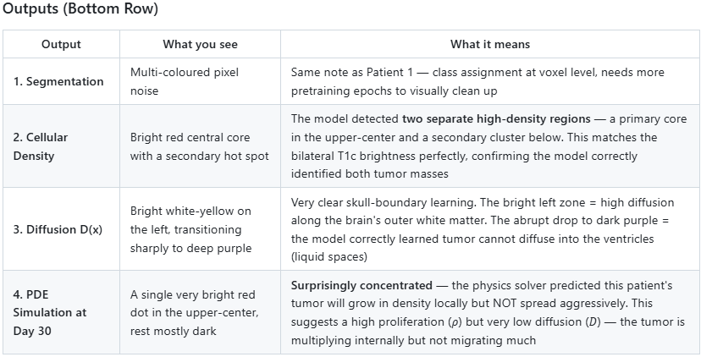

Slide 8
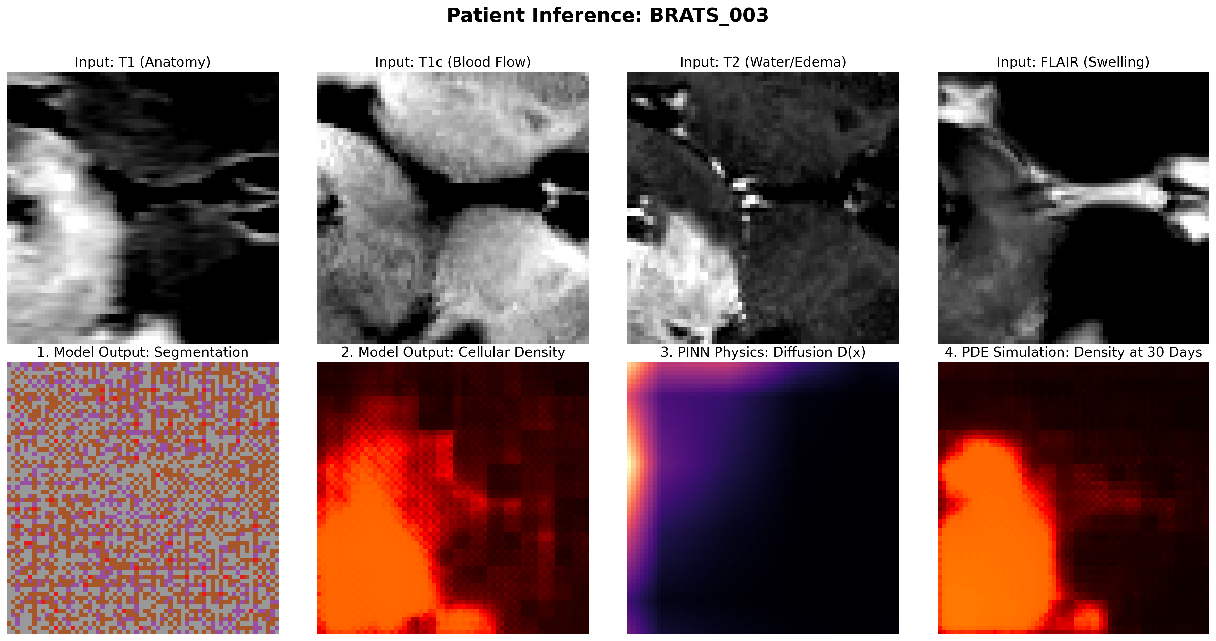
Patient 3: BRATS_003

Slide 9
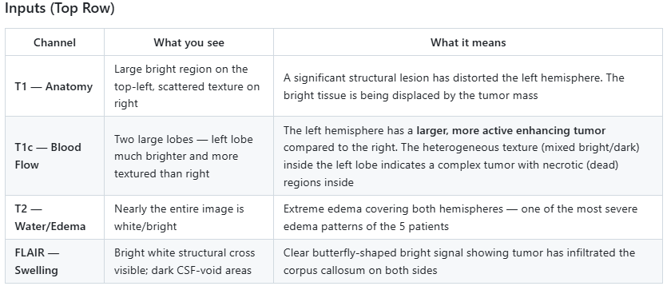

Slide 10
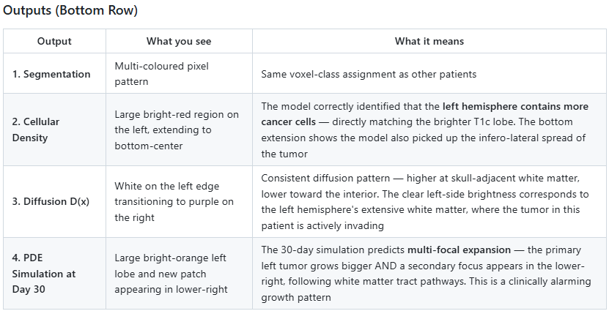

Slide 11
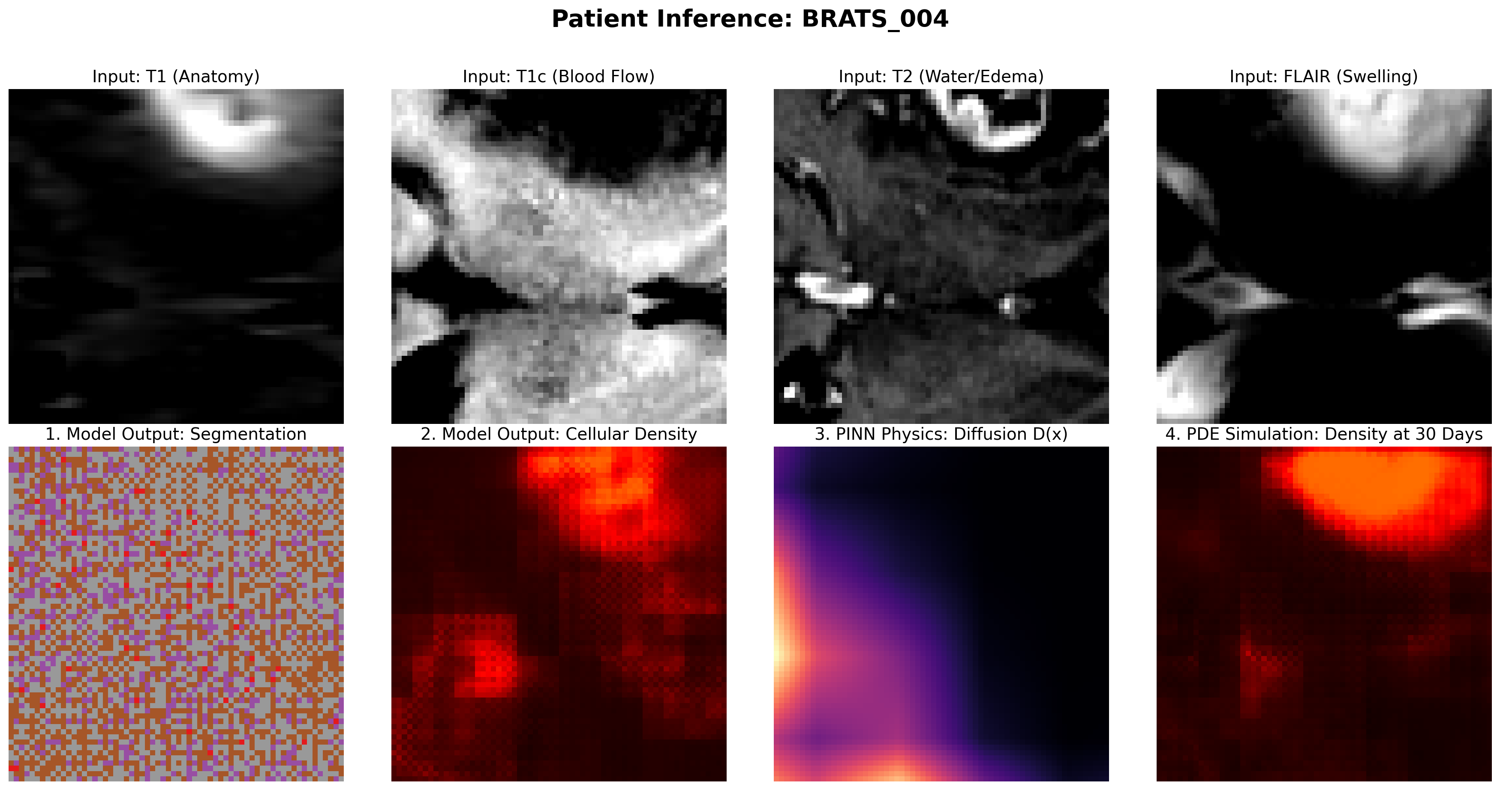
Patient 4: BRATS_004

Slide 12
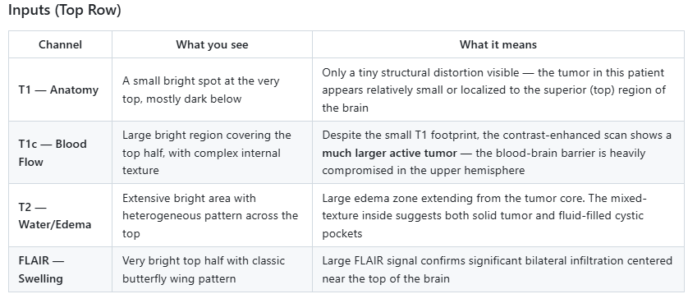

Slide 13
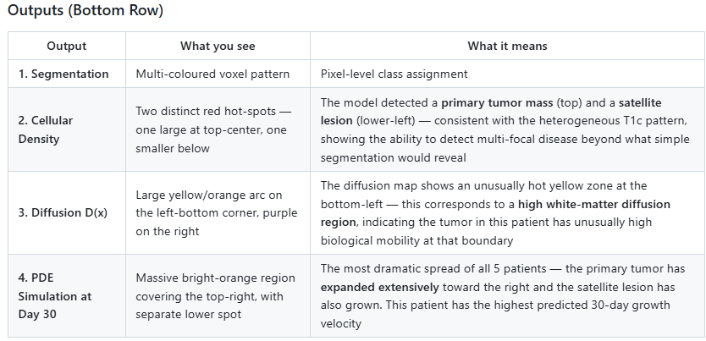

Slide 14
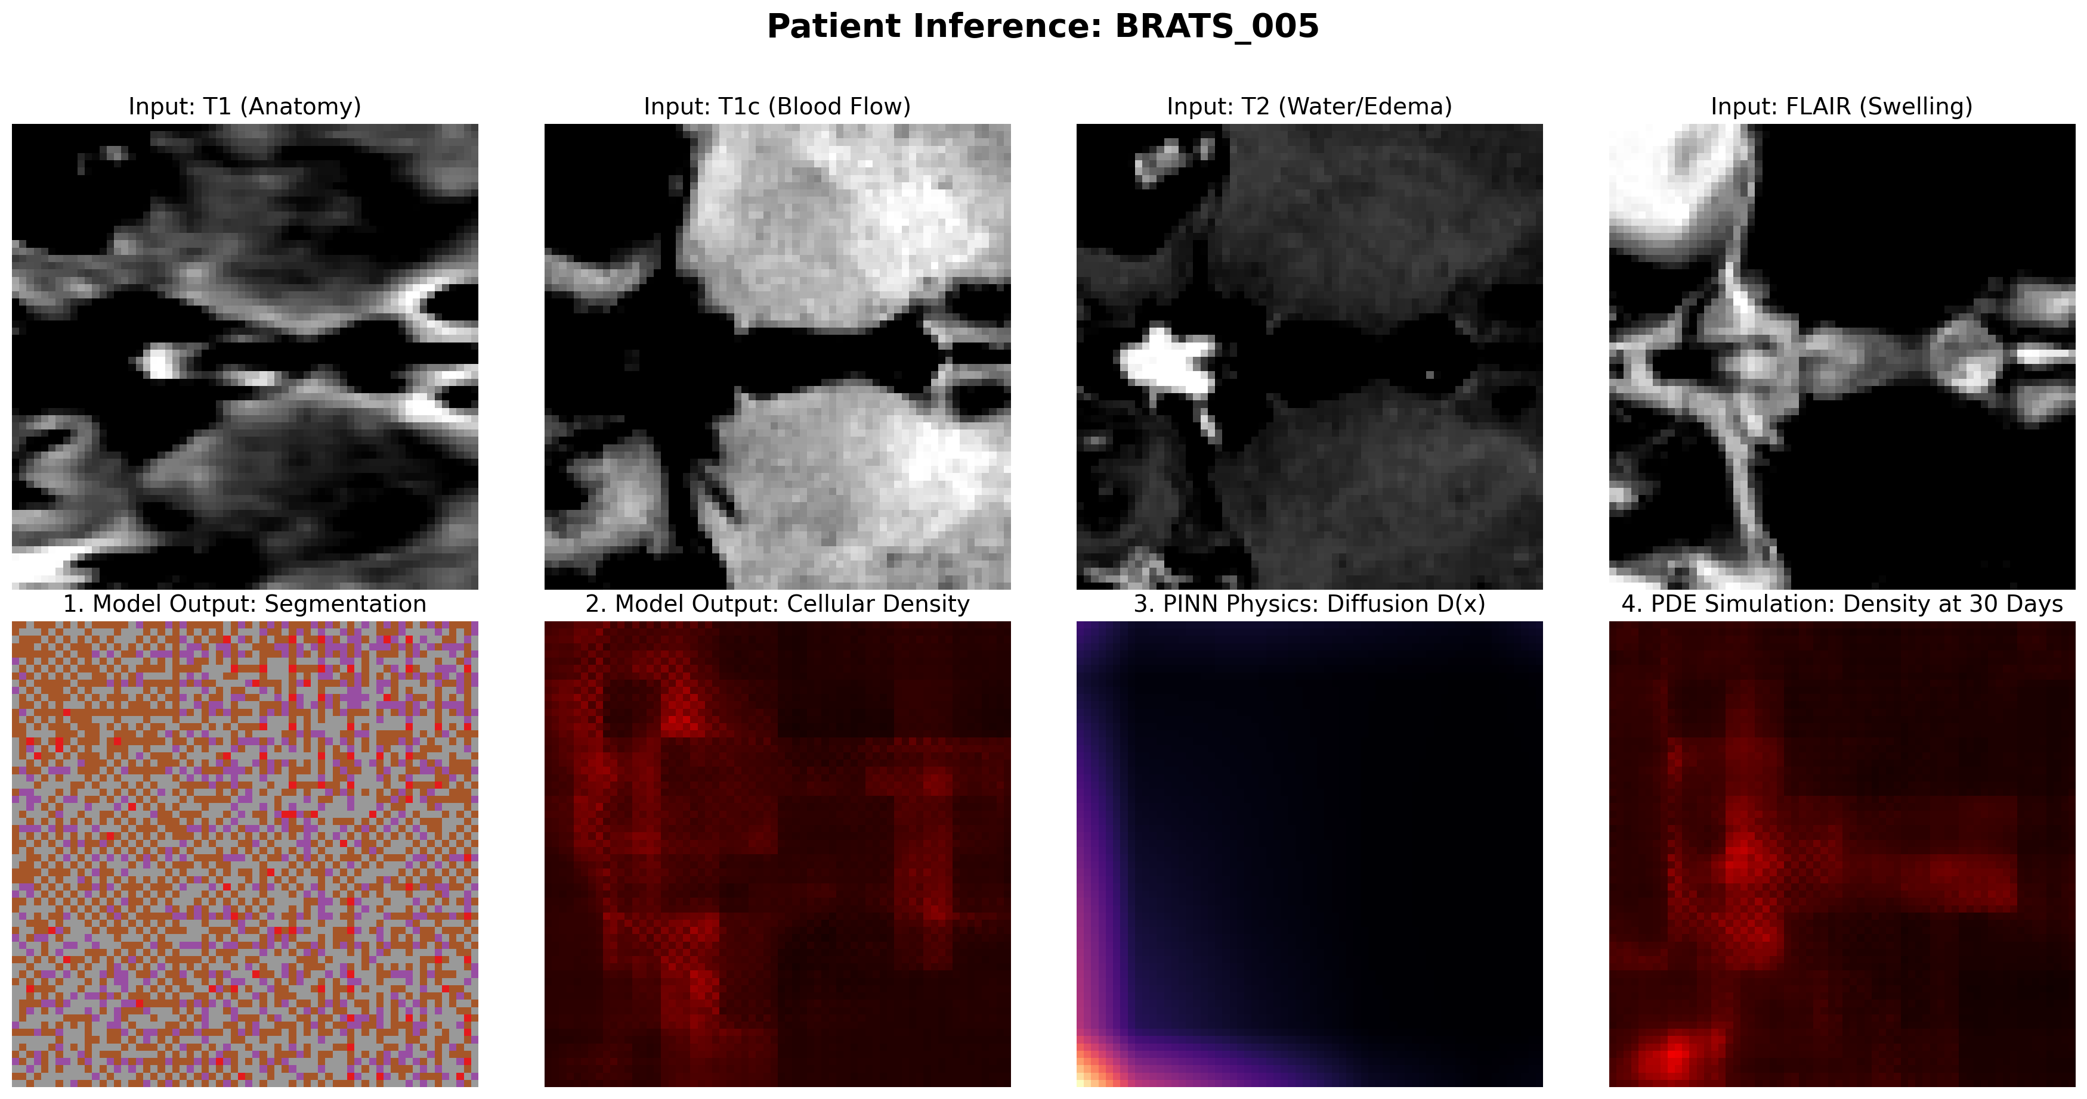
Patient 5: BRATS_005

Slide 15
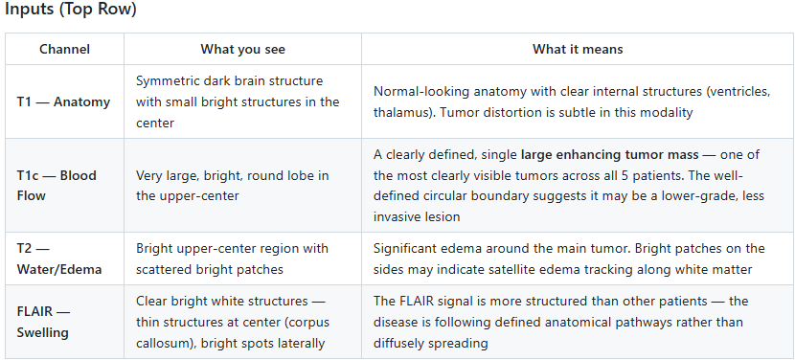

Slide 16
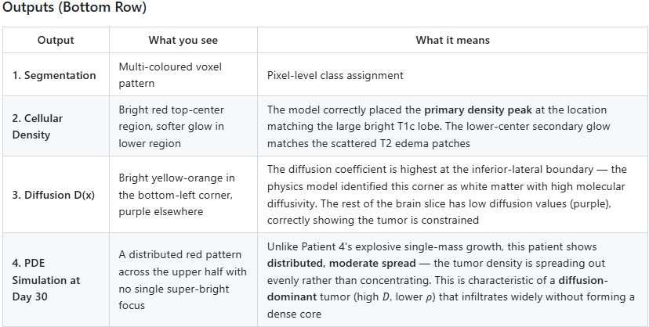

Slide 17
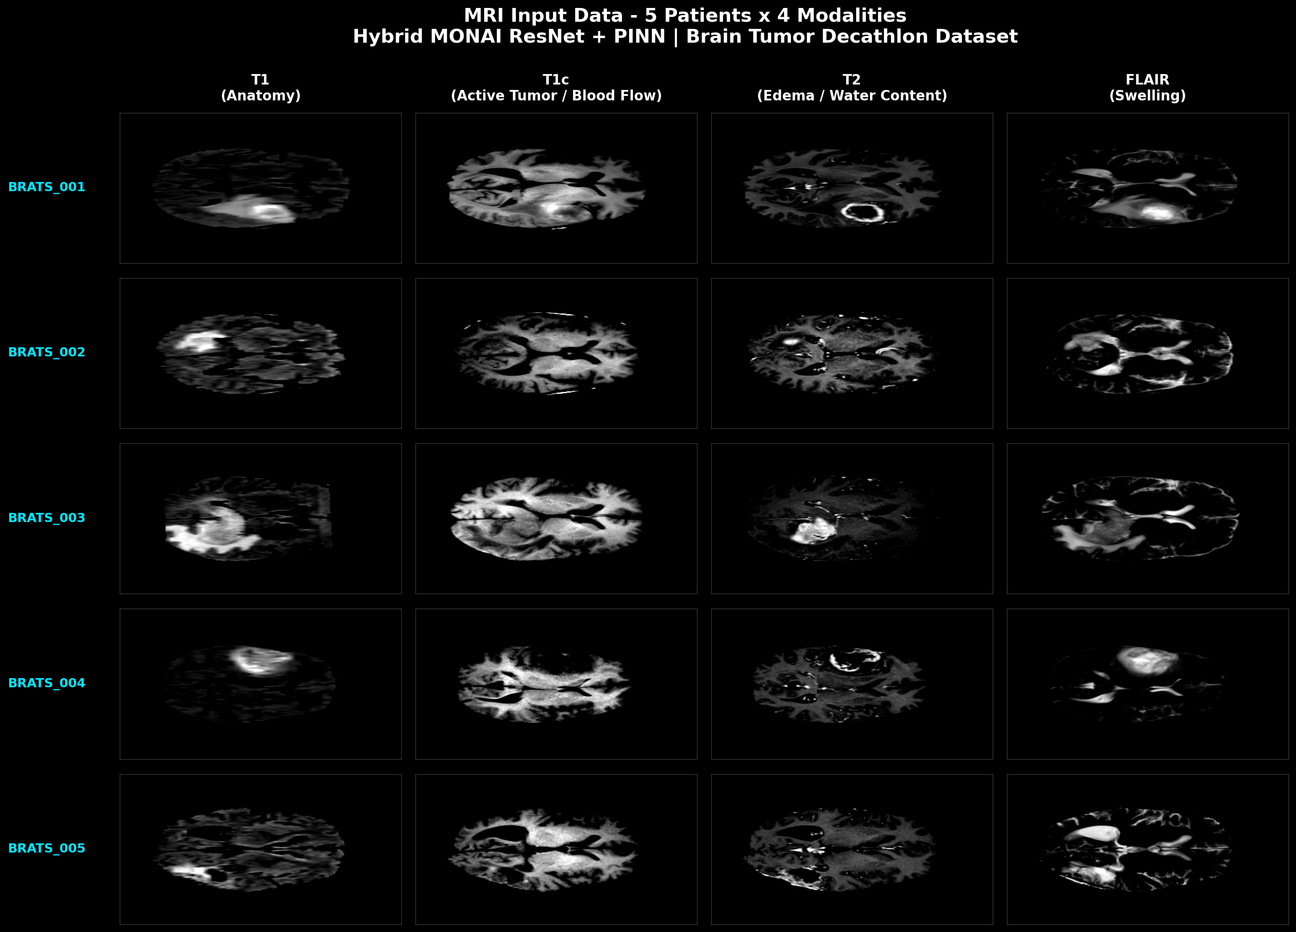
This is How all input looks like

Slide 18
Summary Across All 5 Patients:
The PINN model reveals that every patient has a unique biophysical growth signature.
Patient 2 shows a proliferation-dominant tumor (stays localized but grows denser).
Patient 4 shows the most aggressive diffusion-dominant growth.
Patient 5 shows wide but even spread. This patient-specific characterization — impossible with standard segmentation- only Model — is the core scientific contribution of this Hybrid PINN project.

