Slide 1
PAPER DEEP DIVE | LITERATURE REVIEW
Deep Learning for Fast Glioma Growth Modeling
Martens et al. (2022): estimating tumor cell density and Fisher-KPP parameters (D, ρ) with 3D CNNs
Harsh Gupta (23U01011) & Mayank Kumar Verma (23U01026)
Supervisor: Dr. Kamlesh Kumar Chauhan | Dept. of ECE, IIIT Bhopal
Project: HybridTumorNet – Hybrid DL + PINN for Brain Tumor Growth Prediction

Slide 2
ROADMAP
Presentation Outline
Part A – Basics (slides 3–6): MRI, tumor, PDE, CNN. Recommended starting point for first-time readers.
Part B – The idea (slides 7–9): the problem, the solution, and the overall pipeline.
Part C – Data synthesis (slides 10–14): Figures 1–4 and Table 1.
Part D – Networks (slides 15–18): Figures 5–6 and training details.
Part E – Results (slides 19–25): Figures 7–12, with the actual numbers.
Part F – Critical analysis (slides 26–32): limitations, relation to our project, glossary, teacher Q&A.
▸ On every figure slide: the original figure on the left, a panel-by-panel explanation on the right.
Martens et al. (2022) | HybridTumorNet | IIIT Bhopal
2

Slide 3
PART A | BASICS
Basics 1: Brain tumor and MRI
What is a glioma / glioblastoma (GBM)?
▸ A tumor of the brain's glial cells. GBM is the most aggressive type. It does not form a compact mass; it infiltrates surrounding tissue along tentacle-like extensions.
What does MRI show?
▸ MRI shows only the region where tumor cell density is high. Regions with lower cell density appear normal on the scan, although tumor cells are present there.
Why is that a problem?
▸ If surgery or radiotherapy targets only the visible tumor, the hidden cells regrow it. So we need a map of the invisible cells.
Key terms
▸ T1Gd: contrast MRI, shows the enhancing core
▸ T2 FLAIR: shows the oedema (swelling) region
▸ DTI: MRI that measures nerve-fibre direction
▸ Voxel: a 3D pixel (here 1 mm³)
Martens et al. (2022) | HybridTumorNet | IIIT Bhopal
3

Slide 4
PART A | BASICS
Basics 2: PDE and the Fisher-KPP model
A PDE is a rule that says how a quantity changes over space and time.
Fisher-KPP: ∂u/∂t = ∇·(D∇u) + ρu(1−u)
▸ u = tumor cell density (0 to 1). First term = spreading (diffusion), second term = growth (proliferation).
▸ D = diffusion: how fast cells spread. ρ = proliferation: how fast cells divide.
▸ u(1−u): when u is small, growth is fast; when u→1 (voxel full), growth stops. This is called saturation.
Analogy: ink spreading in water (diffusion) while the ink also multiplies itself (reaction).
Forward vs Inverse
▸ Forward: D, ρ and the starting tumor are known → simulate the future (easy).
▸ Inverse: we only have the MRI → find D, ρ and the hidden cells (hard).
▸ This paper solves the inverse problem fast.
Martens et al. (2022) | HybridTumorNet | IIIT Bhopal
4

Slide 5
PART A | BASICS
Basics 3: Front width and speed (λ, v)
▸ A Fisher-KPP tumor moves like a travelling wave: the front moves at a constant speed and its edge decays exponentially.
Infiltration depth: λ = √(D/ρ) (mm). It describes how wide or diffuse the tumor front is.
Front velocity: v = 2√(Dρ) (mm/year). It describes how fast the tumor boundary advances.
▸ Inverting these: D = λv/2 and ρ = v/(2λ) (paper's Eq. 12 and 13).
▸ So the network predicts λ and v (easy to read from images), and then we compute D and ρ from them.
How to measure
▸ λ: from the distance between two contours
▸ v: from how far one contour shifts between two times
Martens et al. (2022) | HybridTumorNet | IIIT Bhopal
5

Slide 6
PART A | BASICS
Basics 4: CNN and U-Net
CNN: a neural network that learns patterns (edges, shapes) from images by itself. A 3D CNN works on a full 3D volume.
U-Net: encoder (shrink the image to get context) + decoder (grow it back to get the output) + skip connections (to preserve fine details).
Convolutional encoder: only the encoder part plus a final fully-connected layer. It turns an image into a few numbers (regression).
Loss: MAE (mean |error|) or MSE (mean error²). The Adam optimizer updates the weights.
Training data is synthetic, because nobody knows the true cell density of a real tumor.
Martens et al. (2022) | HybridTumorNet | IIIT Bhopal
6

Slide 7
PART B | IDEA
The paper's problem and contribution
Problem: reaction-diffusion models have existed for decades, but they are not used on patients. Two reasons: (1) the initial condition (hidden cells) and (2) estimating D, ρ.
Contribution: two deep CNNs that solve both problems in seconds.
▸ Network 1 (3D U-Net): contours → full cell density map.
▸ Network 2 (conv-encoder): contours + time gap → λ, v → D, ρ.
▸ Then the model simulates the future tumor (90 and 180 days ahead).
▸ Training data: 1,200 synthetic tumors grown on the real brains of 6 healthy volunteers.
In one line
▸ Visible MRI contours → CNN → hidden-cell map + D, ρ → future growth
Martens et al. (2022) | HybridTumorNet | IIIT Bhopal
7

Slide 8
PART B | IDEA
Pipeline at a glance
Step 1 – Data: MRI + DTI of healthy volunteers → brain map and tumor diffusion tensor (Fig 1, 2).
Step 2 – Simulate: random λ, v, seed and time gaps → grow a tumor with Fisher-KPP (Fig 3, 4).
Step 3 – Contours: threshold the density at t₂ (c₁=0.80, c₂=0.16) and at t₁ (c₂).
Step 4 – Train: Network 1 and Network 2, separately (Fig 5, 6).
Step 5 – Validate: estimate density at t₂, simulate t₃ and t₄, compare with the truth (Fig 7–11).
Step 6 – Real data: apply Network 1 to one real GBM patient (Fig 12).
Martens et al. (2022) | HybridTumorNet | IIIT Bhopal
8

Slide 9
PART B | IDEA
Imaging contours and thresholds (c₁, c₂)
▸ MRI does not show the exact density. It shows a boundary: voxels with density above a threshold appear 'inside'.
c₁ = 0.80: the enhancing core on T1Gd (dense tumor).
c₂ = 0.16: the oedema outline on T2 FLAIR (outer boundary).
▸ These thresholds come from Swanson et al. (2008), the paper's ref [5].
▸ In the synthetic data, the same thresholds turn the density into binary masks, and those masks are the network input.
▸ Caveat: oedema is not truly an invasion zone, so the c₂ assumption is approximate (the paper says this in its discussion).
Terms
▸ Γ₁: contour at c=0.80, time t₂
▸ Γ₂: contour at c=0.16, time t₂
▸ Γ₃: contour at c=0.16, time t₁
Martens et al. (2022) | HybridTumorNet | IIIT Bhopal
9

Slide 10
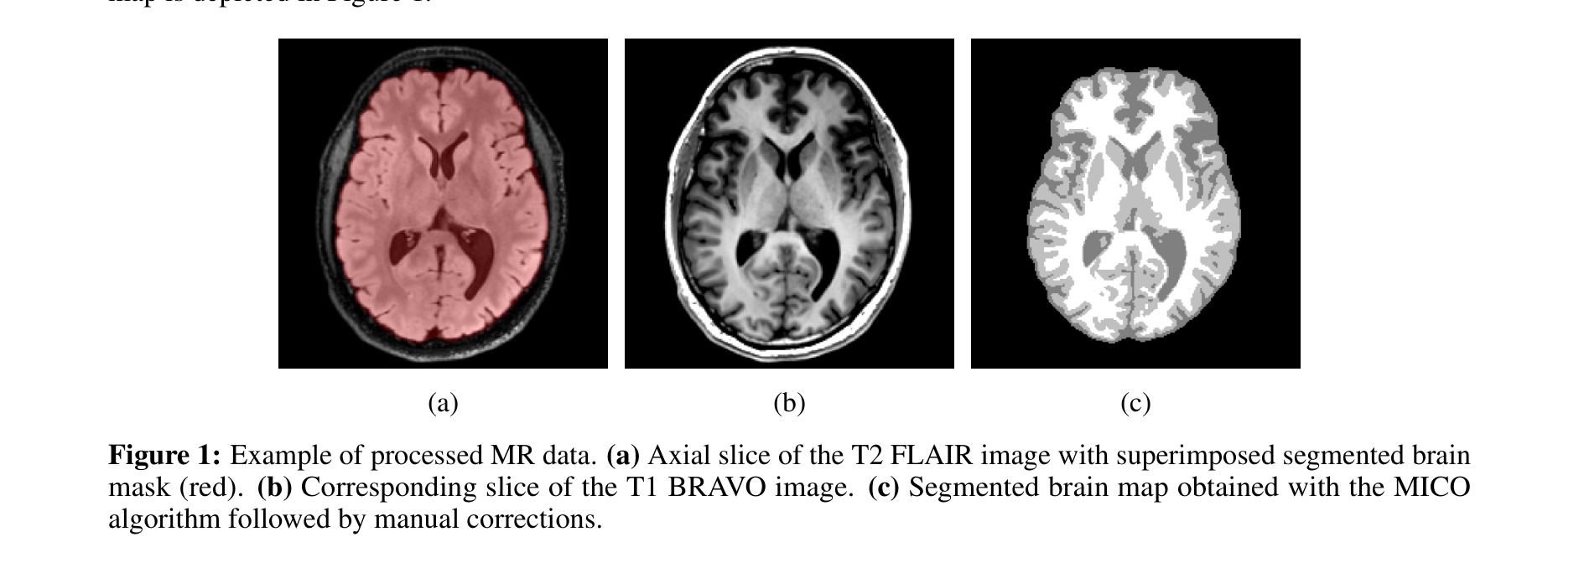
PART C | DATA SYNTHESIS
Figure 1: Splitting the brain into tissue types
Panels
▸ (a) T2 FLAIR slice with the red brain mask: the simulation runs only inside this region.
▸ (b) T1 BRAVO image of the same slice: clear anatomy, the skull is visible too.
▸ (c) Segmented map: white matter, grey matter and CSF get separate labels.
How it was made
▸ MICO algorithm (removes the brightness bias, then clusters) + manual correction.
Why it matters
▸ Tumor cannot spread into CSF, and WM and GM have different D.
▸ This map is used to build the diffusion tensor of Figure 2.
Paper Fig. 1: processed MR data.
Martens et al. (2022) | HybridTumorNet | IIIT Bhopal
10

Slide 11
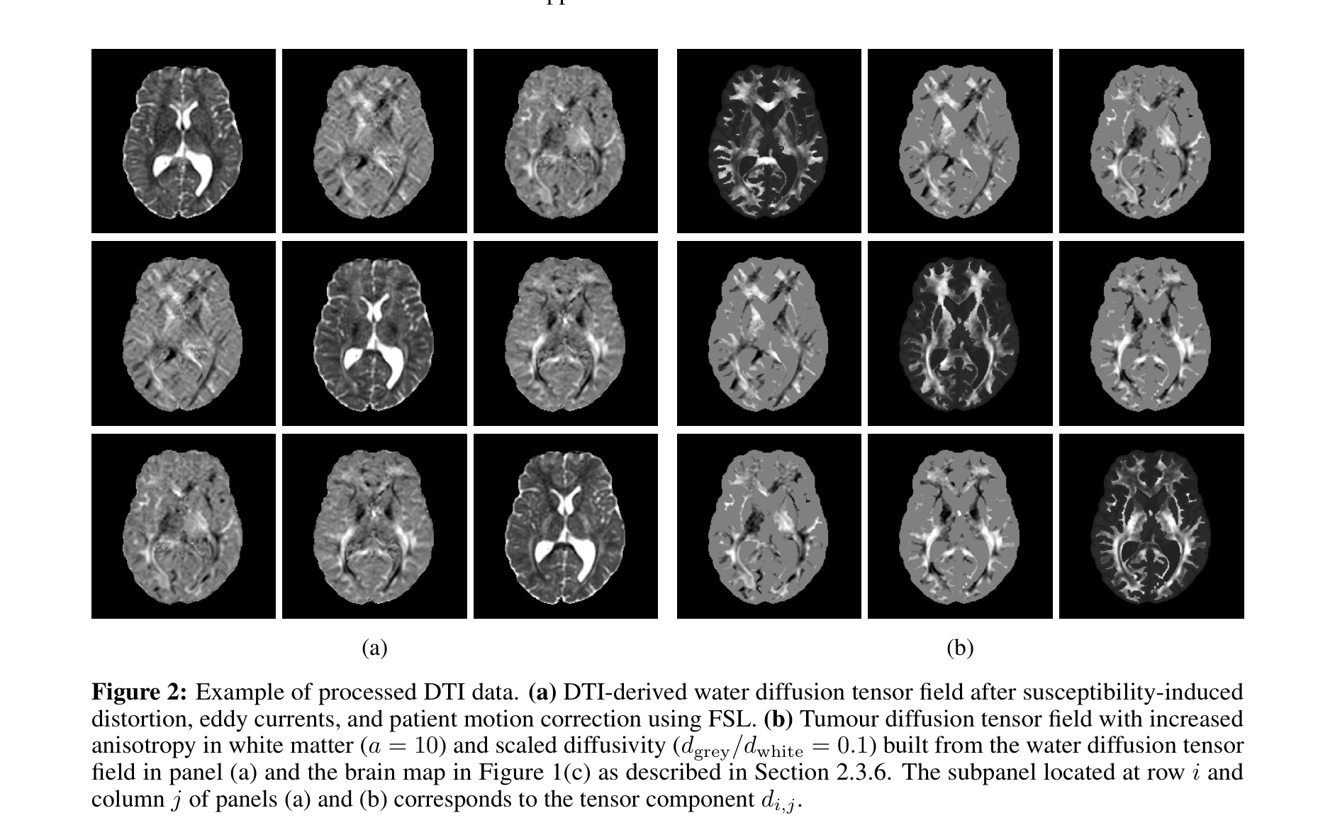
PART C | DATA SYNTHESIS
Figure 2: From DTI to tumor diffusion tensor
What is the grid?
▸ The 3×3 grid shows the 9 tensor components d(i,j). It is symmetric, so only 6 are independent.
(a) Water tensor
▸ Real DTI scan, corrected for distortion, eddy currents and motion with FSL. Ventricles look bright.
(b) Tumor tensor
▸ Built from (a) + the brain map: anisotropy a=10 in WM, d_grey/d_white = 0.1, CSF removed.
Difference
▸ (a) = how water diffuses. (b) = how tumor cells diffuse. The simulation uses (b).
Paper Fig. 2: processed DTI data.
Martens et al. (2022) | HybridTumorNet | IIIT Bhopal
11

Slide 12
PART C | DATA SYNTHESIS
Table 1: Parameter ranges for synthetic tumors
Parameter | Min | Max | Unit | Meaning
λ (infiltration depth) | 0.5 | 2.0 | mm | how wide the front is
v (front velocity) | 28.28 | 48.99 | mm/year | how fast the boundary moves
Δt₁ (t₀ to t₁) | 90 | 180 | days | time until the first scan
Δt₂ (t₁ to t₂) | 90 | 180 | days | gap between the two scans
▸ All values are sampled uniformly at random. Δt₃ = Δt₄ = 90 days are fixed for validation.
▸ D = λv/2 and ρ = v/(2λ). Sampling D and ρ independently would give tumors that are too small or too big, which is why λ and v are sampled instead.
▸ Seed: a 3×3×3 voxel block in white matter with c=1. Total: 200 tumors × 6 volunteers = 1,200.
Martens et al. (2022) | HybridTumorNet | IIIT Bhopal
12

Slide 13
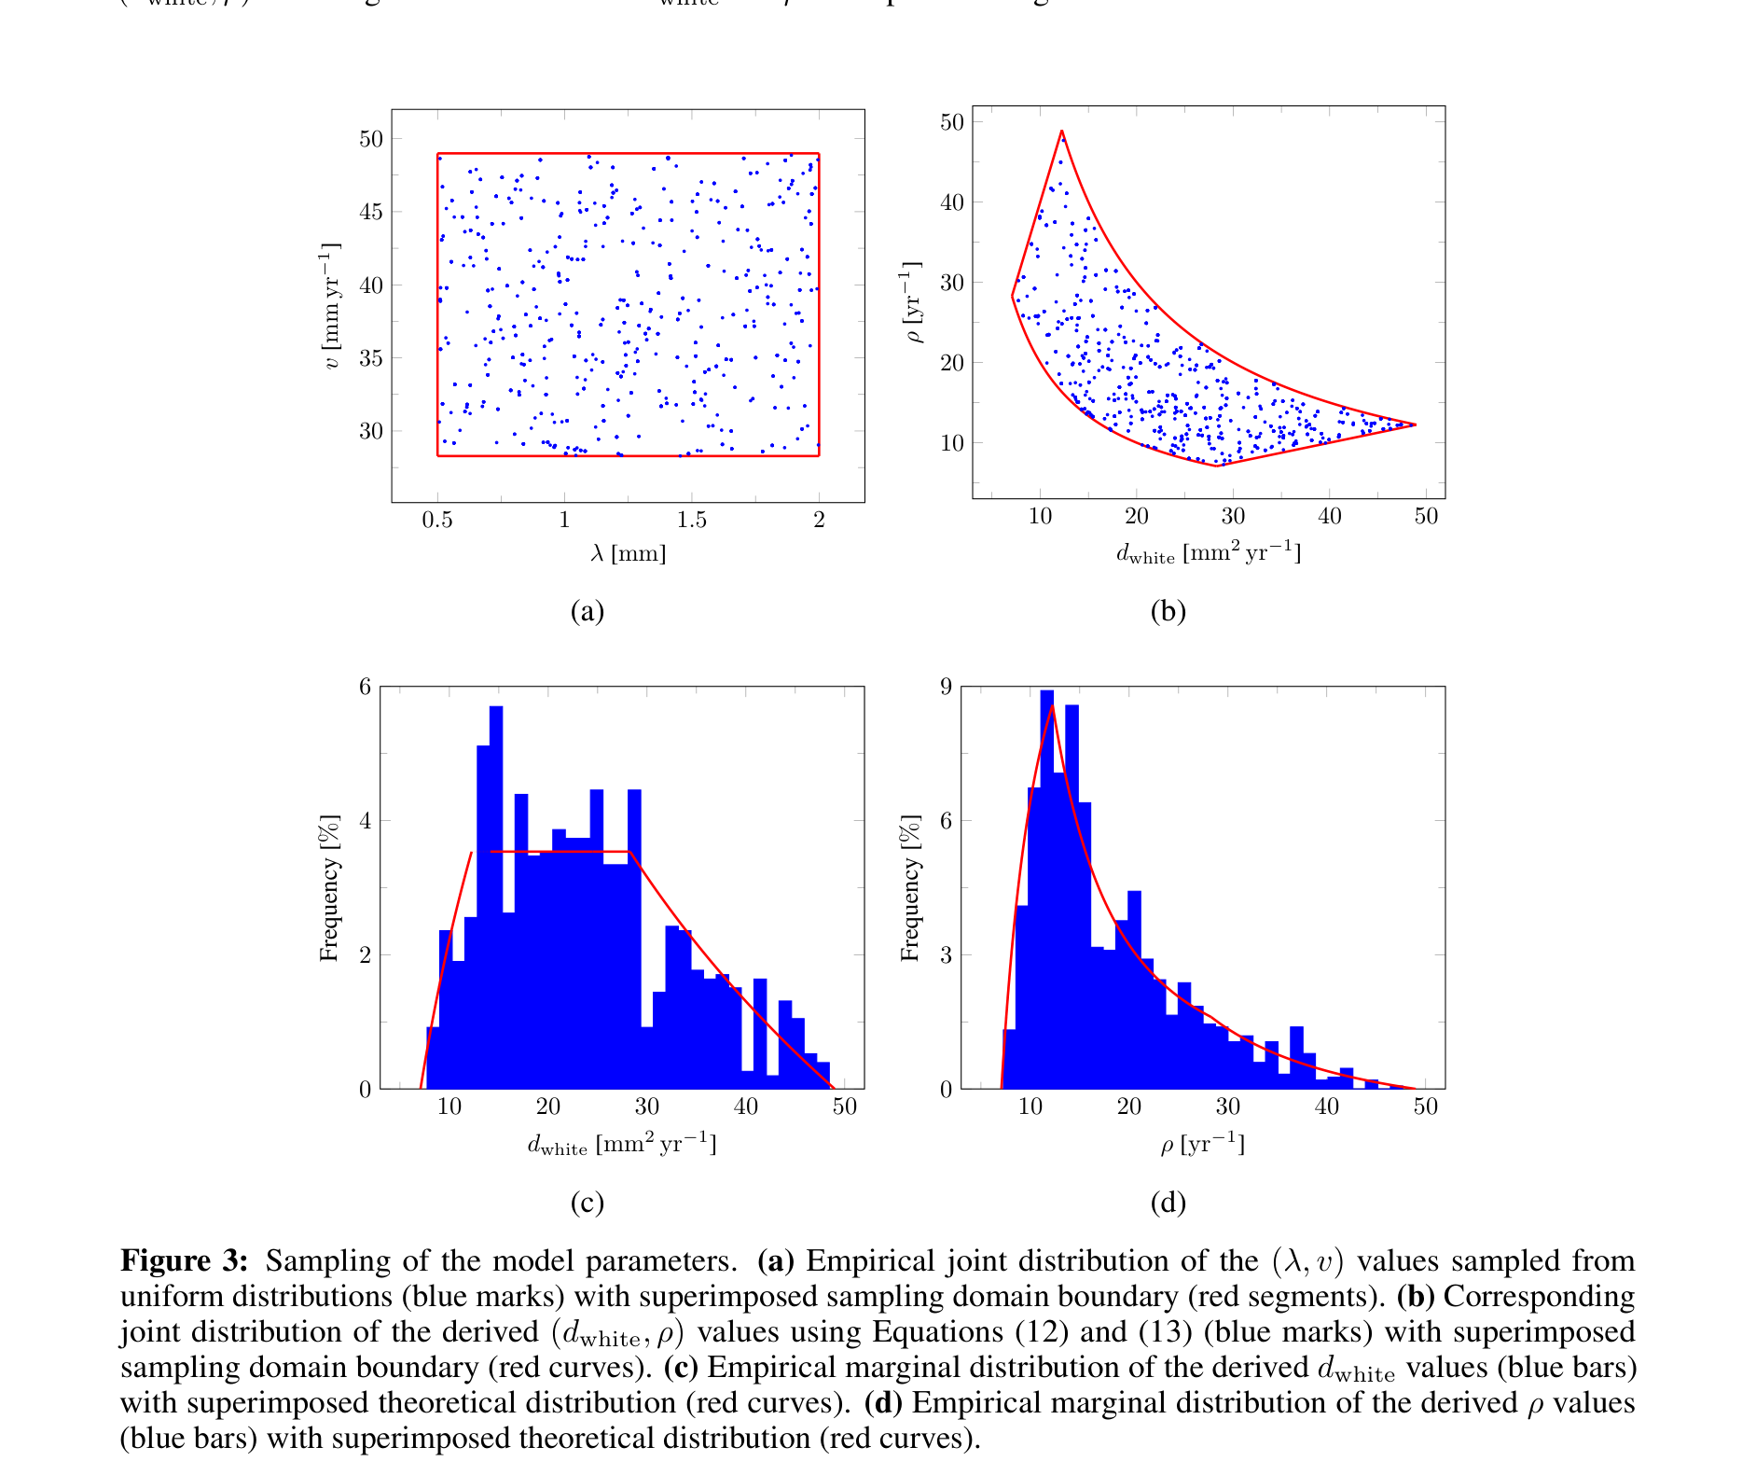
PART C | DATA SYNTHESIS
Figure 3: How the parameters were sampled
(a) (λ, v) scatter
▸ Each blue dot is one tumor. λ in 0.5–2 mm, v in 28–49 mm/yr, uniform. Red box = boundary.
(b) (d_white, ρ) scatter
▸ The same points mapped to D, ρ with Eq. 12, 13. The rectangle becomes a curved shape (non-linear map).
(c) d_white histogram
▸ Blue = sampled, red = theory. d_white spans about 7–49 mm²/yr.
(d) ρ histogram
▸ Right-skewed: peak around 10–12 /yr with a long tail. Most tumors are slow-growing, while a few are very aggressive.
Takeaway
▸ The network sees slow to aggressive tumors alike.
Paper Fig. 3: sampling of model parameters.
Martens et al. (2022) | HybridTumorNet | IIIT Bhopal
13

Slide 14
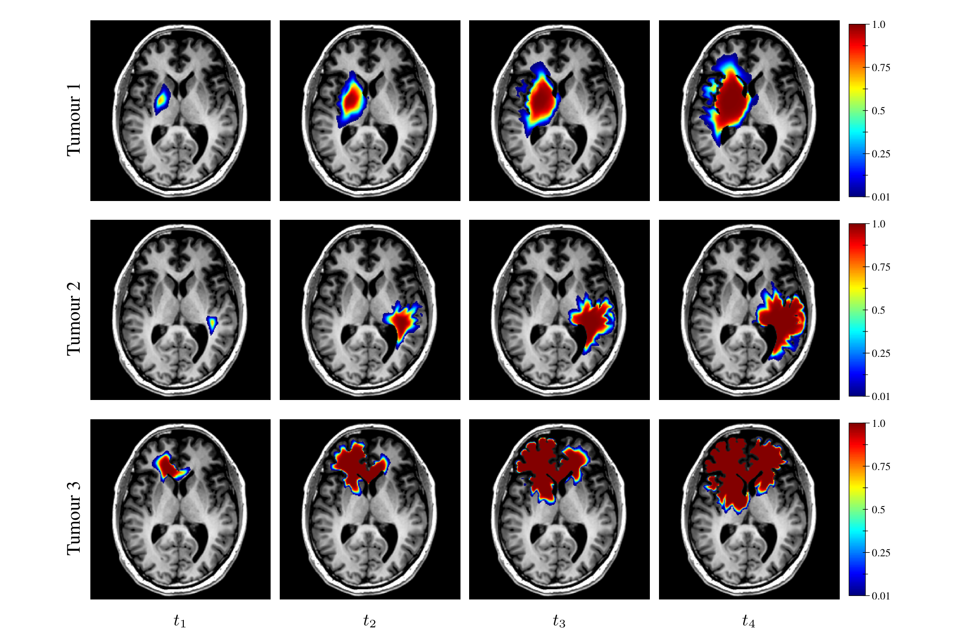
PART C | DATA SYNTHESIS
Figure 4: Synthetic tumor evolution (t₁ to t₄)
What is shown
▸ 3 tumors (rows) at 4 time points t₁–t₄ (columns), axial slices. Colour = cell density 0.01 to 1.
Table 2 values
▸ T1: d=10.87, ρ=31.77, λ=1.71, v=37.16
▸ T2: d=15.07, ρ=13.95, λ=0.96, v=29.00
▸ T3: d=41.49, ρ=11.31, λ=0.52, v=43.33
Observation
▸ Small λ gives a sharp front, large λ a blurry one. The tumor grows with time.
▸ Solver: forward Euler, Δt=0.5 day, about 1 s per tumor on a GPU.
Paper Fig. 4: simulated cell density at t₁–t₄.
Martens et al. (2022) | HybridTumorNet | IIIT Bhopal
14

Slide 15
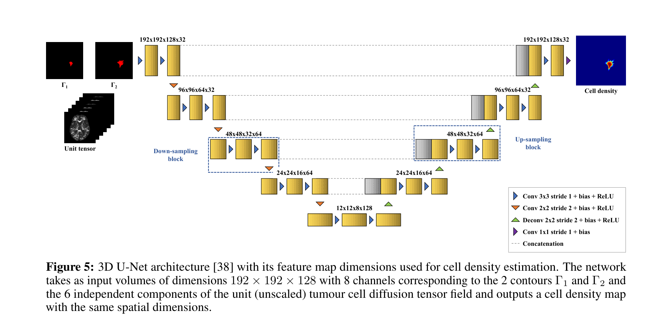
PART D | NETWORKS
Figure 5: Network 1 – 3D U-Net (cell density)
Input (8 channels)
▸ 2 binary contour masks (Γ₁, Γ₂) + 6 unit tensor components. Size 192×192×128.
Output
▸ A cell density map of the same size: u at every voxel.
Structure
▸ 4 down blocks, 4 up blocks, 1 output block. Features 32→64→128 at the bottom.
▸ Grey boxes = skip connections (concatenation).
▸ Arrows: Conv3×3, Conv2×2 stride 2 (shrink), Deconv2×2 (grow), Conv1×1 (final).
Goal
▸ Turn visible contours into a map of invisible tumor cells.
Paper Fig. 5: 3D U-Net.
Martens et al. (2022) | HybridTumorNet | IIIT Bhopal
15

Slide 16
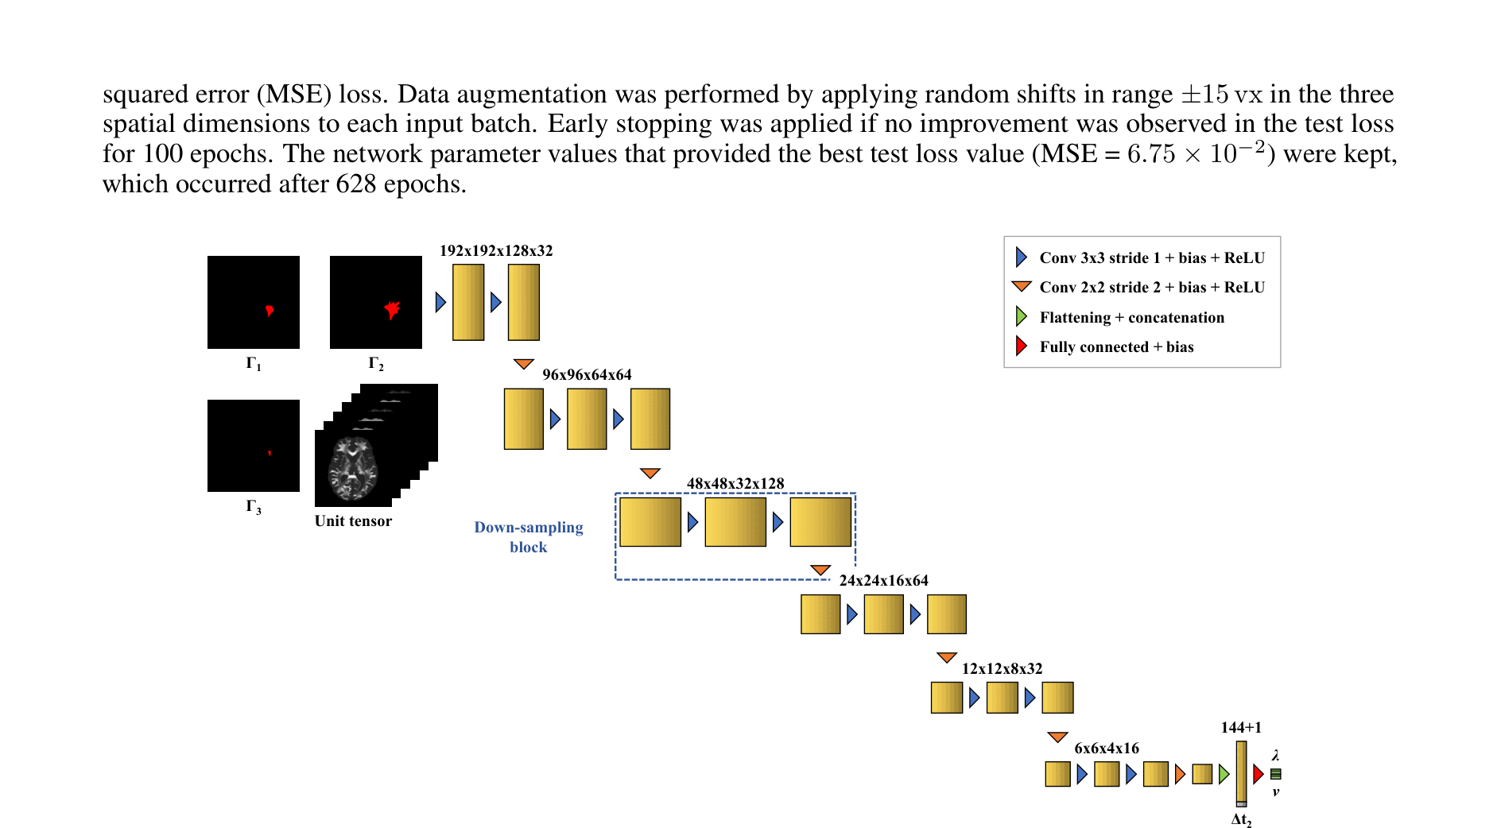
PART D | NETWORKS
Figure 6: Network 2 – Conv-Encoder (λ and v)
Input (9 channels + Δt₂)
▸ 3 contours (Γ₁, Γ₂ at t₂; Γ₃ at t₁) + 6 tensor components, plus the time gap Δt₂.
Structure
▸ 6 down-sampling blocks → flatten (144 features) + Δt₂ → 1 fully connected layer.
Output
▸ Two numbers: λ and v. Then Eq. 12, 13 give d_white and ρ.
Why 3 contours?
▸ λ comes from the distance between two contours, v from the shift of one contour over two times.
Paper Fig. 6: convolutional regressor.
Martens et al. (2022) | HybridTumorNet | IIIT Bhopal
16

Slide 17
PART D | NETWORKS
Training details of both networks
 | Network 1 (U-Net) | Network 2 (Conv-Encoder)
Task | Cell density estimation | λ, v estimation
Input | 192×192×128×8 | 192×192×128×9 + Δt₂
Loss | MAE | MSE (targets standardised)
Optimizer | Adam, lr 1e-4, batch 1 | Adam, lr 1e-4
Augmentation | Random shifts ±15 voxels | Random shifts ±15 voxels
Best test loss | MAE 1.24e-4 (epoch 876) | MSE 6.75e-2 (epoch 628)
Split | 5 volunteers train / 1 test (83% / 17%) | same
▸ Framework: TensorFlow 2.5.0, GPU: RTX 3090. Early stopping after 100 epochs without improvement. No rotation augmentation, because the tensor components would also need rotating.
Martens et al. (2022) | HybridTumorNet | IIIT Bhopal
17

Slide 18
PART D | NETWORKS
Validation protocol and post-processing
Experiment: Network 1 gives the density at t₂, Network 2 gives d_white and ρ. Then Fisher-KPP simulates t₃ (t₂+90 d) and t₄ (t₂+180 d).
Compared with the truth (true density + true parameters): MAE only where c>0.01, plus Hausdorff distance and ASSD between contours.
Hausdorff = the worst boundary error (max). ASSD = the average boundary error.
Post-processing: (1) CSF/background density = 0. (2) clip density above 1 to 1. (3) remove small maxima outside the largest connected region.
▸ Reason: tiny network artefacts would otherwise grow into fake new tumor foci during simulation.
Test set
▸ 200 tumors on one unseen volunteer brain.
▸ Thresholds: c₁=0.80, c₂=0.16
Martens et al. (2022) | HybridTumorNet | IIIT Bhopal
18

Slide 19
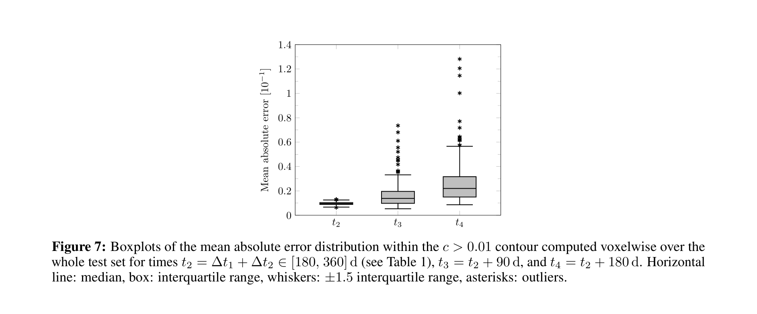
PART E | RESULTS
Figure 7: Density error (MAE) boxplot
Axes
▸ Y: mean absolute error [10⁻¹], X: t₂, t₃ (+90 d), t₄ (+180 d).
▸ Box = middle 50%, line = median, whiskers = 1.5×IQR, dots = outliers.
Medians
▸ t₂: 9.58×10⁻³ | t₃: 1.38×10⁻² | t₄: 2.20×10⁻²
Takeaway
▸ The further ahead we predict, the larger the error (errors accumulate).
▸ Still, the median error stays below 0.03.
Paper Fig. 7: MAE within c>0.01.
Martens et al. (2022) | HybridTumorNet | IIIT Bhopal
19

Slide 20
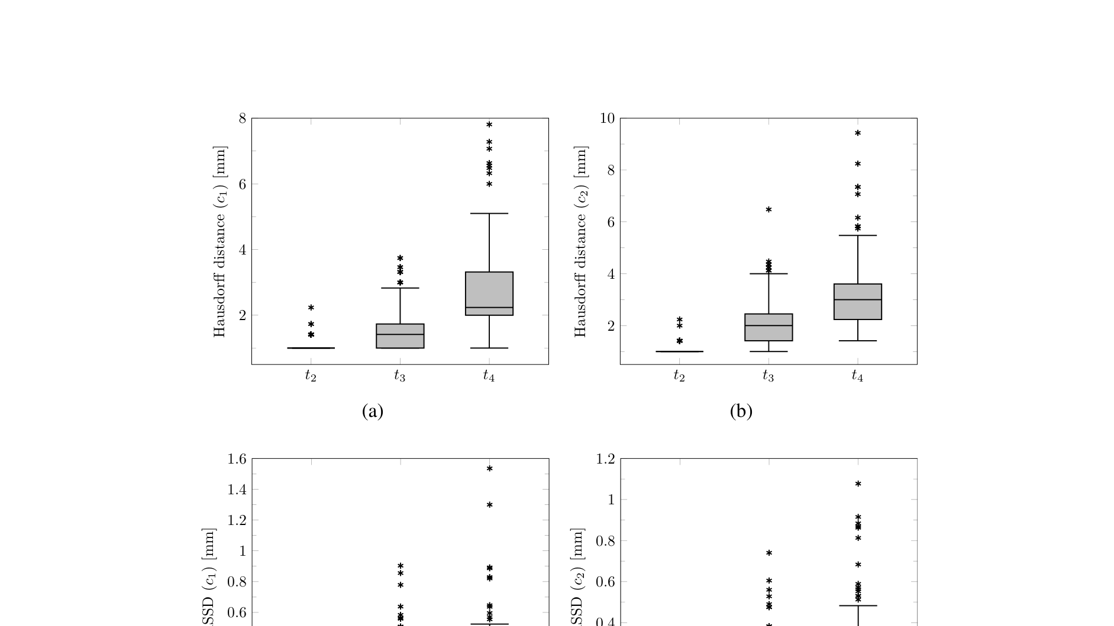
PART E | RESULTS
Figure 8: Hausdorff distance and ASSD
Panels
▸ (a) Hausdorff, c₁=0.80 (b) Hausdorff, c₂=0.16
▸ (c) ASSD, c₁=0.80 (d) ASSD, c₂=0.16. Y axis in mm.
What it tells us
▸ How far the predicted contour is from the true one. Hausdorff = worst point, ASSD = average.
Authors' claim
▸ ASSD is ≤ 1 mm (the voxel size) in most cases.
▸ A few outliers have large Hausdorff but small ASSD: caused by artefact foci.
Paper Fig. 8: Hausdorff and ASSD.
Martens et al. (2022) | HybridTumorNet | IIIT Bhopal
20

Slide 21
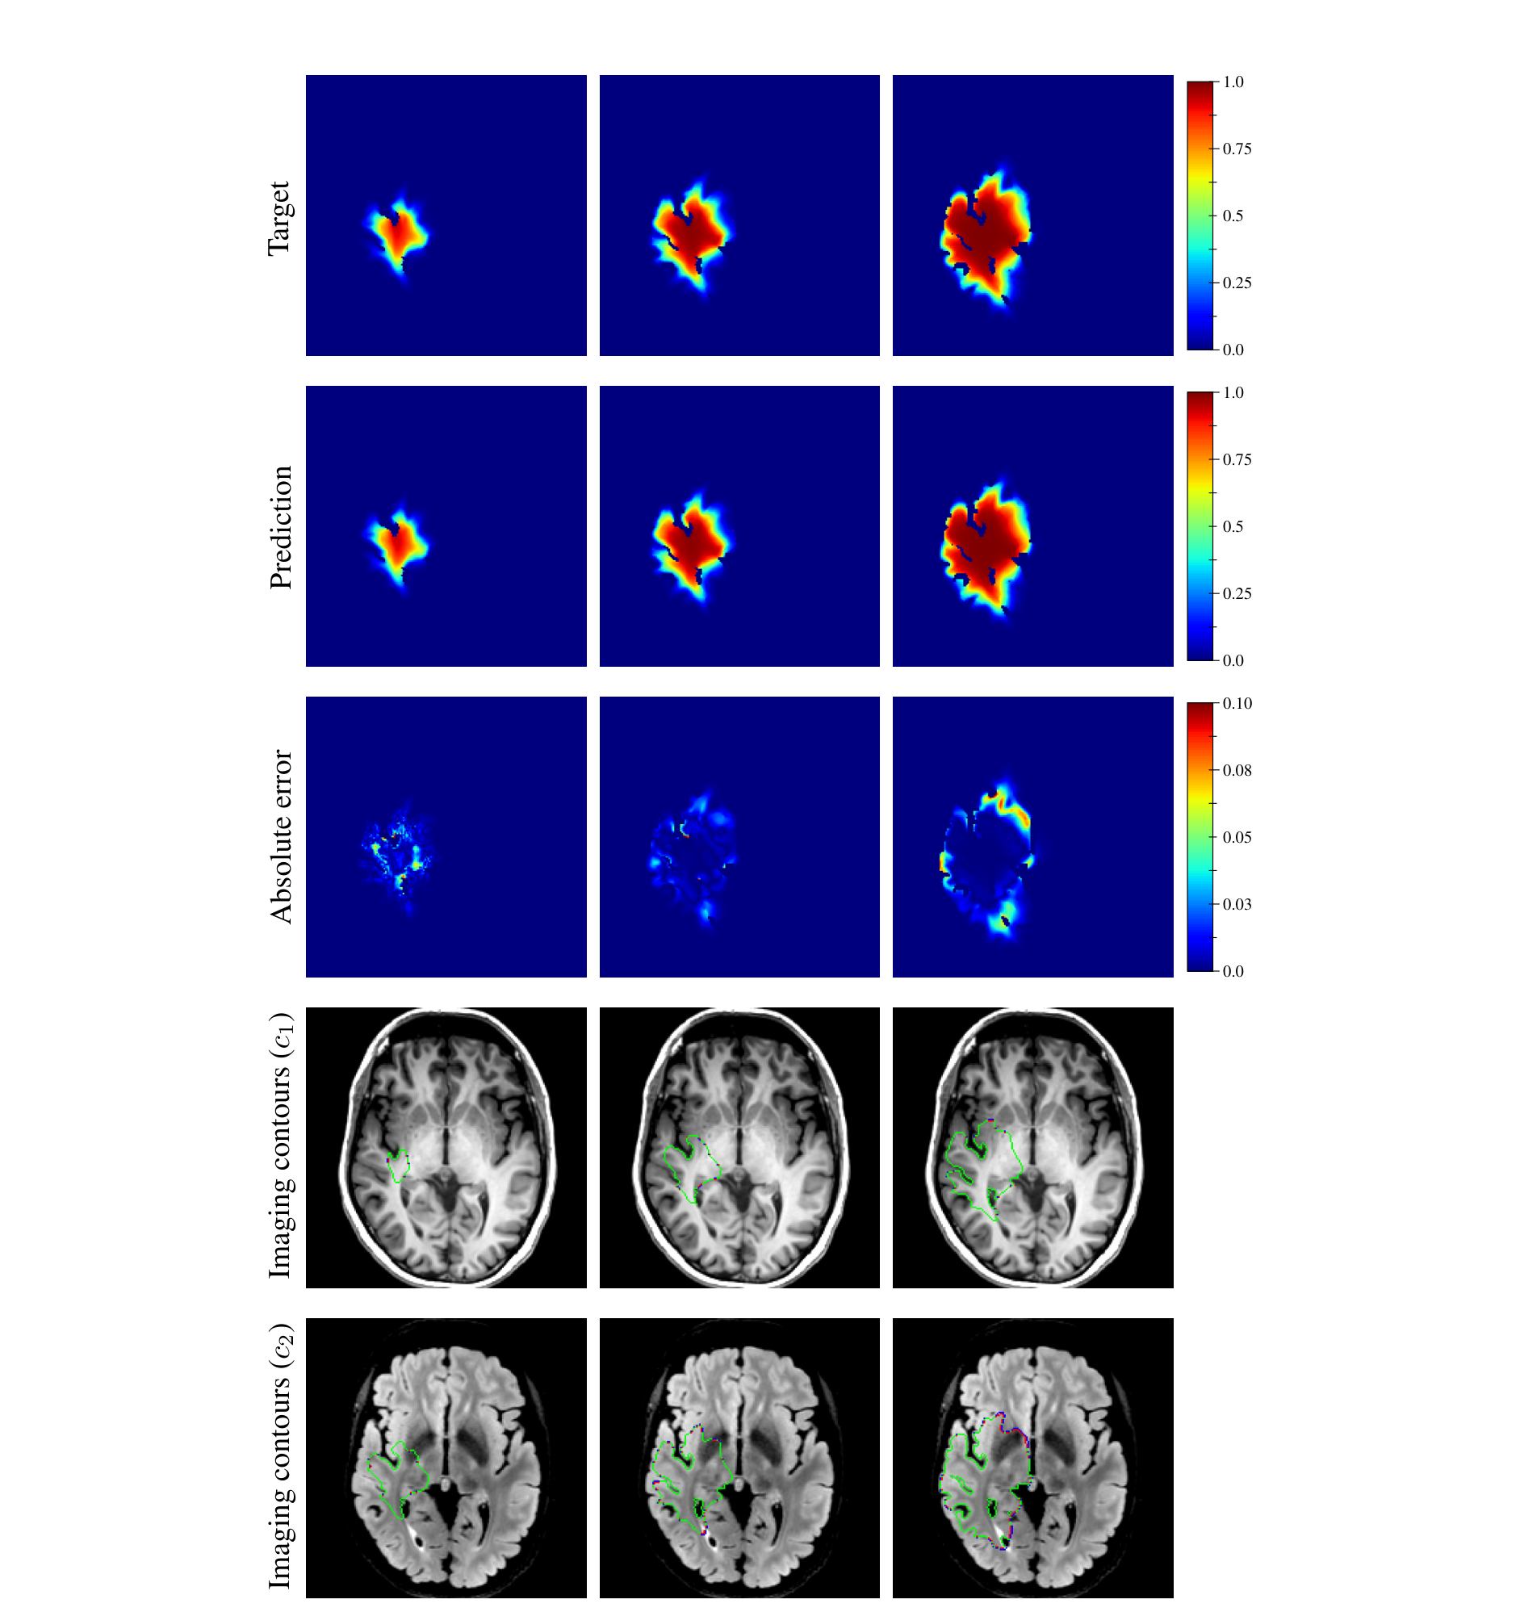
PART E | RESULTS
Figure 9: True vs predicted density (one example)
Rows
▸ 1: target density, 2: predicted density, 3: absolute error (0–0.10).
▸ 4 and 5: contours on T1 and T2 FLAIR. Blue = target, red = prediction, green = overlap.
Columns
▸ t₂, t₃, t₄ (axial slices).
Example tumor
▸ d=43.47 mm²/yr, ρ=11.22 /yr, t₁=94 d, t₂=264 d.
Note
▸ Density at t₂ comes from Network 1; t₃, t₄ come from simulation with Network 2's parameters.
▸ Error grows with time, mostly along the boundary.
Paper Fig. 9: true vs estimated density.
Martens et al. (2022) | HybridTumorNet | IIIT Bhopal
21

Slide 22
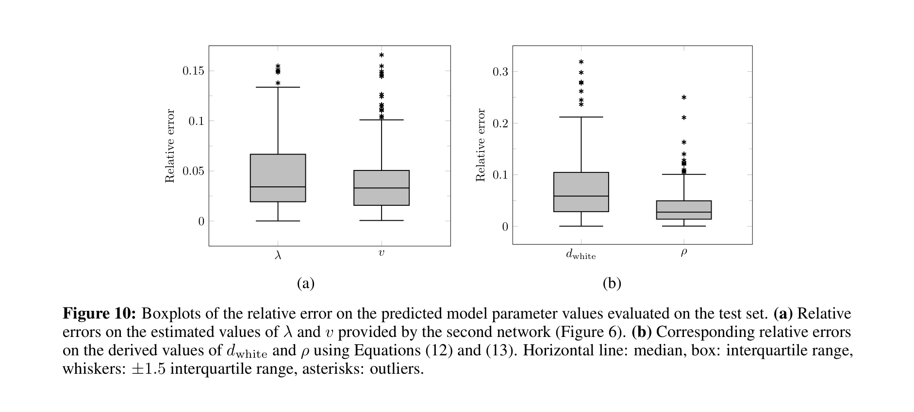
PART E | RESULTS
Figure 10: Relative error of the parameters
Panels
▸ (a) relative error of λ and v (Network 2's direct output).
▸ (b) relative error of d_white and ρ (derived with Eq. 12, 13).
Median errors
▸ λ: 3.41% v: 3.30%
▸ d_white: 5.86% ρ: 2.75%
Takeaway
▸ The parameters are estimated accurately. d_white has a bit more error because the errors of λ and v combine.
Paper Fig. 10: relative error of parameters.
Martens et al. (2022) | HybridTumorNet | IIIT Bhopal
22

Slide 23
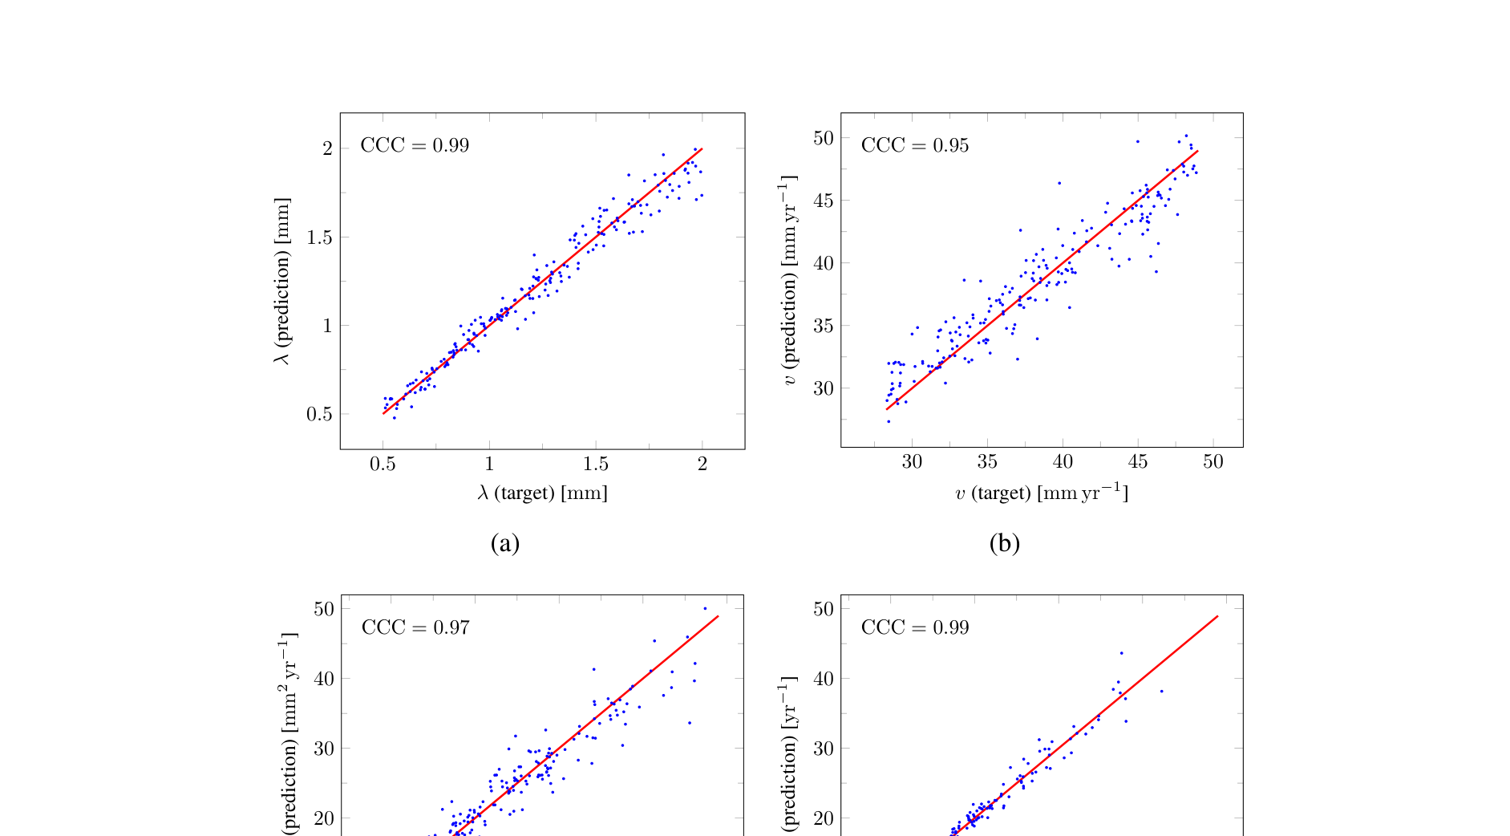
PART E | RESULTS
Figure 11: True vs predicted scatter (CCC)
Panels
▸ (a) λ (b) v (c) d_white (d) ρ. X = true, Y = predicted. Red line = perfect (y=x).
CCC (Lin)
▸ λ: 0.99, v: 0.95, d_white: 0.97, ρ: 0.99.
▸ CCC = 1 means perfect agreement. It checks correlation and bias together.
Takeaway
▸ Points lie near the diagonal, so predictions match the true values.
▸ These results are on synthetic data only.
Paper Fig. 11: true vs predicted parameters.
Martens et al. (2022) | HybridTumorNet | IIIT Bhopal
23

Slide 24
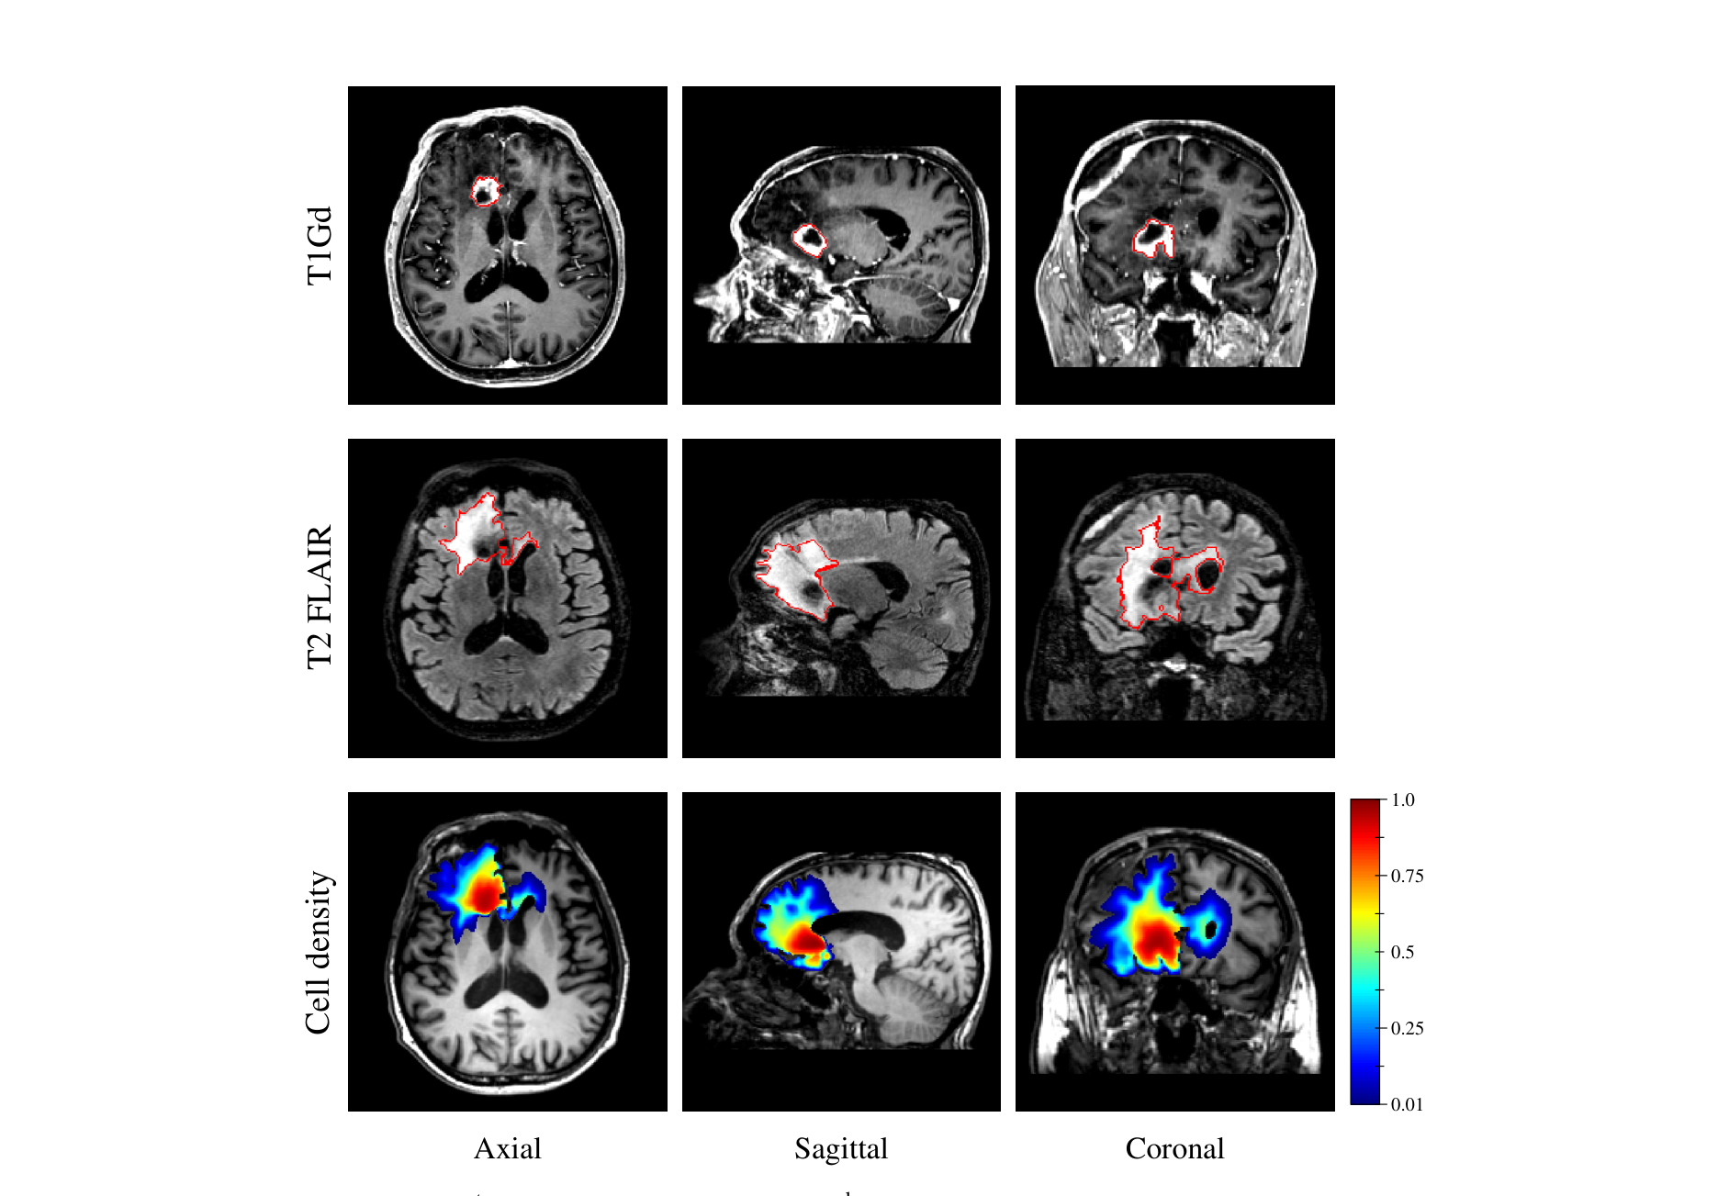
PART E | RESULTS
Figure 12: A real GBM patient
Layout
▸ Rows: T1Gd, T2 FLAIR, estimated cell density. Columns: axial, sagittal, coronal.
▸ Red contour = segmented enhancing core (T1Gd) and oedema (T2 FLAIR).
Patient
▸ IDH-wildtype glioblastoma (only Network 1 was used).
Important
▸ No biopsy and the patient had already been treated, so the result is not validated.
▸ The dense region (c~1) overlaps the necrotic area, which the paper calls counter-intuitive (necrosis is not in the model).
Paper Fig. 12: real GBM patient.
Martens et al. (2022) | HybridTumorNet | IIIT Bhopal
24

Slide 25
PART E | RESULTS
Results summary
Metric | Value | Meaning
Density MAE at t₂ (median) | 9.58×10⁻³ | very accurate density
Density MAE at t₃ / t₄ (median) | 1.38×10⁻² / 2.20×10⁻² | error slowly accumulates
Median rel. error λ, v | 3.41% / 3.30% | direct outputs
Median rel. error d_white, ρ | 5.86% / 2.75% | derived parameters
CCC λ, v, d_white, ρ | 0.99, 0.95, 0.97, 0.99 | strong agreement
ASSD | ≤ 1 mm in most cases | contour within voxel size
▸ All numbers are on synthetic test tumors (200 tumors, one unseen volunteer brain).
Martens et al. (2022) | HybridTumorNet | IIIT Bhopal
25

Slide 26
PART F | CRITICAL ANALYSIS
Limitations (as stated by the authors)
Synthetic validation: assumes Fisher-KPP describes real gliomas, which has not been extensively proven.
No real validation: one GBM patient, no biopsy, after treatment.
Mass effect and necrosis are not in the model.
Treatment effects (surgery, chemo, radiotherapy) are not modelled.
Fixed thresholds: if c₁, c₂ change, the networks must be retrained.
Constant D, ρ assumed over time in untreated patients.
Error accumulation: at longer times, artefact foci and errors grow.
Martens et al. (2022) | HybridTumorNet | IIIT Bhopal
26

Slide 27
PART F | CRITICAL ANALYSIS
Relation to our HybridTumorNet
Same: both predict PDE parameters (D, ρ) and use Fisher-KPP.
Same: both train on synthetic Fisher-KPP simulations.
Solver: Martens uses forward Euler (Δt=0.5 d); our code uses RK4.
Loss: in Martens the PDE only generates the data; in ours the PDE is also a physics loss during training.
Data: Martens has 6 healthy brains + 1 GBM; we have LUMIERE with 91 real GBM patients.
Our contribution: validation on real longitudinal data, which Martens lists as future work.
Comparison
▸ Martens: U-Net + conv-encoder, TensorFlow
▸ Ours: ResNet-based HybridTumorNet, PyTorch/MONAI
▸ Martens: contours as input
▸ Ours: MRI modalities as input
Martens et al. (2022) | HybridTumorNet | IIIT Bhopal
27

Slide 28
PART F | CRITICAL ANALYSIS
Our results so far (LUMIERE)
▸ MONAI SegResNet (SOTA bundle) on LUMIERE: average Whole-Tumor Dice 89.7%, median 93.1%, peak 96.1%.
▸ Our pretrained ResNet-10 HybridTumorNet: average WT Dice about 49.2% (10 patients), peak about 70%.
▸ The gap: a smaller backbone and synthetic pretraining; fine-tuning on real data is still pending.
▸ Evaluation was done on atlas-space data (skull-stripped, 1 mm) after fixing a coordinate mismatch bug.
▸ Note: this is segmentation Dice, not a growth-prediction metric. For growth we need Martens-style ASSD/Hausdorff and parameter CCC.
Takeaway
▸ SOTA benchmark ready
▸ Gap measured
▸ Next: fine-tune on LUMIERE
Martens et al. (2022) | HybridTumorNet | IIIT Bhopal
28

Slide 29
PART F | CRITICAL ANALYSIS
Next steps
▸ Upgrade the backbone: use SegResNet / SwinUNETR inside HybridTumorNet.
▸ Fine-tune growth prediction on LUMIERE longitudinal pairs (tᵢ → tᵢ₊₁).
▸ Use Martens-style metrics: MAE, ASSD, Hausdorff, parameter CCC.
▸ Add uncertainty quantification (MC dropout / ensembles).
▸ Address Martens' limitations where data allows: real data, mass effect, treatment.
Martens et al. (2022) | HybridTumorNet | IIIT Bhopal
29

Slide 30
PART F | CRITICAL ANALYSIS
Glossary
Term | Simple meaning
GBM | Glioblastoma, the most aggressive brain tumor
Voxel | 3D pixel (1 mm³)
DTI | MRI that measures the direction of nerve fibres
WM / GM / CSF | White matter (fibres) / Grey matter (neurons) / Brain fluid
MICO | Algorithm that segments tissues and also corrects the MRI brightness bias
MAE | Mean absolute error
Hausdorff / ASSD | Boundary error: worst case / average
CCC | Agreement score (1 = perfect)
Anisotropy a=10 | In WM, diffusion along the fibre is 10× larger
Martens et al. (2022) | HybridTumorNet | IIIT Bhopal
30

Slide 31
PART F | CRITICAL ANALYSIS
Anticipated Discussion Questions
Q: Why not predict D, ρ directly? A: λ and v can be measured from images; D and ρ are just combinations of them.
Q: Why only synthetic data? A: Nobody knows the true cell density of a real tumor, so ground truth exists only in simulation.
Q: Can we trust the results? A: They are on synthetic data; the authors themselves say real validation is pending.
Q: How is our work different? A: We have real longitudinal LUMIERE data and a physics loss during training.
Q: Why does error grow with time? A: Errors in the initial density and parameters accumulate in the simulation.
Martens et al. (2022) | HybridTumorNet | IIIT Bhopal
31

Slide 32
SUMMARY
Conclusion
▸ Martens et al. showed that deep CNNs can estimate cell density and Fisher-KPP parameters from MRI contours in seconds (median relative error 2.75–5.86%, CCC ≥ 0.95).
▸ But the validation is entirely synthetic; validation on real gliomas is still pending.
▸ Our HybridTumorNet takes the same idea forward with real longitudinal LUMIERE data and physics-informed training.
▸ Thank you. Questions and discussion.
Martens et al. (2022) | HybridTumorNet | IIIT Bhopal
32

