Slide 1

Bellman-ford
Presented By:-
Bhagwat Jarande
Mansi Jeurkar
Krishna Jolamwar
Suraj Jude
Gayatri Jumale
algorithm

Slide 2





introduction
Imagine you have a map with different cities connected by roads, each road having a certain distance. The Bellman-Ford algorithm is like a guide that helps you find the shortest path from one city to all other cities, even if some roads have negative lengths. It’s like a GPS for computers, useful for figuring out that quickest way to get from one point to another in a network.
2017)

Slide 3
What Is Bellman-Ford Algorithm
The Bellman-Ford algorithm is a very popular algorithm used to find the shortest-path from one node to all the other
nodes in a weighted graph.
The Bellman-Ford algorithm can work on graphs with negative-weighted edges.
It is slower than Dijkstra’s algorithm for the same problem, but it is capable of handling graphs in which some of the edge
weights are negative numbers.
The Bellman-Ford algorithm’s primary principle is that it starts with a single source and calculated the distance to each
node. The distance is initially unknown and assumed to be infinite.

Slide 4
The Idea Behind The Bellman-Ford
Algorithm
Negative Weighted edges
The Bellman-Ford algorithm’s primary principle is that it starts with a single source and calculates the distance to each node.
The distance is initially unknown and assumed to be infinite, but as time goes on, the algorithm relaxes those paths by identifying a few shorter paths.
Hence it is said that Bellman-Ford is based on “Principle of Relaxation“.
It states that for the graph having N vertices, all the edges should be relaxed N-1 times to compute the single source shortest path.
Negative weights are edge values that represent a cost or a loss, such as a penalty, a fee, or a discount.
For example, in a currency exchange graph, a negative weight could indicate a favorable exchange rate that gives you more money.
Negative weights are not necessarily problematic for graph algorithms, as long as they do not create negative cycles.
In fact, some algorithms, such as Dijkstra's algorithm, can handle negative weights by using a priority queue or a heap to keep track of the nodes with the lowest distance from the source.

Slide 5
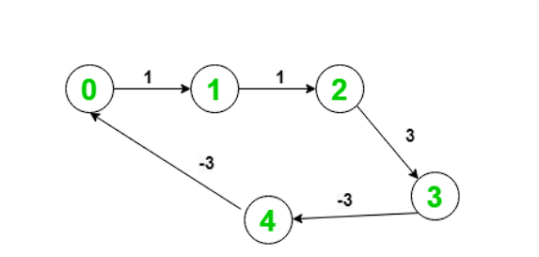
Negative Weighted Cycle
Negative cycles are loops in the graph that have a negative sum of weights, meaning that traversing the cycle reduces the total cost or distance.
For example, in a currency exchange graph, a negative cycle could indicate an arbitrage opportunity that allows you to make profit by repeating the cycle.
Negative cycles are problematic for graph algorithms, because they make the shortest path or the maximum flow undefined or infinite.
For example, if there is a negative cycle in the path from A to B, then you can always reduce the distance by going through the cycle one more time. Therefore, some algorithms, such as Dijkstra's algorithm, cannot handle negative cycles and may produce incorrect or inconsistent results.

Slide 6
Detecting A Negative Weight Cycle
Principle Of Relaxation
One way to handle negative cycles is to detect them and report them as an error or a special case.
For example, if you are using Bellman-Ford algorithm to find the shortest path from a single source to all other nodes, you can detect a negative cycle by running one more iteration after n-1 iterations, where n is the number of nodes in the graph. If any distance value changes in the last iteration, then there is a negative cycle in the graph.
It states that for the graph having N vertices, all the edges should be relaxed N-1 times to compute the single source shortest path.
In order to detect whether a negative cycle exists or not, relax all the edge one more time and if the shortest distance for any node reduces then we can say that a negative cycle exists. In short if we relax the edges N times, and there is any change in the shortest distance of any node between the N-1th and Nth relaxation than a negative cycle exists, otherwise not exist.

Slide 7
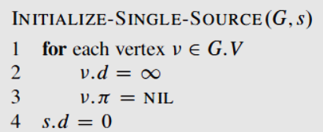
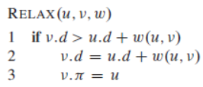
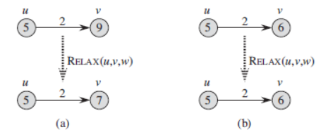
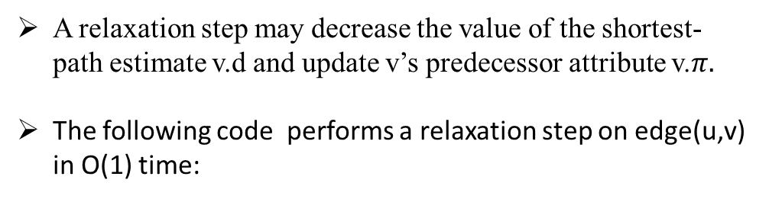
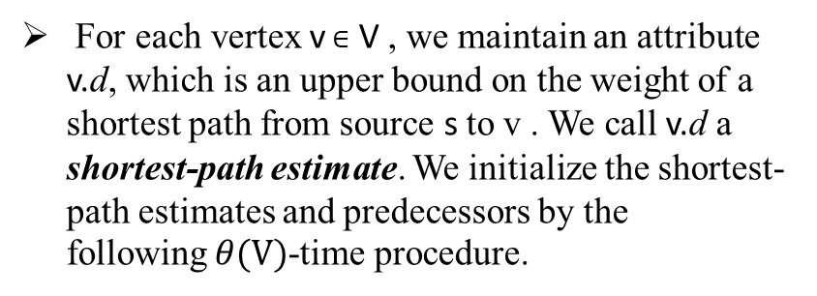
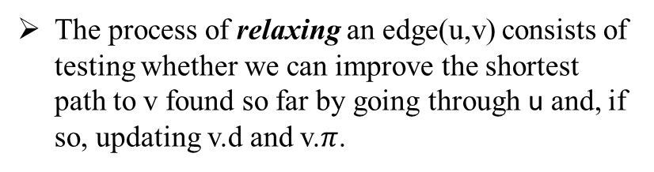
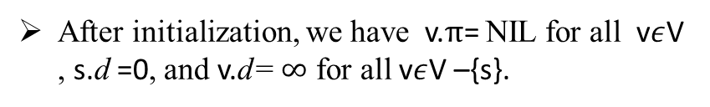
Principle Of Relaxation For Bellman-Ford
For each vertex v$∈$ V , we maintain an attribute v.d, which is an upper bound on the weight of a shortest path from source s to v . We call v.d a shortest-path estimate. We initialize the shortest-path estimates and predecessors by the following$θ(V)$-time procedure.
A relaxation step may decrease the value of the shortest-path estimate v.d and update v’s predecessor attribute v.$π.$
The following code performs a relaxation step on edge(u,v) in O(1) time:
After initialization, we have v.π= NIL for all v$ε$V , s.d =0, and v.d= $∞$ for all v$ε$V –{s}.
Example:-
The process of relaxing an edge(u,v) consists of testing whether we can improve the shortest path to v found so far by going through u and, if so, updating v.d and v.$π$.

Slide 8
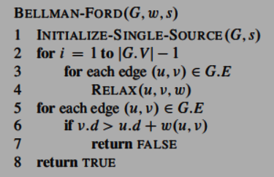
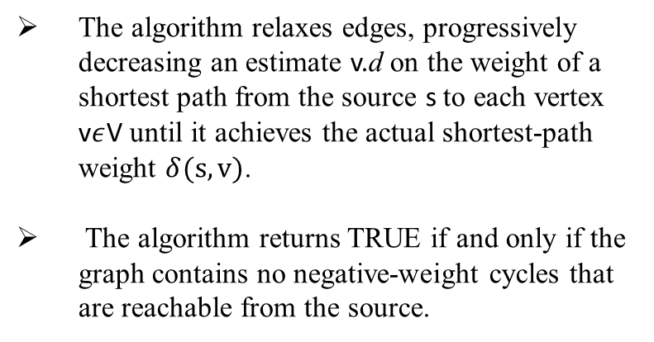
Algorithm For Bellman-Ford
The algorithm relaxes edges, progressively decreasing an estimate v.d on the weight of a shortest path from the source s to each vertex v$ε$V until it achieves the actual shortest-path weight $δ(s,v)$.
The algorithm returns TRUE if and only if the graph contains no negative-weight cycles that are reachable from the source.

Slide 9
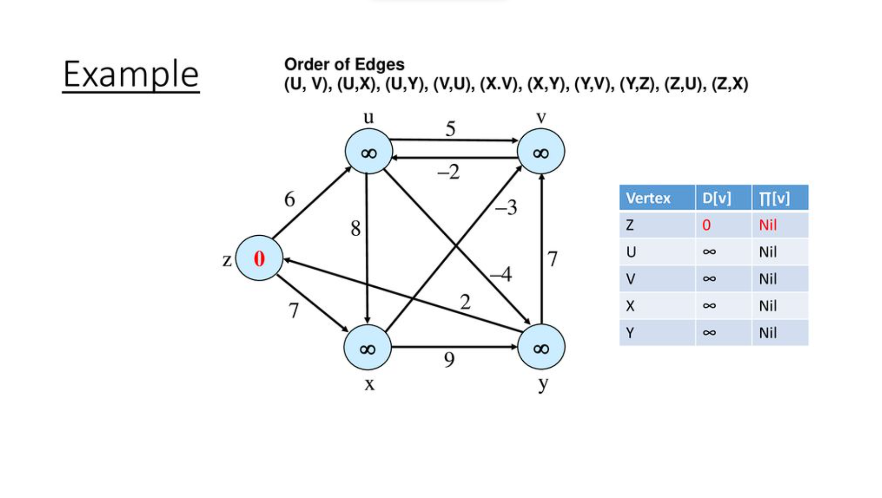

Slide 10
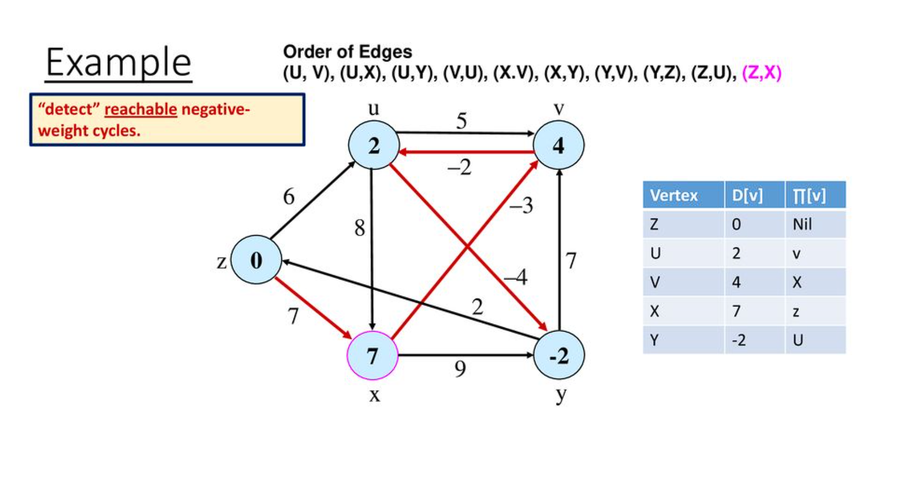

Result :-

Slide 11
THANK YOU

