Slide 1


Principles of Data Science
Analysis of Suicides in India
CIA 3
By:
Harsh Seksaria (2048011)
Harshita (2048035)
Jerlyn S (2048037)

Slide 2

Introduction
Suicide in India is a serious issue
Increase in suicide rate of young adults in recent years
Students, Farmers, Housewives, Teenagers
More than 1 lakh people every year take their lives
Distinct from global demographic risk factors, in India, the female to male ratio for suicide is higher
Prevention strategies need to be tailored in order to stop suicide

Slide 3

Problem Statement
Analyse the suicide trend in India and the major influencers for the increased suicide rate
Build a model to predict the total number of cases that can arise in a given year for a particular state
Compare the predicted value with the actual value

Slide 4
How we are using Technology to analyse this?
Collecting data from different sources
Preparing data for analysis
Understanding the data
Analysing data using Machine Learning methods
Visualising data
Draw conclusions
Support the interpreted results

Slide 5

Flow of the case study
Data Collection
Data Pre-Processing
Exploratory Data Analysis
Report
Prediction
Model Building

Slide 6
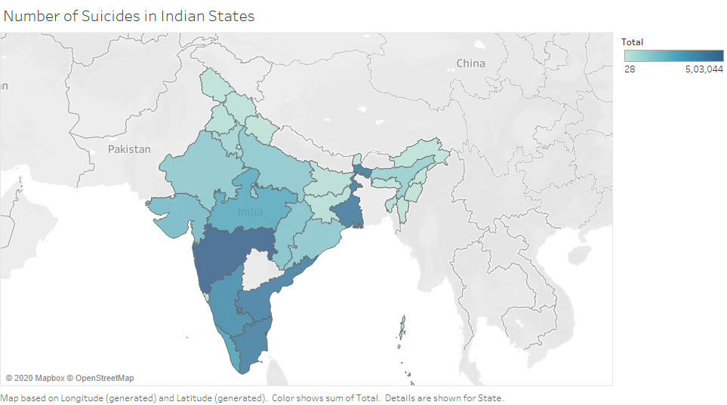
India Heat-Map for number of suicides in different states

Slide 7
Thank You

