Slide 1
Earthquake Prediction
St. John College of Engineering and Management
Presented by:
Suhas Digole (EU1162095)
Harsh Mendapara (EU1162099)
Manthan Thakur (EU1162006)
Guided by:
Mr. Chetan Patil

Slide 2
Contents:
Abstract
Introduction to Domain
Problem Definition
Proposed System
Objectives
Scope
Literature Survey
Requirement Analysis
System Architecture
System Design
Observations
Results
Conclusion
Future Scope
References

Slide 3
Abstract:
Earthquake is the major problem in this world from all the disasters. The waves with high energy are able to demolish different types of infrastructures. To the upcoming problem from many years, data analytics is well developed with the help of different kinds of prediction techniques earthquake analysis is carried out. Our project takes the data from a specified region and can predict the magnitude of the earthquake and their locations. Our project can help the government/authorities to protect and minimize the loss of life and property.

Slide 4
Introduction to Domain:
Machine learning is the scientific study of algorithms and statistical models which enables computer system to get into a mode of self learning without being explicitly programmed.
Deep learning is an subset of Machine learning that has networks of capable of learning unsupervised from data that is unlabeled.
Data analytics is a field where data analyst can perform various analysis which can benefit the companies/organizations to gain more profit.
With the help of machine learning we can perform methods like cleaning, transforming and analyzing the data-set with the help of which we can design a machine learning model.

Slide 5
Introduction to Domain:
Example:
In Data-Analysis , here we use various functions like bar plot , plot etc and libraries on the data-set to get the required output in the form of graphs.
We gather data from various sources and apply various data analysis functions to visualize and sort the data.
Algorithm is then applied to the sorted data to give the required output.

Slide 6
Problem Statement:
Earthquakes are among the natural disasters created by sliding of the large land plates
Here we choose the previously tested problem statement.
In this case , we can show the maximum number of magnitude as well as the prediction with the help of graph and functions.

Slide 7
Proposed System:
The main idea of our project is to help people know earlier about the most prone areas where earthquake may occur and what measures can be taken by the governing authorities.
In our project we took the dataset from the sites and implemented the functions for data pre-processing ,and get the output in form graph.

Slide 8
Objectives:
Our main objective is to show the magnitude-scale of the earthquake.
To show our results in graphical manner.
To predict the earthquake prone areas.

Slide 9
Scope:
Advantages:
Our project can do analysis and prediction.
Drawbacks:
Our project cannot do ground-motion analysis.
The scope of our project follows the necessary steps:
Analysis
Visualization
Prediction

Slide 10
Literature Survey I:
Gaurav Gupta and Inder(2016)
Studied on the list of earthquakes which occurred in india from 1800 to 2014.
In this paper, analysis and visualization was done with help of Hadoop Hive tools of Big data techniques.
Maps as well as graphs were plotted with the help of tableau.

Slide 11
Literature Survey I:
System Architecture:
Cleaning phase
Featured
vectors
Dataset
ML
Algorithm
Predictive model
Output

Slide 12
Literature Survey I:
Advantages:
In this paper, analysis and duration of seismic data has been done by Hadoop Hive tools of big data techniques.
Analysis and visualize as per the choice data can be extracted.
Disadvantages:
Depth and wave velocity analysis

Slide 13
Literature Survey II:
Amir suratgar, Farbod Setoudeh and Ali(2008)
In this paper, prediction was based on the geomagnetic declination, horizontal component and hourly relative humidity.
The earth’s geomagnetic field data was used.
The above mention parameters were used to predict magnitude of earthquake 2 days before.

Slide 14
Literature Survey II:
Advantages:
One part of data is used for learning and other one for testing.
Actual data is used for the learning of neural network.
Disadvantages:
Damage degree of earthquake to human’s life.
Depth analysis.

Slide 15
Literature Survey III:
Paper by Shuo Sun ,Wan-zhen and Shuo sun (2017)
In this paper, SVM and neural network algorithm were used.
In order to reduce the damage intensity caused by earthquake, calculation of high magnitude earthquake.
Prediction model based on existing earthquake data.

Slide 16
Literature Survey III:
Advantages:
Prediction ability of magnitude caused at different locations.
Focal depth is realized using combination earthquakes.
Longitude, latitude and focal depth are used as prediction parameters.
Disadvantages:
Only three factors are considered here for prediction which are longitude, latitude and focal depth.

Slide 17
Requirement Analysis:
Functional Requirements:
We can detect the magnitude of earthquake in a specified region.
We can perform analysis, prediction and visualization of earthquake prone regions.

Slide 18
Requirement Analysis:
Non-Functional Requirements:
Our project focuses on creating awareness of earthquake prone regions.
Our project will help organizations to take measures against natural calamities.

Slide 19
Requirement Analysis:
Hardware Requirements:
Intel core i5 8th Gen processor(4 core).
Intel UHD graphics 620.

Slide 20
Requirement Analysis:
Software Requirements:
Anaconda Navigator.
Jupyter Notebook
Python libraries.

Slide 21
System Architecture:
5.1.1 Flow Chart of Proposed System
Start
Reading the dataset
Analyzing the features
Making the Prediction
Training the model
Calculating the statistics
Visualizing the output
End

Slide 22
System Design:
Use Case Diagram :
User Analyst
Latitude
Longitude
Feed data
Date
View data
Magnitude

Slide 23
System Design:
Class Diagram :
Analyst
Dataset cleaning
ML
ML
Training and testing.
ANN algorithm
To visualize the
Trained dataset
Visualization
Results
Calculations ,
Prediction

Slide 24
System Design:
DFD Diagram :
User
Predicting System
Analyst
Employee

Slide 25
System Design:
Activity Diagram
Coordinate database
Start
Input data
Depth database
Analyze
Date database
predict
Visualizing
calculate
Generate
End

Slide 26
Observations:
Firstly, data is collected and sorted for relevancy from various sources.
Then analysis is carried out on the collected data by understanding their attributes values, reducing errors by replacing null values, selecting specific features for taking input and output for earthquake prediction and finally we calculated statistical measure of each attributes.

Slide 27
Observations:
Secondly prediction is carried out on sorted dataset, here the obtained data is initially separated into training and testing purpose.
A simple ANN is designed and a suitable algorithm yielding best accuracy is chosen to predict the magnitude value.
At last the visualization of the calculated output with different attributes is to be carried out and illustrated in the graphical format.

Slide 28
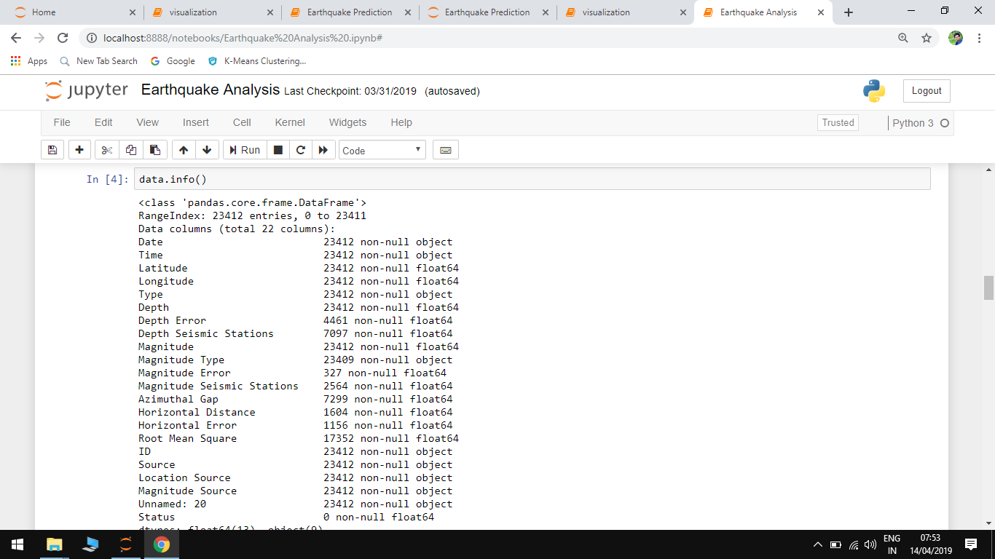
Results:
Analysis :
In this project, the factors are taken for data analysis are: Date, Time, Latitude, Longitude, Depth, Depth Error, magnitude.
Figure: Information about significant dataset.

Slide 29
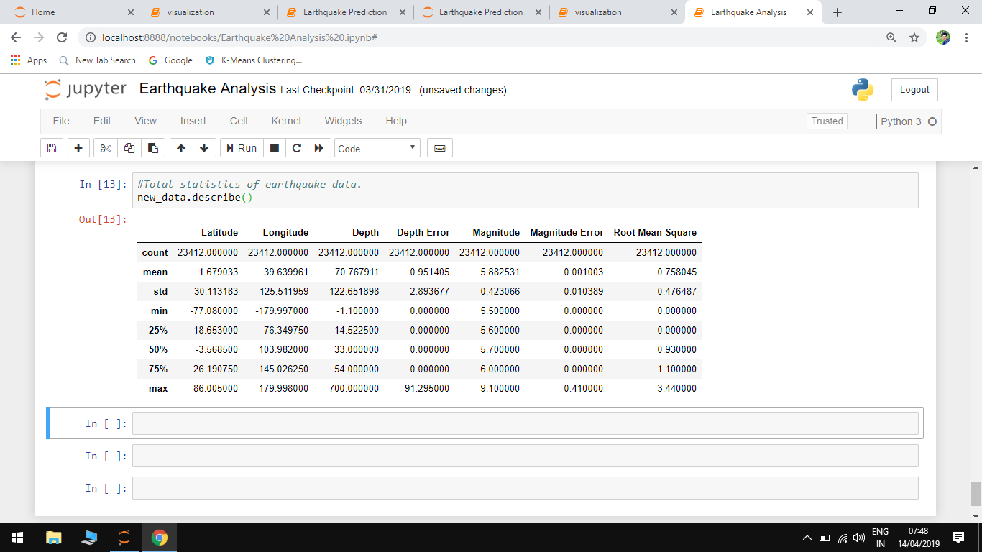
Results :
Here in above figure, the basic statistical measures are carried out. With the type of the attribute the mathematical measures such as the mean, the mode, the standard deviation, etc.

Slide 30
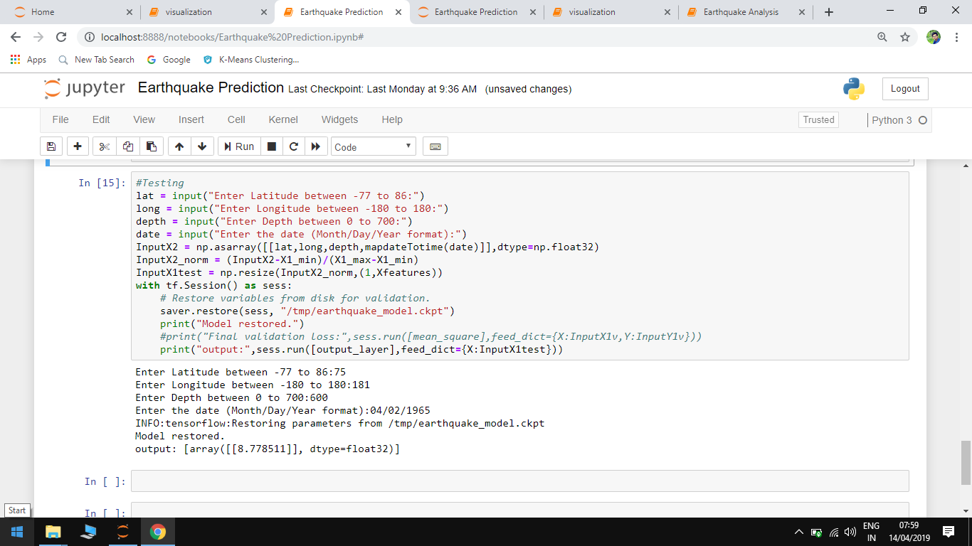
Results:
Prediction of earthquake significant dataset.

Slide 31
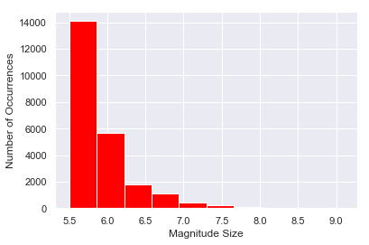
Results:
From the given figure , the histogram is plot to understand the relationship between the two parameters No of occurrences and Magnitude Size.

Slide 32
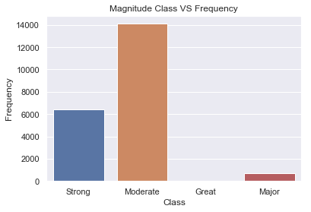
Results:
This figure shows the relationship between Magnitude Class Vs Frequency in which bar graph represent the type of magnitude over the frequency class.

Slide 33
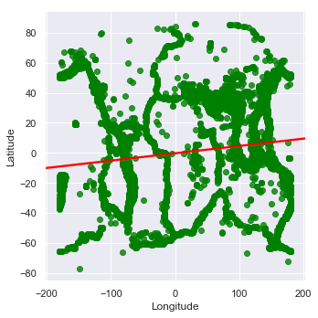
Results:
This graph gives the brief information about the geological locations which are plotted in the form of coordinates.

Slide 34
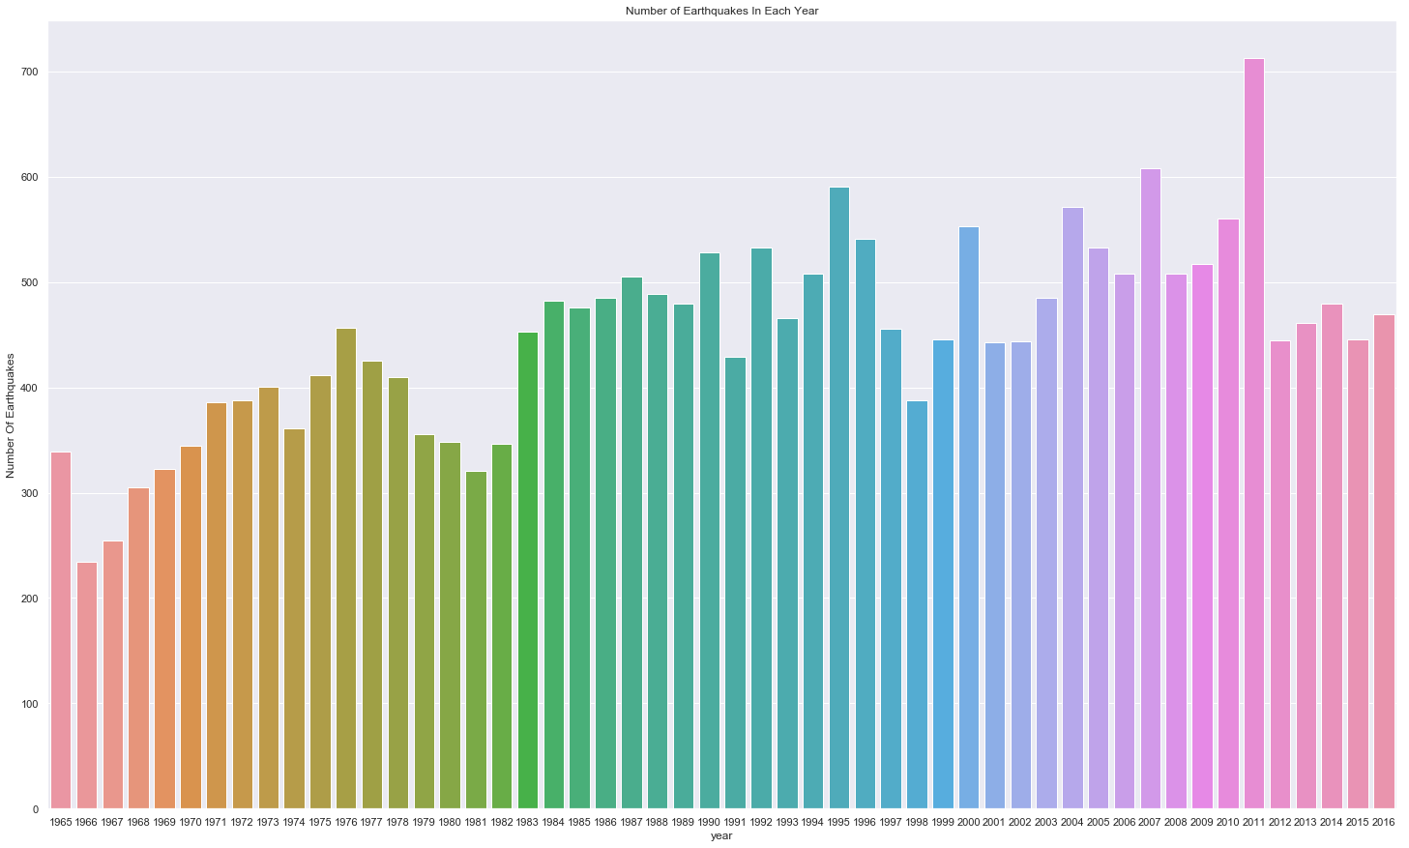
Results:
Now, the significant earthquakes occurred over the world is illustrated here from 1965 to 2016.

Slide 35
Conclusion:
Here, after getting hold of such a raw dataset our first aim was to convert it into understandable format.
Also, prediction of earthquake magnitude after giving specific date , longitude, latitude was our main task.
Lastly, Visualization of the data with different graphs like histogram, bar graph was also the important task.
Thus, we successfully design a prototype model of earthquake prediction.

Slide 36
Future Scope:
Our project will be able to analyse and visualize the earthquake situation.
With the help of which we will be able to help people know about the earthquake prone regions.
Our project can do analysis and prediction.
Our project cannot do ground-motion analysis.

Slide 37
References:
[1] Amir Suratgar, “Magnitude of Earthquake Prediction using Neural Network”,2008.
[2]Gourav Gupta, “Earthquake Data Analysis and visualization using Big Data Tool”,2016.
[3]Wan-zhen Zhou, ”Study on Seismic Magnitude Prediction Based on combination Algorithm ”, 2017.

