Slide 1
FACTORY MANAGEMENT
SYSTEM
A modular CLI-based Python application
Submitted by
Submitted to
Harsh Vijay
Dr. Priyadharshini B.
Registration No.
26BCE10808
VIT Bhopal University

Slide 2
01 | INTRODUCTION
Project Overview
What is it?
Core idea
Beginner-friendly CLI system for small-scale factories.
Digitize stock, categories and machine audit records.
Technology
Run
Python 3.x, OOP and standard libraries.
python main.py
2

Slide 3
02 | PROBLEM DEFINITION
Problem Statement & Objectives
Problem
Objectives
Manual logs can cause lost records and inaccurate efficiency tracking.
Digitize basic operations and persist inventory between runs.
3

Slide 4
03 | SCOPE
Scope & Target Users
Factory Supervisor
Inventory Manager
Maintenance Staff
Products, stock updates, audits.
Stock and categories.
Audit results and machine faults.
4

Slide 5
04 | REQUIREMENTS
Functional Requirements
FR-01 Add
FR-02 View
Capture product ID, name, category, stock and price.
Display all inventory.
FR-03 Categories
FR-04 Update
Track unique categories.
Add manufactured units.
FR-05 Audit
FR-06 Persist
Simulate machine status and efficiency.
Save/load factory_stock.txt.
5

Slide 6
05 | FEATURES
High-Level Features
Inventory
Categories
Add and update products.
Unique category set.
Machine Audit
Efficiency
Four predefined machines.
Working/total percentage.
Persistence
Modularity
Flat-file storage.
Focused Python modules.
6

Slide 7
06 | ARCHITECTURE
System Architecture
CLI
Logic
main.py controls interaction.
inventory.py + audit.py.
Models
Data
Product + Machine.
data_manager.py + text file.
• main.py -> inventory.py / audit.py -> data_manager.py -> factory_stock.txt
• models.py provides Product and Machine objects.
7

Slide 8
07 | WORKFLOW
System Workflow
1 Start
2 Menu
Load saved inventory.
Select one of six actions.
3 Process
4 Persist/Report
Delegate to module.
Save or print audit.
5 Continue
Repeat or exit.
• Start -> Load Data -> Show Menu -> Process Request -> Save/Report -> Continue or Exit
8

Slide 9
08 | DESIGN DIAGRAMS
Module / Component Design
main.py
inventory.py
CLI and orchestration.
Product operations.
data_manager.py
audit.py
Persistence.
Machine audit.
models.py
Domain classes.
9

Slide 10
09 | OOP DESIGN
Class / Component Diagram
Product
Machine
p_id, name, stock, price; display_info().
m_id, name, is_working.
• Product: p_id, name, stock, price | Machine: m_id, name, is_working
10

Slide 11
10 | DATA DESIGN
Data Storage Model
In-memory
Persistent
ER note
Dictionary for inventory + set for categories.
factory_stock.txt stores ID, name, stock, price.
No relational database is used in the current implementation.
11

Slide 12
11 | IMPLEMENTATION
Implementation Details
Python
OOP
Core language.
Product and Machine classes.
Libraries
Audit logic
os, random, math, datetime.
Efficiency = floor(working/total*100).
12

Slide 13
12 | RESULTS
Screens / Results
CLI Menu
Audit Report
Persistence
Six operations are exposed.
Machine status and efficiency are printed.
Saved inventory reloads on restart.
• Representative CLI output based on the implemented menu and audit logic; machine status is randomized at runtime.
13

Slide 14
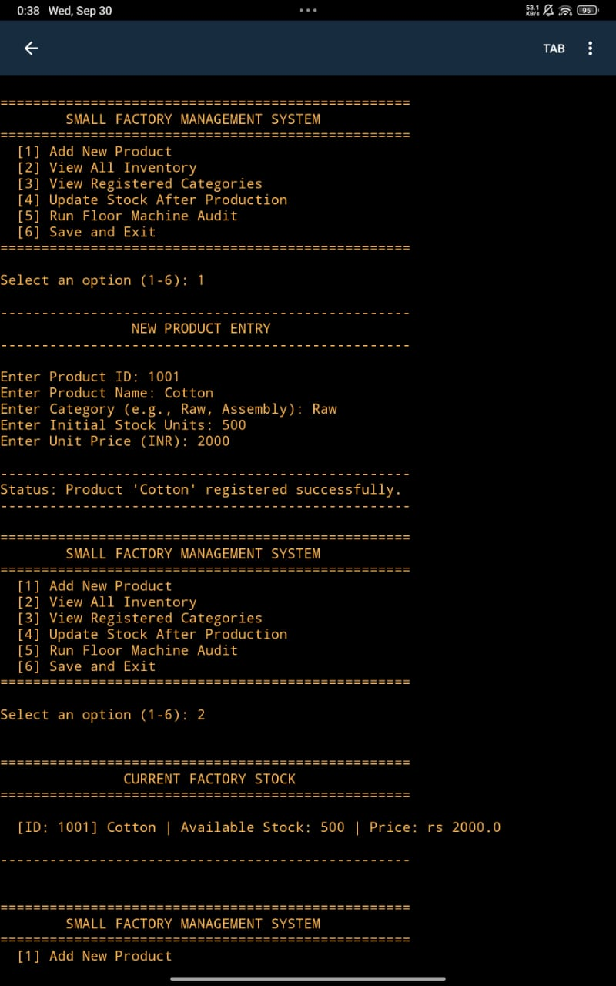
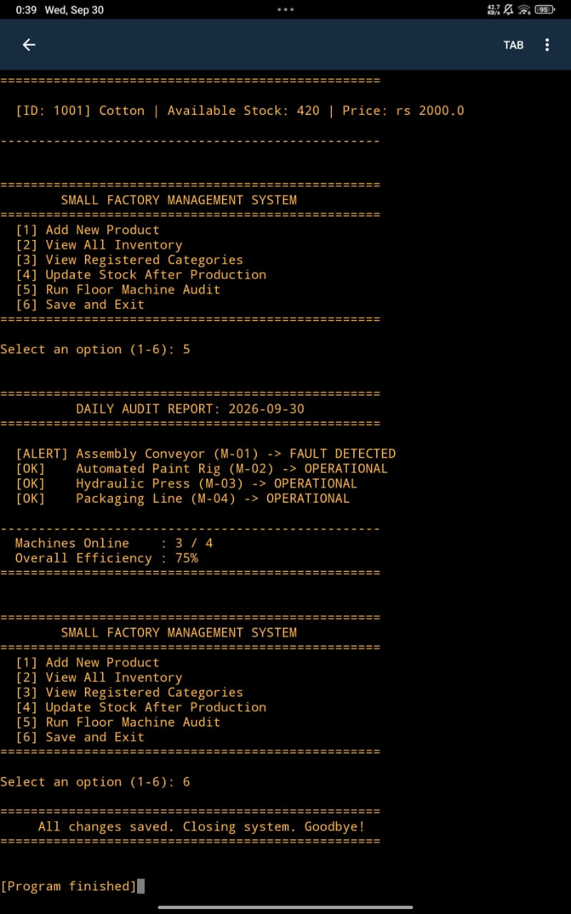
12A | LIVE OUTPUT
Program Execution Screenshots
Actual console output showing product registration, inventory, machine audit and save/exit.
14

Slide 15
13 | TESTING
Testing Approach
Registration
Duplicate ID
Add and view product.
Reject existing ID.
Stock update
Persistence
Verify quantity changes.
Restart and verify records.
Audit
Input validation
Run repeatedly and verify output.
Check invalid numeric input.
15

Slide 16
14 | EVALUATION
Challenges Faced & Design Decisions
Data loss
Machine visibility
Maintainability
Solved with local persistence.
Solved with audit module.
Solved through modular files and OOP.
16

Slide 17
15 | LEARNING OUTCOMES
Learnings & Key Takeaways
Python
OOP
Core syntax, functions and libraries.
Entity-based design.
File handling
Modularity
Save and load structured records.
Separation of responsibilities.
Problem solving
Map real workflow to software.
17

Slide 18
16 | CLOSING
Conclusion
Current version
Future scope
Thank You
Lightweight CLI system for small-scale operations.
Database, GUI/web UI, authentication, sensors and analytics.
Questions & Discussion
• The current implementation is intentionally lightweight and can be extended with a database, GUI/web interface, authentication and real sensor data.
18

