Slide 1
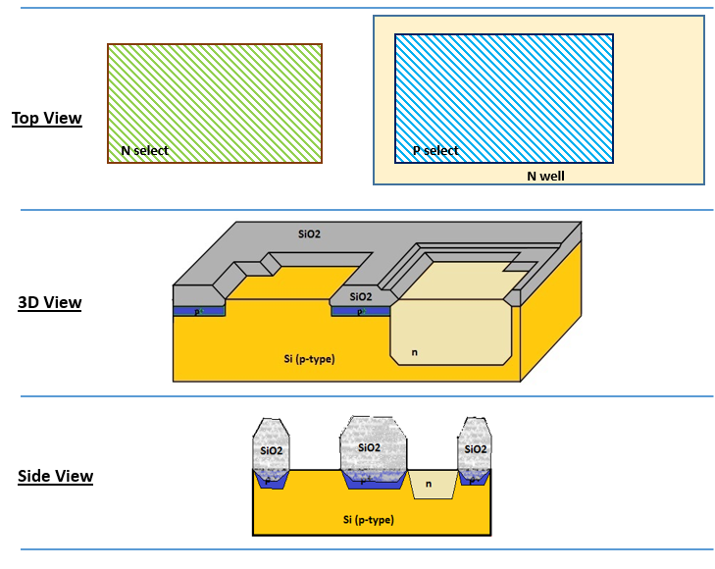

Slide 2
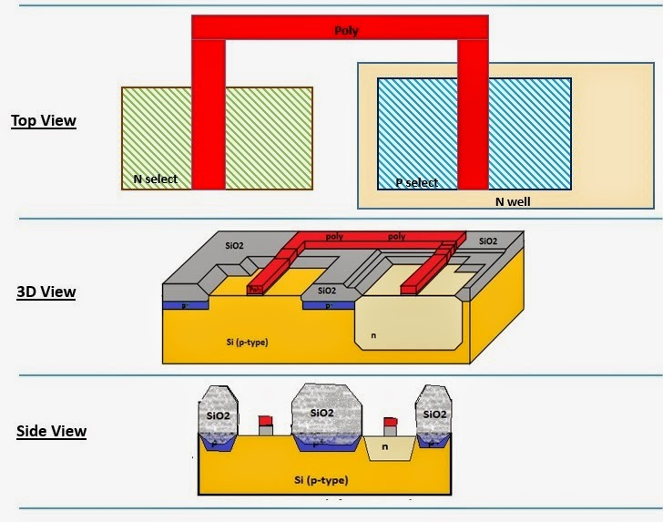

Slide 3
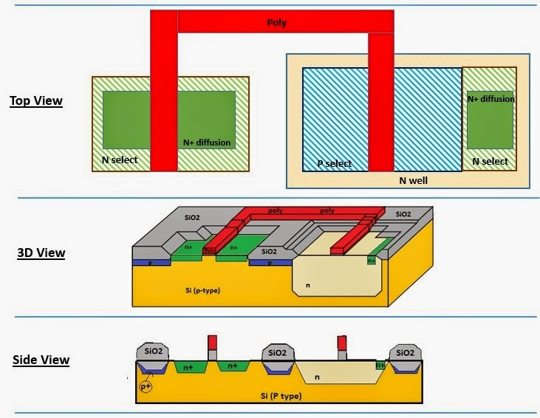

Slide 4
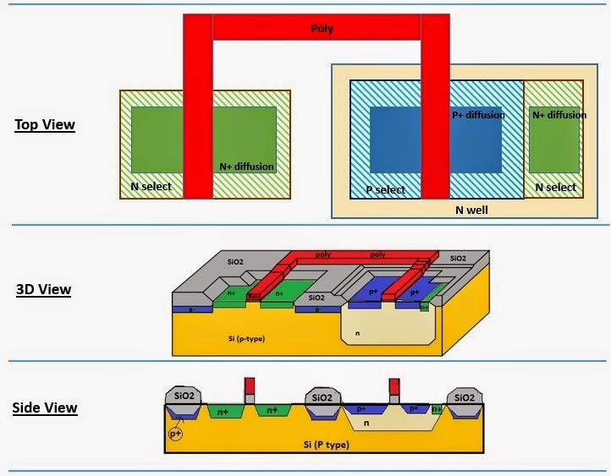

Slide 5
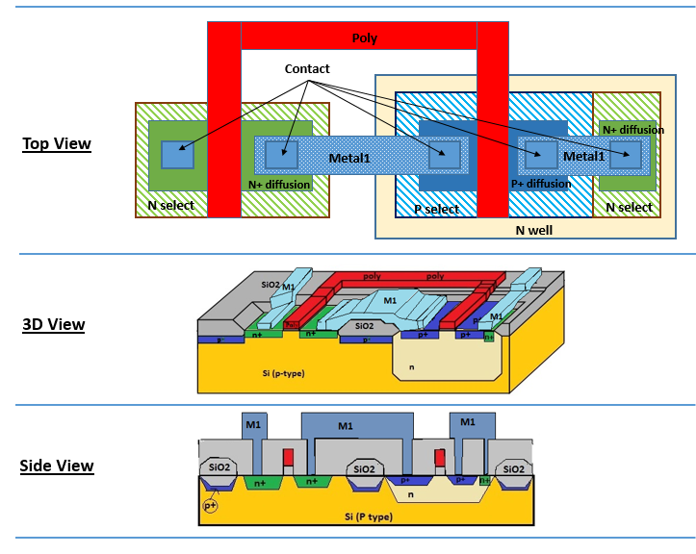

Slide 6
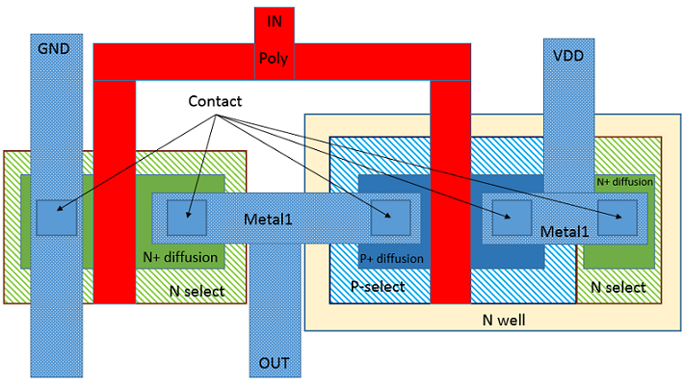

Slide 7
http://opencircuitdesign.com/magic/tutorials/tut1.html
http://www.ece.iit.edu/~eoruklu/courses/ece429/tutorial/MAGIC1x.html
https://vlsiarch.ecen.okstate.edu/VLSI/magic.htm
http://opencircuitdesign.com/magic/download.html

