Slide 1
Diaspora and Transnationalism: An Introduction
Instruction: Dr Ratna Bharati B
HM 494
Week 4 Class 2

Slide 2
INDIAN LABOUR EMIGRATION TO BURMA (C. 1880-1940): RETHINKING INDIAN MIGRATORY PATTERNS
Author(s): Ritesh Kumar Jaiswal
Source: Proceedings of the Indian History Congress , 2014, Vol. 75, Platinum Jubilee (2014), pp. 911-919
Published by: Indian History Congress
Stable URL: https://www.jstor.org/stable/44158476

Slide 3
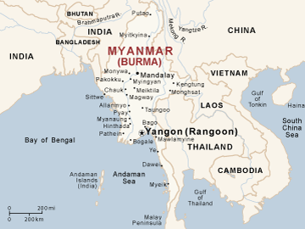
Introduction
The First Anglo-Burmese war saw Indian emigrants to Burma who were primarily traders, apart from Indian sepoys in colonial troops, as the EIC ended the monopoly enjoyed by prior Burmese govt over major articles of commerce
However the 2nd and 3rd Anglo-Burmese war which brought about the complete annexation of Burma (lower and upper respectively), and more specifically the opening of Suez Canal by 1869, opened up Burma more vibrantly to the 'outer' western world

Slide 4
Introduction
Labour needs of the southern rice cultivation areas were initially met by migrant labourers from Northern Burma
However this proved to be insufficient to meet the burgeoning labour demands of expanding rice cultivation and exports. In 1874, the colonial state made an effort to settle a class of zamindar-agriculturalists from Bihar by bestowing upon them land grants, which was not
much successful.
The 1880's were marked by sugar crisis in West Indies colonies which led to decline in Indian overseas emigration as well as British revenues. This led to the promotion of emigration to colonies where other commodities such as tea, coffee, rubber, tobacco, rice were grown.
https://www.youtube.com/watch?v=ETXnhbDKJc8

Slide 5
Introduction
It was in this context that the newly annexed regions of Burma the caught attention of colonial officials. The British in their quest to reap economic benefits, by developing agricultural and industrial enterprises in Burma, turned towards the surplus pool of cheap Indian labour.
Efforts were made by the colonial government by appointing a Recruiting Agent and setting up the Coconada Recruiting Agency in East Godavari district of Madras Presidency in 1876 under the Burma Labour Act.
Under this system the labourers were recruited and dispatched to Burma by entering into a contract with the government which provided them with a fixed wage, whether they found
employment in Burma or not, along with food and shelter for the labourers and families

Slide 6
Introduction
the scheme was not successful because of multiple reasons, the most important being that majority of the mills in Rangoon met their labour demands through native contractors or Maistries which was seen as easier to manage
The British Indian govt continued with efforts to promote Indian labour emigration by introduction of fortnightly/weekly steamer services in the 1870's from the Commandai coast, as well as offering subsidies to Indian shipping, apart from the shipping companies themselves reducing fares to increase traffic
Roads and communication networks from Chittagong to Akyab and other parts of Arakan were also being improved to promote brisk emigration via the land route.

Slide 7
Introduction
by the 1880's we see that, labour recruitment, emigration as well as life in Burma came to be informally regulated by the network of kin intermediaries called Maistries.
The 'comfort' of recruitment and work under networks of family and friends coupled with
miserable living conditions in colonial India and luring dreams of better socio-economic life in Burma were some important reasons which marked the beginning of a great Indian influx to Burma.
In the period 1900-1938, which was a phase of high mobility, a total of 1,15,15,000 Indian migrants went to Burma.
Who were these migrants? Which regions did they come from? Where did they
find employment?

Slide 8
Census Commissioner of Madras (1931)
The Burmans often referred to the Indians as kala whose etymology is not very clear but can be taken to be derivative of Burmese words Ka La which meant foreigner par excellence or one coming from overseas.
The children of mixed marriages were called Zerbadi or 'Child of Gold'. Intermarriages between Indian, mostly Muslim men, and Burmese women was despised by Burmese as it
led the offspring to adopt father's religion and lose 'their religion' and induced a
sense of cultural loss.
The zerbadis , however, preferred to call themselves Burman-Muslims so as to distinguish themselves from the Burmese in religion and identify with them otherwise.

Slide 9
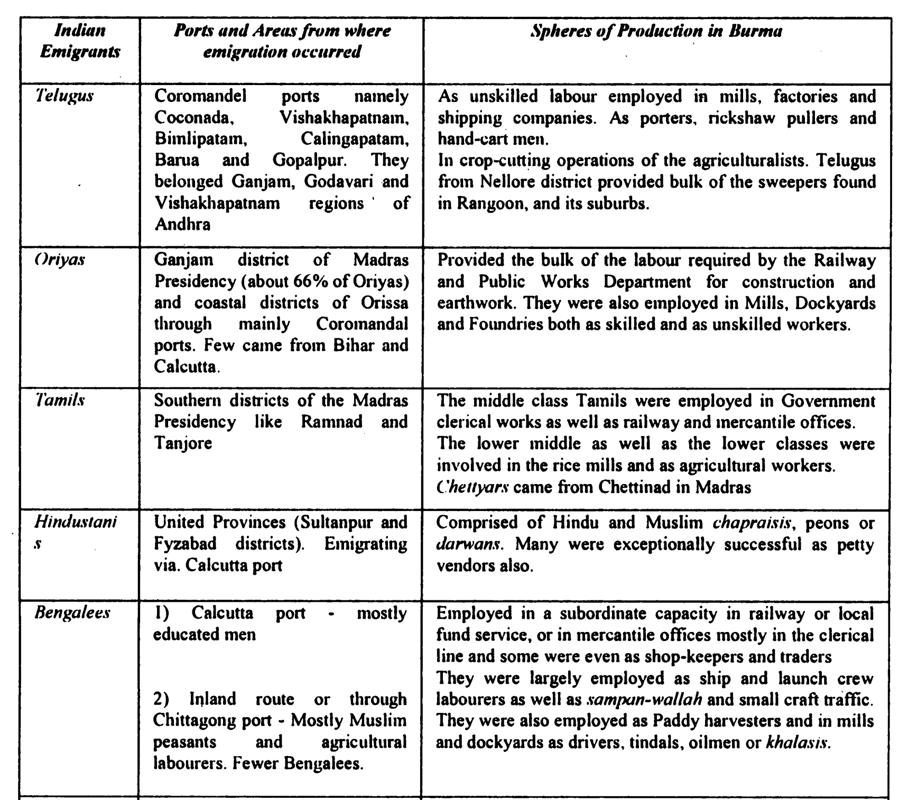

Slide 10
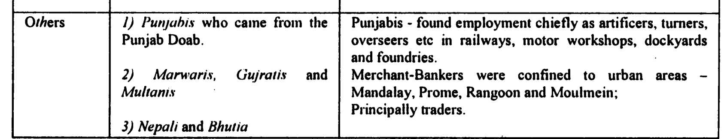
majority of the emigrants were Telugu unskilled labourers coming from Ganjam and belonging to 'untouchable' castes and lower caste' sudras. The bulk of them settled down for employment at Rangoon. In the early 20th century in Rangoon alone about 80,000 Indian labourers found employment in various industries, of this number about 55,000 were Telugus.
At the other end of the spectrum, an important category were the upper class prosperous Chettyars

Slide 11
Census Commissioner of Madras (1931)
The Burma Provincial Banking Enquiry Committee stated that 'the Chettiars are the mainstay of the agricultural finance... without their support the internal and external trade of the country would break down and the rice crop could not be produced
few in numbers they had immense economic strength in Burma which is very visible from the fact that 83% of bankers and moneylenders in Rangoon were Indians, that Indians at 25% were second only to Europeans (40%) in overall tax payment in the financial year 1931-32 of which 15% was contributed by the Chettiars alone.

Slide 12
Census Commissioner of Madras (1931)
Moreover the networks of this prosperous community were spread not only in Burma but even to other countries like Malaya, Ceylon, Java, Sumatra, Siam, and Mauritius.
It remains beyond doubt that Chettiars capitalists and entrepreneurs through their finances and money lending activities played an important role in aiding the functioning of the Maistry intermediaries and stimulating the flow of labour as well as capital to the colonies in which they operated.

Slide 13
Census Commissioner of Madras (1931)
that though about 75 percent of the Indian emigrants to Burma were labourers, the distinction was that the Indian labourers formed a relatively small proportion of the total population directly involved as plantation labourers or cultivating tenants on the (rice) plantations in Burma
The Indian labourers instead largely manned the industry, dealt with transport development, cleared the streets and built the sewage system in the cities of Burma
They were involved in tasks connected with the new export-oriented rice cultivation such as packing, loading, transporting, bagging, weighing etc.

Slide 14
Census Commissioner of Madras (1931)
Agent of GOI in Burma conveys that while he undertook tours throughout Burma in 1939 to get firsthand knowledge of the conditions in which Indians were living, he found the leading role which Indian labour and enterprise had played in the construction and maintenance of roads and railways. The steamers were almost exclusively commanded and manned by Indians
it would not be wrong to state that the demand in Burma was not mainly for agricultural but for urban labour, not for raising of a crop, but for its disposal and for the large commercial and industrial needs of the town.
though Indian labourers were not directly involved in significant numbers in the development of plantations, but Burma definitely owed its contemporaneous plantation development to Indian enterprise and Indian capital leased out to agricultural Burmans by the Indian absentee landowners and capitalists,—mainly the Chettiyars

Slide 15
The Pattern of Indian Emigration to Burma: Birds of Passage
In between 1911 and 1921 the total flow of Indian migrants to Burma
accounted for more than two million
The Royal Commission on Labour of 1930 mentioned that for the years 1922-29 the numbers of Indian emigrants to Burma were 25,60,000, but the surplus was merely 4,80,000 all of
whom cannot be necessarily labelled settlers.'
Thus it would not be wrong to say that an important feature of almost 125 years of ‘free’ and ‘unregulated’ Indian emigration to Burma was that it was largely unsettled and temporary in nature and that the emigrants were Birds of Passage

Slide 16
The Pattern of Indian Emigration to Burma: Birds of Passage
the migratory labour force travels backwards and forward between India and Burma at intervals of 3 years or so throughout the Individual working life’. Most classes of labourers preferred to stay for some time, usually 3-5 years, because they could not afford more frequent trips and also because a sojourn of less than 3 years did not enable them to save ‘sufficient money’ to take back to their homes
Since large numbers of the unsettled Indian emigrants kept rotating or circulating back and forth over a period of time, it can be ascertained that the numbers of new immigrants would have been considerably smaller. This pattern is evidenced by the Burma India Chamber of Commerce estimate that ‘only 10 % of unskilled labourers at rice mills were composed of new recruits or first timers, rest were migratory i.e. men who went back and forth between Indian and Burma’.

Slide 17
The Pattern of Indian Emigration to Burma: Birds of Passage
Further the census figures for the place of birth of the Indian migrant' shows us that a large proportion of Burman Indians were born in India.
why is as to the Indian labourers did not wish to settle down in Burma, despite the fact that most of the immigrants were young and single males, aged between 20-30 years?
A very significant explanation for the existence of such a pattern, which shows us yet another pertinent characteristic of Indian emigration to Burma - the desire of the majority of labourers to earn and return '’ which rested on the dynamics of separation from family and women. Women never formed more than 10% in the annual flow of male emigrants to Burma which led to highly imbalanced sex-ratio.

Slide 18
The Pattern of Indian Emigration to Burma: Birds of Passage
Maistry system with its ubiquitous debt-contract, induced through networks of recruiting-supervising intermediaries, functioned to maintain the apparently self adjusting or unsettled emigration pattern. Based on the advance debts owed to the Maistry, the system mobilised labourers only to render them immobile through low wage jobs in Burma, irregular deductions and payment, high commissions and interest rates- which led to formation of a vicious cycle of ever-persisting advance-debt.
Breach of Contract Act, 1859 with its vaguely defined clauses for criminal prosecution, punishments and fines was an important tool not only to strengthen the immobility and bondage of the labourers but also to enforce their return to Burma in cases when they were allowed to go home for a sojourn or some urgent work.

Slide 19
The Pattern of Indian Emigration to Burma: Birds of Passage
Many a times a family member or relative worker was held back as hostage by the Maistries to ensure the return of the labourers to repay debt. Moreover the shifting/seasonal nature of employment, improper facilities for medical aids, housing and accommodation (especially at Rangoon), rigorous conditions of work provided and the exclusive powers upheld by the Maistries of selection and dismissal of labourers and distribution of wages- which was conveyed to intending emigrants through networks of family, friends and returnees- were important reasons lesser new recruits as well instability of emigrants.

Slide 20
The Pattern of Indian Emigration to Burma: Birds of Passage
By 1930’s the rising anti-Indian and anti- immigration sentiments as a result of conditions created by depression, the Baxter Commission called for regulation on emigration of Indian labourers through passports, visas and permits by the /immigration Order of 1941. However the Order could not come into effect as Burma came to be occupied by Japan by this time and it led to huge returns, marked by deaths and casualties on way, as well as an abrupt end of Indian emigration to Burma and the decline of Maistry system.

Slide 21
Caste
The Adi- Andhra movement in colonial Andhra derived both moral and material support from Burma immigrant labourers. 1917-1930. Similarly, the growth of Buddhism among the untouchable laborers in Burma is an extremely important aspect of socio-cultural awakening.
The Telugu Speaking people in Burma were known as “Coringhees” to the local people as well as the press and Government. Since the Andhra migrated in earlier times from a port called Korangi in the present day East Godavari District of Coastal Andhra Pradesh in South India, they were identified with that place.

Slide 22
Caste
Interestingly, there was a broad correspondence/correlation between caste and occupation. For instance, barbers, washermen, goldsmiths, carpenters were provided by the castes of Mangali, Tsakali, Kamsali and Vadrangi respectively. Likewise, labourers who were engaged as scavengers, particularly in Rangoon (Burma) belonged to Adi-Andhra (Malas and Madigas) and Adi-Dravida castes, while the traders and shop-assistants came from the castes such as Chettis, Komatis and Balijas.
For instance, dalit communities like Rellis, Malas, pariahs and so on worked mainly as scavengers of Rangoon municipality
manual labourers, the upper-cas mostly as professionals, employers, contractors, co moneylenders,

Slide 23
Caste
wages for untouchables were as much as 25 percent lower than those paid to caste Hindu labourers for similar tasks
The onset of world economic depression in the 1930's witnessed great socio-political turmoil in colonial Burma. It also caused intense rivalry between natives and immigrants in terms of economic and employment opportunities. Violent anti-Indian and Anti-Telugu ( Coringhee ) riots broke out in Burma in the 1930's
"Dalit labdlords" in some of the villages of Sakinetipally and Amalapuram mandais of East Godavari district. A perceptive journalist commented: "When migration began the dalits took to it quickly. Many others feared losing their caste by going overseas. The dalits had no such status to lose. Before the Gulf, they went to Burma (Myanmar). Abroad, even as coolies in Rangoon (Yangoon), they had great social freedom. So they began questioning the status quo at home."

Slide 24
Caste
Adi-Andhras attempted to find a respectable place within Hinduism, to a large extent, through Bhakti and Shuddhi. The notions of Bhakti—simple devotion to attain Moksha or the blessing of God for which idol worship, caste status and Brahmin priests were not necessary—were popularised during the second decade of the twentieth century in Andhra by Brahmin social reformers to advocate that Dalits too could attain spiritual emancipation within Hinduism. Adi-Andhras were also connected to Bhakti when their leaders like Verma, as mentioned above, within the process of composing their identity, claimed that some of their ancestors were medieval Bhakti saints such as Nanda, Chokamela and Lohidasa
Suddhi - Purification - popularised by the Arya Samaj, and aimed at reconversion to Hinduism of the so-called Hindu converts to other religions.

Slide 25
Conclusion
Indians migrated to Burma because of Britishers but it was the non-European indigenous players like maistries, shipping agents, village moneylenders, merchants and bankers like Chettiyars and their capital which played a very crucial role not only in stimulating large scale Indian emigration to the colonies with great success but also in the expansion and integration of the global economy.

