Slide 1
Indian Diaspora and Transnationalism: An Introduction
Instructor: Dr Ratna Bharati B
Course Code: HM 494
Winter Semester 2024-25

Slide 2
Labour and Imperial Diasporas: Indentured Indians and the British
Reading Name: Labour and Imperial Diasporas: Indentured Indians and the British.
Author Name: Robin Cohen
This Reading is a Chapter from the book: Global Diasporas: An Introduction
Author of the Book: Robin Cohen

Slide 3
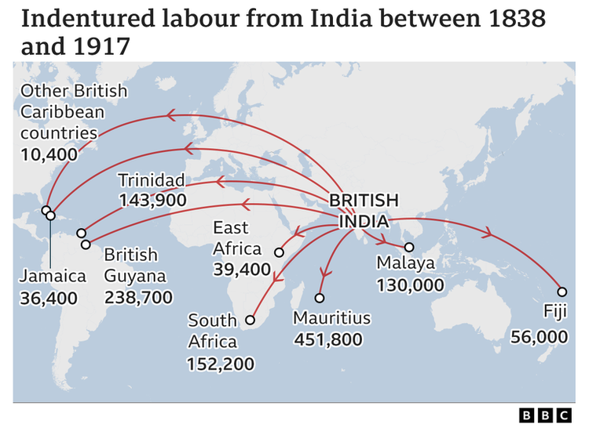
Introduction
Cohen thinks diasporas can also be created in search of work
Not just because of trauma
This gives rise to the labour diasporas and imperial diasporas
Example studied by Cohen: Indian Indentured Labourers deployed in British, Dutch and French tropical plantations from 1830s to 1920.
Picture Credit: https://www.bbc.com/news/world-asia-india-65693512

Slide 4
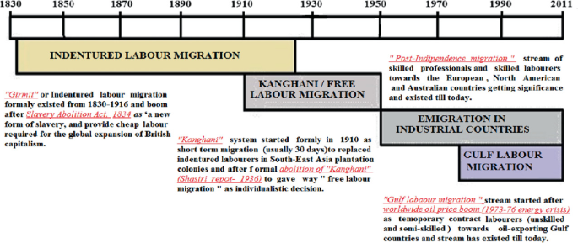
Introduction
When is a labour diaspora set to exist?
(a) a strong retention of group ties sustained over an extended period (in respect of language, religion, endogamy and cultural norms)
(b) a myth of and connection to a homeland; and
(c) significant levels of social exclusion in the destination
societies, a labour diaspora can be said to exist.

Slide 5
Introduction
Weiner: confines the notion of a labour diaspora to those who ‘move across international borders to work in one country while remaining citizens in another’.
These countries: the Gulf (Kuwait, Qatar, Bahrain, the United Arab Emirates and Oman) that use vast numbers of foreign workers but resolutely deny them or their children the right of citizenship even through long residence or birth.
https://www.youtube.com/watch?v=lHMQ2SFfveQ
https://u.ae/en/information-and-services/passports-and-traveling/emirati-nationality

Slide 6
Introduction
Two kinds of diaspora: Proletarian Diaspora and the Mobilized Diaspora - Armstrong
Proletarian Diaspora: characterized by low communication skills and comprises ‘a nearly undifferentiated mass of unskilled labor’, with little prospect of social mobility.
Mobilized Diaspora: deploy their linguistic, network and occupational advantages to modernize and mobilize – thereby offering to the nation-state valued services and skills.

Slide 7
Introduction
within all diasporas, including the most economically
successful, there are (sometimes large) proletarian elements.
over time occupational mobility can radically alter a group’s profile.
Example: In some countries, Indians showed dramatic gains in terms of their political and social mobility. In others, dispossession and poverty were unrelenting. Time and circumstance
Diasporas are neither uniform in class terms at the moment
of their migration, nor do they remain so over time.

Slide 8
A NEW SYSTEM OF SLAVERY?
Unfree labour important for growth of the modern world system.
European Merchantiles built trading empires using: tropical commodities and extraction of precious metals
Triangular trade between - Europe, Africa and America - Modern world capitalism
Slavery was banned, indentured labour was introduced - Labour Supply changed from Africans to Indians
https://www.youtube.com/watch?v=pyk2LetcGnY
https://www.youtube.com/watch?v=dy0XiL61wWY

Slide 9
A NEW SYSTEM OF SLAVERY
Rationale behind Indentured labour: abundant land and cheap
Labour. Fixed period: 5 to 7 years
The recruiters were ruthless, the journey was horrific and the arrangements made for the legal protection of the workers were inadequate.
Legally, indentured labourers could not be bought or sold.

Slide 10
A NEW SYSTEM OF SLAVERY
Indians lived in Slave Barracks of former African Slaves
The indentured worker ‘lived on the plantation which he was forbidden to leave without a pass, worked unlimited hours, was barred from taking any other employment, and in case of misconduct subjected to financial penalty and physical punishment. In return he received a basic pay, free accommodation, food rations, and a fully or partially paid return passage to India’.

Slide 11
The Songs of Ramayana and Political Outcomes
Did the Indian labourers abroad constitute themselves as a diaspora?
Sikh, Hindu and Muslim Diasporas are considered to be equal and same by the nationalists
Parekh argues that there were three features that were particular to Hindu indentured workers and that helped them to create a distinctive diasporic consciousness – the reconstitution of family life, their religious conviction in general and, more specifically, the adoption of the Ramayana as ‘the essential text of the Hindu diaspora’.

Slide 12
The Songs of Ramayana and Political Outcomes
The first aspect of the Hindu diaspora, the re-establishment of the family, was made difficult by the official policy of limiting the numbers of women allowed to between one and four for every ten men.
Given the level of abuse from Indian men, colonial officials and employers alike, it is probably an error to see the scarcity of women as that strong a bargaining counter.

Slide 13
The Songs of Ramayana and Political Outcomes
orthodox forms of Hinduism became predominant in the diaspora and were the principal means whereby the Indian labour diaspora was reconnected to the ‘Great Tradition’ of India.
Christian Missionaries made it difficult
Whether in orthodox or deviant forms,the vital attachment between diaspora and homeland had been re-established. ‘Mother India’ had reached out to her children abroad.

Slide 14
The Songs of Ramayana and Political Outcomes
The third constitutive aspect of the Hindu diaspora was the adoption of the Ramayana as the key religious text.
This occurred for four reasons.
book’s central theme was exile, suffering, struggle and eventual return parallel with the use of the Bible by religious and Zionist Jews.
The text is simple and didactic, with a clear distinction between good and evil, a useful simplification in the harsh world of the plantation.
Third, the Ramayana hammered home what the Brahmins and many conservative men wanted to hear. The eldest son should be dutiful, wives should be demure and obedient
Ramayana was relatively casteless, but it especially stressed the virtues of the lower castes, namely physical prowess and economic resourcefulness.

Slide 15
IMPERIAL DIASPORA
EIC - Trade Diaspora
In several instances commercial contact was followed by the settlement and colonization of the areas the merchants penetrated.
Countries like China confined Britishers to ‘treaty ports’.
But much of Asia and Africa was relatively easily overcome by imperialist adventurers, usually from Europe, and often dragging their home governments behind them.

Slide 16
IMPERIAL DIASPORA
A number of countries remained unsuitable for European settlement, either because of particular difficulties of subduing local rulers or because the climate was unsuitable.
Nearly all the powerful nation-states, especially in Europe, established their own diasporas abroad to further their imperial plans.
The Spanish, Portuguese, Dutch, German, French and British colonists fanned out to most parts of the world and established imperial and quasi-imperial diasporas. ‘Quasi’, because in a number of instances, localization or creolization occurred, with the new settlers marrying into the local community or turning against their homelands.

Slide 17
IMPERIAL DIASPORA
An imperial diaspora, by contrast, is marked by a continuing connection with the homeland, a deference to and imitation of its social and political institutions and a sense of forming part of a grand imperial design – whereby the group concerned assumes the self-image of a ‘chosen race’ with a global mission.

Slide 18
THE SETTLEMENT OF BRITISH EMPIRE
Emigration from Britain from the seventeenth century onwards was one of the highest in volume and one of the longest in duration in the world.
bulk of British emigrants left because new opportunities – land and work to be blunt – were available in greater measure than in the British Isles.
After Britain ‘conquered half the world in a fit of absence of mind, it peopled it in a mood of lazy indifference’
Colonies or Dominions: https://www.youtube.com/watch?v=BWLnTmchdic

Slide 19
THE SETTLEMENT OF BRITISH EMPIRE
the idea and promise of migration had filtered down
to all sections of the British population. In terms of their order of magnitude,
self-sponsored migration was the most important, followed by government-supported, charity-supported, destination country-supported and trade union-supported movements.
Empire settlement also provided an outlet for ‘distressed gentlewomen’, often left penniless by the common pattern of inheritance to the eldest son. Over the period 1899–1911, 1,258,606 women emigrated from Britain, many of them single and a surprising

Slide 20
Indian Indentured Labour Migration across the World: Case Studies
**Not in the reading
Mauritius
The Caribbean
Fiji
South Africa/Natal
French Colonies
Malaysia and Singapore
https://www.idiaspora.org/en/contribute/blog-entry/instagram-new-identity-descendants-indentureship

