Slide 1

Robotic process automation
name – Harshika t
Roll no – 57
Mca S4 a

Slide 2
content
What is RPA?
Where is RPA used?
Traditional automation v/s RPA
Benefits of using RPA
RPA characteristics
Working of RPA
Impact and future of RPA
Application
RPA tools
RPA challenges

Slide 3
What is rpa?
RPA is software technology.
The developers create and educate the AI, so their actions will match real humans.
RPA is the use of robots to handle repetitive, rule-based digital tasks such as filling in the same information in multiple places, re entering data, or copying and pasting.

Slide 4
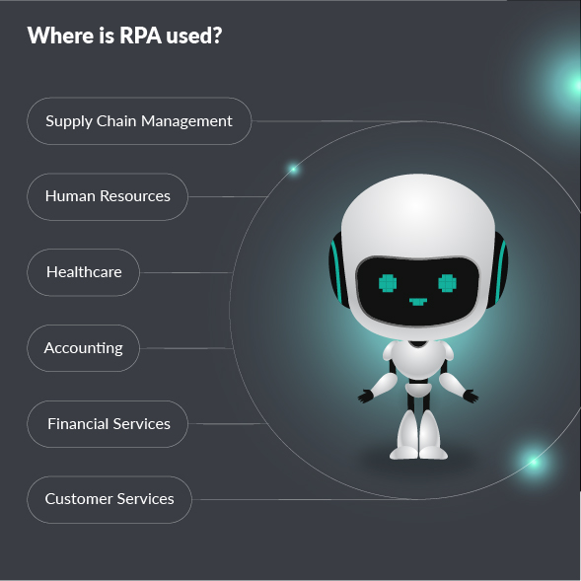

Slide 5
Traditional automation v/s rpa
TRADITIONAL AUTOMATION
Requires modification to existing structure
Requires coding skill
Strict in performing once programmed
Requires months to be implemented
RPA
Operates on a surface of the systems
No programming skills required
Flexible, imitates human repetitive tasks
Requires days to be implemented.

Slide 6
Benefits of rpa
Enabling better customer service
Ensuring business operations and processes comply with regulations and standards
Allowing processes to be completed much more rapidly
Providing improved efficiency by digitizing and auditing process data
Creating cost savings for manual and repetitive tasks
Enabling employees to be more productive

Slide 7
Characteristics of RPA
Code-Free
Non-disruptive
User-friendly
Scalability
Speed

Slide 8
Working of RPA
The working of RPA includes 4 crucial phases
1)planning phase
2)Development phase
3)deployment and testing phase
4)Support and maintenance phase

Slide 9
Impact of RPA on employment
RPA have promised their employees that automation would not result in layoffs. Instead, workers have been redeployed to do more interesting work.
It increases the productivity as repetitive processes are handed over to digital workers
More time for employees to perform value-adding tasks that improve quality and service

Slide 10
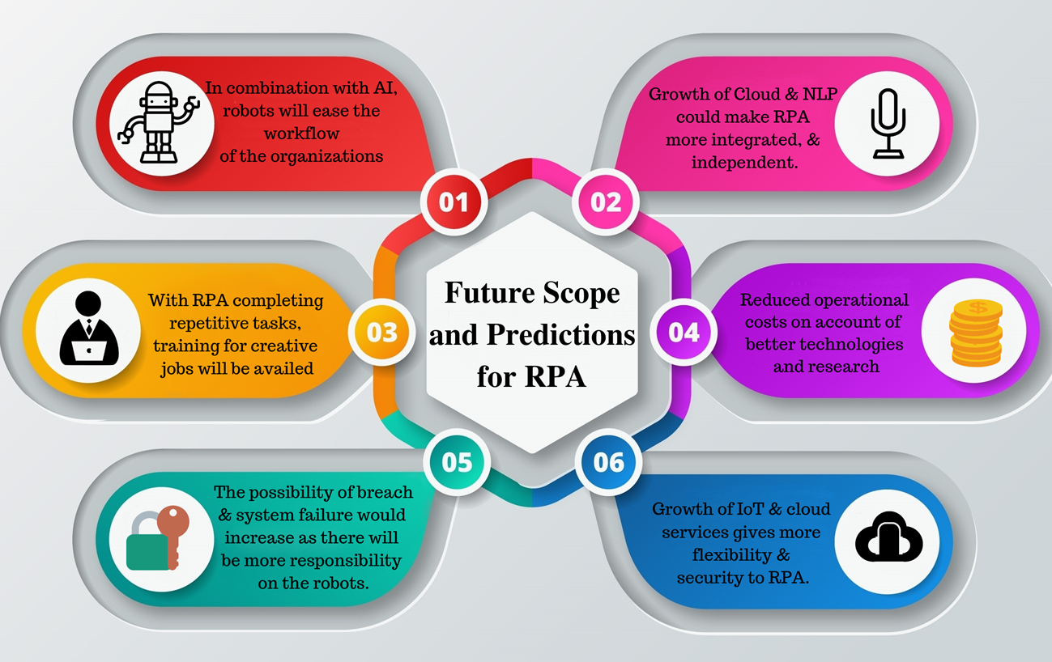

Slide 11
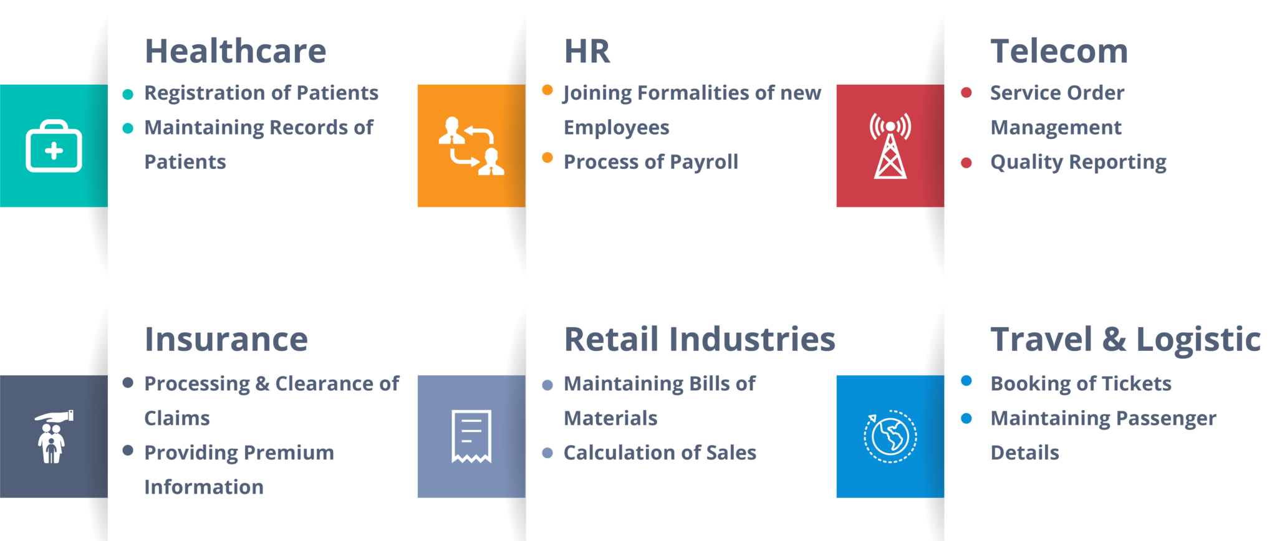
applications

Slide 12
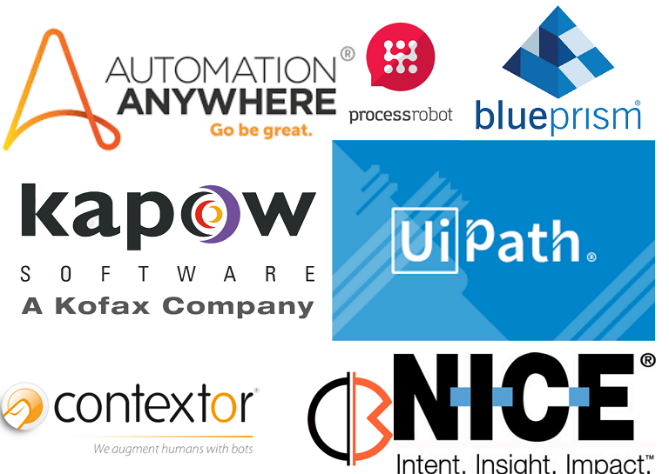
RPA TOOLs
UiPath – The open-source RPA tool can automate any desktop or web app.
Blue Prism does not require advanced programming skills to generate flowcharts.
Automation Anywhere is Microsoft technology it has employees worldwide know, understand, and use.

Slide 13
Challenges of rpa
Shortage of Skilled resources
Unable to automate end to end use cases
Lack of required support from Business
Improper selection of processes for automation

Slide 14
Future of rpa
RPA has grown exponentially over the past few years.
The demand for RPA is increasing in the RPA market as it promises to replace repetitive, rule-based, mundane, manual digital tasks with software robots.

Slide 15
Thank you

