Slide 1
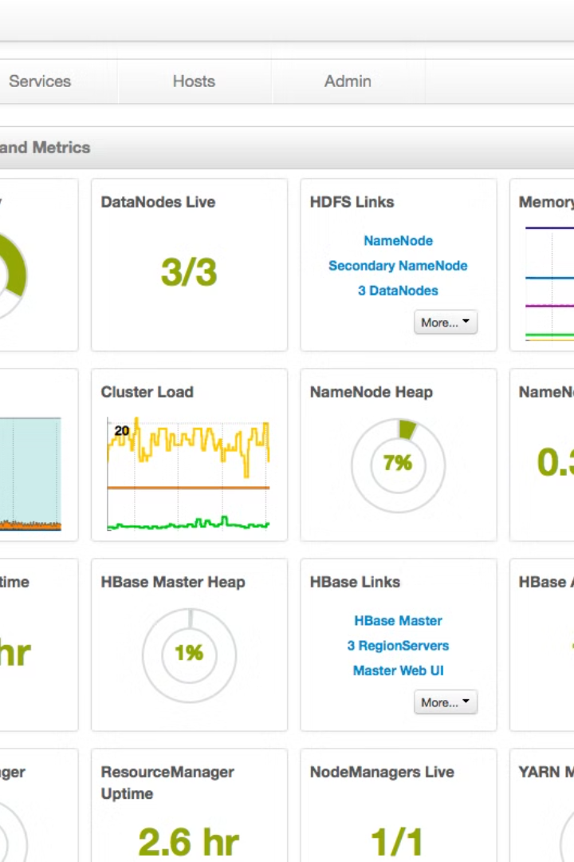

Understanding Hadoop and HDFS
Hadoop is a cornerstone in the realm of big data, offering a robust framework for distributed storage and processing of large datasets. It leverages a cluster of commodity hardware to manage vast amounts of data, drawing inspiration from Google's pioneering technologies. Hadoop's architecture is designed for scalability, allowing it to handle ever-growing data volumes with ease. As an open-source project under the Apache Software Foundation, it has evolved into an essential tool for batch processing and data analysis, supported by a rich ecosystem of components and tools.
Sa
by Sri Harshitha Battula

Slide 2
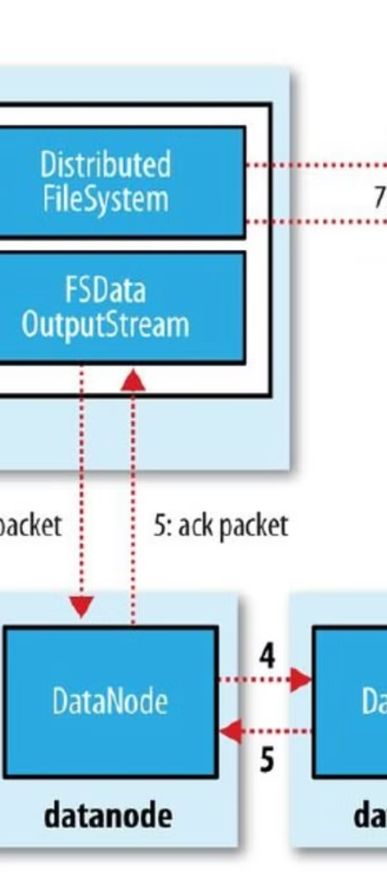
Hadoop's Core Components
1
HDFS
2
MapReduce
The Hadoop Distributed File System (HDFS) is a distributed file storage system that ensures data availability and fault tolerance by dividing and replicating large files across a network of nodes.
MapReduce is a programming model that enables parallel data processing across a Hadoop cluster, consisting of a Map phase for parallel processing and a Reduce phase for combining results.

Slide 3
Exploring HDFS Features
Distributed Storage
Fault Tolerance
Scalability
HDFS stores large files by breaking them into smaller blocks, distributing these across multiple nodes for parallel processing.
Data replication across DataNodes ensures durability and fault tolerance, maintaining data integrity even in case of node failures.
HDFS's design allows for horizontal scaling, enabling organizations to add more nodes to the cluster to handle increased data volumes.

Slide 4
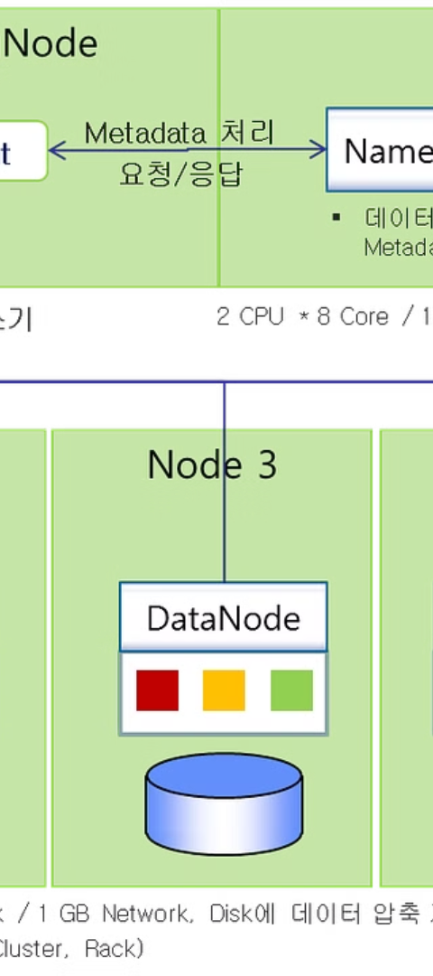
HDFS Architecture
1
Master/Slave Architecture
The NameNode manages the file system metadata, while DataNodes store the actual data blocks in HDFS's master/slave setup.
2
High Throughput
HDFS is optimized for high-throughput rather than low-latency, making it ideal for batch processing and analytical tasks.
3
MapReduce Integration
MapReduce jobs can efficiently process data stored in HDFS, benefiting from its distributed and parallel computation capabilities.

Slide 5
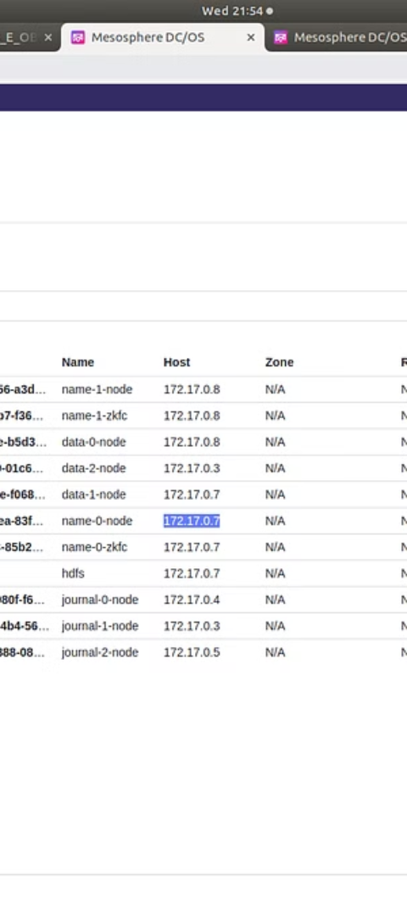



HDFS Commands
Create Directory
Use 'hdfs dfs -mkdir -p' to create a new directory structure in HDFS, specifying the username and directory path.
Move File
The 'hdfs dfs -put' command moves a file from the local Unix/Linux machine to the specified HDFS directory.
List Contents
To see the contents of files in HDFS, 'hdfs dfs -ls' lists the files in the given directory.

Slide 6
File Operations in HDFS
Command
Description
hdfs dfs -cat
Displays the contents of a specified file within HDFS.
hdfs dfs -copyToLocal
Copies a file from HDFS to the local file system, specifying both source and destination paths.

Slide 7
Scaling with HDFS
128MB
3
Block Size
Replication
Default block size for storing data, ensuring efficient handling of large files.
Default replication factor, providing fault tolerance by storing copies across nodes.

Slide 8
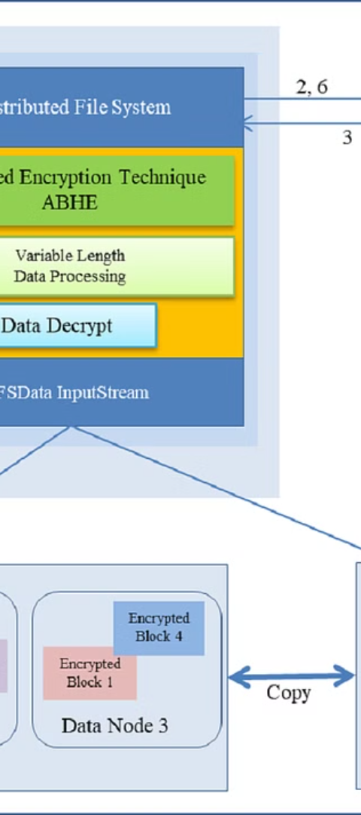
HDFS in the Big Data Ecosystem
Foundation
Versatility
HDFS serves as a foundational building block in the Hadoop ecosystem, enabling reliable and efficient big data storage and processing.
Its integration with various tools and frameworks has made HDFS a versatile component for diverse data processing needs.
Industry Adoption
With its fault-tolerant and scalable architecture, HDFS is widely adopted across various industries for big data challenges.

