Slide 1
HUMAN FACTORS IN CYBER SECURITY
HARSHIL KANAKA MADATHIL
P2753548
MSc CYBER SECURITY

Slide 2
INTRODUCTION
Innovations in technology and the growing complexity of cyber threats cause a
constant evolution in the cybersecurity scene. Human behavior, psychology, and
cognitive processes have a significant role in developing cybersecurity practices,
even though technology solutions are still necessary. Examining "human factors
in cybersecurity" and how they affect information security protocols is the focus
of this abstract. With the recognition that people are a major factor in establishing
an organization's cybersecurity posture, this research attempts to develop tactics
that take into account decision-making, human vulnerabilities, and relationships
with technology. The objective of this research is to enhance safety measures,
reduce security breaches, and reinforce defenses against the dynamic cyber threat
landscape. It places a particular focus on the importance of user awareness,
training, and organizational culture in creating a security-conscious workplace

Slide 3
RESEARCH MOTIVE
Establish a profound understanding of how human behavior, cognition, and decision-making processes influence information security. The research on human aspects of cybersecurity aims to enhance the effectiveness of security strategies and practices by addressing various human factors and issues related to cybersecurity. Some specific objectives of the research include:
Recognizing the influence of human behavior on cybersecurity: The research seeks to delve into individual attitudes, perceptions, and decision-making processes and their impact on cybersecurity norms. It aims to understand the psychological and cognitive elements contributing to secure or insecure behaviors in the digital realm.
Detecting vulnerabilities with an emphasis on humans: The objective here is to scrutinize information systems and cybersecurity procedures for vulnerabilities stemming from human behavior. The goal is to identify gaps in cybersecurity defenses that could be exploited due to insider threats, social engineering, or human errors, and then develop targeted strategies to bolster cybersecurity defenses.

Slide 4
RESEARCH MOTIVE (CONT..)
Evaluation of security awareness and training programs' effectiveness: The research aims to assess the impact of cybersecurity awareness and training programs on users' retention of security best practices and overall knowledge.
Analyzing human errors and misconfigurations: This objective focuses on understanding the types and frequency of human errors, misconfigurations, and unintentional actions leading to cybersecurity incidents.
Countering social engineering attacks: The research aims to explore how cybercriminals exploit human vulnerabilities by examining their techniques.
Creating a cybersecurity-aware culture: The primary goal is to explore ways to make organizations and the general public more aware of cybersecurity issues, fostering a sense of responsibility for maintaining a secure digital environment.

Slide 5
ROLE OF SOCIAL ENGINEERING IN CYBER SECURITY
The concept of governing people by using false pretenses is not a unique concept.
Even before the invention of modern technology, the art of social engineering has
existed. The tale of the Trojan horse's journey during the Greek-Trojan conflict is
among the most widely remembered events in the history of ancient Greece. The
defensive fortifications of Troy were extremely difficult for the Greeks to
penetrate, so they employed deceit in this mythical story. . They built a huge
wooden horse and concealed the most talented warriors inside of it before leaving
it at Troy's gates as a purported peace gift. The horse was delivered to the
inhabitants of the Trojans, who took it as a gift. Trojans had been taken over by
the Greek army shortly after they emerged at night and opened the city's gates for
the remaining members of them.

Slide 6
SOCIAL ENGINEERING
Social engineering is a sophisticated technique that leverages the psychological manipulation of individuals, compelling them to undertake specific actions or disclose sensitive information. At its core, this method exploits human vulnerabilities, tapping into emotions, trust, and cognitive biases rather than relying on technical hacking strategies. While many might associate social engineering with face-to-face deception, such as someone impersonating an IT technician to gain physical access to a facility, its reach extends far beyond. In the digital age, social engineering has evolved to exploit the vast interconnectedness of the online world. Cyber attackers craft deceptive emails, design counterfeit websites, and even create fake social media profiles, all with the intent of deceiving their targets. These digital tactics, often termed as phishing, baiting, or pretexting, are designed to instill a sense of trust, urgency, or fear in the victim. For instance, an attacker might send an email posing as a bank, urging the recipient to click on a link and update their account details, only for that link to lead to a malicious website designed to harvest personal data. Social Engineering attacks can divided into two: Technology Based Attacks and Human Based Attacks.

Slide 7
SOCIAL ENGINEERING(CONT….)
HUMAN BASED ATTACKS
Human-based social engineering attacks use psychological methods to trick
people into disclosing confidential data or taking security-compromising acts.
Human-based social engineering focuses more of an emphasis on interactions
with people and behavioural vulnerabilities than automated attacks, who just
utilise methods for hacking. To earn the victim's trust or produce urgency,
attackers can resort to a variety of strategies, including impersonation,
manipulation of emotions, or use of authoritative cues.
TECHNOLOGY BASED ATTACKS
Technology-based social engineering attacks use technology platforms as the
primary conduit to trick people into revealing private information or carrying
out specific behaviours that violate security. These assaults frequently use
digital platforms like emails, social media, or fake websites, compared to
conventional methods of social engineering, which may only rely on
interpersonal relationships. In order to take advantage of people's psychological
preferences for authority and trust, cyber attackers create probable
circumstances or assume the real identities of reliable individuals. The final
objective is to collect sensitive information, spread malware, or get
unauthorised access

Slide 8
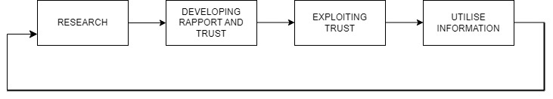
TECHNOLOGY BASED ATTACKS
Mobile Based: Quick Response(QR) Code, Smishing
Computer Based : Baiting, Email Phishing
HUMAN BASED ATTACKS
Voice Based : Fraud/Scam, Vishing
Physical: Attacks at Console, Impersonation
KEVIN MITNICKS SOCIAL ENGINEERING ATTACK CYCLE
Kevin Mitnick’s Social Engineering Attack Cycle(Hussain Aldawood and Skinner, 2018).
Notes:
Smishing is a social engineering attack that uses fake mobile text messages to trick people into downloading malware, sharing sensitive information, or sending money to cybercriminals.
Baiting is a social engineering technique where attackers offer
something alluring, such a free download, to entice targets into
completing an operation that compromises their security. Human interest
or a desire for something important are the usual draws for the bait.
Vishing (voice or VoIP phishing) is a type of cyber attack that uses voice and telephony technologies to trick targeted individuals into revealing sensitive data to unauthorized entities.

Slide 9
Mitnick’s attack model has four phases: research, developing rapport and trust,
exploiting trust, and utilising information.
Research: It is an approach to acquiring data in which information about the
object of interest is retrieved. Prior to initiating the attack, the person who
attacked should have as much information as possible about the victim.
Developing Rapport and Trust: A victim who trusts an attacker is more likely
to provide the information demanded by the attacker. Rapport and trust
development may be accomplished by using insider knowledge, faking one's
identity, referencing people the victim is connected with, expressing a desire for
assistance, or assuming a position of power.
Exploiting Trust: A request for information, a demand that the victim execute
an action, or, alternatively, manipulation of the victim into approaching the
attacker for assistance are all ways to extract data from the target. In this phase,
the connection that was previously established is abused to obtain the
information or result that was first wanted.
Utilise Information: The attack's aim is finally reached, or any additional
actions that might be necessary for getting there are shifted once the prior
phase's result has been utilized.

Slide 10
BARCLAYS-SANTANDER BANKING ATTACK
High street banks' branches were attacked by cybercriminals who appeared to
be from the IT division of the business. They were granted access to the bank's
computer network by officials from the bank. They set up a KVM (keyboard,
video, and mouse) switch that gave them the ability to connect to the bank's
Computer. The attackers took £1.25 billion from the bank accounts after gaining access to
consumer personal information such as credit and debit card numbers, placing
them at risk of committing more crimes. Police were able to capture the group,
and the majority of the funds were recovered. The bank's reputation was probably
harmed by the media attention, and safety issues were raised.
The problem wasn't restricted to a single bank or location, which is a crucial point
to keep in mind. It is possible that organisational fundamental reasons and human
mistakes were responsible for considering this. Spreading of blame happens when
staff members fail to verify the credentials of the attacker, which confirms that
none of them has checked them. It's conceivable that the failure to verify
credentials has been exacerbated by the tendency to believe in the statements
from people we like as well as conforming to social standards

Slide 11
PROPOSED FRAMEWORK
Strategies to Raise Awareness and Prevent Social Engineering Attacks
Training in Security Awareness for All Users:
Employees must receive training on how to identify sensitive information and
understand their duty to protect it. Additionally, they ought to be given the
power to reject requests, particularly ones that seem odd or improper, knowing
that upper management will assist them in doing so.
Social engineering and Security Policy:
Every strong security for information architecture is built on its rules and
regulations. The policy itself ought to lay out the specific needs and degrees of
safety that apply to various systems and situations.
The policy must make it clear what kind of data may and may not be provided
and should assist end users in fending off demands from hackers.

Slide 12
Rejection from Key Personnel:
Social engineers are frequently choosing to target key employees including
technical support desk staff, customer service agents, business assistants,
secretaries, system administrators, and engineers.
Such staff members might gain from resistance training to help them fend off
social engineers' methods of persuasion. Employees can be prepared by
employing strategies from the study of social psychology.
Triggering the memory:
To keep staff members informed of possible dangers, frequent reminders are
essential. This might be accomplished through regular incident reporting,
security newsletters, or other forms of communication.
The goal is to maintain the significance of security awareness in the thoughts of
Employees.
Social Engineering Pitfalls: They are the defences put into effect by systems that identify and prevent an
ongoing social engineering attempt. The devices can notify security personnel
as well as potential victims of the assault as soon as they are set off, enabling
quick action .

Slide 13
Recognising the Threat Landscape:
ICT security measures are growing more advanced at the exact same time that
ICT use increases, notably for safe money transactions. Although people are
becoming more technically sophisticated, there has been a lag in the growth of
awareness of social engineering concerns. Both the business and local
environments need to close this discrepancy
SOCIAL ENGINEERING ATTACK PREVENTION
Combating social engineering attacks is now crucial in the complicated field of
cybersecurity. The flowchart goes into an exactly crafted framework
that involves education, tactic recognition, verification, and the implementation
of safety precautions with the goal of demonstrating a holistic plan. The
flowchart's intersections and branches form an intricate structure intended for
avoiding the all-pervasive hazards presented by social engineering attacks.

Slide 14
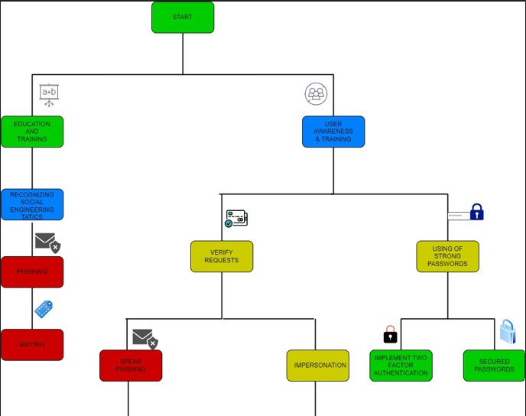
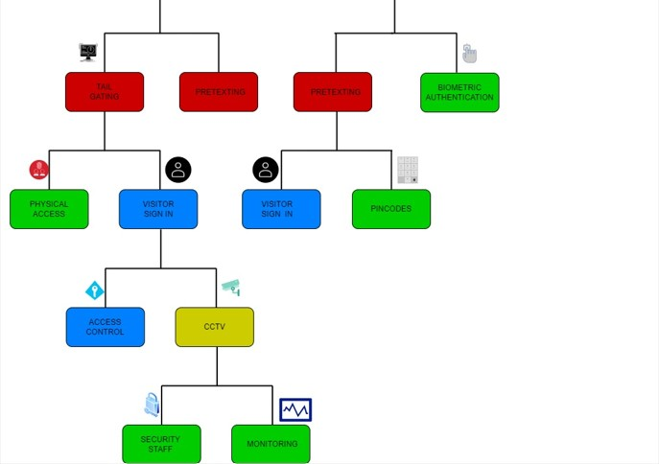

Slide 15
SOCIAL ENGINEERING ATTACK PREVENTION
Start: The process of defence begins right at the beginning of the
flowchart. This is the first stage of constructing an impregnable fortress to
protect against the approaching dangers of social engineering attacks.
Education and Training: This component, which is located in the
center, emphasises the importance of sharing knowledge. People who
have education and training have a greater ability to identify and reject all
of the techniques used by social engineers. This information serves as the
foundation on which other defence layers are built.
Connection to Recognize Social Engineering Tactics: This connection
represents the change from acquiring knowledge to using it to recognise
Social Engineering methods. The sole method to enable people to
comprehend the specifics of these strategies is by means of education

Slide 16
Recognize Social Engineering Tactics: An important turning point that
explores the ability to recognise SE methods, an essential tool in the
armoury against cunning cyber threats. It is similar to using an obstacle
against digital deceit to be able to tell what differentiates honest
exchanges and malevolent ruses.
Phishing: The flowchart shows phishing as a branch, which is a
specialised social engineering method. To trick receivers into disclosing
confidential data or committing malicious acts, involves sending fake
emails, texts, or other forms of communication. Phishing
emails frequently pose as trustworthy organisations, arousing recipients’
interest or creating a sense of urgency.
Baiting: Baiting is a social engineering technique where attackers offer
something alluring, such a free download, to entice targets into
completing an operation that compromises their security. Human interest
or a desire for something important are the usual draws for the bait.
User Awareness and Training: Employees should be trained on the most
common social engineering techniques as part of successful user
awareness and instruction, and should be given the knowledge and
abilities necessary to recognise dangers and stop them from happening in
tracks.

Slide 17
Connection to Using of Strong Passwords: The connection represents
the data is more safe when using strong passwords. So that the attacker
cannot be able to get the private data easily.
Using of Strong Passwords: The using of Strong Passwords makes the
data more secured. So that the attacker cant easily access the confidential
data’s. Its better to avoid the passwords like Name, DOB, and Common
Numeric passwords. Making passwords with the mix of special
characters, alphabets and numerals makes the password strong.
Implement Two Factor Authentication: The safety measure known as
two-factor authentication (2FA), sometimes known as two-step
verification or dual-factor authentication, requires users to provide two
separate authentication factors in order to verify their identity. A user’s
login information and any assets they may access have been more
securely safeguarded by the usage of 2FA
Secured Passwords: Data remains more safe when using secure
passwords. To avoid easy access to the sensitive data by the attacker.
Avoid using common numeric passwords, your name, your DOB, and
comparable passwords. The strength of a password is increased by using
an arrangement of special characters, alphabets, and numbers.

Slide 18
Verify Requests: The user must cross check each and every single
requests for the access to improve the security and to avoid the attacks
from outside. It operates as a vital defence against deceptive techniques
Like phishing, pretexting, and impersonation through motivating people to
respond to messages and requests with caution and vigilance. This
method encourages people to independently verify the validity of request
via authorised channels prior to making any decisions.
Connection to Spear Phishing: The idea that using the method of
verification to counter the subtle aspects of spear phishing attacks is a
connection among "Verify Requests" and "Spear Phishing" is the basis of
this connection.
Spear Phishing: Accuracy and expertise are exactly make spear phishing
so unique. Spear phishing focuses on a smaller area than usual phishing,
which casts a wider net to entice prospective victims. In order to
customise and authenticate their interactions, attackers do research on
those they are targeting and collect information from sources which are
openly accessible.

Slide 19
Connection to Tailgating: The connection between spear phishing and
tailgating is that both include attempts to acquire unauthorised entry,
however by means of different channels: digital and physical.
Tailgating: A physical social engineering technique is tailgating, which
is also known as piggybacking. It involves an attacker carefully adhering
to an individual with authorised entry to a defended location with the goal
to gain unauthorised access.
Impersonation: A unique social engineering technique is portrayed as
impersonation. Attackers who imitate others frequently use figures of
authority or other reputable individuals to trick victims into granting them
access or information.
Connection to Pretexting: Impersonation and pretexting have much in
connection since both involve tricking and manipulating people in order
to get information from them. Pretexting is the process of creating a
plausible story to establish rapport and win the confidence of the victim,
as compared to impersonation, that focuses on taking on a specific
identity to take advantage of the trust.

Slide 20
Biometric Authentication: As part of a larger cybersecurity defence
strategy, biometric authentication is presented as a security preventative
measures. The application of distinctive physical or behavioural traits for
verification of identity is known as biometric authentication.
Physical Access: Physical access refers to limiting who has access to
specific areas inside a physical place, including offices, data centres, and
restricted zones. It necessitates putting security measures in place in order
to keep out unauthorised persons.
Connection to Tailgating: The connection between tailgating and
physical access draws awareness to the inherent susceptibility of actual
places to social engineering techniques. Key cards and biometric scanners
are two examples of physical security techniques that are employed to
stop unauthorised entrance. However, when individuals knowingly allow
access to others, especially if they are authorised staff, these security
measures can be evaded.
Visitor Sign In: Visitors must sign in in order to access a facility; this
means of authentication is used to identify individuals who aren't regular
employees or authorised staff. Their name, the reason of their visit, the
place they are going to, and who they are going to see typically appear in
this information.

Slide 21
Pin codes: The identity of a person is verified by their Personal
Identification Number (PIN), which is a numerical password which gives
them access to multiple accounts, networks, and physical locations.
Access Control: A vital component of the entire security plan involves
access control. Implementing policies and procedures that regulate access
to private data, premises, and digital resources is referred to as access
control.
Connection to CCTV: Merely the fact that it's present highlights the
significance surveillance technology is in recording and monitoring
events to improve security and find feasible security gaps. The position of
CCTV in the flowchart emphasises how important it is as a tool for in the moment
observation and event research.
CCTV: CCTV(Closed-Circuit-Television) uses cameras and other video
recording devices to record and keep an eye on activity in a specific area
or place. To prevent crime, improve security, and document occurrences,
CCTV cameras are frequently installed in a variety of settings, including
workplaces, public areas, retail locations, and more.

Slide 22
Connection to Security Staff: The fact that it exists highlights the
significance it is for an organization's security policy to include skilled
security personnel. The positioning of security personnel inside the
flowchart highlights their function in constantly tracking operations,
responding to issues, and offering a human layer of protection in
alongside technology.
Security Staff: Maintaining the safety and security of a physical site,
assets, and people is the responsibility of security employees, who are
qualified professionals. Security staff may be responsible for duties
including keeping an eye on CCTV feeds, patrolling often, verifying
people's identification, responding to alarms or incidents, as well as
making sure security protocols are followed.
Monitoring: Monitoring is a methodical examination and assessment of
numerous variables, including digital systems, physical spaces, and staff
behaviour, inside an organisation. Monitoring's primary goal is to spot
abnormalities and take action if they occur. This includes breaches of
security, unauthorised entry, and other irregular measures that could pose
a security hazard.

Slide 23
SUMMARY
The goal of the research of human factors in cybersecurity is to decrease
human-caused mistakes and vulnerabilities by examining how human
behaviour, psychology, and technology combine. The study investigates
different facets including user views towards security protocols, the function of
organisational culture in conformity, and the psychology behind attacks
involving social engineering by using a multifaceted strategy that incorporates
disciplines like psychology and human-computer interaction.

Slide 24
THANK YOU

