Slide 1
PORTCO X’s 2019 SALES PIPELINE HEALTH ANALYSIS

Slide 2
PIPELINE ANALYSIS VS TARGET REVENUE
$9M
$1M
$8M
TARGET REVENUE
GAP
PIPELINE VALUE
Notes:
The analysis reveals a total weighted probability net revenue (Pipeline value) of $8.19 million. While this represents a strong pipeline, it falls short of the $9 million target by approximately $805,387. This gap necessitates strategic adjustments to ensure we meet our revenue goals.
Pipeline value calculation - =IF(E6="Q1", (I6*9 + I6*0.5*3)*0.625, IF(E6="Q2", (I6*6 + I6*0.5*3)*0.625, IF(E6="Q3", (I6*3 + I6*0.5*3)*0.625, IF(E6="Q4", (I6*0.5*3)*0.625, 0))))
This is excel formula which I used to calculate the pipeline value it does this-
For Q1, (it multiplies the weighted probability monthly net revenue by 9 and adds it to the product of half of the monthly revenue and 3)*0.625.
For Q2, (it multiplies the weighted probability monthly net revenue by 6 and adds it to the product of half of the monthly revenue and 3)*0.625.
For Q3, (it multiplies the weighted probability monthly net revenue by 3 and adds it to the product of half of the monthly revenue and 3)*0.625.
For Q4, (product of half of the monthly revenue and 3)*0.625.

Slide 3
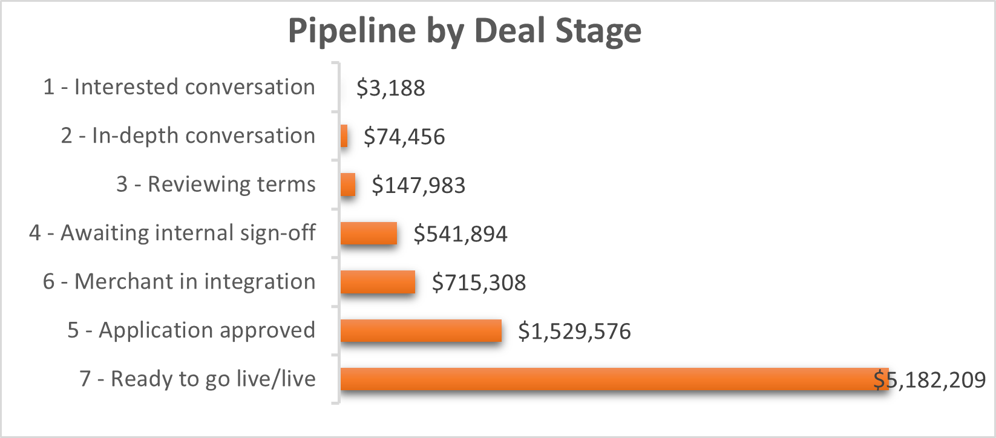
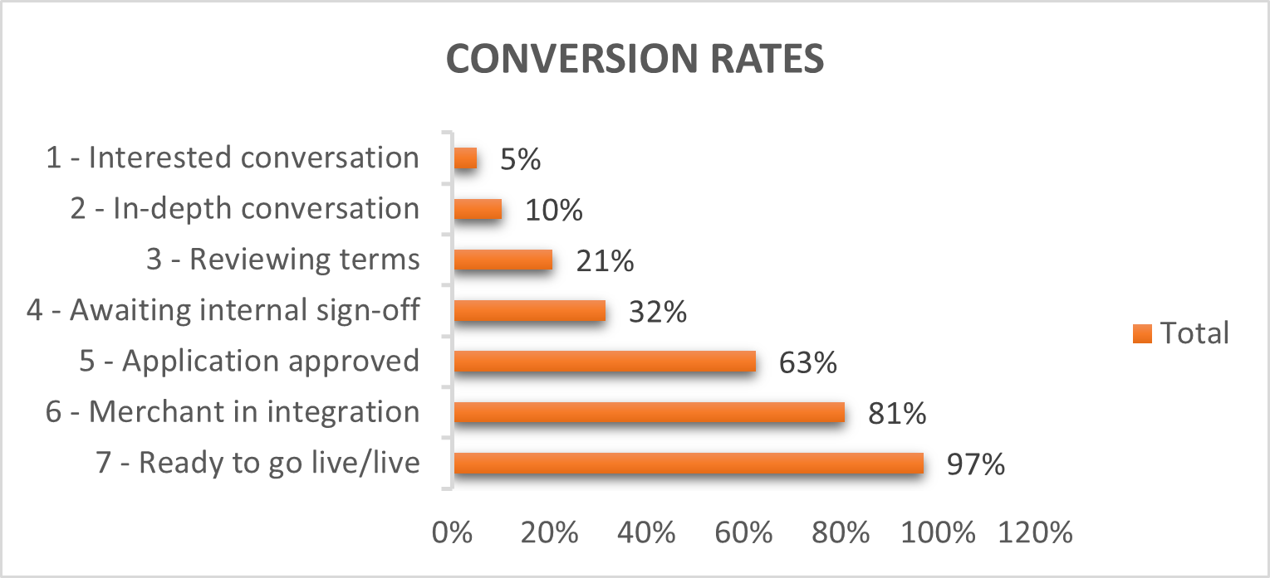
PIPELINE OVERVIEW: DEAL STAGE BREAKDOWN AND CONVERSION RATES
CONCENTRATION IN FINAL STAGE
LIMITED PIPELINE DEPTH
A significant portion of the pipeline value is concentrated in the final stage .”Ready to go live”, with a high pipeline value $5M.
This is positive.
The remaining pipeline value is spread thin across earlier stages with lower closing probabilities.
This suggest a lack of deals progressing efficiently through the pipeline.
Notes:
Analysis reveals
1. High conversion rates at the "Ready to go live/live" stage (97%):
Implication: Indicates strong readiness of deals in this stage, likely to result in successful closures and revenue generation.
2. Lower conversion rates for "Awaiting internal sign-off" (32%) and "Reviewing terms" (21%) stages:
Implication: Indicates potential bottlenecks or challenges in these stages that need to be addressed to improve conversion rates and deal progression.
3. It is important to take the later deal stages to the final stage to meet the target value.

Slide 4
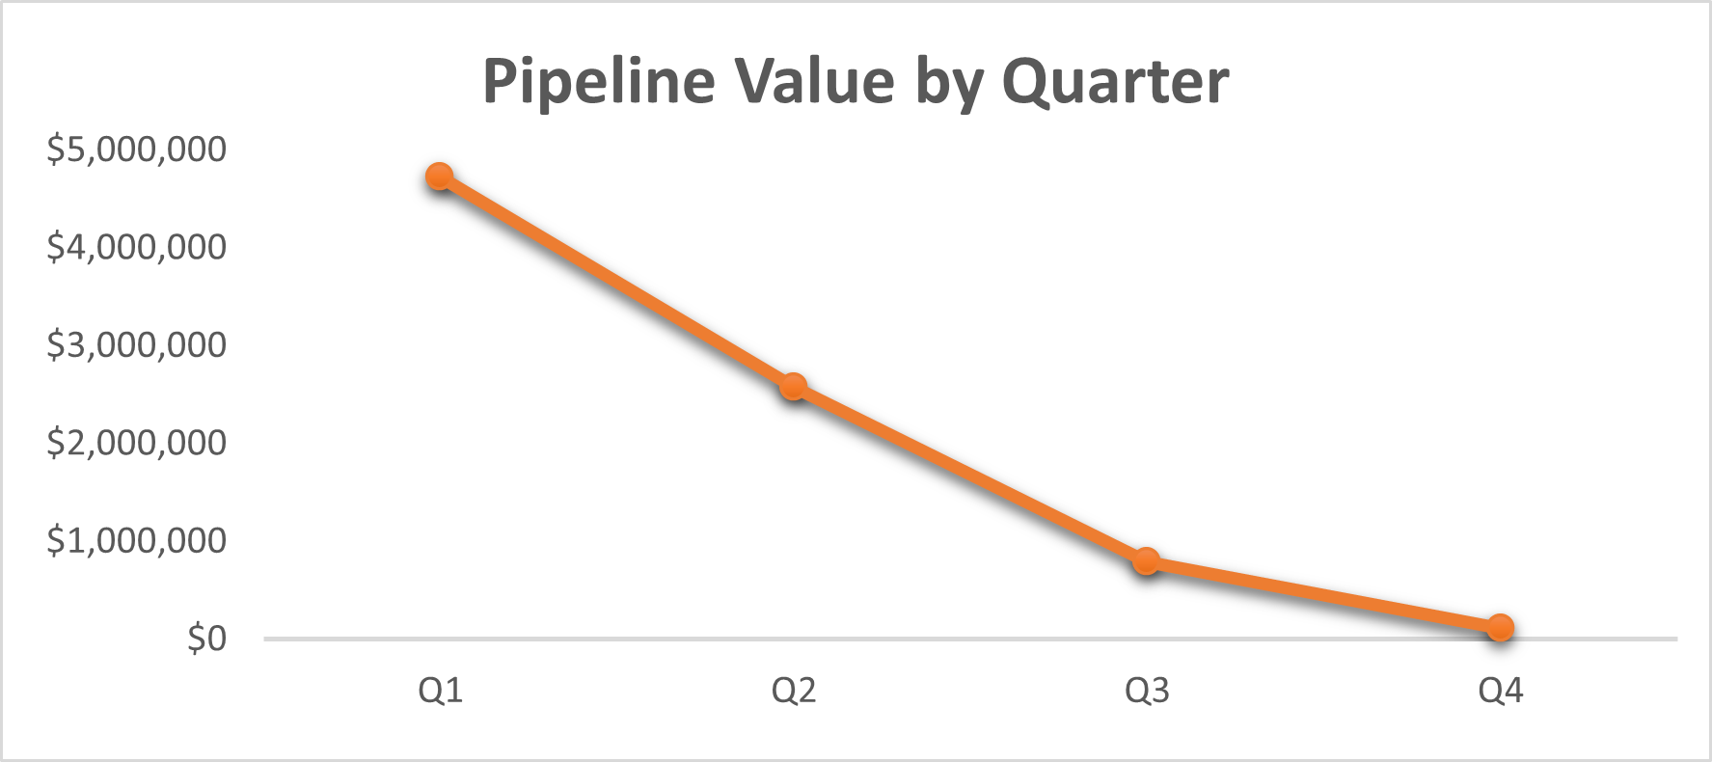
Pipeline distribution by quarter
Pipeline heavily weighted towards Q1 with significant drop-offs in later quarters.
Potential cash flow and resource allocation challenges.
Reasons for drop –
Holiday Season
Budget Constraints
Notes:
The analysis of the pipeline by quarter reveals a critical point. A significant portion of the weighted probability net revenue(Pipeline Value), $4.7 million, is concentrated in Q1. This front-loaded pipeline structure presents potential challenges for cash flow management and resource allocation in later quarters, where revenue is expected to drop significantly (Q2: $2.57 million, Q3: $784,588, Q4: $113,100).This might be due to --
Holiday Season: Sales cycles can slow down during the holiday season (Q4) as businesses prioritize year-end tasks, budgeting for the upcoming year, and employee vacations. Decision-makers might be less readily available or focused on closing new deals.
Budget Constraints: Companies often finalize their budgets for the following year towards the end of the current year (Q4). This can lead to a reluctance to commit to new expenditures, impacting deal approvals.
Year-End Performance Reviews: Sales teams might prioritize closing deals earlier in the year (Q1-Q3) to meet annual targets and secure performance bonuses. This can lead to a decrease in deal flow and activity in the later months.
I recommend reevaluating go-live dates with merchants, if possible, to achieve a more balanced distribution of revenue across quarters and mitigate potential cash flow and resource allocation issues.

Slide 5
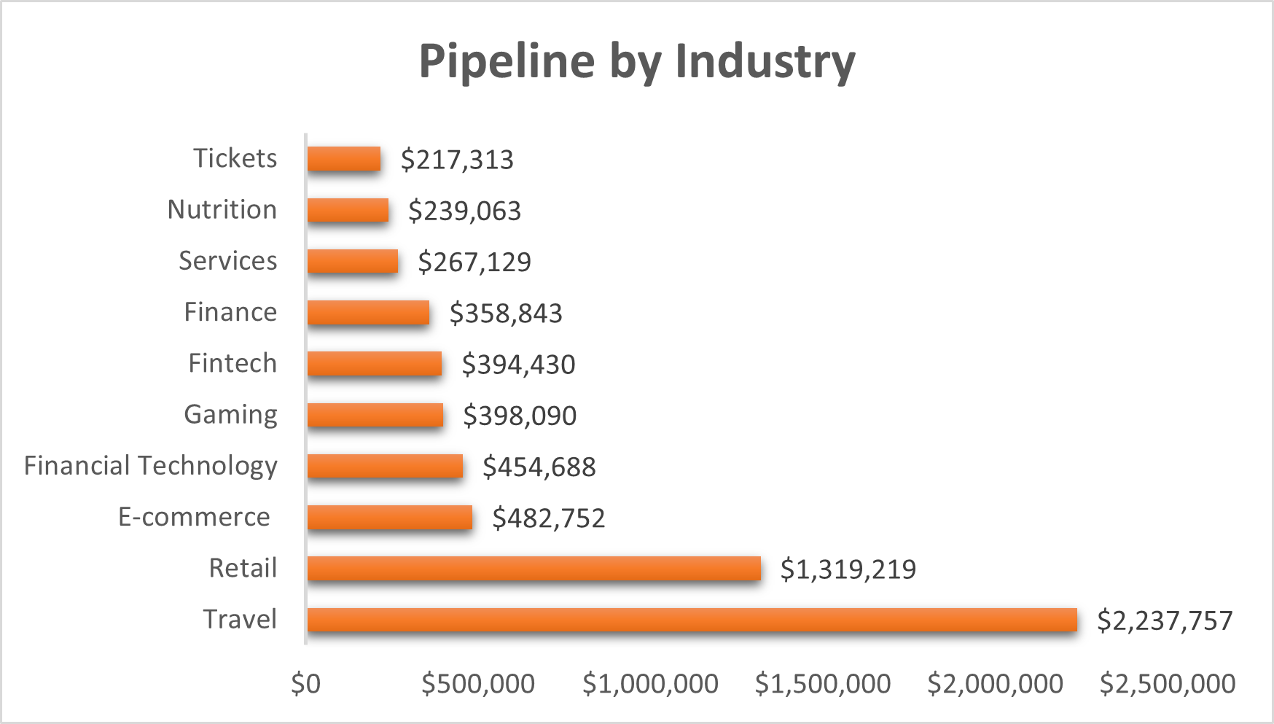
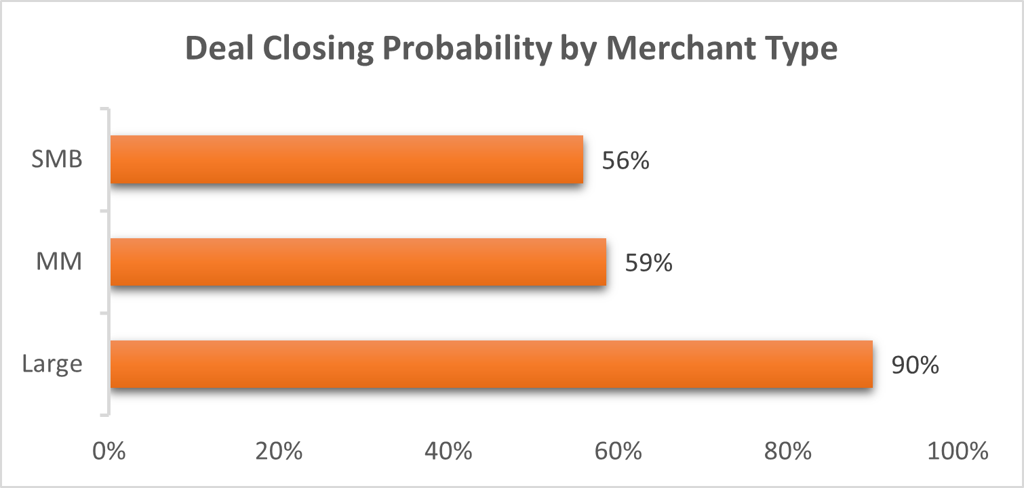
Are there any RISK FROM DEAL CONCENTRATION ?
Majority of the pipeline revenue is concentrated in the “Retail” and “Travel” industries.
These industries predominantly consist of merchants categorized as “MM” and “SMB” and the average probability of deal closing for “MM” is 59% while for “SMB” it is 56%.
Notably , a significant portion of revenue is generated from “MM” Merchants.
Notes:
Yes, there is a risk of deal concentration in the sales pipeline. This can be risky because if these deals falls through, it can significantly impact the ability to meet the revenue target.
The concentration of significant portion of revenue in a few key industries and merchant types exposes the company to risks associated with overreliance on these sectors.
Fluctuations or challenges in the retail and travel industries could significantly impact overall revenue and pose risks to achieving revenue targets.
Prioritizing efforts to close deals with "MM" merchants can improve the likelihood of meeting revenue targets , since the industries contributing more to the revenue are from MM.

Slide 6
CONCLUSION
Increase deal flow
Focus on early stage progression
Mitigate year-end slowdown
Merchant Concentration
Prioritize high probability deals
Adjust sales strategy
Proactive Communication
Notes:
Conclusion/Recommendations-
Increase Deal Flow: Prioritize acquiring new deals to ensure a steady influx of fresh opportunities. This could involve expanding sales outreach efforts, exploring new market segments (beyond Retail and Travel), refining lead generation strategies, and potentially attending relevant industry events.
Focus on Early Stage Progression: A large portion of the pipeline value might be at risk if deals in earlier stages (lower probability) don't progress quickly.
Focus efforts on nurturing deals in advanced stages (application approved, merchant integration) to convert them faster and solidify the pipeline.
Mitigating End-of-Year Slowdown:
Recognize the trend of deals closing less towards the end of the year, potentially due to factors like holidays or budget constraints.
Implement a proactive strategy to counteract this slowdown, such as offering incentives for early commitments or accelerating deal closure timelines through targeted outreach efforts.
Merchant Concentration: The analysis revealed a heavy reliance on a specific merchant type (e.g., MM or SMB), consider tailoring sales strategies to attract a broader mix of clients across different merchant categories.
Prioritize High-Probability Deals: Allocate resources towards nurturing deals in advanced stages ("Application approved," "Merchant in integration") with a higher chance of closing sooner. This can ensure a more predictable flow of revenue and minimize potential shortfalls.
Adjust Sales Strategy: Implement strategies to accelerate deal closure in earlier quarters (Q1-Q3). This could involve offering early sign-up incentives, streamlining approval processes, focusing on shorter sales cycles, or prioritizing deals with less complex integration requirements.
Proactive Communication: Start conversations with potential clients earlier in the year to establish relationships and complete the sales cycle before year-end budget limitations and holiday distractions take effect.
By implementing these strategies, we can strengthen the pipeline's resilience and maximize the chances of achieving our 2019 revenue target.
These additional information to bolster the analysis :
Historical win rates for deals at different stages for more accurate forecasting.
Market trends that might affect deal conversion or revenue potential.

Slide 7
THANK YOU

