Slide 1
Style Transfer in Text: Exploration and Evaluation

Slide 2
Introduction:
The paper aims to achieve stylistic transfer (i.e. writing content from style of one author to the writing style of another author) without parallel data for cross validation.
Major challenges involved in the task that have been taken up in the paper are :
- Lack of parallel data
- Separating style from content and
- Evaluation.
This paper explores two models: 1.Multi-decoder seq2seq network with an adversarial network. 2.Style embedding model (Similar to the prev one but single decoder augmented with style embeddings)
Both the models are based on neural sequence to sequence model and the common aim is to separate out the style from content representation of an input sentence.

Slide 3
Auto-encoder Seq2Seq Model:
In this model the encoder is trained to generate a latent representation of the input sentence X = (x1, . . . , xTx), of lenght Tx. The decoder is trained to recover the input sequence from the latent representation.
Let w = {w1,...,wT} be a sentence,
hi = f(xi, hi−1)
v = q({h1,...,hT})
Where, xi is the input vector of wi, hi is the hidden state of ith sequence and v is the fixed length vector into which the encoder stores the sentence.
The decoder is trained to maximize the conditional probability of next word, yt, given fixed vector v.
p(ˆy) = T′∏t=1 p(ˆyt|{ˆy1,...,ˆyt−1}, v)

Slide 4
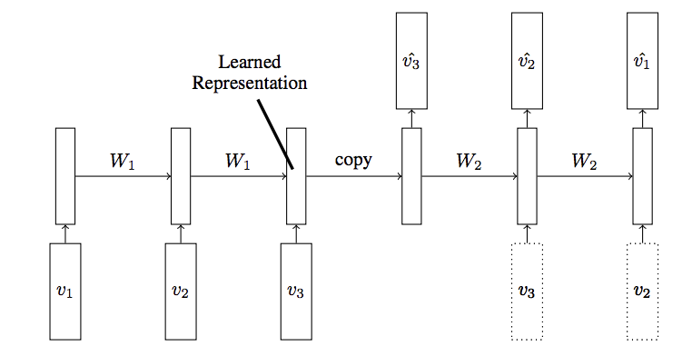

Slide 5


Encoder:
Decoder:
Loss function for the encoder-decoder minimizes the negative log probability of the training data(of size M), Θe and Θd are the parameters of encoder and decoder respectively.
In an auto-encoder we let the output sequence y to be the same as the input sequence x.

Slide 6
Multi-decoder model:
Challenge - generate only content c from input x.
Original auto-encoder :
Encoder output - contain both Content and Style information.
The Multi-decoder model :
Similar to an auto-encoder with several decoders
But we need our encoder to learn Content without Styles.
How ?
Use Adversarial network to separate content from style.
The adversarial network contains two parts:
- Generator and
- Discriminator

Slide 7


Discriminator: The loss function minimizes the negative log probability of style labels in the training data.
Where, Θc is the parameter of a multi-layer perceptron for predicting style labels.
Generator: The loss function aims at making the discriminator unable to identify the style of x by maximizing the entropy of the predicted style labels.
Decoder: The generation loss of Decoders is the sum of generation loss of each decoder -

Slide 8

The final loss function of the multi-decoder model is composed of three parts:
- two for the adversarial network
- one for the seq2seq generation.

Slide 9
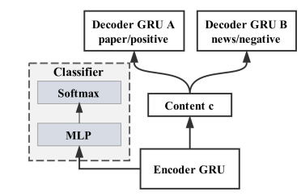
Multi-decoder model -
-Content C represents output of the encoder.
-Multi-layer Perceptron (MLP) and Softmax constitute the classifier.
-This classifier aims at distinguishing the style of input X.
-An adversarial network is used to make sure content c does not have style representation

Slide 10
Style Embedding model:
Encoder and the Adversarial Network parts are same (generates content representation C).
In addition, Style Embeddings, E ∈RN×ds used to represent styles :
- where, N is the number of styles
- ds is the dimension of the style embedding.
Decoder used – single
takes concatenation of the content representation, C and style embedding, E of a input sentence to generate text in different styles.
Loss function for adversial parts are same as previous model , Ladv1 and Ladv2

Slide 11

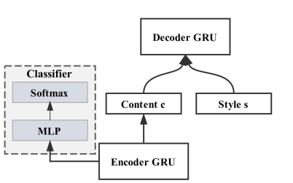
The difference in loss functions between the models is that the loss function for style embeddings contains a different generation loss which contains a parameter for style embeddings E. The loss function for this model is,

Slide 12
Parameter Estimation:
Learning rate : 0.0001
Batch-size : 128
Number of epochs for positive-negative dataset : 10
Evaluation:
1. Transfer strength:
- A LSTM-sigmoid based classifier used to classify the output into different styles
- Transfer strength is defined as the ratio of no.of cases of correct style transfer to total no.of cases.
2. Content Preservation:
- This is essential because in its absence the model would achieve 100% transfer strength by only generating the target style words.
- Content preservation rate is defined as the cosine distance between the source sentence embedding vs and the target sentence embedding vt.
-Sentence embedding consists of max, min, mean pooling of word
embeddings.

Slide 13
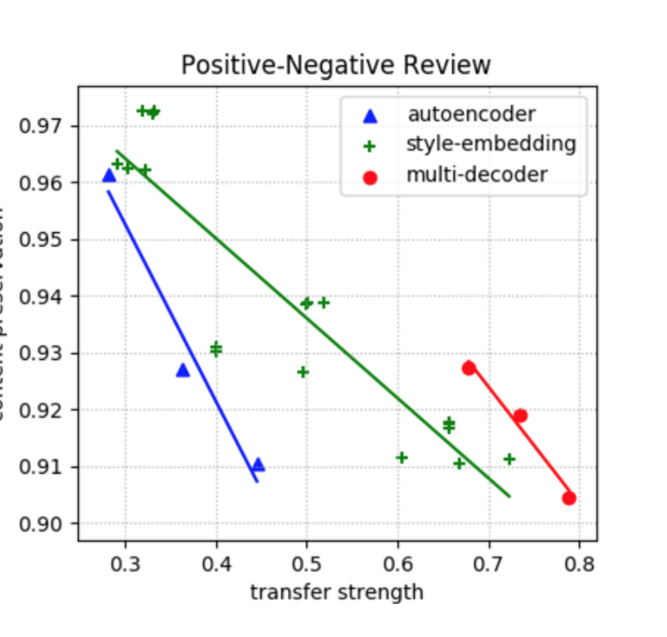

Slide 14
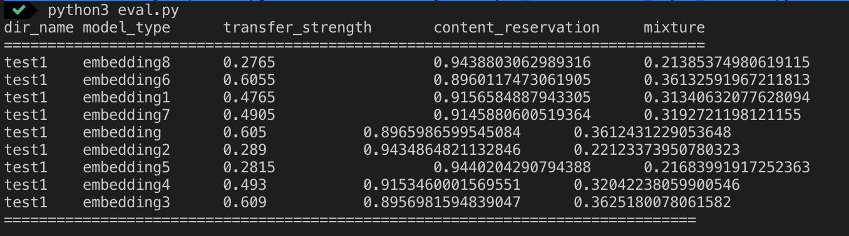
Results:

