Slide 1
CS 6360.002 Database Design:Uber Team: Harshita Rastogi (HXR190001) Shivam Gupta (SXG190040) Tejas Gupta (TXG180021)

Slide 2
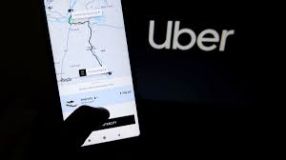
PROJECT DESCRIPTION:
Uber is a ride providing (car-for-hire) company that provides taxi service to the customers. Unlike regular taxi service, Uber lets you join as a driver with your personal registered vehicle and one can make money by completing the customer request.

Slide 3
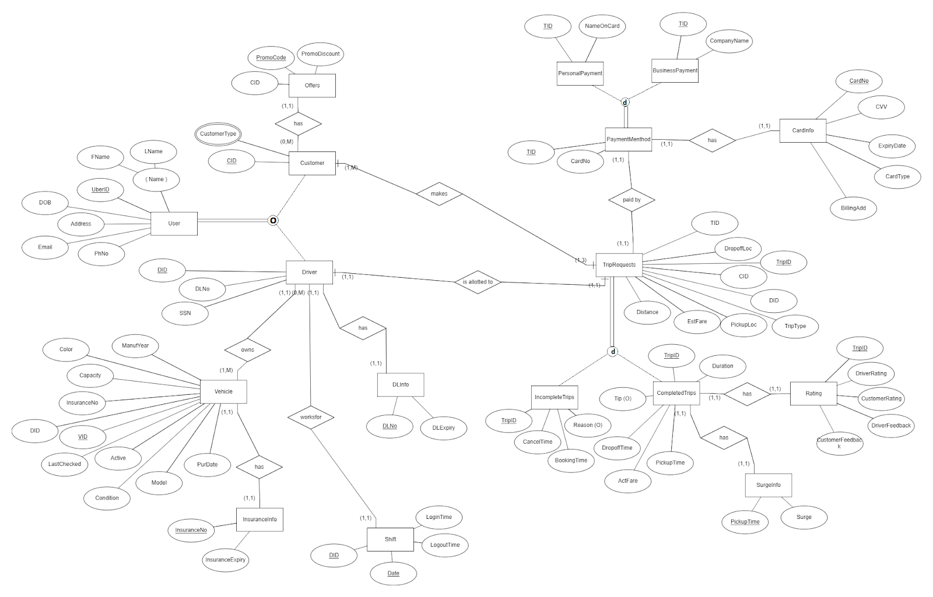

Slide 4
MAPPING EER DIAGRAM TO RELATIONAL SCHEMA *Primary Key - Bold *Foreign Key - Italics and Underlined UberUser { UberID, FName, LName, PhNo, Email, Address , DOB } Customer { CID, CustomerType, PromoCode, PromoDiscount } FOREIGN KEY (CID) REFERENCES UberUser(UberID) Driver { DID , SSN, DLNo, DLExpiry } FOREIGN KEY (DID) REFERENCES UberUser(UberID) Vehicle {VID, DID, Model, Color , ManufYear, PurDate, Active, Condition , Cpty, InsuranceNo, InsuranceExpiry, LastChecked } FOREIGN KEY (DID) REFERENCES Driver(DID) TripRequests { TripID, CID, DID, TripType, PickupLoc, DropoffLoc, Distance, EstFare, TID } FOREIGN KEY (TID) REFERENCES PaymentMethod(TID) FOREIGN KEY (CID) REFERENCES Customer(CID) FOREIGN KEY (DID) REFERENCES Driver(DID)

Slide 5
CompletedTrips { TripID, DriverArrAt, PickupTime, DropOffTime, ActFare, Tip, Surge } FOREIGN KEY (TripID) REFERENCES TripRequests(TripID) IncompleteTrips { TripID, BookingTime, CancelTime, Reason } FOREIGN KEY (TripID) REFERENCES TripRequests(TripID) PaymentMethod { TID, CardNo, CVV, ExpDate, CardType, BillingAdd } PersonalPayment { TID , NameOnCard } FOREIGN KEY (TID) REFERENCES PaymentMethod(TID) BusinessPayment { TID, CompanyName } FOREIGN KEY (TID) REFERENCES PaymentMethod(TID) Rating { TripID , DriverRating, CustomerRating, DriverFeedback, CustomerFeedback } FOREIGN KEY (TripID) REFERENCES CompletedTrips(TripID) Shift { DID , LoginTime, LogoutTime } FOREIGN KEY (DID) REFERENCES Driver(DID)

Slide 6
FUNCTIONAL DEPENDENCIES AND NORMALIZATION All the tables contain atomic values. There does not exist any partial dependency in the tables. Therefore, the schema is already obeys 1NF and 2NF. Driver: There exists transitive dependency. FD2 violates 3NF. Driver { DID , SSN, DLNo, DLExpiry } FD1: DID---> DLNo FD2: DLNo---> DLExpiry So, the new tables are: Driver{ DID, SSN, DLNo} DrivingLicenceInfo{ DLNo, DLExpiry} Customer: There exists transitive dependency. FD2 violates 3NF. Customer { CID, CustomerType, PromoCode, PromoDiscount } FD1: CID ---> PromoCode FD2: PromoCode ---> PromoDiscount So, the new tables are: Customer { CID, CustomerType, PromoCode } Offer { PromoCode, PromoDiscount }

Slide 7
Vehicle: There exists transitive dependency. FD2 violates 3NF. Vehicle { VID, DID, Model, Color , ManufYear, PurDate, Active, Condition , Cpty, InsuranceNo, InsuranceExpiry, LastChecked } FD1: VID---> InsuranceNo FD2: InsuranceNo> InsuranceExpiry So, the new tables are: Vehicle{ VID, DID, Model, Color , ManufYear, PurDate, Active, Condition , Cpty, InsuranceNo, LastChecked } InsuranceInfo{ InsuranceNo, InsuranceExpiry} PaymentMethod: There exists transitive dependency. FD2 violates 3NF. PaymentMethod{ TID, CardNo, CVV, ExpDate, CardType, BillingAdd } FD1: TID ---> CardNo FD2: CardNo ---> CVV, ExpDate, CardType, BillingAdd So, the new tables are: PaymentMethod { TID , CardNo } CardInfo { CardNo, CVV, ExpDate, CardType, BillingAdd } CompletedTrips: There exists transitive dependency. FD2 violates 3NF. CompletedTrips { TripID, DriverArrAt, PickupTime, DropOffTime, ActFare, Tip, Surge } FD1: TripID ---> PickupTime FD2: PickupTime ---> Surge So the new tables are: CompletedTrips { TripID, DriverArrAt, PickupTime, DropOffTime, ActFare, Tip } SurgeInfo { PickupTime , Surge }

Slide 8
NORMALIZED RELATIONAL SCHEMA *Primary Key - Bold *Foreign Key - Italics and Underlined UberUSer { UberID, FName, LName, PhNo, Email, Address , DOB} Customer { CID, CustomerType, PromoCode} FOREIGN KEY (CID) REFERENCES UberUser(UberID) Offer { PromoCode, PromoDiscount } FOREIGN KEY (PromoCode) REFERENCES Customer(PromoCode) Driver { DID , SSN, DLNo} FOREIGN KEY (DID) REFERENCES UberUser(UberID) DrivingLicenceInfo{ DLNo, DLExpiry} FOREIGN KEY (DLNo) REFERENCES Driver(DLNo) Vehicle{ VID, DID, Model, Color , ManufYear, PurDate, Active, Condition , Cpty, InsuranceNo, LastChecked } FOREIGN KEY (DID) REFERENCES Driver(DID) InsuranceInfo {InsuranceNo, InsuranceExpiry} FOREIGN KEY (InsuranceNo) REFERENCES Vehicle(InsuranceNo) TripRequests { TripID, CID, DID, TripType, PickupLoc, DropoffLoc, Distance, EstFare, TID } FOREIGN KEY (TID) REFERENCES PaymentMethod(TID) FOREIGN KEY (CID) REFERENCES Customer(CID) FOREIGN KEY (DID) REFERENCES Driver(DID)

Slide 9
CompletedTrips { TripID, DriverArrAt, PickupTime, DropOffTime, ActFare, Tip } FOREIGN KEY (TripID) REFERENCES TripRequests(TripID) SurgeInfo { PickupTime , Surge } FOREIGN KEY (PickupTime) REFERENCES CompletedTrips(PickupTime) IncompleteTrips { TripID, BookingTime, CancelTime, Reason } FOREIGN KEY (TripID) REFERENCES TripRequests(TripID) PaymentMethod { TID, CardNo } CardInfo { CardNo, CVV, ExpDate, CardType, BillingAdd } FOREIGN KEY (CardNo) REFERENCES PaymentMethod(CardNo) PersonalPayment { TID , NameOnCard } FOREIGN KEY (TID) REFERENCES PaymentMethod(TID) BusinessPayment { TID, CompanyName } FOREIGN KEY (TID) REFERENCES PaymentMethod(TID) RATING { TripID , DriverRating, CustomerRating, DriverFeedback, CustomerFeedback } FOREIGN KEY (TripID) REFERENCES CompletedTrips(TripID) SHIFT { DID , LoginTime, LogoutTime } FOREIGN KEY (DID) REFERENCES Driver(DID)

Slide 10
Snapshots of running stored procedures with output and code created on Oracle SQL Developer Stored Procedure to Calculate Average Ratings of all Drivers: create or replace PROCEDURE Average_Rating AS CURSOR DrivRating IS SELECT AVG(R.DriverRating) as AvgRating, T.DID FROM TripRequests T, Rating R WHERE T.TripID=R.TripID GROUP BY T.DID; thisRating DrivRating%ROWTYPE; BEGIN OPEN DrivRating; LOOP FETCH DrivRating INTO thisRating; EXIT WHEN (DrivRating%NOTFOUND); dbms_output.put_line(thisRating.AvgRating || ' is the Average rating for the driver ID:' || thisRating.DID); END LOOP; CLOSE DrivRating; END; begin Average_Rating; End;

Slide 11
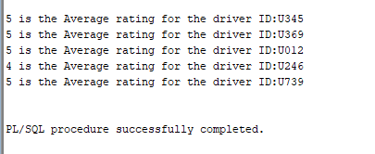

Slide 12
2. Stored Procedure to Calculate Total Fare for a given Ride: create or replace PROCEDURE Calculate_Fare(Base_fare IN number, Service_Tax IN number, Cost_per_mile IN number, Cost_per_min IN number) AS CURSOR Trip_total_fare IS SELECT "A1". "TRIPID" "TRIPID", "A1"."DURATION" "DURATION",:"A2"."DISTANCE" "DISTANCE", "A1"."SURGE" "SURGE" FROM "TRIPREQUESTS" "A2", "COMPLETEDTRIPS" "A1" WHERE "A2"."TRIPID" = "A1"."TRIPID"; thisTrip Trip_total_fare%rowtype; thisTotalFare TripRequests.EstFare%TYPE; BEGIN OPEN Trip_total_fare; LOOP FETCH Trip_total_fare INTO thisTrip; EXIT WHEN (Trip_total_fare%NOTFOUND); thisTotalFare:= (Base_fare + Service_Tax + Cost_per_mile*thisTrip.distance + Cost_per_min*thisTrip.duration )*(1 + thisTrip.Surge); dbms_output.put_line(thisTotalFare || ' is the total fare for the Trip ID:' || thisTrip.TripID); END LOOP; CLOSE Trip_total_fare; END; Begin Calculate_Fare(5,10,1,1); End;

Slide 13
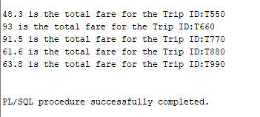

Slide 14
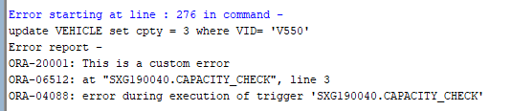
Snapshots of running Triggers with errors fired and code on Oracle SQL Developer 1. Trigger to check that the capacity of a vehicle has to be greater than 4: create or replace TRIGGER Capacity_Check before update on Vehicle for each row Begin if (:new.cpty < 4) then raise_application_error( -20001, 'This is a custom error for Capacity'); end if; End; Query: update VEHICLE set cpty = 3 where VID= 'V550';

Slide 15
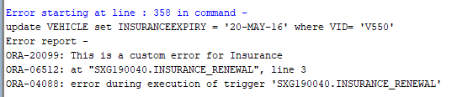
2. Trigger to check that the Driver’s License should not have expired: create or replace TRIGGER DL_Renewal before insert or update on DRIVER for each row Begin if (:new.DLEXPIRY < sysdate) then raise_application_error( -20098, 'This is a custom error for DL EXPIRY'); end if; End; Query: Update VEHICLE set INSURANCEEXPIRY = '20-MAY-16' where VID= 'V550';

Slide 16
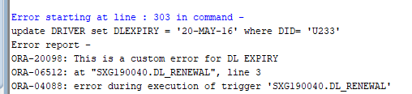
3. Trigger to check that the Insurance for the vehicle should not have expired: create or replace TRIGGER Insurance_Renewal before insert or update on Vehicle for each row Begin if (:new.INSURANCEEXPIRY < sysdate) then raise_application_error( -20099, 'This is a custom error for Insurance'); end if; end; Query: update DRIVER set DLEXPIRY = '20-MAY-16' where DID= 'U233';

