Slide 1

Internship Program: Soulvibe.Tech
“Higher Education Course
Analysis Using PowerBI”
Batch Name: SVT/DAINT/2025/06/B10
Notes:
Hello

Slide 2

Introduction
Overview of the Main Objectives
In this task, I was assigned to analyze a Higher Education Course dataset using Power BI to visually explore and derive meaningful insights related to academic institutions, course structures, and regional distributions. The primary objective was to utilize Power BI’s capabilities in data cleaning, transformation, and interactive visualization to create an insightful and user-friendly dashboard.
Using Power BI Desktop, I connected to the dataset and performed data preparation, including handling missing values, renaming columns for consistency, and deriving new fields like Specialization and Duration Category. This was followed by designing a comprehensive dashboard that included KPI Cards, bar and pie charts, line and area charts, filled map visualizations, and interactive slicers for filtering by course-related categories.
Advanced visualizations such as matrix tables and Q&A report pages were implemented to answer specific analytical questions like identifying top districts, course trends, and university offerings. Interactivity was enabled using slicers and cross-filtering, enhancing the dynamic exploration of the dataset.
This dashboard effectively showcases the distribution of courses across professional and non-professional domains, highlights aided vs unaided patterns, and provides district-level educational insights. The resulting analysis offers valuable perspectives for policy planning, institutional assessment, and strategic educational improvements.

Slide 3
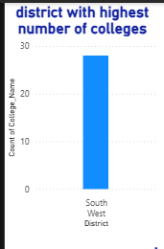
Which district has the most colleges?
1

Slide 4
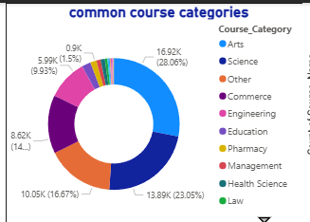
What are the most common course categories?
2

Slide 5
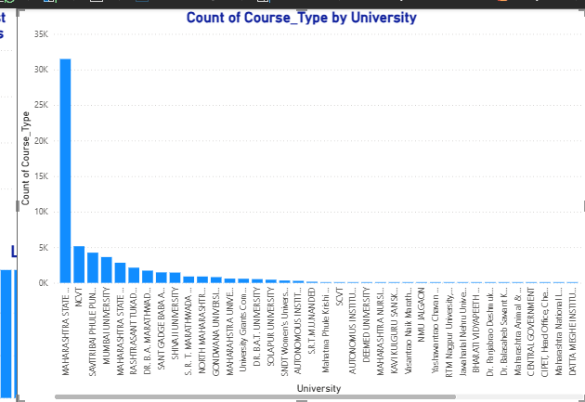
Which universities offer the widest range of course types?
3

Slide 6
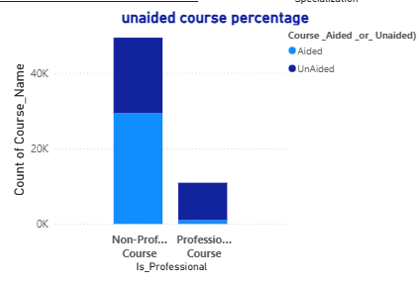
Are unaided courses more common in professional or non-professional programs?
4

Slide 7
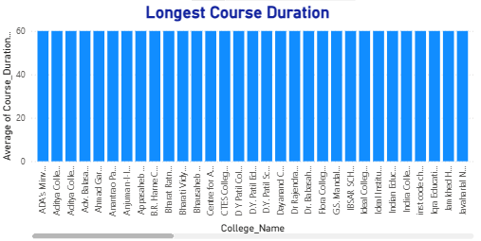
Which college has the longest average course duration?
5

Slide 8
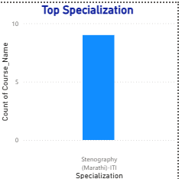
What is the top specialization in the state?
6

Slide 9

Conclusion
Through this Power BI-based exploration of the Higher Education Course dataset, I gained practical experience in visual data analysis, dashboard design, and interactive reporting. By transforming raw data into visual stories, I was able to:
Visualize course distribution across districts, universities, and categories
Analyze the prevalence of professional vs. non-professional programs
Evaluate the distribution of aided vs. unaided courses
Identify patterns in average course duration and specialization trends
Provide institutional and regional insights to support educational planning
Key Takeaways:
Power BI enables intuitive and dynamic analysis, making it easier to uncover hidden trends and communicate findings effectively through visuals.
Designing KPI cards, maps, charts, and matrix visuals helped me understand the real-world impact of data visualization on educational insights.
The use of slicers and cross-filtering enhanced user interactivity, allowing stakeholders to explore specific aspects of the data based on filters like course type, funding, and category.
This project demonstrated how cleaning, transforming, and modeling data in Power BI creates a strong foundation for data-driven decision-making in academia.
Power BI bridges the gap between raw data and strategic planning, making it a valuable tool for educational data analytics alongside SQL and Python.

Slide 10
Thank You

