Slide 1

Internship Program: Soulvibe.Tech
“Higher Education Course
Analysis Using SQL”
Batch Name: SVT/DAINT/2025/06/B10
Notes:
Hello

Slide 2

Introduction
Overview of the main objectives
In this task, I was assigned to analyze a Higher Education Course dataset using SQL to derive valuable insights related to academic distribution and institutional operations. The major aim was to apply SQL to effectively filter, group, join, and aggregate data in a way that reveals trends in the type of course, funding status, professional course distribution, and regional offers from universities and districts.
I employed SQLite as my query language and analyzed the data through DB Browser for SQLite. Throughout the assignment, I utilized concepts like common table expressions (CTEs), aggregate functions, and joins to summarize and interpret the data. This allowed a better understanding of how courses are organized in institutions, including trends in unaided and aided programs, lengths of courses by category, and professional orientation of various courses.The findings of this analysis help improve a larger understanding of the higher education environment, informing data-driven decision-making in educational planning, policy development, and institutional assessment.

Slide 3
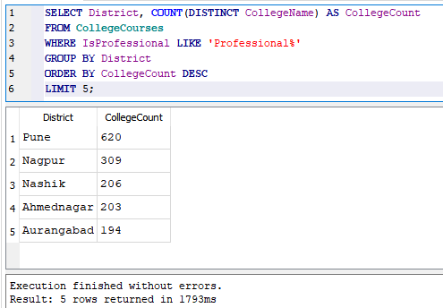
Find the top 5 districts with the highest number of colleges offering professional courses.
1

Slide 4
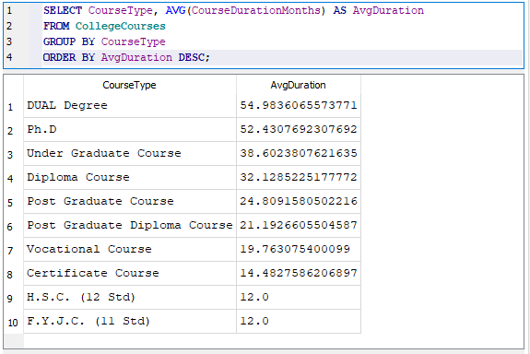
Calculate the average course duration (in months) for each Course Type and sort them in descending order.
2

Slide 5
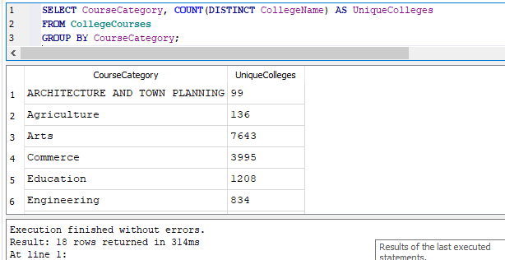
Count how many unique College Names offer each Course Category.
3

Slide 6
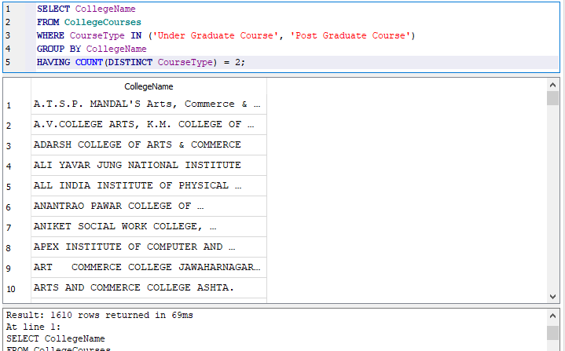
Find the names of colleges offering both Post Graduate and Under Graduate courses.
4

Slide 7
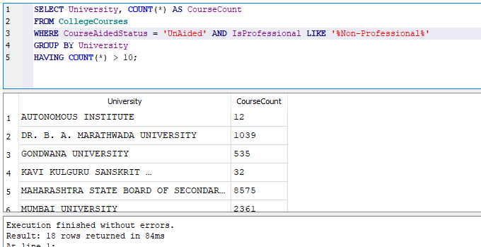
List all universities that have more than 10 unaided courses that are not professional.
5

Slide 8
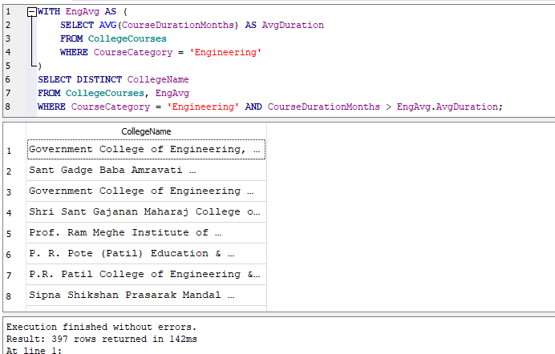
Display colleges from the "Engineering" category that have at least one course with a duration greater than the category’s average.
6

Slide 9
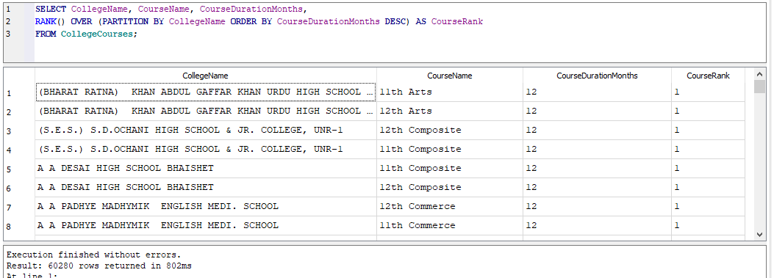
Assign a rank to each course within a College Name based on course duration, longest first.
7

Slide 10
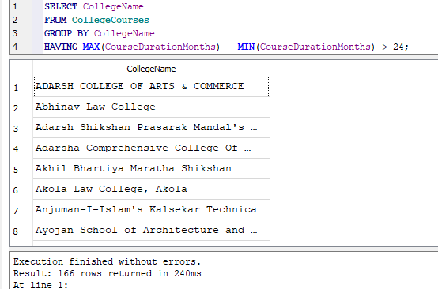
Find colleges where the longest and shortest course durations are more than 24 months apart
8

Slide 11
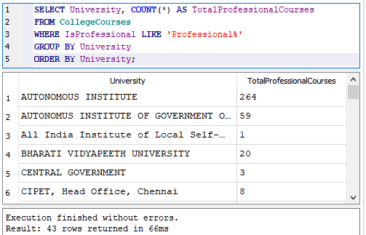
Show the cumulative number of professional courses offered by each university sorted alphabetically.
9

Slide 12
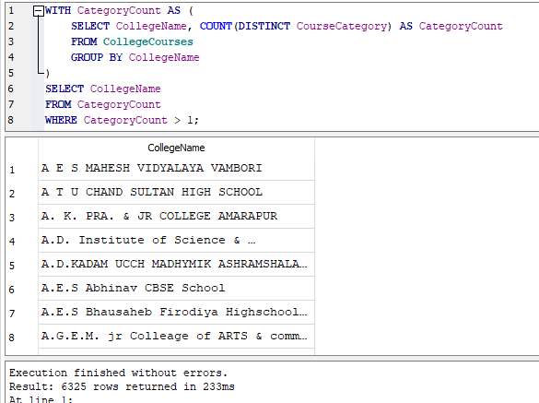
Using a self-join or CTE, find colleges offering more than one course category
10

Slide 13
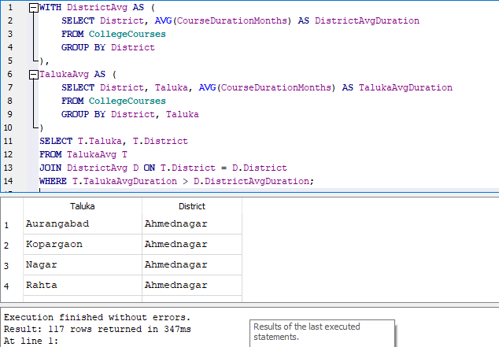
Create a temporary table (CTE) that includes average duration of courses by district and use it to list talukas where the average course duration is above the district average.
11

Slide 14
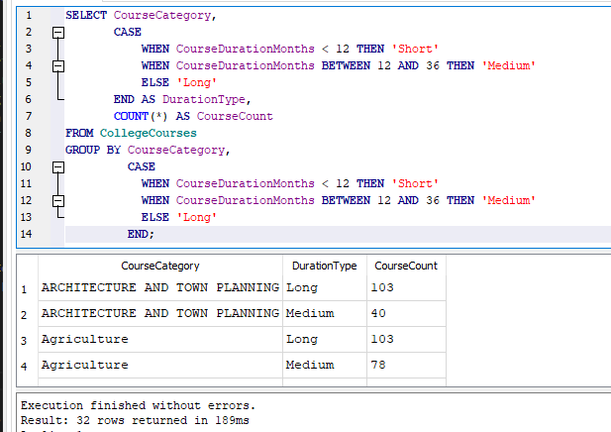
Create a new column classifying course duration as:Short (< 12 months),Medium (12-36 months),Long (> 36 months).Then count the number of each duration type per course category.
12

Slide 15
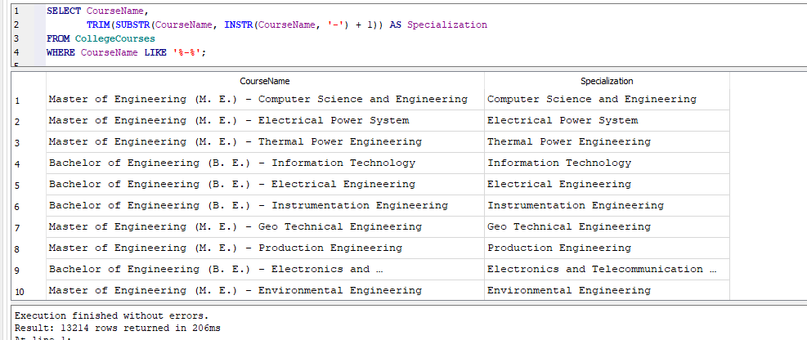
Extract only the course specialization from Course Name. (e.g., from "Bachelor of Engineering (B. E.) - Electrical", extract "Electrical")
13

Slide 16
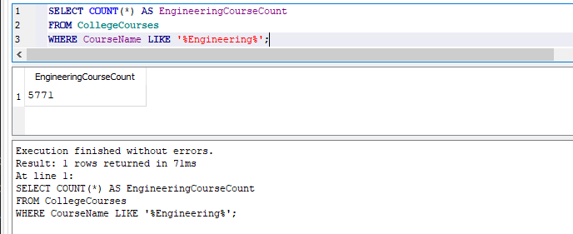
14 Count how many courses include the word Engineering in the name.

Slide 17
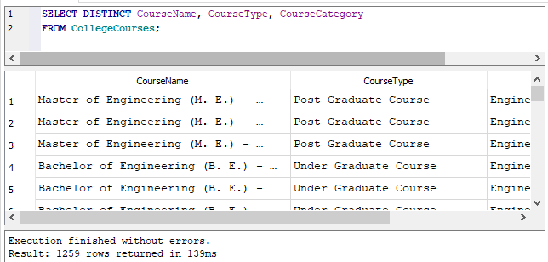
15 List all unique combinations of Course Name, Course Type, and Course Category.

Slide 18
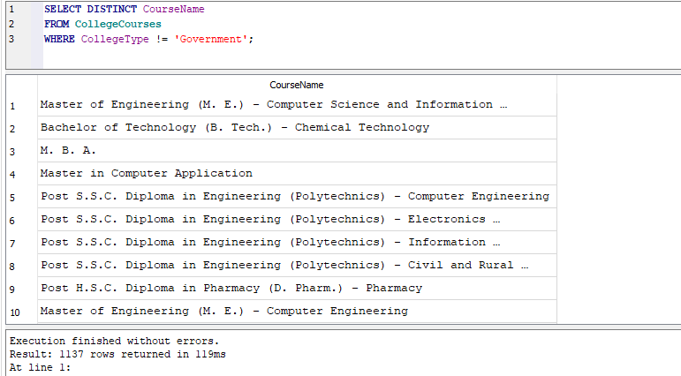
16 Write a query to get all courses that are not offered by any Government college.

Slide 19
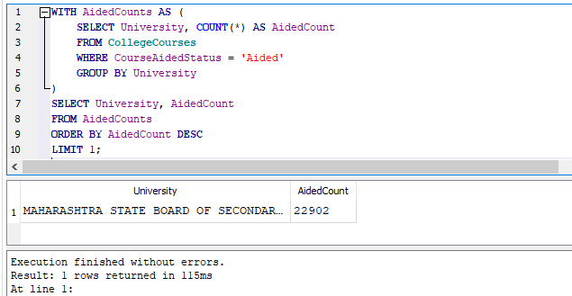
17 Find the university that has the second-highest number of aided courses.

Slide 20
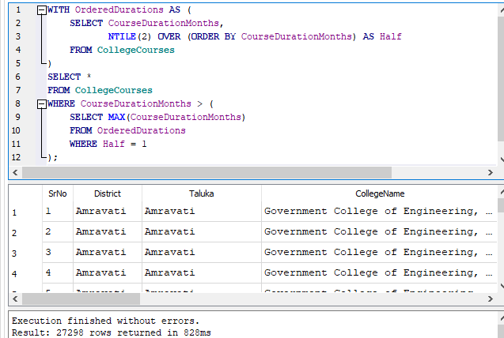
18 Show courses whose durations are above the median course duration.

Slide 21
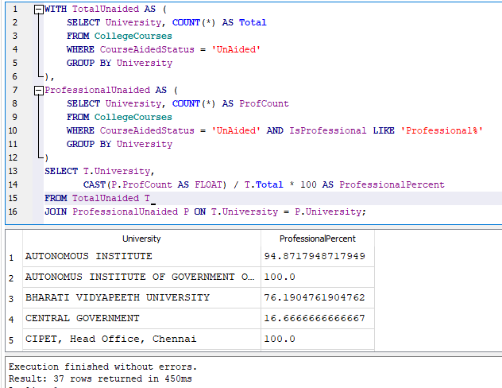
19 For each University, find the percentage of unaided courses that are professional.

Slide 22
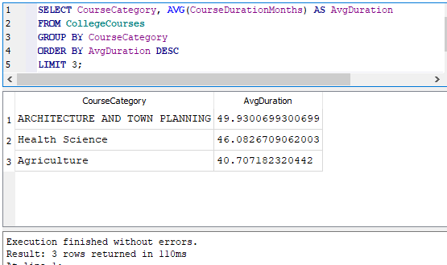
20 Determine which Course Category has the highest average course duration and display the top 3.

Slide 23

Conclusion
Through this SQL-based exploration of the Higher Education Course dataset, I gained hands-on experience in extracting, filtering, grouping, and summarizing data effectively. By writing and analyzing a series of diverse queries, I was able to:
Understand course distribution across universities and districts
Analyze the prevalence of professional and non-professional programs
Evaluate the status and spread of aided vs unaided courses
Identify patterns in course duration and category offerings
Explore institutional-level insights for academic planning
Key Takeaways
SQL is a powerful tool for conducting structured data analysis with precision in the education domain.
Writing queries helped me understand the structure and relationships within the dataset, including institutional, geographic, and academic factors.
These insights can be leveraged for informed decision-making in areas like curriculum planning, resource allocation, and policy formulation.
Data exploration using SQL lays a strong foundation for advanced analytics and visualization using tools such as Power BI or Tableau.

Slide 24
Thank You

