Slide 1
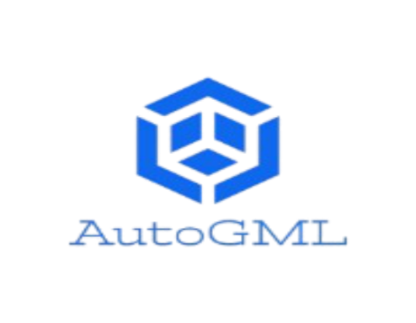
Auto GML
Team :- Team TriDev
Members : Harshid Koladara
Ishan Agrawal
Vaibhav Gondaliya

Slide 2
Problem Statement
Today, Machine Learning and Artificial Intelligence is a big hype in the IT industry.
Their goal is to improve user experience, But the Machine Learning is a most complex to implement and developers can not work with ML Algorithms.

Slide 3
Problem Statement (Cont...)
So, they need to hire ML Engineers and Data Scientists to embed ML into their system which is too costly and also time consuming.
For the experienced Data Scientists and ML Engineers it's too much hard and time consuming to make models with acceptable accuracy because it includes many steps on data preprocessing and Hyperparameter tuning.

Slide 4
Abstract
AutoGML is a Graphical User Interface based Automated Machine Learning System which provides a Machine Learning model without writing a single line of code. AutoGML makes the power of ML available to everyone even if they have limited or no knowledge of ML.
AutoGML reduces developers efforts to build machine learning system from days to hours. AutoGML have features like AutoGML Tables, Image Classification, Object Detection and Face Detection.

Slide 5
Abstract (Cont…)
AutoGML Tables enables you to automatically build and deploy state-of-the-art machine learning models on structured data at massively increased speed and scale by importing datasets and a few clicks and then deploy it to in your system.
AutoGML Image Classification, Object Detection and Face Detection enables you to train machine learning models to classify your images according to your own defined labels.

Slide 6
Limitation of Existing System
Mostly ML and AI systems is developed by ML engineer and Data Scientists which is very much costly and time consuming.
To develop ML and AI system, it requires high-end systems and too much computation power, which is not afforded by everyone.

Slide 7
Limitation of Existing System
Tech giants like Google is provided a AutoML to users but it is very costly for average developer to use and charge per single train and usage, also it provides only in-system use and API.
System developed by this must be connected to internet all the time.

Slide 8
Proposed System
AutoGML - Automated Graphical based Machine Learning is a Graphical User Interface based Automated Machine Learning System which provides a Machine Learning model without writing a single line of code.
AutoGML makes the power of machine learning available to everyone even if they have limited or no knowledge of machine learning.

Slide 9
Proposed System (Cont…)
AutoGML reduces developers efforts to build machine learning system from days to hours. By using AutoGML, We can build machine learning capabilities to create our own custom machine learning models that are tailored to our business needs, and then we can integrate those models into our applications and websites.

Slide 10
Proposed System (Cont…)
AutoGML provides a trained models for later use and developers can include them into their system with small line of code which is also provided by our system and user can use power of machine without internet connection.
Developer can use ML by any way in-system and can later use with just download without any additional cost.

Slide 11
Modules
Login / Signup / Forgot & Reset Password
AutoGML Tables
AutoGML Image Classification
AutoGML Object Detection
AutoGML Facial Recognition

Slide 12
AutoGML Tables
AutoGML Tables enables you to automatically build and deploy state-of-the-art machine learning models on structured data at massively increased speed and scale. It provides trained model by just importing dataset and a few clicks and then deploy it in to your system.
Users can download a trained model and use it in their system with some library imports and little code which is directly provided by our system. The main advantage of this method is system can work while offline.

Slide 13
AutoGML Image Classification
It enables you to train machine learning models to classify your images according to your own defined labels.
To train such kind of models require high-end graphics and too much memory. Models are trained on our server with highly optimized algorithms, So it doesn’t require costly setup for users.

Slide 14
AutoGML Object Detection
It enables you to train custom machine learning models that are capable of detecting individual objects in a given image along with its bounding box and label.
To train such kind of algorithms user need a millions of training examples.
But user can use our pre-trained algorithms, So users can train algorithms with descent size of training set.

Slide 15
AutoGML Facial Recognition
It enables you to classify faces by just training with some images.
It can also detect all persons in a same image frame.

Slide 16
Tools and Technology
Machine Learning
Deep Learning
Neural Networks
Python
HTML5 / CSS3 / BootStrap4
AJAX

Slide 17
Frameworks
Django
TensorFlow
Keras
Scikit-Learn
Numpy
Pandas
Matplotlib

Slide 18
Future Scope
Our future goal is to develop efficient and fully optimized system that can fulfil any condition and develop accurate Machine Learning model for it.
After completed whole project, lunch it on global platform and make available for whole developers community in couple of years.
Integrate API service with system, So user can use their custom developed model with any service and embed them into their project.

Slide 19
Future Scope
Provide Pre-build APIs to user, So user can use these APIs of custom ML models and use them without any training efforts.
Make in-app purchase system available, so it can generate revenue for our team.

Slide 20
Thank You

