Slide 1

JARVIS Virtual Assistant Project
Prepared by:
Vedant Saxena
2111514
Integrated-16-VII sem

Slide 2
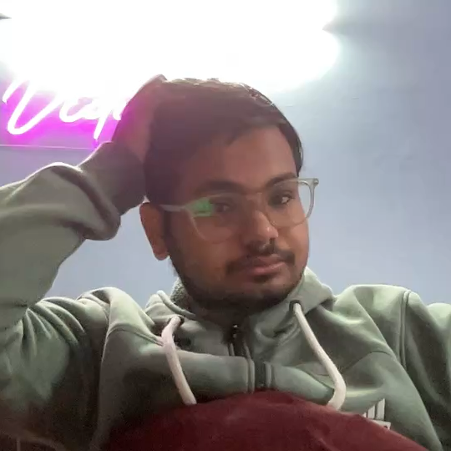
Problem Statement
Existing voice assistants have limitations such as restricted accessibility, complex interfaces, and lack of customization, making them less effective for specific tasks.
Develop a user-friendly virtual assistant using web technologies.

Slide 3
Objectives
Provide hands-free operations for browsing and information retrieval.
Lay the foundation for IoT and chatbot integrations.
The JARVIS Virtual Assistant is an interactive web application designed to execute tasks through voice commands.
It leverages SpeechSynthesis and SpeechRecognition APIs to provide Text-to-Speech and voice recognition functionalities.

Slide 4
Methodology
The project employs:
- HTML, CSS, and JavaScript for web interface development.
- SpeechSynthesis API for Text-to-Speech functionality.
- SpeechRecognition API for real-time voice command recognition.

Slide 5
Results
The JARVIS Virtual Assistant successfully:
- Recognizes and processes voice commands.
- Provides real-time responses using Text-to-Speech.
- Performs tasks like opening websites and fetching information.

Slide 6
Conclusion
The JARVIS Virtual Assistant demonstrates the feasibility of implementing a functional virtual assistant using modern web technologies, with potential for future advancements.
The JARVIS Virtual Assistant is a robust implementation of web technologies for building an interactive assistant.
It lays the foundation for future advancements in virtual assistance systems.

Slide 7
Future Scope
1. IoT device control.
2. Enhanced voice recognition accuracy.
3. Expanded command set and chatbot capabilities.
4. Advanced animations and UI/UX improvements.

Slide 8
References
1. SpeechSynthesis API Documentation
2. SpeechRecognition API Documentation
3. Project files (index.html, app.js, style.css)
MDN website :- https://developer.mozilla.org/en-US/docs/Web/JavaScript

