Slide 1
SPAPK PROJECT 01 : Travel Booking System
C++ Based Project on Booking Management System
Team Name: Tech Squad
Members: Harshita Parsendiya, Priyank Mundel, Gracy Mathur
College: MBM University, Jodhpur

Slide 2
Project Goal
Create, update, and delete bookings
Store all data in a file (bookings.txt)
Manage bookings using C++ class

Slide 3
Project Explanation
Each booking includes:
- Passenger Name
- Phone Number
- Destination
- Seat Number
- Booking ID
All bookings are stored in a file

Slide 4
Tasks Performed
Add a new booking (with validation)
Edit existing booking (by ID)
Cancel booking (by ID)
Display all bookings

Slide 5
Code Highlights
Key functions:
- inputDetails(), saveToFile() , seatAvailablity ()
- editBooking(), cancelBooking() , searchBooking()
Validation for name, age, phone number, destination

Slide 6
File Handling
Bookings stored in bookings.txt
Edit/Delete using temp.txt as intermediate file
Read/write with fstream (ifstream/ofstream)

Slide 7
Sample Booking Data
101, Harshita Parsendiya, Kota, 18
102, Priyank Mundel, jodhpur, 21
103, Gracy Mathur, Jaipur, 15
(Each line: BookingID, Name, Destination, SeatNo)

Slide 8
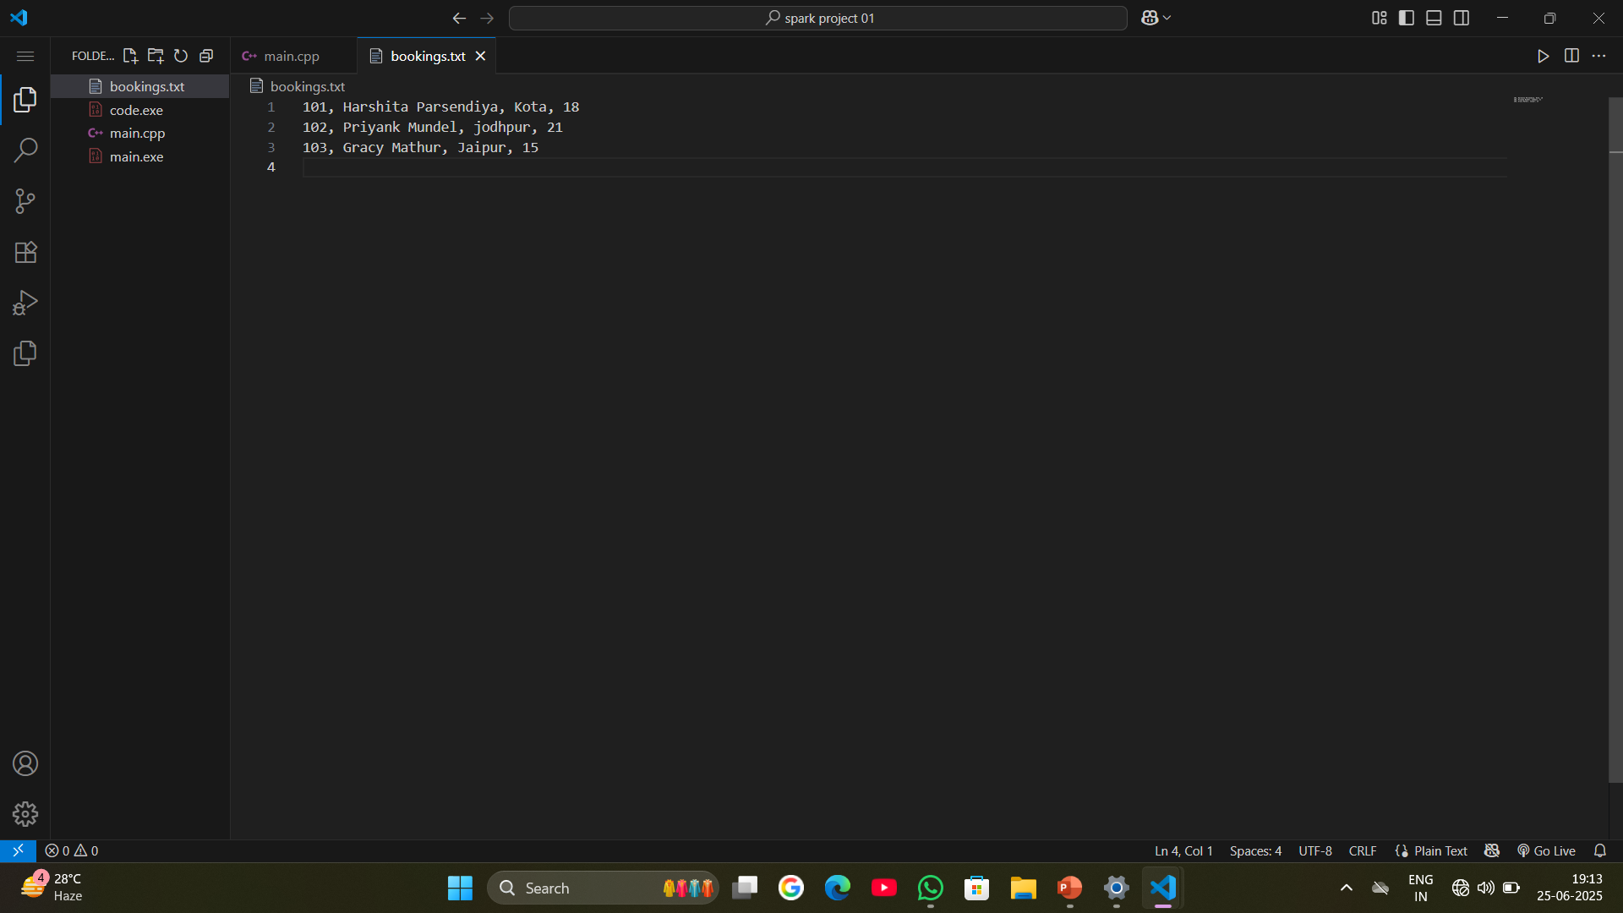
Screenshot Sample Booking Data

Slide 9
Conclusion
Learnt C++ basics, file handling, OOPs
Created a real-world console application
Can be extended to GUI or web app in future

