Slide 1
KONERU LAKSHMAIAH EDUCATION FOUNDATION (KL DEEMED TO BE UNIVERSITY)
Customer Churn Prediction Using Random Forest and XGBoost
Machine Learning Course Project | B.Tech | A.Y. 2026-27
Submitted by
Ch. Madhulika - 2520090056
M. Harshika - 2520090047
Under the guidance of
Dr. Y. Lakshmi Prasanna
Assistant Professor
Dept. of Computer Science and Information Technology
Notes:
Introduce the team, guide and project title.

Slide 2
Introduction
Background
Domain Overview
Why It Is Needed
Customer churn = a customer stops using a company's product or service
Common in telecom, banking, insurance, subscription services
High churn reduces revenue and growth
Companies collect large amounts of customer data: tenure, contract, charges, payment, services
Machine Learning learns churn patterns from this historical data
Knowing who already left does not prevent loss
Early identification of at-risk customers enables timely retention action
Manual analysis cannot reveal hidden patterns

Slide 3
Problem Statement
Existing Problem
Challenges
Who Is Affected
Businesses struggle to identify customers likely to leave
Customer data is large, complex, with many interacting attributes
Manual analysis is slow and misses non-linear patterns
Churn is imbalanced: only 26.6% of customers churn
Insights rarely reach non-technical users
Service providers losing revenue
Retention and marketing teams
Customers who get generic, untargeted offers

Slide 4
Motivation
Why This Project
Real-World Need
Industry Motivation
Understand which factors drive churn
Compare two leading ensemble algorithms
Practice the full ML cycle: EDA, modelling, evaluation, deployment
Retaining a customer is cheaper than acquiring a new one
Retention teams need a ranked list of at-risk customers
Telecom and subscription firms use predictive churn models
Gradient boosting and Random Forest are strong baselines for tabular business data

Slide 5
Objectives
Main objective: predict customer churn using Random Forest and XGBoost and present the results through a web application.
1
Clean and preprocess the customer dataset
2
Perform EDA to find churn patterns
3
Train and evaluate Random Forest and XGBoost
4
Compare models with accuracy, precision, recall, F1 and ROC-AUC
5
Build a web app (FastAPI + HTML) for live prediction and insights

Slide 6
Existing System
Current Approach
Existing Technologies
Limitations
Manual review of customer records and spreadsheets
Rule-based thresholds, e.g. flag short-tenure customers
Reactive: acts after the customer has left
Spreadsheets / BI dashboards
Simple statistical reports
Single-model ML scripts without a user interface
Cannot capture complex feature interactions
No per-customer churn probability
Hard to scale; not usable by non-technical staff

Slide 7
Proposed System
ChurnX: an ML-based churn prediction system that trains Random Forest and XGBoost on historical customer data and serves predictions through a FastAPI backend and web interface.
Predicts churn
Compares models
Both models return a Churn / Not Churn label plus churn probability %
Side-by-side accuracy, precision, recall, F1, ROC-AUC
Explains drivers
Easy to use
Top-10 feature importance and EDA analytics
Web pages: Analyze Customer, Insights, Comparison, Reports

Slide 8
System Architecture / Block Diagram
INPUT
PROCESSING
MODELS
OUTPUT
User enters 19 customer attributes (web form)
FastAPI POST /predict (JSON validation)
preprocessor.pkl One-Hot Encoding (45 features)
Random Forest
Churn label + probability %
XGBoost
Offline training pipeline (Jupyter notebook)
customer_churn.csv (7,043 rows)
Clean + EDA
Train/test split 80/20
Fit RF + XGBoost
Evaluate
Save .pkl models
Other API endpoints: GET /analytics (churn by contract, payment, tenure, charges) | GET /feature-importance (top 10 features)
Frontend: HTML/CSS/JS pages call these APIs with fetch() and render results with Chart.js.
Notes:
Training happens offline in the notebook; the saved .pkl files are loaded by FastAPI at startup.

Slide 9
Methodology / Workflow
Load dataset
Clean data
EDA
Encode + split
Serve via API + UI
Save models
Evaluate & compare
Train RF & XGBoost
Clean: TotalCharges to numeric, 11 blank rows dropped, customerID removed
Encode + split: One-Hot on 15 categorical columns; stratified 80/20 split (5,625 train / 1,407 test)
Evaluate: Accuracy, Precision, Recall, F1, ROC-AUC on the held-out test set

Slide 10
Technology Stack
Language
Frameworks
ML Libraries
Python 3.11
HTML, CSS, JavaScript
FastAPI + Uvicorn
Pydantic (input validation)
scikit-learn (Random Forest)
XGBoost, joblib
Data & Visuals
Storage
Tools / Hardware
Pandas, NumPy
Matplotlib, Seaborn, Chart.js
CSV dataset (no database)
Models saved as .pkl files
Jupyter Notebook, VS Code
Runs on a standard laptop; no GPU or cloud needed

Slide 11
System Modules / Components
User Interface
Data Collection
6 web pages: Home, Analyze, Insights, Comparison, Reports, Profile
Telco customer_churn.csv
Data Preprocessing
ML Module
Cleaning, One-Hot Encoder (preprocessor.pkl)
Random Forest + XGBoost models
Prediction Module
Visualization / Reporting
FastAPI /predict returns label + probability
/analytics, /feature-importance, Chart.js charts, Reports page
Profile Settings
Storage
Name, email, theme saved in browser localStorage
CSV + .pkl files (no database or login yet)

Slide 12
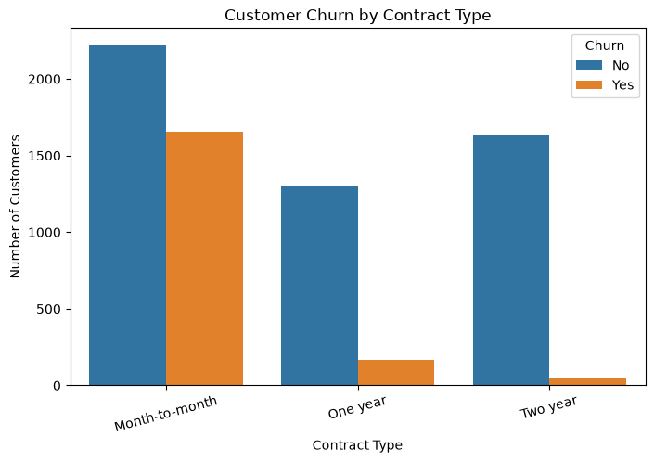
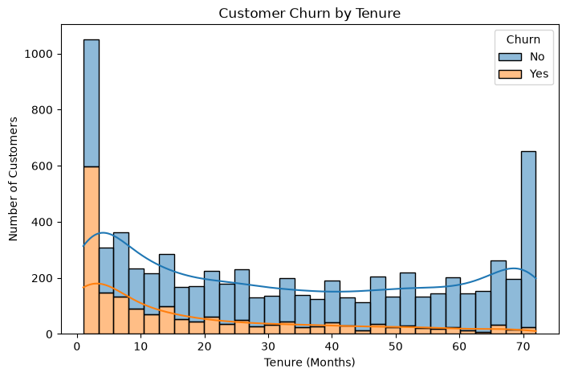
Implementation
Loaded 7,043 x 21 dataset with Pandas; no nulls, but 11 blank TotalCharges removed
Separated 19 features from the Churn target (No=0, Yes=1)
ColumnTransformer: One-Hot for 15 categorical columns, numeric columns passed through
Trained both models, saved with joblib
FastAPI loads the models and exposes /predict, /analytics, /feature-importance
EDA: churn by contract type
rf_model.predict_proba(X)[0][1]
xgb_model.predict_proba(X)[0][1]
-> churn probability (%) per model
EDA: churn by tenure

Slide 13
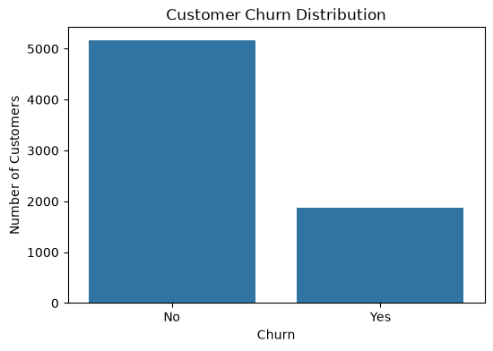
Dataset / Input Data
7,043
21
26.6%
45
records
columns
churned (1,869)
features after encoding
Dataset: Telco Customer Churn (customer_churn.csv)
Customer: gender, SeniorCitizen, Partner, Dependents
Services: phone, internet, security, backup, tech support, streaming
Account: tenure, Contract, PaperlessBilling, PaymentMethod, MonthlyCharges, TotalCharges
Target: Churn (Yes/No)
Preprocessing: 11 rows dropped, ID removed, One-Hot, 80/20 stratified split
Churn distribution: 5,163 retained vs 1,869 churned

Slide 14
Algorithm / Model
Random Forest
XGBoost
Many decision trees on bootstrap samples; majority vote
n_estimators = 200, random_state = 42
Robust, handles non-linear patterns, gives feature importance
Trees built sequentially, each correcting previous errors
n_estimators 200, learning_rate 0.05, max_depth 4, subsample 0.8, colsample_bytree 0.8
Regularized; strong on tabular data
Why these two? Both are ensemble tree methods that suit mixed numeric/categorical business data, need little scaling, and are easy to compare: bagging (Random Forest) versus boosting (XGBoost).

Slide 15
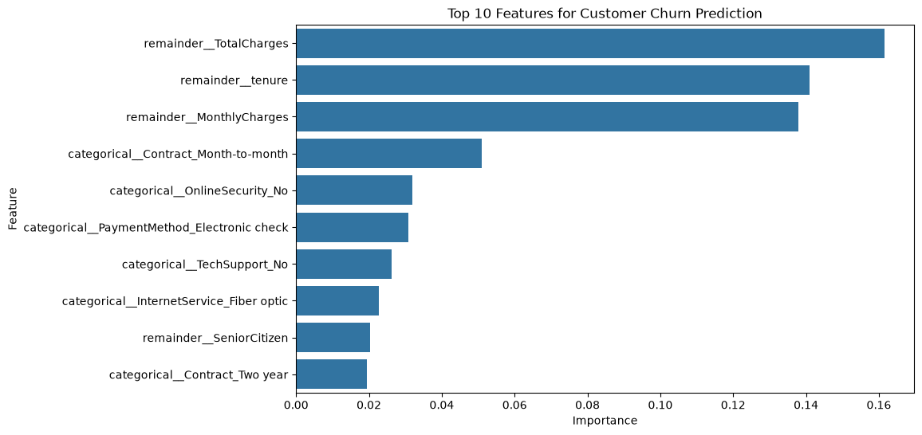
Results
Top features (Random Forest)
XGBoost wins on every metric; the biggest gain is recall (+4.3 pts) and ROC-AUC (+2.4 pts).
Top drivers: TotalCharges, tenure, MonthlyCharges, month-to-month contract.

Slide 16
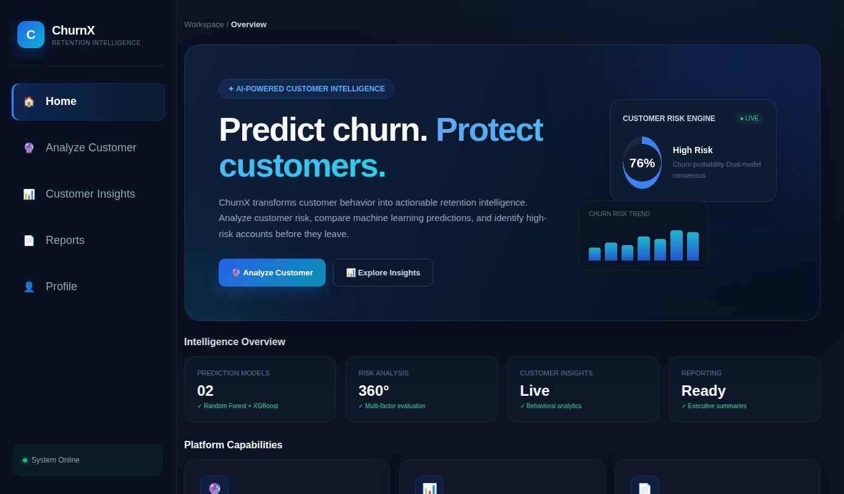
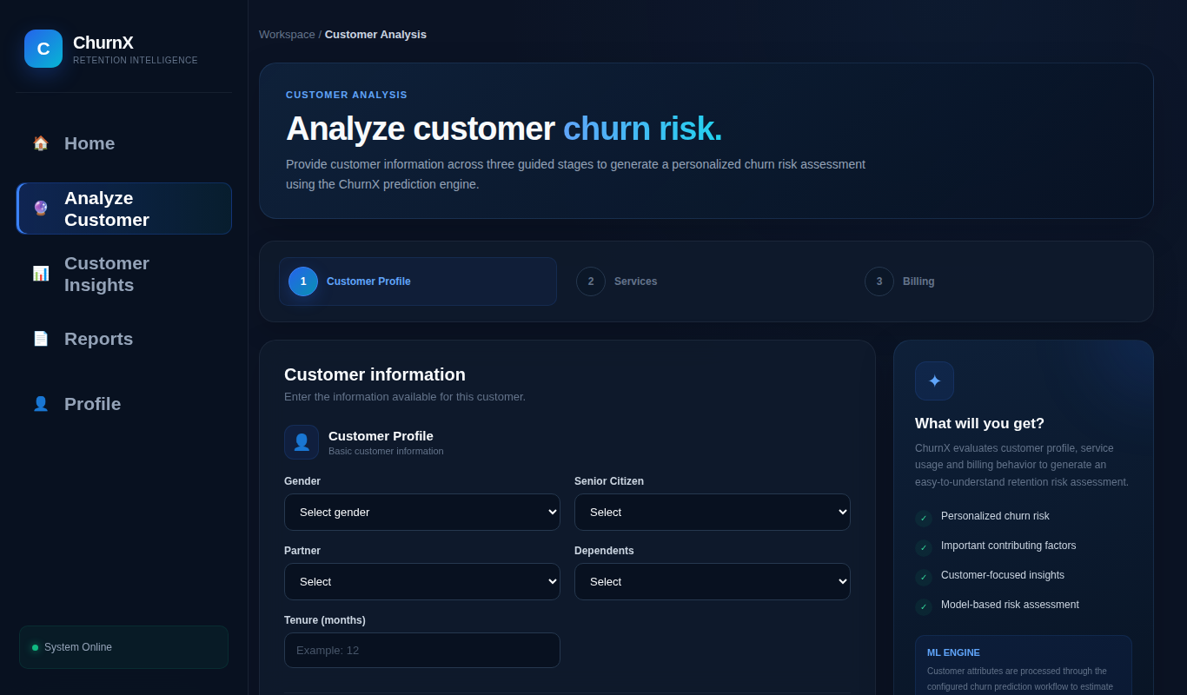
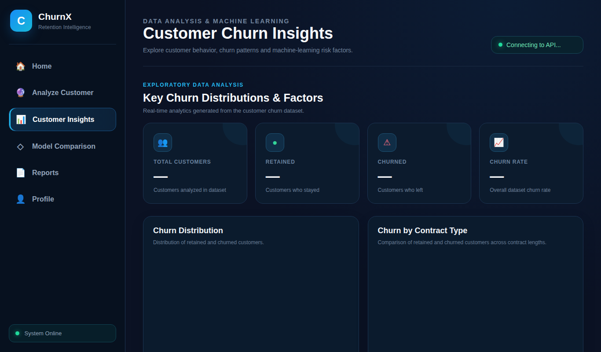
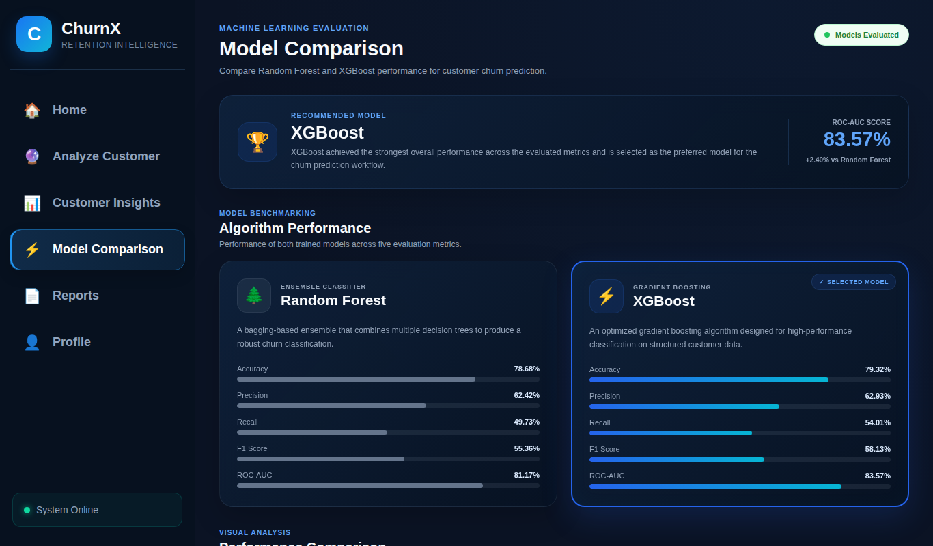
Screenshots / Demo
Home page
Input screen: Analyze Customer
Processing / insights: Customer Insights
Output screen: model comparison
Notes:
Screenshots are from the ChurnX frontend (HTML pages).

Slide 17
Advantages
Benefits of ChurnX
Improvement Over Existing Approach
Per-customer churn probability from two models at once
Finds high-risk customers before they leave
Insight pages show what drives churn
Simple web interface for non-technical users
Proactive instead of reactive
Learns non-linear interactions that manual rules miss
Reuses saved models for instant predictions
Transparent model comparison with five metrics

Slide 18
Applications
Real-World Use
Target Users / Industries
Flagging at-risk subscribers for retention offers
Targeting loyalty and discount campaigns
Prioritising customer-support follow-up
Planning contract upgrades (e.g. month-to-month to annual)
Telecom and internet providers
Banks and insurance companies
OTT / subscription platforms
Retention, marketing and CRM analysts

Slide 19
Limitations
Current Limitations
Dataset / Technical Constraints
Recall is only 50-54%: many churners are missed
No hyperparameter tuning or class-imbalance handling yet
No login/authentication; no database
Predictions show correlation, not the cause of churn
Single Telco dataset of 7,032 customers
Static snapshot; behaviour changes over time
Models must be retrained manually
Random Forest file is about 38 MB

Slide 20
Future Scope
Model Improvements
New Features
Deployment / Scaling
Hyperparameter tuning (GridSearch)
SMOTE / class weights to raise recall
SHAP explanations
User login and role-based access
Database for stored predictions
Batch CSV upload; exportable reports
Docker + cloud hosting
Scheduled model retraining
Integration with CRM tools

Slide 21
Conclusion
Achieved
End-to-end churn system: preprocessing, EDA, two trained models, FastAPI backend and ChurnX web app.
Key outcome
XGBoost performed better: 79.3% accuracy, 58.1% F1, 0.836 ROC-AUC vs 78.7%, 55.4%, 0.812 for Random Forest.
Contribution
Shows how ML turns customer data into actionable retention insights usable by non-technical teams.
Thank you | Questions?

