Slide 1


MULTI-PROCESS COMMAND PIPELINE SYSTEM
B .T E C H 2 N D Y E A R · O S S P · P R O J E C T 1
user@linux: ~
user@linux:~$ ./pipeline
Multi-Process Command Pipeline System Enter commands separated by | :
> ls | grep .c | wc -l
Concurrent Linux Command Execution Using Pipes
P R E S E N T E D B Y
Bathula Neha
2520090013
Chakrika Reddy
2520090044
Harshika
2520090047
pipe
pipe
ls
grep .c
wc -l
Process 1
Process 2
Process 3
Department
Course Academic Year
CSIT
Operating Systems and System Programming 2026–2027
stdout of one process → stdin of the next

Slide 2
$ Introduction
Linux supports multitasking, so many processes can run at the same time.
A command pipeline connects commands so the output of one becomes the input of the next.
Our project builds this idea in C using Linux system calls.
Example
$ ls | grep .c | wc -l
Main Features
•
•
•
•
•
•
•
Executes multiple Linux commands
Supports up to 10 commands in one pipeline Creates a separate child process for each command Transfers data through pipes
Accepts commands dynamically at run time Handles command execution errors
Waits for child processes to complete
ls
lists the files
grep .c
keeps lines matching .c
wc -l
counts the lines
Output of each command flows into the next one

Slide 3

$ Problem Statement
When commands are executed one by one, extra steps are needed to pass data between them. Intermediate files may be used to store the output, which increases manual work and file-handling overhead.
Problems Identified
Our Solution
1 Difficult to connect multiple commands programmatically
A C-based system that accepts commands separated by the pipe symbol (|) and runs them concurrently using child processes and POSIX pipes.
2 Need for efficient communication between processes
3
Unnecessary use of temporary files
4 Complexity in managing multiple child processes
cmd1 | cmd2 | cmd3
5
Need for proper error handling and synchronization

Slide 4

$ Project Objectives
Primary objective: implement a Linux command pipeline execution system using C.
1 Accept multiple commands from the user |  | 6 | Execute commands using execvp()
2 Separate commands using the | symbol |  | 7 | Support a maximum of 10 commands
3 Create child processes using fork() |  | 8 | Handle invalid commands and system-call failures
4 Establish communication using pipe() |  | 9 | Synchronize processes using waitpid()
5 Redirect input and output using dup2() |  | 10 | Display the final command output
Expected Outcome: a working command-line application that demonstrates concurrent process execution and inter-process communication.

Slide 5



$ Existing vs Proposed System
EXISTING APPROACH
PROPOSED SYSTEM
separate commands
our pipeline program
$ ls > files.txt
$ grep .c files.txt > result.txt
$ wc -l < result.txt
> ls | grep .c | wc -l
Advantages
•
•
•
•
•
•
Direct communication between processes No intermediate files required Concurrent command execution
Dynamic command input Efficient data streaming Basic error detection
Limitations
•
•
•
•
Requires intermediate files Involves extra file operations Needs more manual steps
Makes command chaining less convenient
Important: Linux shells already support pipelines. Our project recreates this using C system calls to show how pipelines work internally.

Slide 6






$ System Architecture
USER
types the pipeline
COMMAND INPUT
fgets() reads the line
C PROGRAM · PARSING
strtok_r() splits
PARENT PROCESS
pipe() + fork()
fork() × 3
C H I L D 1
ls
stdin: terminal stdout → PIPE 1
C H I L D 2
grep .c
stdin ← PIPE 1 stdout → PIPE 2
C H I L D 3
wc -l
stdin ← PIPE 2 stdout → terminal
FINAL OUTPUT
PIPE 1
PIPE 2
stdout
shown in the terminal
User Input Module
Command Parser
Process Manager
Pipe Manager
Execution Module
Synchronization Module
Waits for children using waitpid()
Accepts commands separated by |
Separates commands and arguments
Creates child processes using fork()
Creates channels using pipe()
Runs commands using execvp()

Slide 7
$ Working of Our System
1
User Input
2
Command Parsing
3
Pipe Creation
4
Process Creation
Prompt is shown, then the user types:
Input is split into 3 commands:
3 commands need 2 pipes (one fewer than the commands).
Parent creates 3 child processes using fork().
ls
grep .c wc -l
ls | grep .c | wc -l
5
I/O Redirection
6
Command Execution
7
Output Generation
8
Completion
Processes are connected using
dup2().
Each child runs its command using execvp().
The final process displays the result.
Parent waits for all children using waitpid().
Number of Pipes = Number of Commands − 1
e.g. 3 commands → 2 pipes

Slide 8
$ Technologies and Tools
Technology | Purpose
C Programming | Main programming language
Ubuntu Linux | Operating environment
GCC Compiler | Compilation
POSIX System Calls | Process management
Linux Pipes | Inter-process communication
Linux Terminal | Execution and testing
Gedit / VS Code | Code development
Important System Calls
fork()
Creates a new child process
pipe()
Creates a one-way communication channel
dup2()
Redirects standard input and output
execvp()
Replaces the child with a Linux command
waitpid()
Waits for a child process to end
close()
Closes unused file descriptors
Additional Functions
fgets()
Reads user input
strtok_r()
Separates commands and arguments
perror()
Displays system errors
WIFEXITED()
Checks normal process termination
WEXITSTATUS()
Gets the process exit status

Slide 9
$ Implementation Methodology
Phase 1: Input Handling
Reads up to 1024 characters, including the null character
1
fgets(input, sizeof(input), stdin);
Phase 2: Command Parsing
Splits on | ; arguments split on spaces and tabs
2
strtok_r(input, "|", &saveptr);
Phase 3: Pipe Creation
One pipe for every command except the last
3
pipe(fd);
Phase 4: Process Creation
Each command runs in its own child process
4
pid_t pid = fork();
Phase 5: Communication
Previous pipe to stdin, new pipe to stdout
5
dup2(previous_read, STDIN_FILENO); dup2(fd[1], STDOUT_FILENO);
Phase 6: Command Execution
The child replaces itself with the Linux command
6
execvp(argv[i][0], argv[i]);
Phase 7: Synchronization
The parent waits for every launched child
7
waitpid(pids[i], &status, 0);

Slide 10
$ Core Implementation
1. Project Configuration
4. Creating Pipes and Processes
#define MAX_COMMANDS 10
#define MAX_ARGS 20
#define MAX_INPUT 1024
if (i < count - 1 && pipe(fd) == -1) { perror("pipe");
failed = 1; break;
}
2. Reading Input
fgets(input, sizeof(input), stdin); input[strcspn(input, "\n")] = '\0';
pid_t pid = fork();
5. Redirecting Input and Output
3. Separating Commands
if (previous_read != -1) dup2(previous_read, STDIN_FILENO);
char *token = strtok_r(input, "|", &saveptr);
while (token != NULL && count < MAX_COMMANDS) { while (*token == ' ' || *token == '\t')
token++;
if (i < count - 1)
dup2(fd[1], STDOUT_FILENO);
6. Executing Commands
7. Waiting for Processes
commands[count++] = token;
token = strtok_r(NULL, "|", &saveptr);
execvp(argv[i][0], argv[i]);
waitpid(pids[i], &status, 0);
}
Note: these are simplified extracts. The full program also includes error checking and descriptor cleanup.

Slide 11









$ Features Implemented
Dynamic Command Input
Commands are typed at run time, e.g. ls
| sort | wc -l
Multi-Process Execution
Each command runs in a separate child process.
Current Limitations
•
No shell operators such as &&, ||,
> or <
No quoted-string argument parsing No wildcard expansion
Maximum of 10 commands
Input is accepted once per program run
Some malformed pipelines are not fully detected
Pipe-Based Communication
Output moves directly between connected processes.
Multiple Command Support
Up to 10 commands in a single pipeline.
•
•
•
I/O Redirection
dup2() connects the processes.
Error Handling
Empty input, pipe/fork/exec failure, unsuccessful child exit.
•
•
Process Synchronization
The parent waits for launched children to finish.
Resource Management
Unused pipe file descriptors are closed.

Slide 12
$ Testing and Validation
Strategy: run different command pipelines and compare the output with what is expected.
Test Case | Input | Expected Result | Actual Result | Status
1. Single command | pwd | Displays the current working directory. | Displays the current working directory. | PASS
2. Two commands | ls | wc -l | Displays the number of lines produced by ls. | Displays the line count. | PASS
3. Three commands | ls | grep .c | wc -l | Displays the count of directory-listing lines matching .c. | Displays the filtered line count. | PASS
4. Sorting | printf banana | sort | Displays banana. | Displays banana. | PASS
5. Invalid command | invalidcommand | Displays a command execution error and a pipeline error message. | Displays a command error and pipeline failure message. | PASS
6. Empty input | Press Enter without typing a command | Error: No commands entered. | Displays Error: No commands entered. | PASS

Slide 13
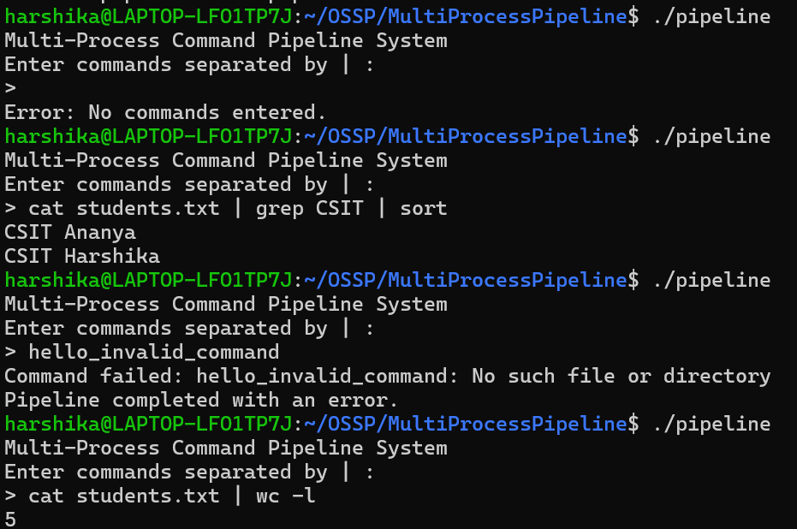
$ Results and Output
Compile and Run
Save the source as pipeline.c
EXAMPLE OUTPUT
user@linux: ~/project
$ gcc -Wall -Wextra pipeline.c -o pipeline
$ ./pipeline
Assumed directory contents
main.c
test.c
notes.txt
data.txt
Result Explanation
Expected Observations
ls lists the directory entries.
grep .c keeps the lines matching its pattern.
wc -l counts the filtered lines.
The final result is shown in the terminal.
•
•
•
•
•
Multiple child processes are created Pipes connect adjacent processes Commands run concurrently
Intermediate output moves through pipes The final process displays the result

Slide 14







$ Applications and Impact
Linux Shell Development
Log File Analysis
Project Impact
Helps us understand how shells build command pipelines.
Connects commands to filter and analyze log data.
•
Demonstrates Linux process management
Improves understanding of IPC mechanisms
Shows concurrent command execution
Reduces dependence on temporary files
Demonstrates POSIX system calls
Develops practical operating-system programming skills
•
Data Processing
System Administration
•
Command-based filtering, sorting and counting.
Shows the basics of automated command-line workflows.
•
•
OS Education
Key Learning Outcomes
•
Gives practical learning of process creation and IPC.
How processes are created, how pipes connect them, how descriptors are redirected, and how the parent manages children.

Slide 15
$ Conclusion and Future Scope
Conclusion
The Multi-Process Command Pipeline System is a C-based Linux application that runs multiple commands concurrently using pipes.
It uses fork(), pipe(), dup2(), execvp() and
waitpid().
It builds practical knowledge of process management, inter-process communication and Linux system programming.
Future Enhancements
1
Build a complete custom Linux shell
2
Add input and output redirection
3
Support quoted arguments and special characters
4
Add background process execution
5
Improve command parsing and validation
6
Support unlimited commands with dynamic memory
7
Add execution time measurement
8
Improve error reporting and process monitoring
THANK YOU
“Efficient Process Communication Through Linux Pipes.”
P R E S E N T E D B Y
Bathula Neha — 2520090013 Chakrika Reddy — 2520090044 Harshika — 2520090047

