Slide 1

Pathpilot
Career Decision Simulator
An intelligent platform that transforms your education, skills, and ambitions into personalized career roadmaps — complete with salary predictions, risk analysis, and real-time market insights.

Slide 2

How It Works
User Input
Frontend
Backend
Gemini AI
PathForge AI connects a clean web interface to a Node.js backend that builds structured prompts and calls the Gemini API — returning career paths, salary data, risk scores, and market trends in real time.

Slide 3
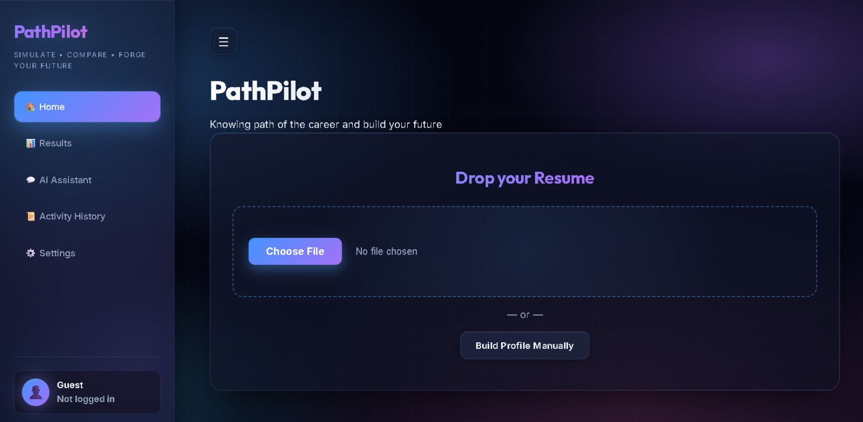
From Confusion to Clarity
Career planning is overwhelming. PathForge AI replaces guesswork with data-driven guidance — giving students and early professionals the confidence to choose a path that fits their unique profile.

Slide 4
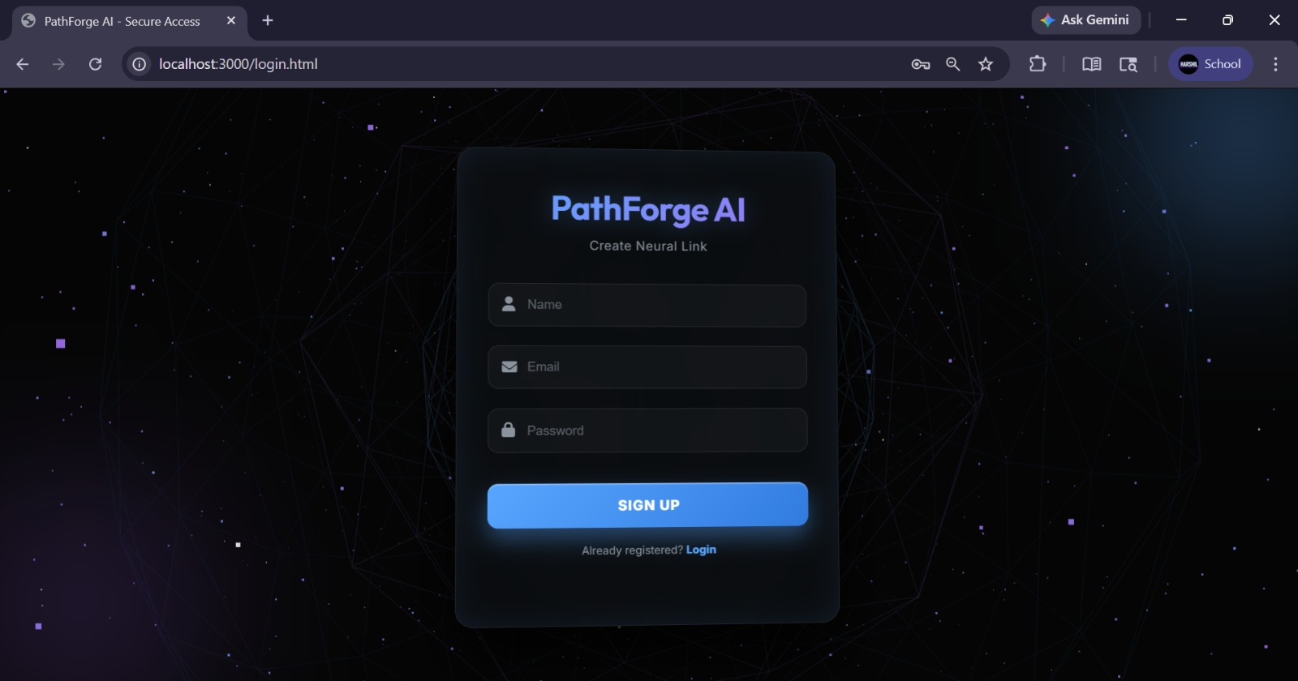
Abstract
PathForge AI is an intelligent career decision simulator designed to assist students and early professionals in making informed career choices. The system analyzes user inputs — education, skills, interests, and uploaded documents — to generate personalized career pathways.
AI-Powered Insights
Real-time predictions via Gemini API
Modern Web Interface
It provides salary projections, job demand trends, and automation risk scores, enabling meaningful comparison across career options.
Premium 3D UI with chatbot and PDF export
Data-Driven Decisions
Reduces uncertainty in career planning

Slide 5
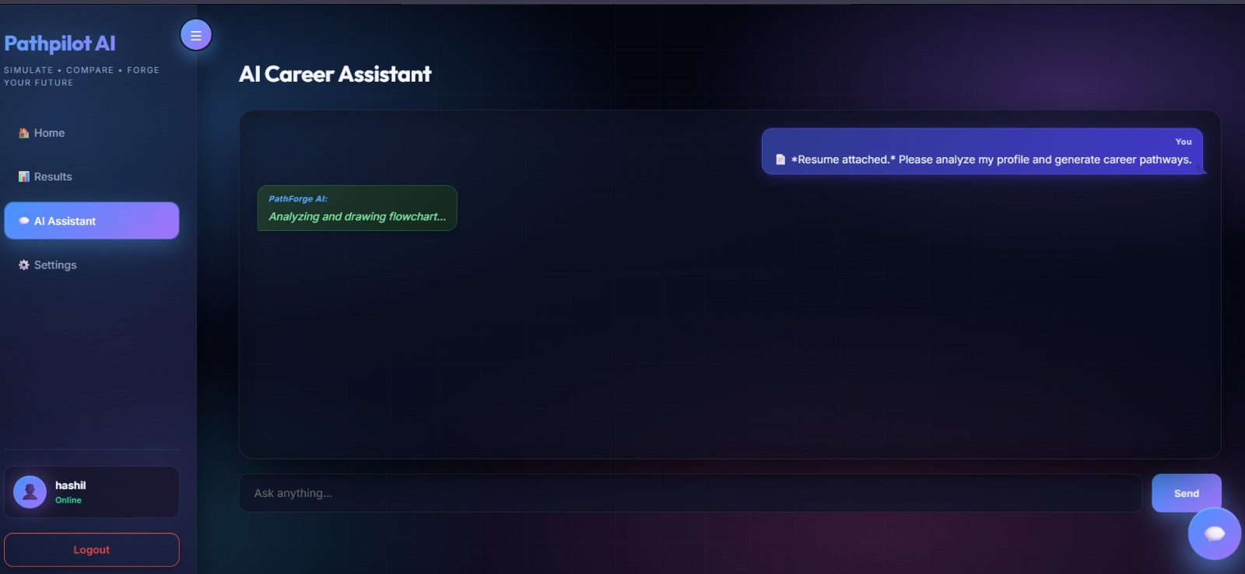
Key Features
AI Career Prediction
Personalized pathways generated from your unique profile
Career Comparison
Side-by-side evaluation of salary, demand, and risk
Chatbot Assistant
Ask follow-up questions and explore options conversationally
Save and share your career report with one click

Slide 6
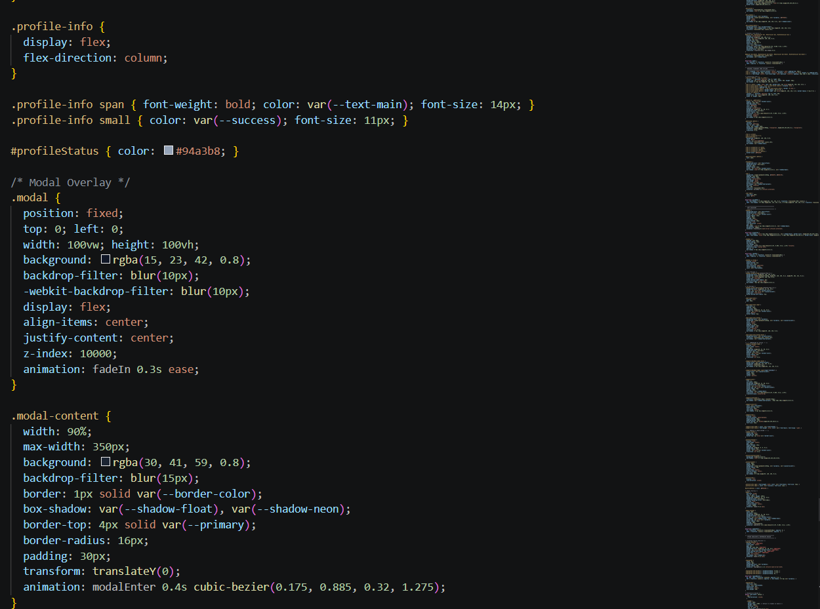

Project Structure
Backend
Frontend /public
server.js — Node.js + Express API server
index.html — Main dashboard UI
package.json — Dependencies and scripts
login.html — 3D animated login page
.env — Gemini API key configuration
style.css — Premium 3D visual styles
script.js — Full frontend logic and data handling
The frontend collects structured arrays (educationArray, skillsArray, etc.) and sends them to the backend, which constructs the AI prompt and calls Gemini.

Slide 7
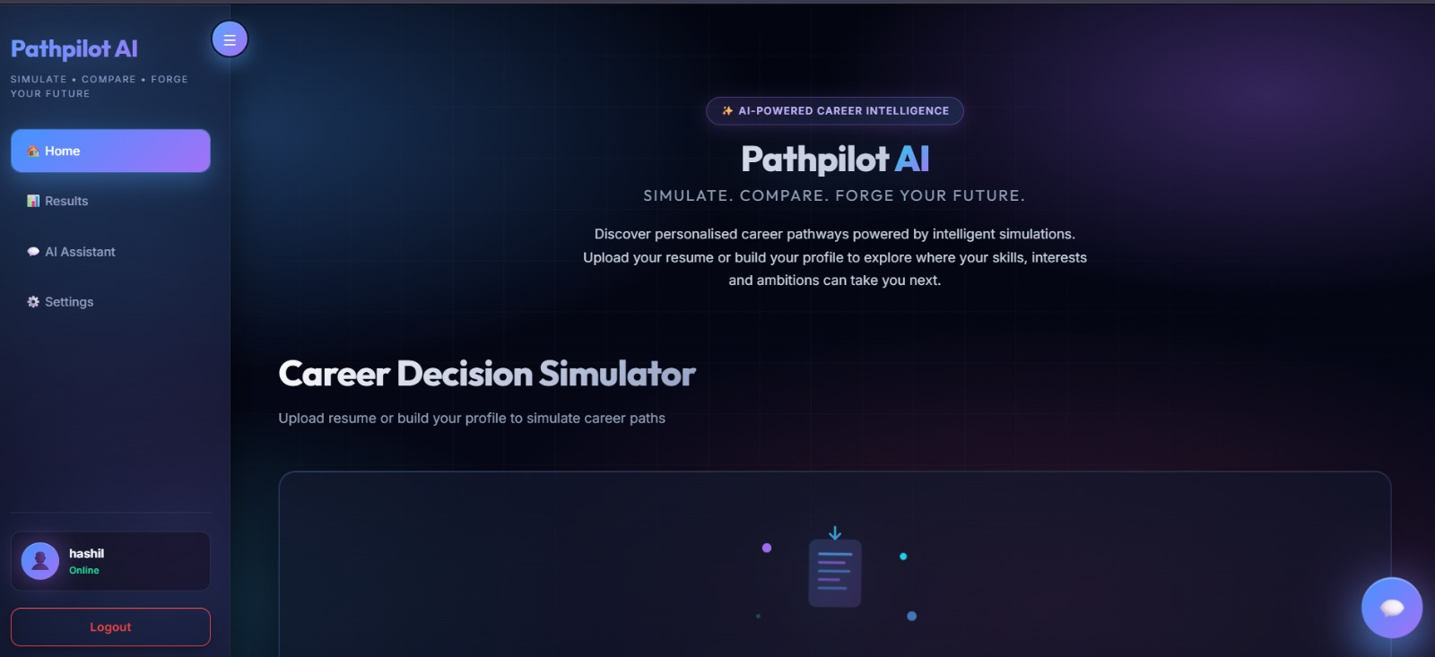
Enhanced User Experience
💬 Chatbot
Conversational AI assistant to explore careers interactively
📊 Comparison
Evaluate multiple career options side by side
📄 PDF Export
One-click report generation via html2canvas + jsPDF
⚙️ Developer Mode
Input your own API key for direct Gemini integration

Slide 8

Conclusion & Future Scope
What PathForge Achieves Today
What's Next
PathForge AI empowers students and early professionals to move beyond guesswork. By combining AI predictions with intuitive design, it delivers clarity, confidence, and actionable direction in career planning.
Live Job APIs
Integrate real-time job listings from LinkedIn, Indeed, and more
ML Models
Reduces career uncertainty through real-time, personalized, data-driven guidance.
Custom trained models for hyper-personalized predictions
College Recommender
Match career paths with the best institutions and programs

