Slide 1
Laptop And Desktop Rental System
Parul Institute of Computer Applications
Semester 4 Project -2
2021-22
210510123009 Harshil Patel
210510123012 Shaikh Yamanuddin
210510124013 Sai Sankar Majji

Slide 2
INDEX
Abstract
Tools and Technology Used
Features of Proposed System
Limitation of Proposed System
Users and their role description
System Flow Diagram
Data Flow Diagram ( All Levels)
Use Case Diagram
Data Dictionary
Screenshots of Development Phase 1 ( Designing of your Project)
Screenshots of Development Phase 2 ( Features Implementation)

Slide 3
Abstract
In today’s competitive world, learning skills through a laptop or system has become a basic need for almost every students. But that requirement comes with a cost.
A well configured laptop costs a lot for a middle class family.
Renting a laptop could be an alternative, but there is no secured platform to allow any user to rent one.
To overcome these problems, we propose a web application called Laptop Renting System.
The basic idea is to create a web application platform to rent the laptops on demand online which is available 24/7 removing the problem of high cost.
This website eases the task of renting a laptop online.

Slide 4
Tools and Technology Used
Processor : intel core I3/I5.
RAM : 4GB/8GB.
Hard disk : 512GB/1TB.
Monitor : 15.6 color monitor or advance.
Device : Keyboard, Mouse.
Operating System : windowsXP,windows10.
Control Panel :Xampp Control panel/Wamp Control Panel.
Software Development Kit : google chrome,internet Explorer,Mozilla FireFox(any appropriate or suitable browser).
Programming language : PHP, HTML, JAVASCRIPT.
Server : Apache Web Server.
Database : MySQL.

Slide 5
Features of Proposed System
Registration.
User login.
Admin Login.
Booking.
Manage products.
Manage bookings.

Slide 6
Limitation of Proposed System
It can only rent laptop in limited area. For example campus.
One user can only rent one laptop at a time.
Once the renting time is over , user have to return the laptop. For extending the renting period the user have to book the slot again.
The user can rent the laptop for maximum 3 days.
No online payments.
No license verification.

Slide 7
Users and their role description
Admin
Dashboard: In this section, admin can view the details of total products which is available for rent and view booking details in briefs.
Products: admin can manage the laptop.
Reg Users: In this section, admin can view detail of registered users.
Booking For Rent: admin can view, manage and cancel the booking
Search: In this section, admin can search laptop and desktop booking by user’s name.

Slide 8
Users and their role description
Registered Users
Home Page: Users can see the listed laptop and desktops on the home page.
About Us: Users can view the about us page.
Laptop: User can view the total laptops available for rent.
Contact Us: Users can view the contact us page.
My Booking: In this user can view the detail of the booking like the status of the booking, how much cost will be taken, and also take a print of the invoice.
My Account: The user can update his/her profile, change the password and recover the password.

Slide 9
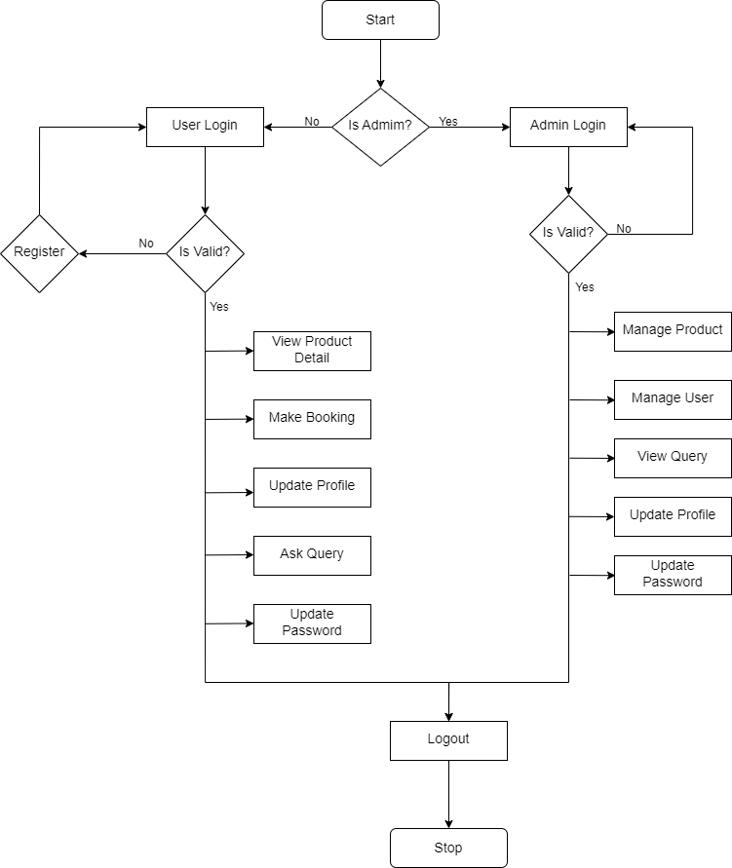
System Flow Diagram

Slide 10

Data Flow Diagram

Slide 11
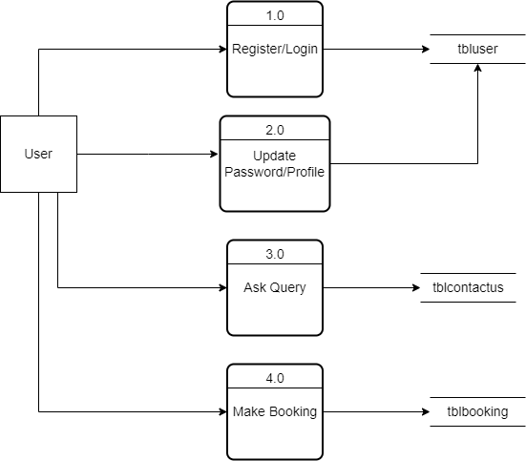
Data Flow Diagram

Slide 12
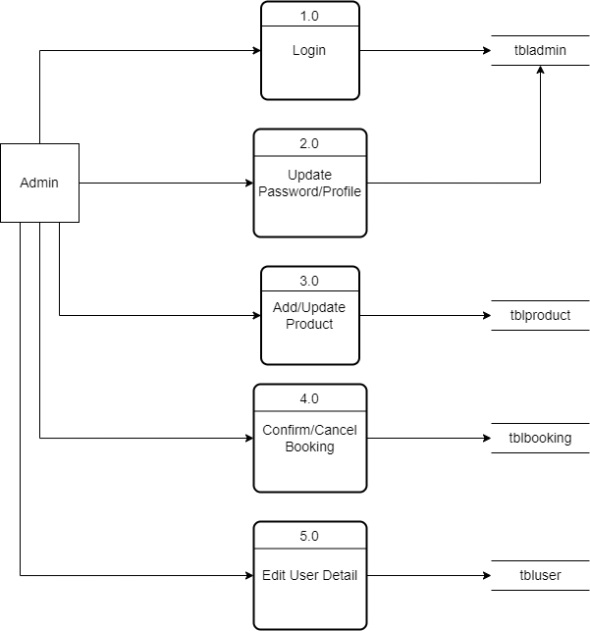
Data Flow Diagram

Slide 13
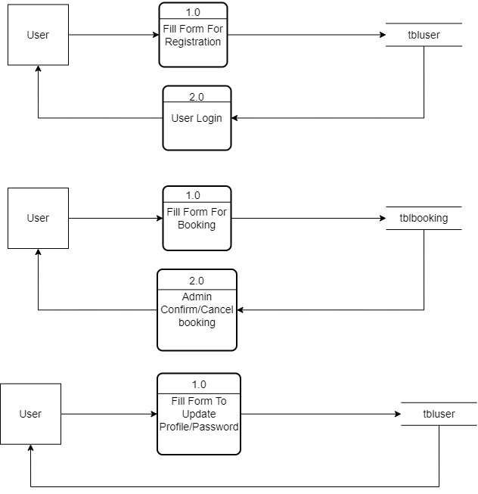
Data Flow Diagram

Slide 14
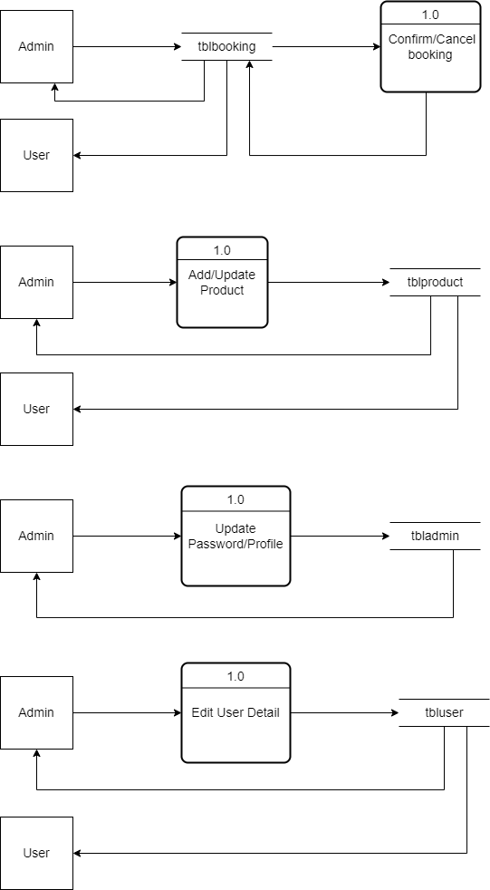
Data Flow Diagram

Slide 15
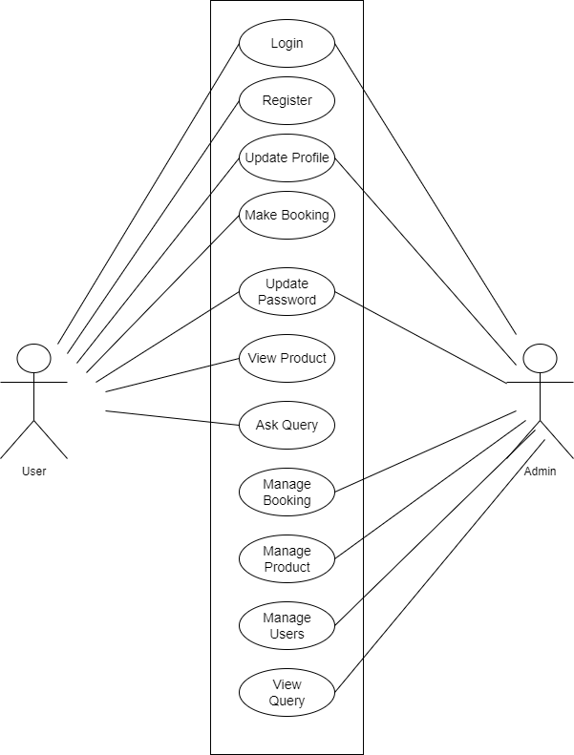
Use Case Diagram

Slide 16
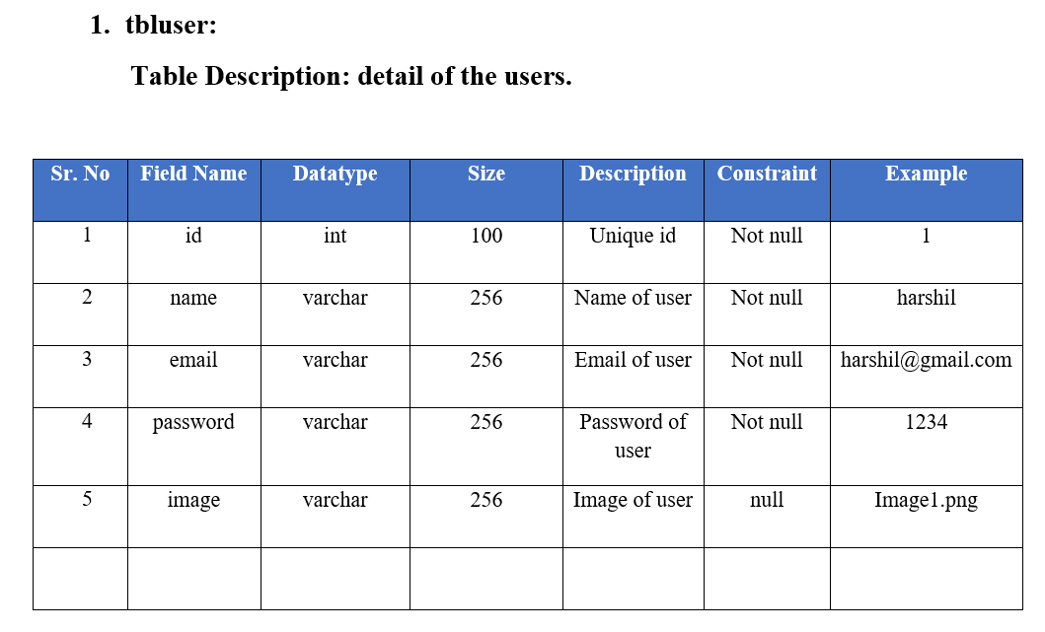
Data Dictionary

Slide 17
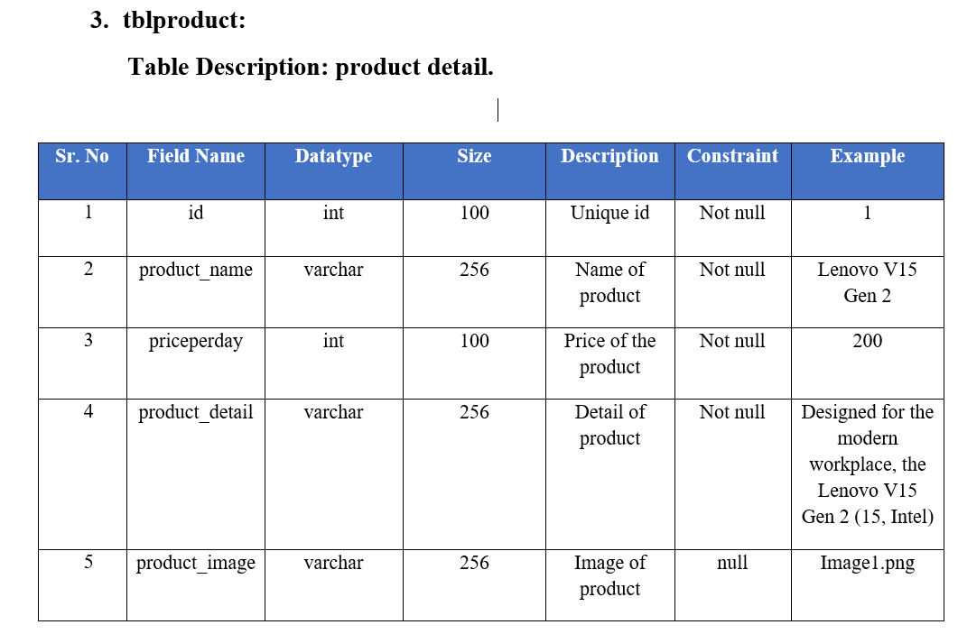
Data Dictionary

Slide 18
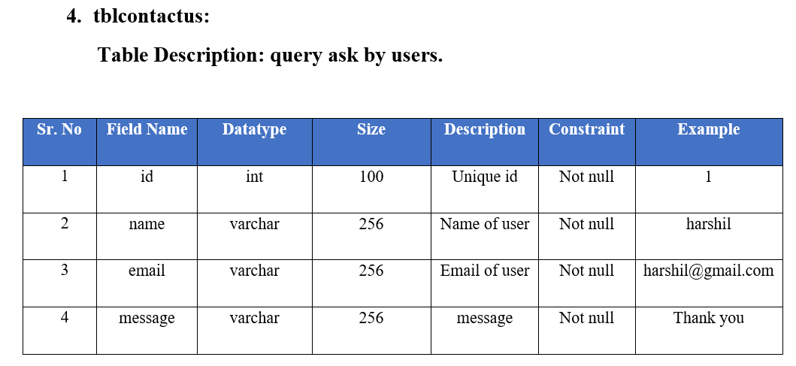
Data Dictionary

Slide 19
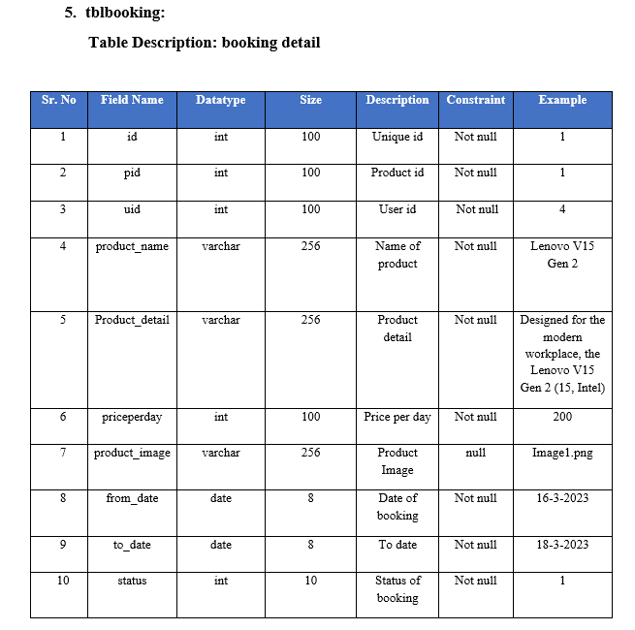
Data Dictionary

Slide 20
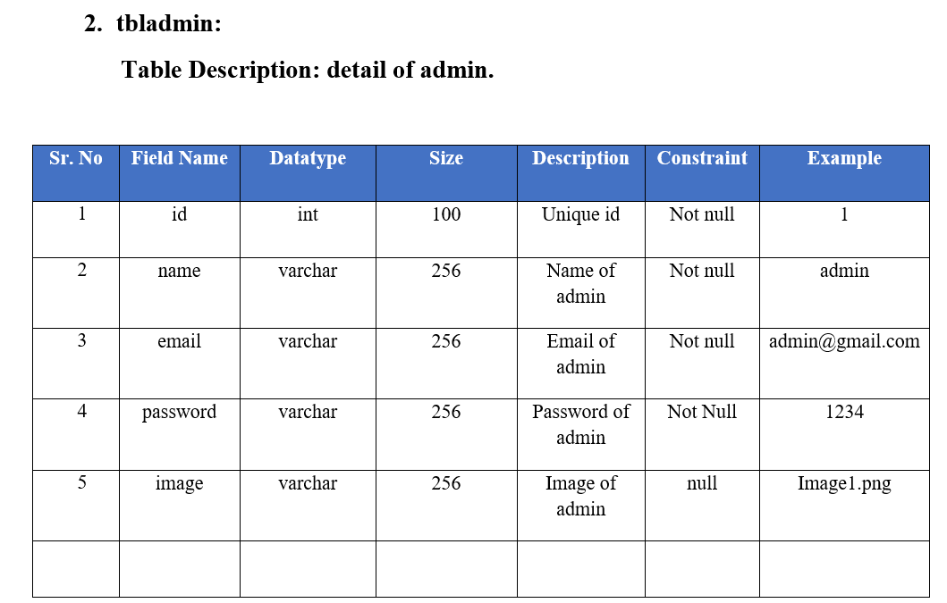
Data Dictionary

Slide 21
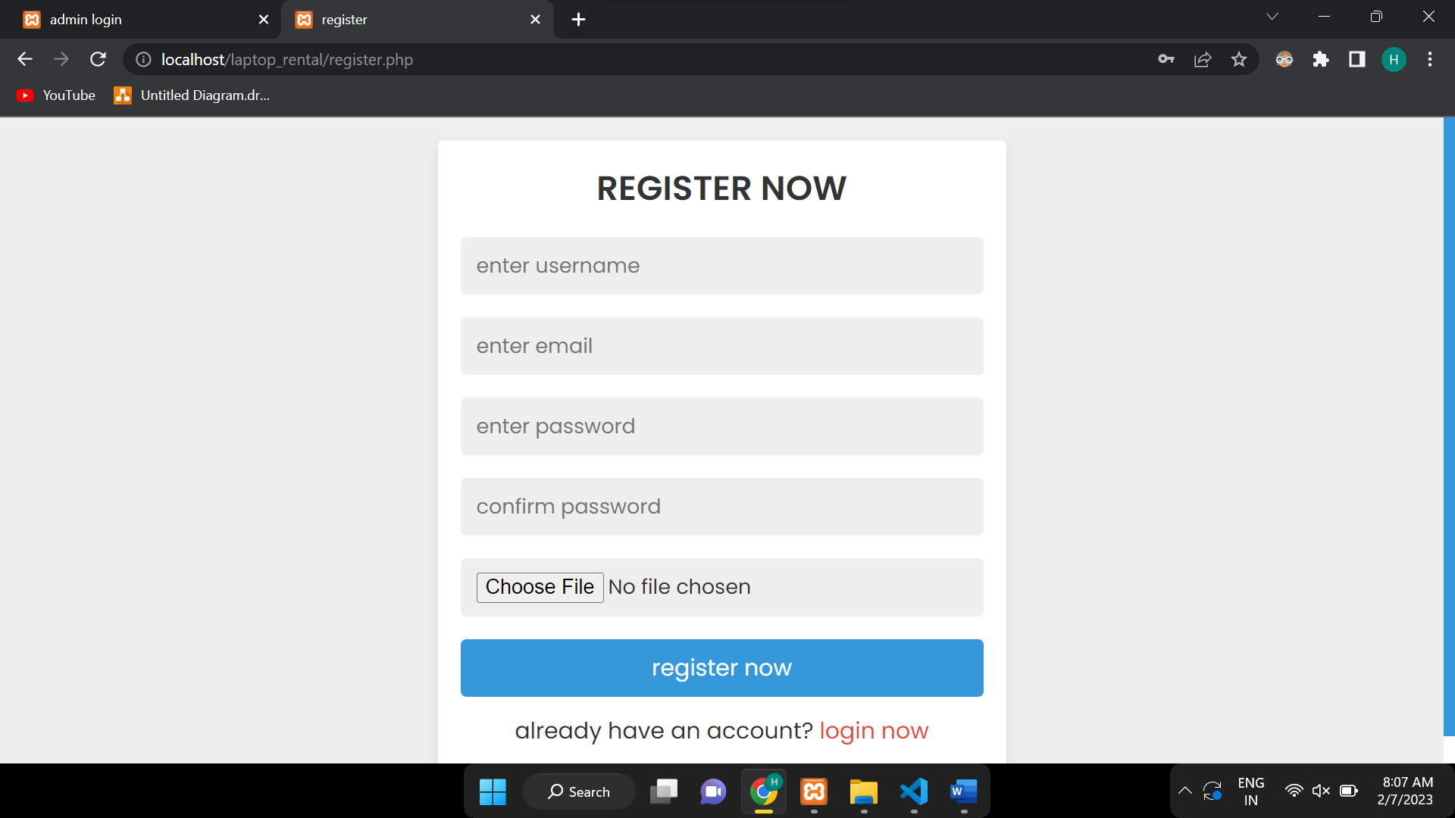
Screenshots of Development Phase 1 ( Designing of your Project)
Screenshots of Designing of your System

Slide 22
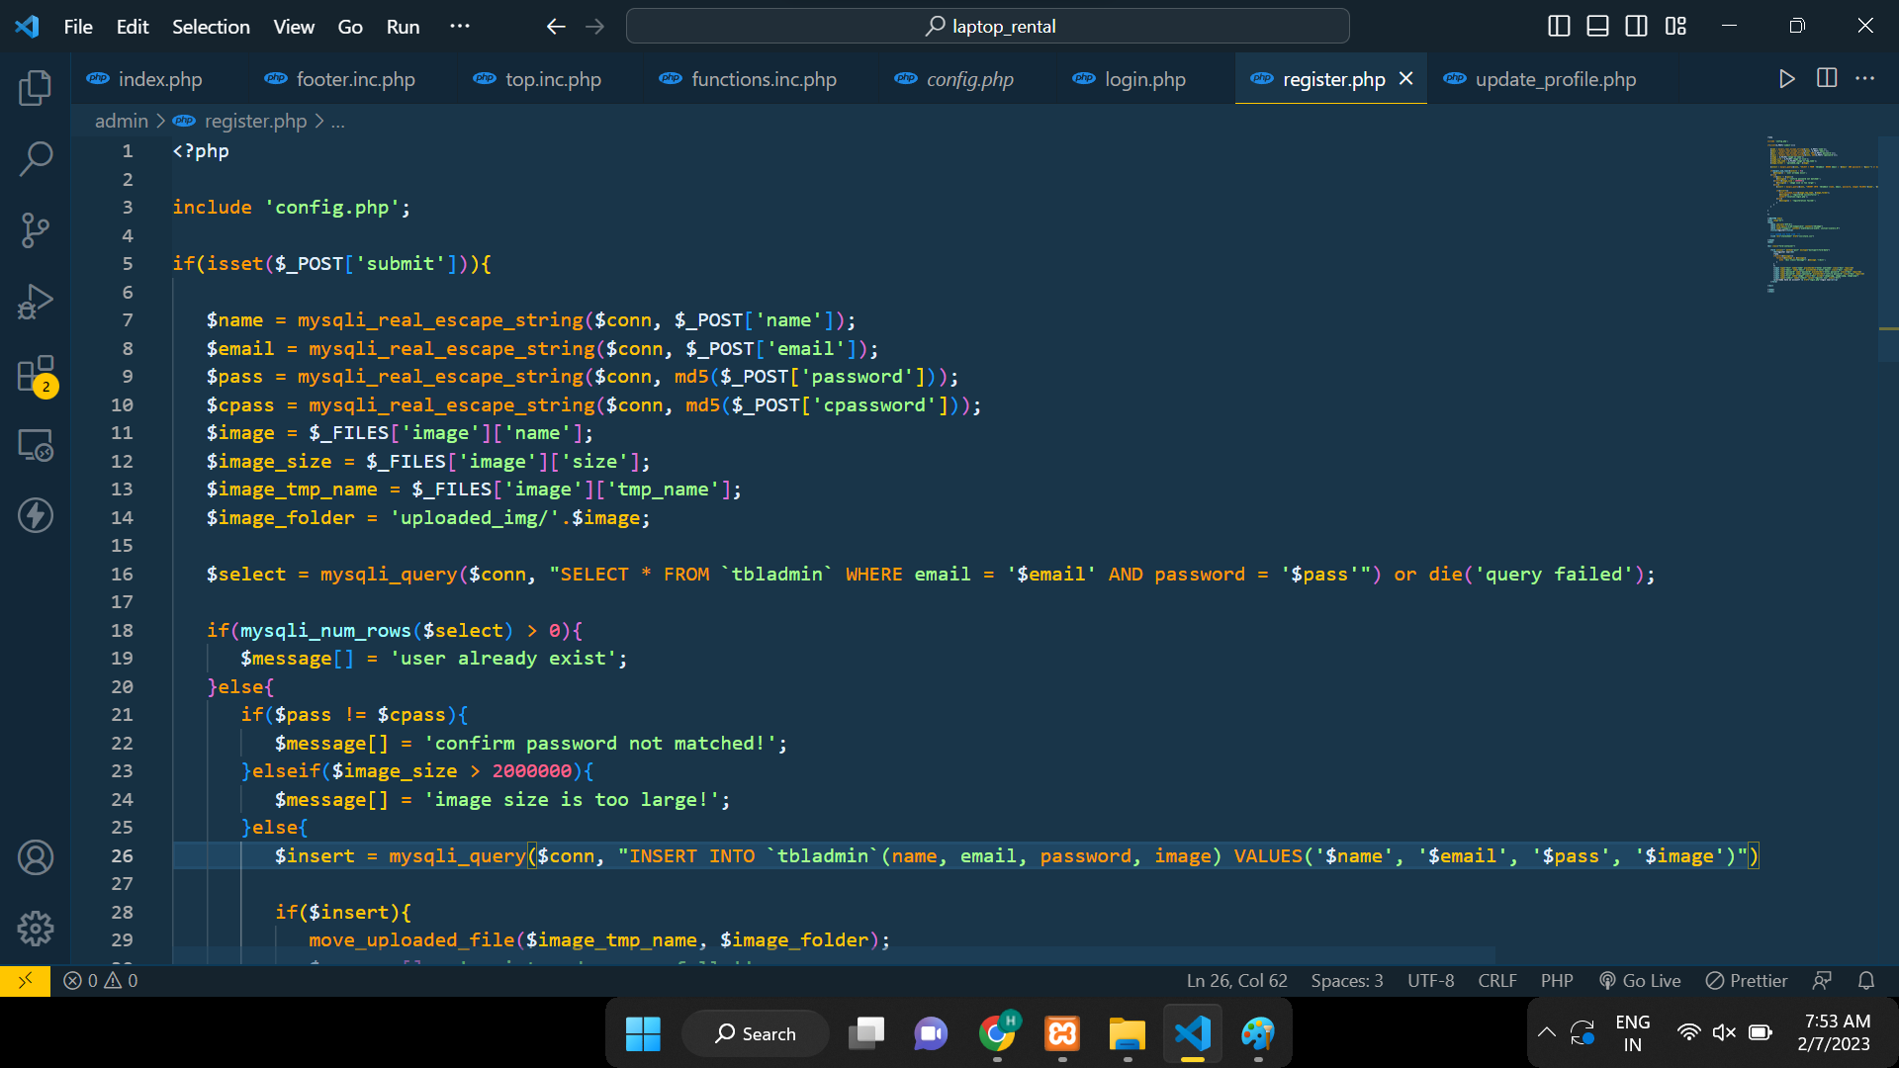
Screenshots of Development Phase 2 ( Features Implementation)
Screenshots of your System’s Features Implementation

Slide 23
Thank you !!!

