Slide 1
The Automated Travel Agent: Hotel Recommendations Using ML
Kushagra Chandak
Diplav Srivastava
Harshil Jain
Mentor Name- Tarun Gupta
Project Guide- Dr. Avinash Sharma

Slide 2
Dataset Information
Data Source - Kaggle
Number of Instances - 4 million
Number of features -22

Slide 3
Problem Statement
Recommending best hotel to customer on the basis of some parameters and hence giving a personalized hotel recommendation to all users.
Expedia is interested in predicting which hotel group a user is going to book.
In-house algorithms to form hotel clusters
These hotel clusters serve as good identifiers to which types of hotels people are going to book, while avoiding outliers such as new hotels that don't have historical data

Slide 4
Feature Explanation
There are many features given like user location,hotel location,hotel rating,distance between origin and destination etc.
All these features play a significant role while booking a hotel like if the hotel lies in different continent with other features similar has less probability compared to other hotel within the same continent or state.
Similarly hotel rating and family specifications matter for making a recommendation better.

Slide 5
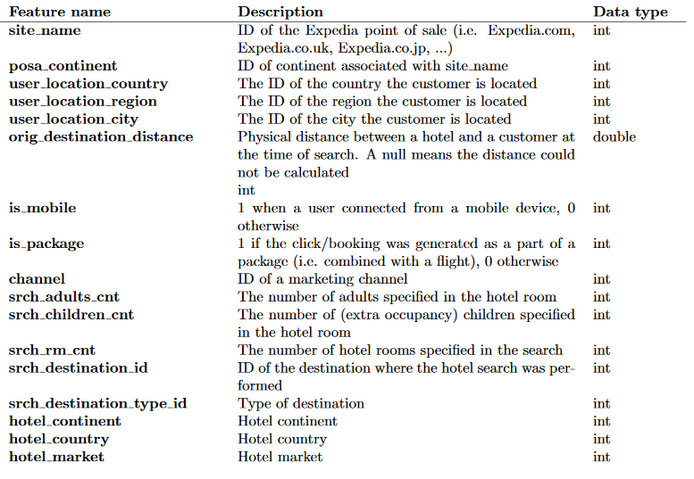
Features

Slide 6
Feature Extraction and Selection
Most of the features are specified correctly but some new features are introduced from the current features like in_time and out_time from a hotel is given.We have converted into length_of__stay which is a more significant or a useful feature for our problem.

Slide 7
Algorithms Implemented
Naive Bayes
User Similarity Kernel
SVM(RBF Kernel)

Slide 8
Naive Bayes

Slide 9
Pre Processing Done
Replaced Missing attribute with their Mean
We filter out all training examples where the user did not actually book the hotel cluster that they clicked on and replaced all the example that contained missing information with their mean.
Downsampling
Since the training dataset was so huge( 30 million data point) and required a lot computational time , we downsampled the training dataset such that prior probability of all the hotel cluster remained same

Slide 10
More useful feature obtained
Some of the feature like date in time and out time was converted into length_of__stay which is a more significant or a useful feature for our problem
Performed PCA
Performed PCA on the resultant training dataset to reduce the number of attribute from 24 to 12

Slide 11
Analysis of Naive Bayes
For Naive Bayes, we hand-selected a few features, to get a basic machine learning algorithm running.We calculated target class probabilities for the categorical features, and we normalized continuous variables based on target label values. For each attribute in the test set, we converted its value to booking probability based on the the observed probabilities in the training set.

Slide 12
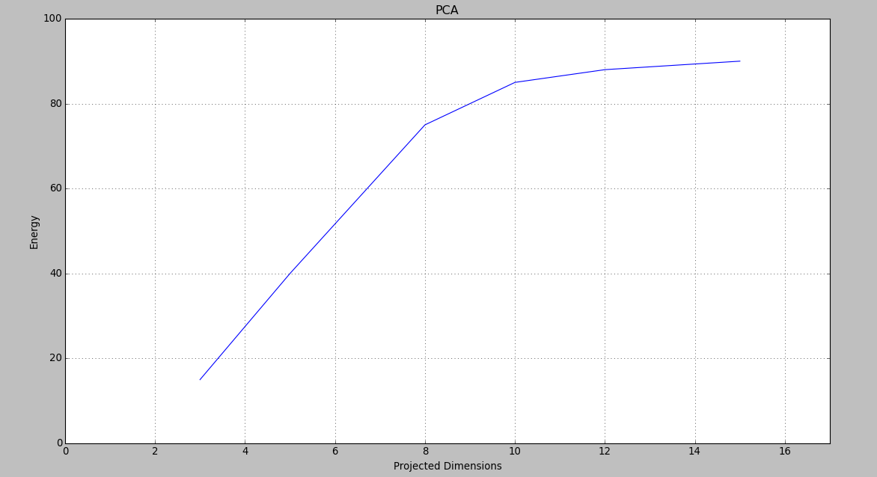
Choosing the value of K(Projected Dimension)
Energy=(∑ _{i =1}^{K} ƛ_{i})
( ∑_{j=1}^{N} ƛ_{j} )

Slide 13
Prior Probability of Cluster

Slide 14
Assumptions
Attribute Linearly Independent
The main assumption made while applying Naive Bayes classifier was that attribute of training dataset obtained after PCA are linearly independent so that we can directly treat each attribute as independent random variable and multiply each of them to get probability of each cluster

Slide 15
Results
Algorithm | Precision | Recall | F1
Naive Bayes | 0.0596321 | 0.0567834 | 0.057489

Slide 16
Validation Technique Used
We used holdout technique for validation.
The features used to train the model were generated using only hotel cluster and data prior to '2014-07-01'.
A portion of the training data from '2014-07-01' onward was set aside for validation.

Slide 17
Support Vector Machines(SVM)
Support vector machines (SVMs]) are supervised learning models with associated learning algorithms that analyze data used for classification and regression analysis.

Slide 18
Support Vector Machine (SVM)
Applied PCA
We have first applied PCA to the data to reduce the size of features which in place reduces the computation a lot . On Applying PCA we reduced the number of features from 22 to 10.
Downsampling
Since the training dataset was so huge( 30 million data point) and required a lot computational time , we downsampled the training dataset such that prior probability of all the hotel cluster remained same

Slide 19
Support Vector Machine (SVM)
Changed the value of Gamma and test and train data
Then applied SVM RBF Kernel over the downsampled data and observed the results by varying different values of gamma and ratio of training and testing data(K).

Slide 20
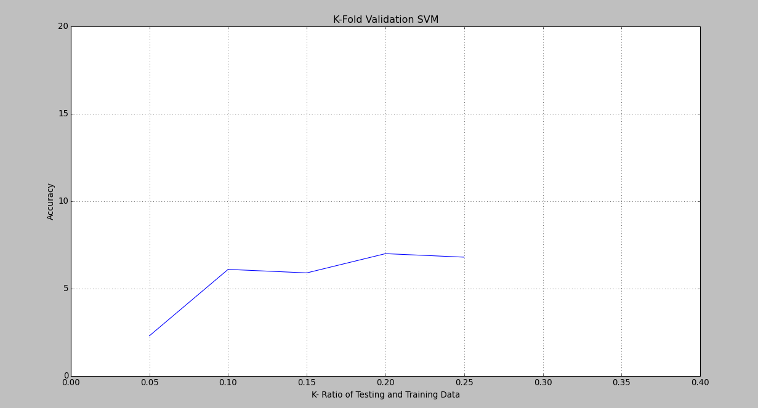
K-Fold Validation(SVM)

Slide 21
Assumptions
After applying PCA ,then Kernel function the training data has become linear upto certain extent.

Slide 22
Results
SVM RBF
Algorithm | Precision | Recall | F1
SVM RBF | 0.073425 | 0.069846 | 0.071976

Slide 23
Results
SVM Polynomial
Algorithm | Precision | Recall | F1
SVM Polynomial | 0.073425 | 0.069846 | 0.071976

Slide 24
Results
SVM Linear
Algorithm | Precision | Recall | F1
SVM linear | 0.034829 | 0.032112 | 0.034091

Slide 25
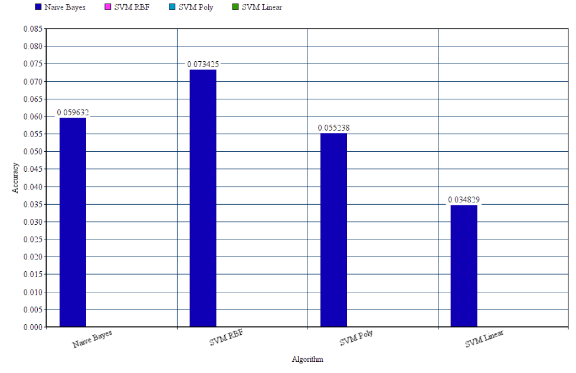
Comparison of Algorithm

Slide 26
Problem Challenges
Huge Dataset
Since the training dataset was so huge( 30 million data point) and required a lot computational time one of the important task was to downsample data such that most of the useful information is retained
Few attribute were non vectorial
Few feature were of string form but had significant importance , so converting that attribute into integer form.

