Slide 1
Continuous Integration
Advanced Programing practices
(SOEN 6441)

Slide 2
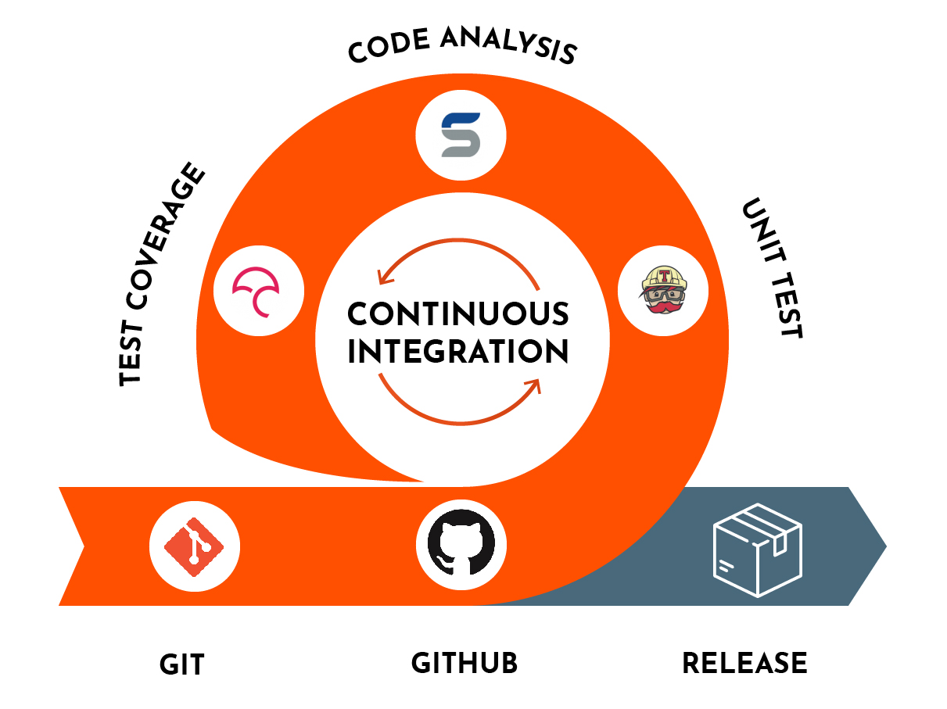
What is Continuous Integration?
A very important software development practice in which developers integrate their code into a shared repository frequently, mostly several times a day.
Each integration can then be verified by an automated build and automated tests.
Often done with Continuous Delivery and Continuous Deployment.

Slide 3
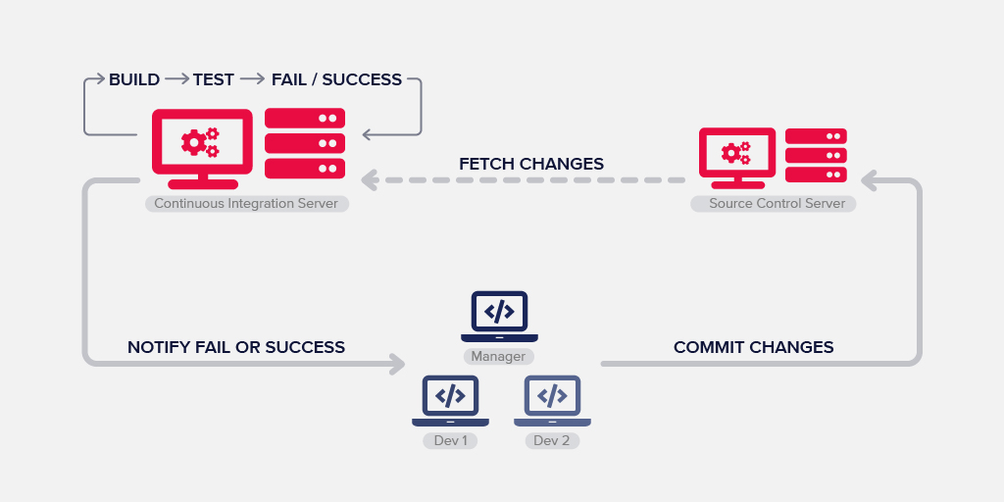
CI/CD Pipeline (Overview)

Slide 4
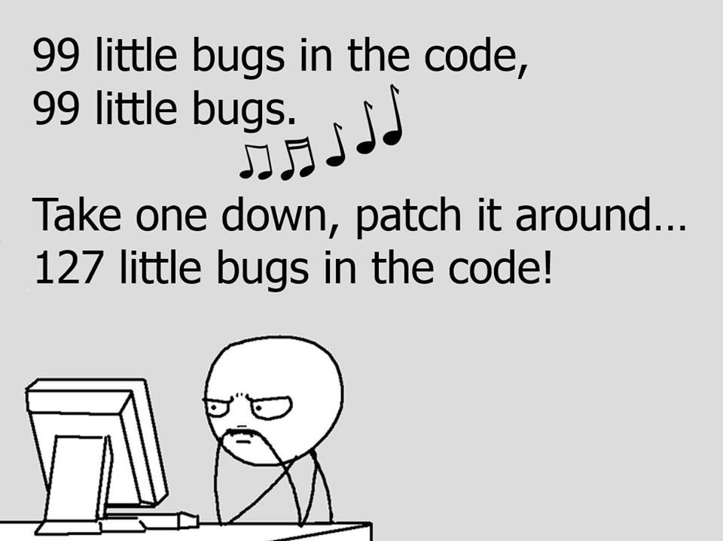
Why Continuous Integration?
Faster Feedback loop
Increased transparency and visibility amongst teams
Avoids the difficulties by modular programming
Detection and fixing of issues early
Improved quality and testability of code

Slide 5
Martin Fowler’s original principles of CI
Maintain a code repository – GitHub
Automate your build – CI Tool
Make your build self-testing – CI Workflow
Daily commits to the baseline by everyone on the team
Every commit (to the baseline) should be built – CI deployment
Keep your builds fast
Clone the production environment and test there – Deployment Server
Make it easy to get the latest deliverables
Everyone on the team can see the results of your latest build
Automate build deployment – CI Tool

Slide 6





Continuous Integration Tools
Buddy
Jenkins
TeamCity
Bamboo
GitHub Actions
and many more…

Slide 7
Choosing a based on needs
Open source or proprietary
Self-hosted or cloud deployment
Build Status of the project
Ease of Setup

Slide 8
Our choice: GitHub Actions
GitHub Actions is built in entirely in GitHub which allows you to enable software deployment lifecycle automation using workflows.
Discover, Create and Share actions in the workflow with your team in the shared repository.
All the available options make CI and CD process in Actions as easy as working on a normal GitHub repository.

Slide 9
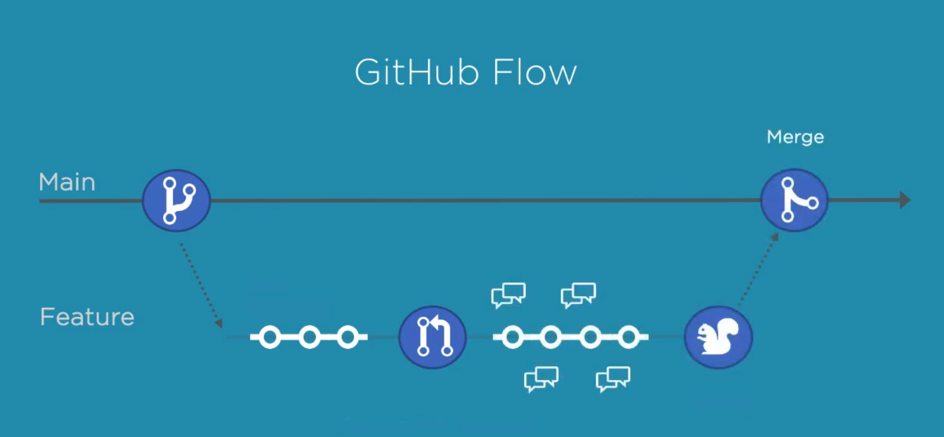
Basic GitHub Workflow

Slide 10
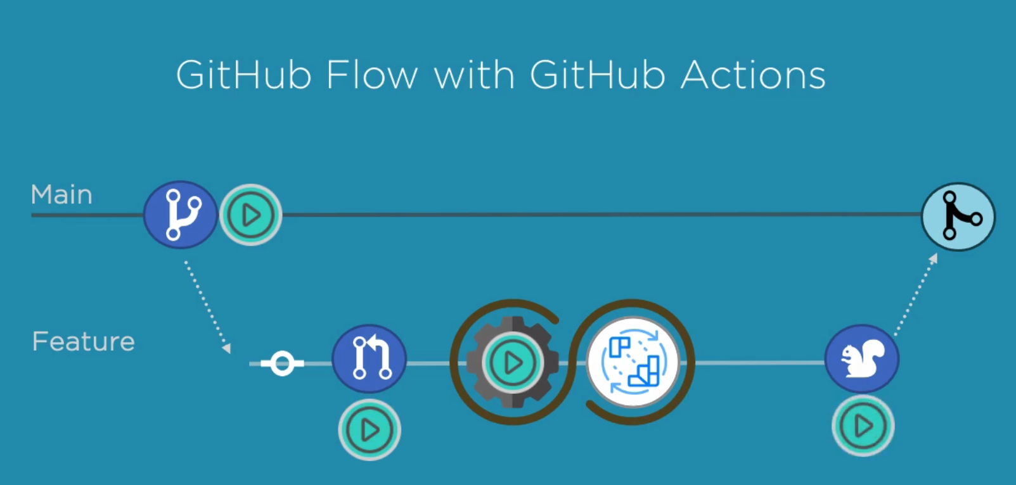
GitHub Flow with GitHub Actions

Slide 11
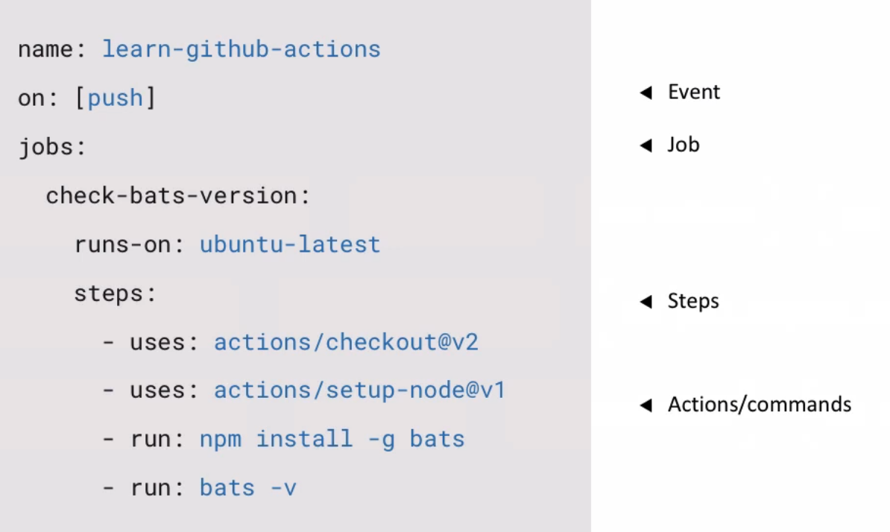
Basic GitHub Action file

Slide 12
Tutorial Time
Let’s see how to out GitHub Actions into action.
Requirements
Windows Terminal or any Command line terminal with git installed
GitHub account
that’s it

Slide 13
Challenges to Continuous Integration
Your Task…

