Slide 1

Javadoc
-PIYUSH KUMAR

Slide 2
Agenda
- A small example of java maven project from scratch with build and unit testing functionality in the CI/CD workflow using GitHub actions.
- API Documentation Tool- Javadoc
What is Javadoc?
Why do we use it?
Javadoc for classes
Javadoc for methods
How to use it an IDE?
How to add generation of Javadoc in CI/CD workflow?
What is expected in the project for Javadocs?

Slide 3
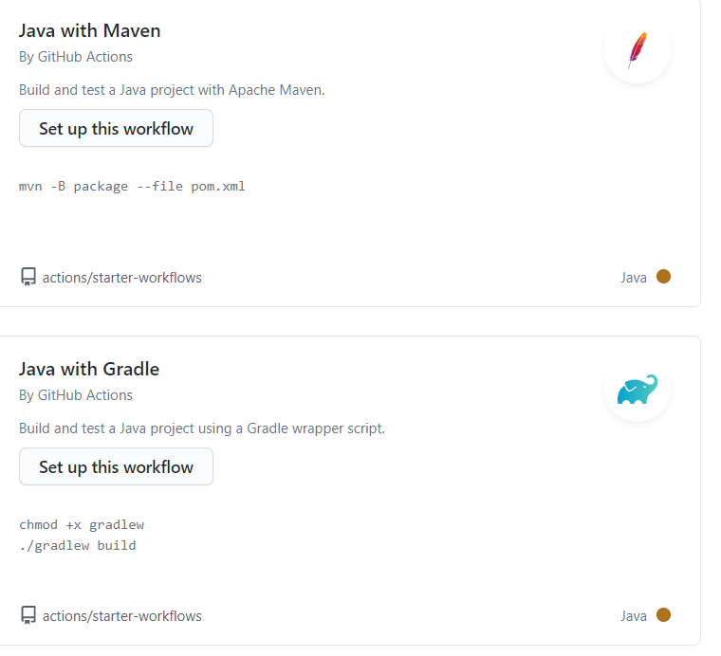
GitHub actions supports Java codes with Maven/Gradle.
We’ll be using Maven for this demonstration.

Slide 4
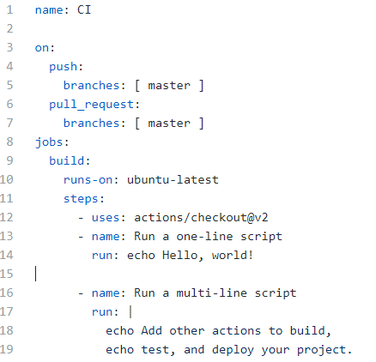
Basic structure of a workflow file(.yaml)

Slide 5
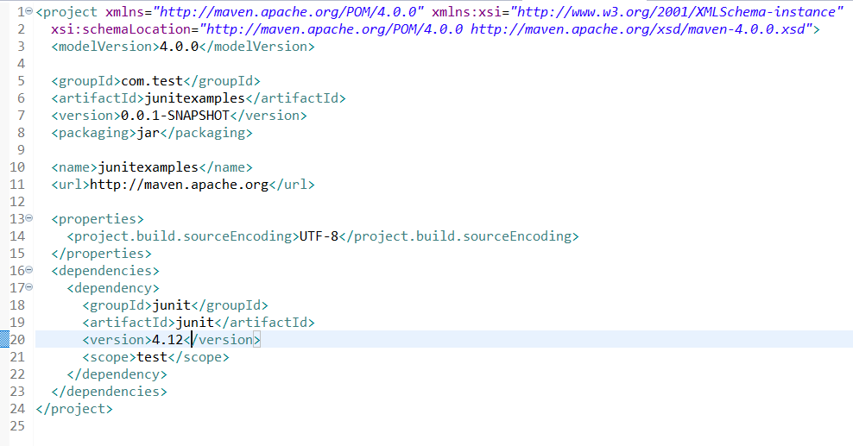
Pom.xml for the maven project

Slide 6
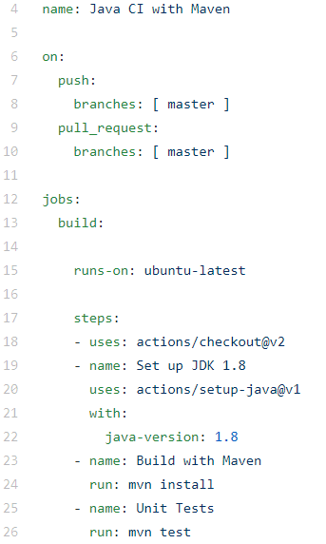
workflow file(.yaml)

Slide 7
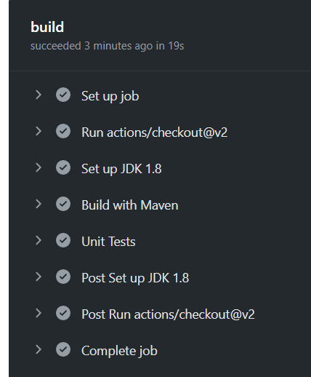
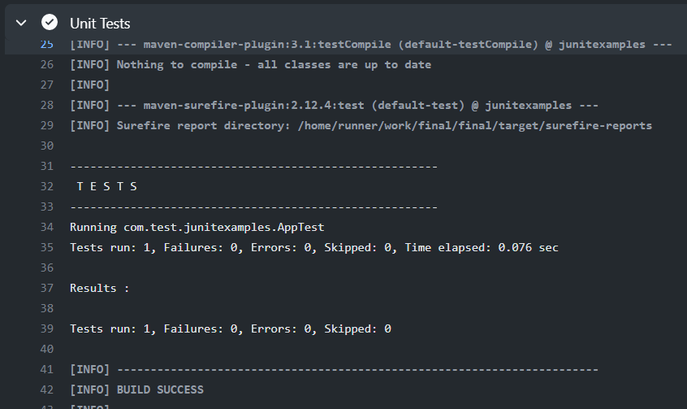
Summary of the job- build

Slide 8
What is Javadoc?
Javadoc is a documentation generator for the Java language for generating API documentation in HTML format from Java source code.
The HTML format is used for adding the convenience of being able to hyperlink related documents together.

Slide 9
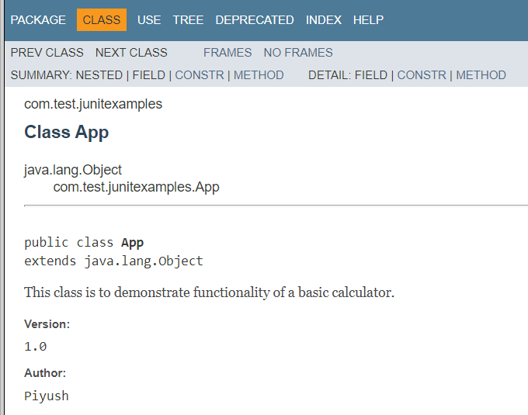
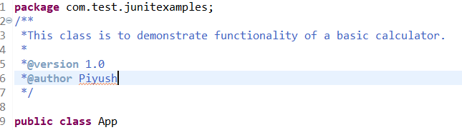
Javadoc for classes

Slide 10
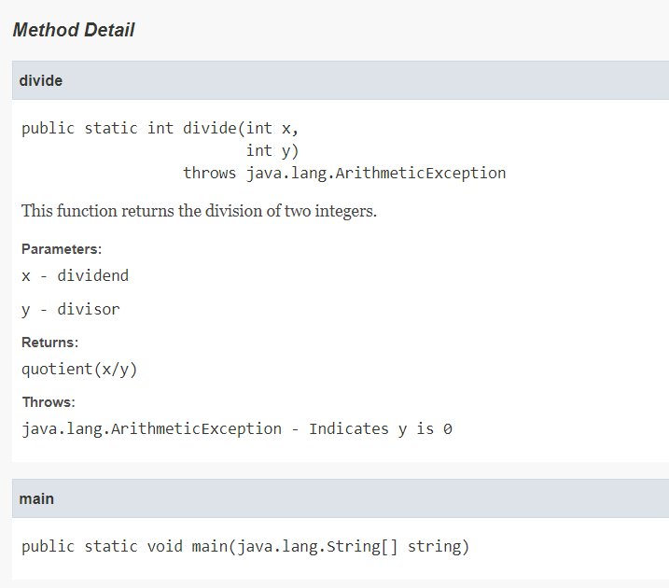
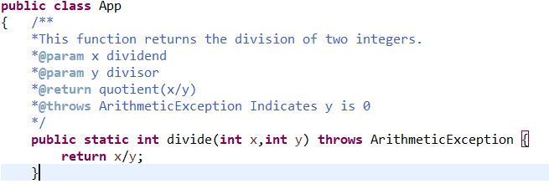
Javadoc for methods

Slide 11
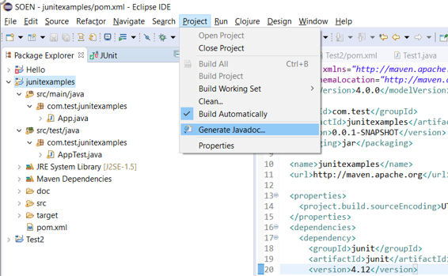
Let’s generate Javadoc using eclipse

Slide 12
How to add Javadoc generation in the CI/CD workflow? -Use mvn javadoc:javadoc

Slide 13
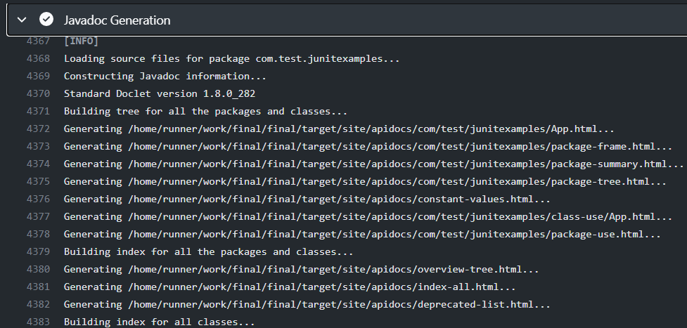
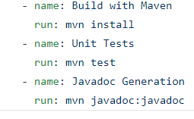
Addition of Javadoc in .yaml file

Slide 14
Javadoc Requirements for the project
Javadoc for all the classes and methods should be present.
Make sure to check that you’re generating Javadoc for all classes and methods while compiling.
Addition of javdoc generation in the GithHub actions workflow.
Grading for documentation will be strict.

