Slide 1
MVC and Observer Pattern
-PIYUSH KUMAR

Slide 2
Model View Controller Architecture
MVC is more of an architectural pattern, but not for complete application.
MVC mostly relates to the UI / interaction layer of an application.
The Model View Controller (MVC) pattern specifies that an application consist of a data model, presentation information, and control information.
The pattern requires that each of these be separated into different objects.

Slide 3
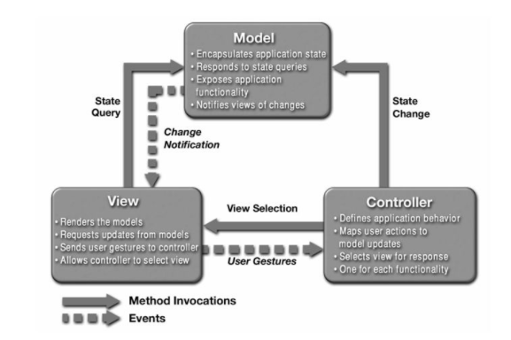

Slide 4
The Model contains only the data, it contains no logic describing how to present the data to a user.
The View presents the model’s data to the user. The view knows how to access the data, but it does not know what this data means or what the user can do to manipulate it. It also interacts with the user and sends the input to the controller.
The Controller exists between the view and the model. It listens to events triggered by the view (or another external source) and executes the appropriate reaction to these events. In most cases, the reaction is to call a method on the model. The result of this action is then automatically reflected in the view.

Slide 5
Advantages of MVC
A main advantage of MVC is separation of concern.
We can easily maintain our application because of separation of concern.
We can split many developers work at a time to develop faster.
It supports TTD (test-driven development)

Slide 6
Observer Pattern
The observer pattern is a software design pattern in which an object, named the subject, maintains a list of its dependents, called observers, and notifies them automatically of any state changes
Observer pattern is used when there is one-to-many relationship between objects such as if one object is modified, its dependents are to be notified automatically. Observer pattern falls under behavioral pattern category.

Slide 7
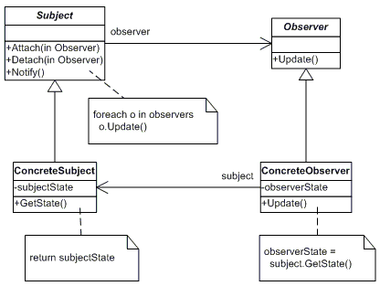

Slide 8
MVC vs Observer
MVC is more an architecture style rather than a design pattern whereas Observer Design pattern is a Behavioral pattern which is used when we want to notify all of the dependents of an object(say x) in the event of change of the object x
Both are closely related, we can say one way to achieve MVC is by using Observer design pattern.
MVC to me is an architectural pattern where it "contains" the observer pattern as well.

Slide 9
Let’s see an example code.

