Slide 1

State and Command Patterns
SOEN 6441
- Vashisht Marhwal

Slide 2

State Design Pattern
State pattern is part of the behavioral design pattern class.
Why?
  State design pattern is used when an Object changes its behavior based on its internal state.
Three Important Components
  Context: - Provides an interface for the client to interact. Also has the reference to concrete state object which can be used to define the curretn state.
  State: - Interface which defines what each concrete state should perform
  ConcreteState: - Each subclass implements a behaviour associated with a state of Context.

Slide 3
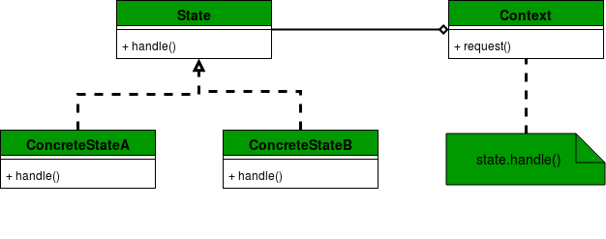

State Design Pattern

Slide 4
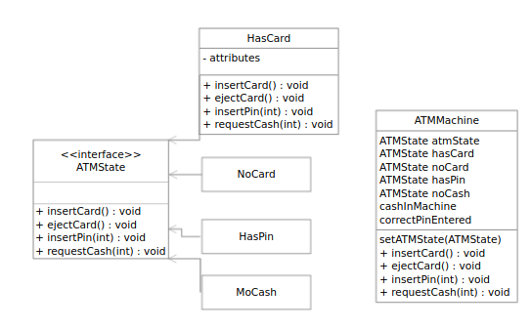
ATM Machine Example

Slide 5
Coding Example
The example is in accordance with your project.
States in the Code
  Preload
  Postload
  PlaySetup
  MainPlay

Slide 6
Command Design Pattern
It’s a behavorial design pattern which uses an object to represent and encapculate all information needed to call a method at a later time,
The information include:
  Method name
  Object that owns the method
  Values for method parameters

Slide 7
What exactly happens in Command Design Pattern
Command decouples the object that invokes the operation from the one that knows how to perform it.
To achieve this, the designer creates an abstract base class that maps a receiver (an object) with an action (a pointer to a member function). The base class contains an execute() method that simply calls the action on the receiver.
All clients of Command objects treat each object as a "black box" by simply invoking the object's virtual execute() method whenever the client requires the object's "service".
A Command class holds some subset of the following: an object, a method to be applied to the object, and the arguments to be passed when the method is applied. The Command's "execute" method then causes the pieces to come together.

Slide 8
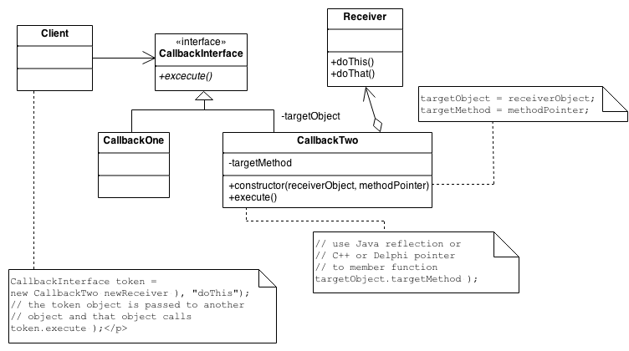
Structure

Slide 9
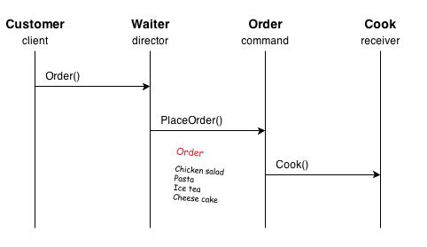
Restaurant Example
*There will be questions based on this during class

Slide 10
Coding Example
The example is in accordance with your project.
Command Pattern in the code:
  Client: CommandsDriver
  Receiver (in): Players
  Receiver (of): Territory
  ConcreteCommand: Pacify, Deploy

Slide 11


