Slide 1
Strategy and Adapter Pattern
-PIYUSH KUMAR

Slide 2
Strategy Pattern
In Strategy pattern, a class behavior or its algorithm can be changed at run time. This type of design pattern comes under behavior pattern.
In Strategy pattern, we create objects which represent various strategies and a context object whose behavior varies as per its strategy object. The strategy object changes the executing algorithm of the context object.

Slide 3
Structure

Slide 4
Context- it is the class whose behavior is dependent on the strategy object it has. Each strategy has different implementation.
Strategy- Abstract class or interface to declare the methods to be implemented in each strategy.
ConcreteStrategy- Actual Implementation of the strategies.

Slide 5
State vs Strategy Pattern
State and Strategy pattern might seem similar, but they are not, the intent is the main difference.
In state pattern the state of the context changes and according to the current state, the functionality is implemented. Note that the state object can change anytime.
States store a reference to the context object that contains them. Strategies do not.
In Strategy pattern, the strategy is decided at runtime according to the concrete strategy object specified which sets the strategy object of the context and all the implementation is executed according to the methods of that concrete strategy.
So, state pattern encapsulates state-dependent behavior(object behaves as per its current state) whereas strategy encapsulates algorithm (how different objects perform a task depending upon their type).

Slide 6
Let’s see an example of strategy pattern

Slide 7
Adapter Pattern
Adapter pattern works as a bridge between two incompatible interfaces.
This type of design pattern comes under structural pattern as this pattern combines the capability of two independent interfaces.
Exactly like the real-world adapters.

Slide 8
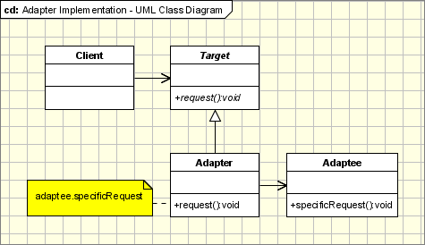
Structure

Slide 9
Target – this is what the client uses and needs a new functionality to be added.
Adaptee - defines an existing interface which provides the required functionality.
Adapter - adapts the interface Adaptee to the Target interface. It inherits Target and contains an object of adaptee to get the required functionality.
Client - collaborates with objects conforming to the Target interface

Slide 10
Let’s see an example

Slide 11
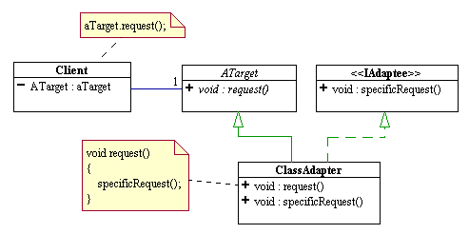
We can also have two-way adapters.
Let’s see an example

