Slide 1
ADVANCED PROGRAMING PRACTICES
SOEN 6441 - Advanced Programming Practices
API documentation generation tools
Javadoc
Joey Paquet, 2006-2021

Slide 2
API documentation generation tools
SOEN 6441 - Advanced Programming Practices
Historically, manual documentation generation was used to write API documentation to help developers to understand how to use libraries or modules.
Good API documentation is necessary for libraries to be widely accepted and used correctly and efficiently.
Manual documentation has many disadvantages:
  Very time-consuming to write.
  Error-prone.
  Requires dedication and time to update.
Outdated or wrong API documentation may be worse than having none.
Joey Paquet, 2006-2021

Slide 3
API documentation generation tools
SOEN 6441 - Advanced Programming Practices
The goal of having API documentation is to make the software more understandable, decreasing the amount of time the programmers spend in learning how to use libraries/modules/classes.
To be really useful and economically viable, the time to write/maintain API documentation must be less than the time it allows to save by its use.
API documentation became much more useful with the advent of hypertext and automation tools.
  Hypertext enables very efficient browsing through huge documentation.
  Automated tools can be used to extract API documentation from code.
  Lowers the cost of writing/maintaining API documentation though automation.
  Many such tools now exist, e.g. Javadoc and Doxygen.
  All of them can generate hypertext documents.
Joey Paquet, 2006-2021

Slide 4
SOEN 6441 - Advanced Programming Practices
Javadoc
Joey Paquet, 2006-2021

Slide 5
What is Javadoc?
SOEN 6441 - Advanced Programming Practices
JavaDoc is a software tool part of Java SDK for generating API documentation from Java source code augmented with special tags in the code’s comments.
Javadoc is an industry standard for documenting Java classes.
How does JavaDoc work?
  Instead of writing and maintaining separate documentation, the programmer writes specially-formatted comments in the Java code itself.
  The JavaDoc tool is a compiler that reads these comments and generates an API documentation out of them.
  It also gets information from the code itself, then merges both of these information sources together to create a structured, hyperlink-browsable document.
Joey Paquet, 2006-2021

Slide 6
Other API documentation generation tools
SOEN 6441 - Advanced Programming Practices
Many such systems exist that can be used for various programming languages:
  Javadoc, Doxygen, …
Many of these can output in different formats:
  HTML, RTF, PDF, LaTeX, manpages, …
  Hypertext has many advantages: portable, browsable, adaptable
Doxygen is probably the most flexible of them all, as it can generate documentation for various programming languages and generate output in various formats.
Most IDEs integrate some features to call API documentation tools.
Joey Paquet, 2006-2021

Slide 7
Advantages and drawbacks
SOEN 6441 - Advanced Programming Practices
Advantages:
  Program documentation process is coupled with the programming process.
  Automated generation of documentation: less error-prone.
  Efficient generation of documentation.
  Efficient update of documentation.
  Short code-to-documentation cycle: all programmers can be made aware of others’ developments almost in real time.
  Can generate highly browsable documentation, accessible electronically over the web (HTML).
Disadvantages:
  Learning curve to learn how to use the tool, though it is minimal.
  Requires dedication, or else the documentation will be obsolete and/or incomplete.
Joey Paquet, 2006-2021

Slide 8
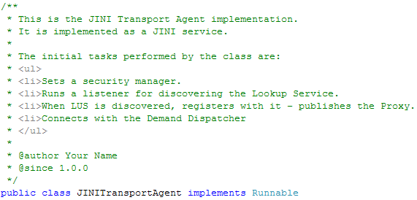
Example
SOEN 6441 - Advanced Programming Practices
Joey Paquet, 2006-2021

Slide 9
Javadoc comments
SOEN 6441 - Advanced Programming Practices
A JavaDoc comment begins with the /** marker and ends with the */ marker. All the lines in the middle start with an asterisk lined up under the first asterisk in the first line.
/**
* This is a <b>javadoc</b> comment.
*/
Because JavaDoc generates HTML files, any valid HTML can be embedded. A JavaDoc comment may be composed of multiple lines, for example:
/**
* This is line one.
* This is line two.
*
* This is intended as a new paragraph.
*/
Joey Paquet, 2006-2021

Slide 10
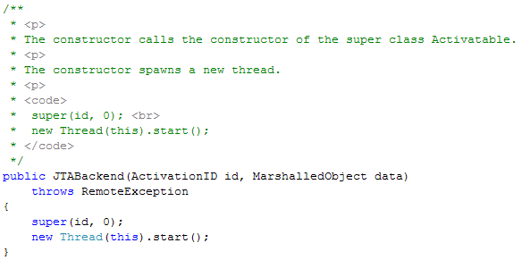
Javadoc comments
SOEN 6441 - Advanced Programming Practices
Another useful HTML marker is <code>, which we can use to include a sample code in a JavaDoc comment. Any text between the <code> and </code> markers will appear in a Courier font.
Joey Paquet, 2006-2021

Slide 11
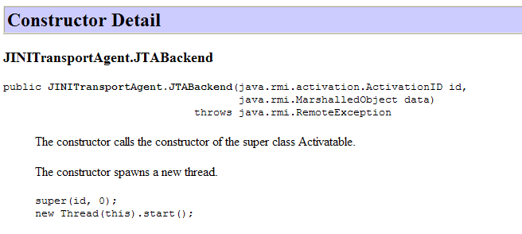
Javadoc comments
SOEN 6441 - Advanced Programming Practices
Generates browsable HTML, where every identifier is a clickable link that leads you to its own documentation.
Joey Paquet, 2006-2021

Slide 12
Javadoc comments
SOEN 6441 - Advanced Programming Practices
For the JavaDoc comments to be recognized as such by the javadoc tool, they must appear immediately before the class, interface, constructor, method, or data member declarations.
For example, if you put the JavaDoc comment for the class before the import statements, it will be ignored.
The first sentence is a “summary sentence”. This should be a short description of the element described by the comment.
Note:
  JavaDoc does not provide a format for commenting elements within methods, i.e. the local variables and the computing going on inside the methods. But you still can use the regular comments marks // or /*..*/, to comment this part of your program.
Joey Paquet, 2006-2021

Slide 13
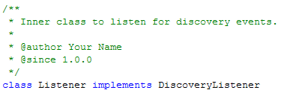
Javadoc tags
SOEN 6441 - Advanced Programming Practices
There are a number of special tags we can embed with the JavaDoc comments. These tags start with the “at” symbol @.
JavaDoc tags must start at the beginning of a line.
Example:
However, information provided in tags such as @author , @version and @since pertain to versioning, which is maintained by a versioning system.
Some say it should not be used, as it is superfluous if using a versioning system.
Joey Paquet, 2006-2021

Slide 14
Javadoc tags
SOEN 6441 - Advanced Programming Practices
@author
  Used to create an author entry. You can have multiple @author tags. This tag is meaningful only for the class/interface JavaDoc comment.
@version
  Used to create a version entry. A JavaDoc comment may contain at most one @version tag. Version normally refers to the version of the software (such as the JDK) that contains this feature. If you are using CVS, you can also use the following to have any CVS commit to fill in the version tag with the CVS revision number: @version $Revision $
@see
  Used to add a hyperlinked "See Also" entry to the class.
Joey Paquet, 2006-2021

Slide 15
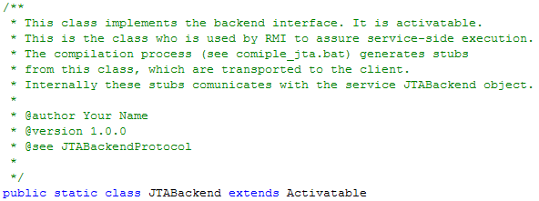
Javadoc tags
SOEN 6441 - Advanced Programming Practices
Example:
Joey Paquet, 2006-2021

Slide 16
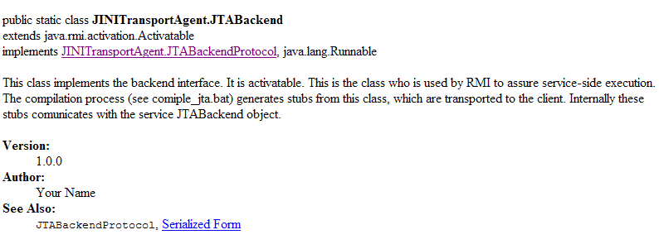
Javadoc tags
SOEN 6441 - Advanced Programming Practices
Generated browsable HTML:
Joey Paquet, 2006-2021

Slide 17
Javadoc tags
SOEN 6441 - Advanced Programming Practices
@param
  Used to add a parameter description for a method. This tag contains two parts: the first is the name of the parameter and the second is the description. The description can be more than one line.
  @param size the length of the passed array
@return
  Used to add a return type description for a method. This tag is meaningful only if the method’s return is non-void.
  @return true if the array is empty; otherwise return false
Joey Paquet, 2006-2021

Slide 18
Javadoc tags
SOEN 6441 - Advanced Programming Practices
@throws
  Used to describe an exception that may be thrown from this method. Note that if you have a throws clause, Javadoc will already automatically document the exceptions listed in the throws clause.
{@inheritDoc}
  Used to copy the description from an overridden method.
{@link reference}
  Used to link to another documented symbol, or to a URL external to the documentation.
Joey Paquet, 2006-2021

Slide 19
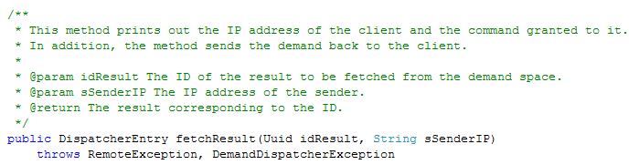
Javadoc tags
SOEN 6441 - Advanced Programming Practices
Example
Joey Paquet, 2006-2021

Slide 20
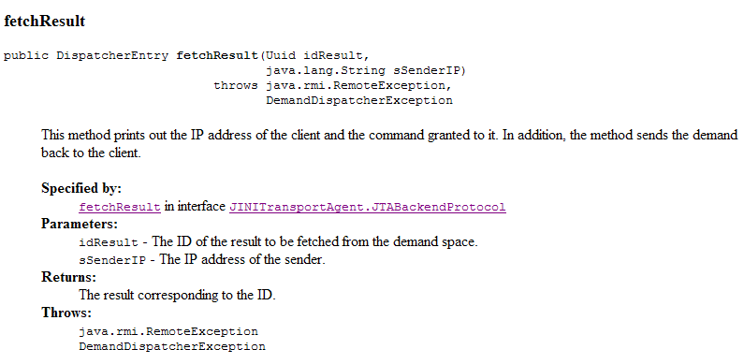
Javadoc tags
SOEN 6441 - Advanced Programming Practices
Generated browsable documentation:
Joey Paquet, 2006-2021

Slide 21
Generating Javadoc documentation
SOEN 6441 - Advanced Programming Practices
After adding the JavaDoc comments to the source files, use the javadoc command to generate the documentation.
Run the javadoc as you run javac or other Java tools.
After the javadoc command, provide the relevant parameters. See the JavaDoc documentation for details.
Most Java IDEs include functionalities to call Javadoc to generate the API documentation.
Example:
  In order to enforce JavaDoc to generate documentation for the complete GIPSY package, we write:
    javadoc gipsy
  In order to enforce JavaDoc to generate documentation for the JINITransportAgent.java file, to include the author and version tag and to include all the classes, attributes and methods we write:
      javadoc -private -version -author JINITransportAgent.java
  In order to check for missing Javadoc, we write:
      javadoc –Xdoclint:missing JINITransportAgent.java
Joey Paquet, 2006-2021

Slide 22
Summary
SOEN 6441 - Advanced Programming Practices
Having an API documentation aims at improving the productivity of programmers by increasing the browseability, readability and understandability of code.
The Javadoc code itself also provides documentation within the code.
Manual documentation is extremely tedious and error-prone.
Automated API documentation generation tools exist that automate the generation of API documentation.
Results in more efficiency in writing/maintaining the API documentation, thus more overall productivity.
Requires dedication and rigor.
Joey Paquet, 2006-2021

Slide 23
In the project
SOEN 6441 - Advanced Programming Practices
You are required to use Javadoc
  To document every class
  To document every method
    Every parameter using @param
    Every returned value using @return
You are required to integrate the Javadoc compilation in the continuous integration pipeline.
Joey Paquet, 2006-2021

Slide 24
References
SOEN 6441 - Advanced Programming Practices
Oracle Corporation. Javadoc Tool.
Oracle Corporation. How to Write Doc Comments for the Javadoc Tool.
Wikipedia. Comparison of document generators.
Joey Paquet, 2006-2021

