Slide 1
H
Secure Deployment & Automation Blueprint
Junior Cloud & DevOps Engineer Hiring Project · Google Cloud Platform / Django / React
Candidate: Harshil Parmar Contact: harshilparmar1907@gmail,com| +91 9824624715
HabotConnect FZCO · Full Time · 100% Remote
Notes:
Introduce myself and state the goal: a secure, mistake-proofed staging blueprint that fixes the reported incident.

Slide 2
The Incident We Must Restore From
A junior developer bypassed the security guidelines on the staging branch.
1 · Leaked credentials
2 · Schema mismatch
3 · No safety net
Unencrypted API credentials were committed in raw application code, exposing a live secret in version control.
A payload field drifted from the agreed schema, breaking the downstream BigQuery analytics sink.
Nothing automatically blocked the bad commit. The pipeline relied on human review, which failed.
Root cause: the system trusted human memory instead of enforcing the rules automatically.
Consequence: exposed secret, broken analytics, and no audit trail of what blocked deployment.
Fix strategy: encrypt and vault every secret, enforce schema at the boundary, and make the pipeline fail closed.
Notes:
Frame the three failures, then pivot to the fix strategy that the next slides implement.

Slide 3
Three Tasks to Restore System Integrity
01
Terraform secure staging
Provision the D0 raw-landing bucket and D1 staged dataset with strict Identity and Access Management and Row-Level Security.
02
Poka-Yoke build gate
A fail-closed pipeline that halts and quarantines any commit with formatting errors or hardcoded secrets.
03
Schema mapping and DCYN
Deconstruct the onboarding payload into a binary Yes/No library and enforce exact field limits in Django.
Notes:
The agenda. Each task maps directly to one of the three incident failures.

Slide 4
Architecture and Data Flow
Two-tier landing pattern: untrusted raw data is never queried directly.
React client
Django REST
D0 raw landing
Pub/Sub
D1 BigQuery
Student onboarding form submits JavaScript Object Notation.
Serializer enforces exact limits. Fail closed on any violation.
Cloud Storage bucket. Encrypted, versioned, private.
Validated records stream with typed attributes.
Staged, enforced, Row-Level Security.
Secret Manager holds every credential. No secret ever lives in code or Terraform state.
D0 accepts writes only from one least-privilege service account, scoped to the incoming/ prefix.
Promotion to D1 happens only after schema validation, so analytics never sees a malformed row.
Notes:
Walk left to right. Emphasise that raw and trusted data are physically separated tiers.

Slide 5
Task 1 · Infrastructure as Code
Modular Terraform provisions the whole staging tier reproducibly.
D0 · Raw landing bucket (Cloud Storage)
D1 · Staged dataset (BigQuery)
Uniform bucket-level access, public access prevention enforced, object versioning on, customer-managed encryption key, and a thirty-day lifecycle expiry so untrusted data never lingers.
Customer-managed encryption, sixty-day table expiry, group-based access only, and an enforced JavaScript Object Notation schema for the student_onboarding table.
Every resource name uses one validated prefix variable, so naming is consistent and collision-free.
Inputs are typed and validated, for example the prefix must match a strict lowercase pattern.
No hardcoded values in logic: thresholds and identities are variables, documented in variables.tf.
Notes:
Show main.tf briefly on screen. Point out uniform access and CMEK as the concrete fixes.

Slide 6
Task 1 · Identity, Access and Encryption
Least Privilege enforced by IAM Conditions, not by trust.
Least-privilege account
IAM Condition
One dedicated service account for ingestion. It can create objects only, never read or delete.
The grant is scoped by a Common Expression Language condition to the incoming/ prefix only.
Row-Level Security
Secret Manager
A BigQuery row access policy restricts analysts to rows for their own region group.
The leaked key is replaced by a vaulted secret; only the ingestion account may read it.
Notes:
These four controls together mean an insider mistake cannot leak data or over-reach access.

Slide 7
Task 2 · The Poka-Yoke Build Gate
Deny by default. A commit deploys only if every gate passes.
Gate 1
Hardcoded secret scan (custom script)
If ANY gate fails
Build halts immediately
Deployment is blocked
Quarantine job records the commit and its author
Developer must fix and re-push
Gate 2
Gitleaks deep secret scan
Gate 3
Black format check and Flake8 lint
Gate 4
Terraform format check and validate
Notes:
Contrast fail-open versus fail-closed. Our default is refusal, which is the safe default.

Slide 8
Task 2 · Fail-Closed Logic Flow
YES → deploy to staging
Commit pushed
Gates run
All pass?
NO → halt, block deploy, quarantine commit, notify author
The pipeline can only reach deployment through the single all-pass path. There is no manual override.
Notes:
Emphasise the single happy path. No human can wave a broken build through.

Slide 9
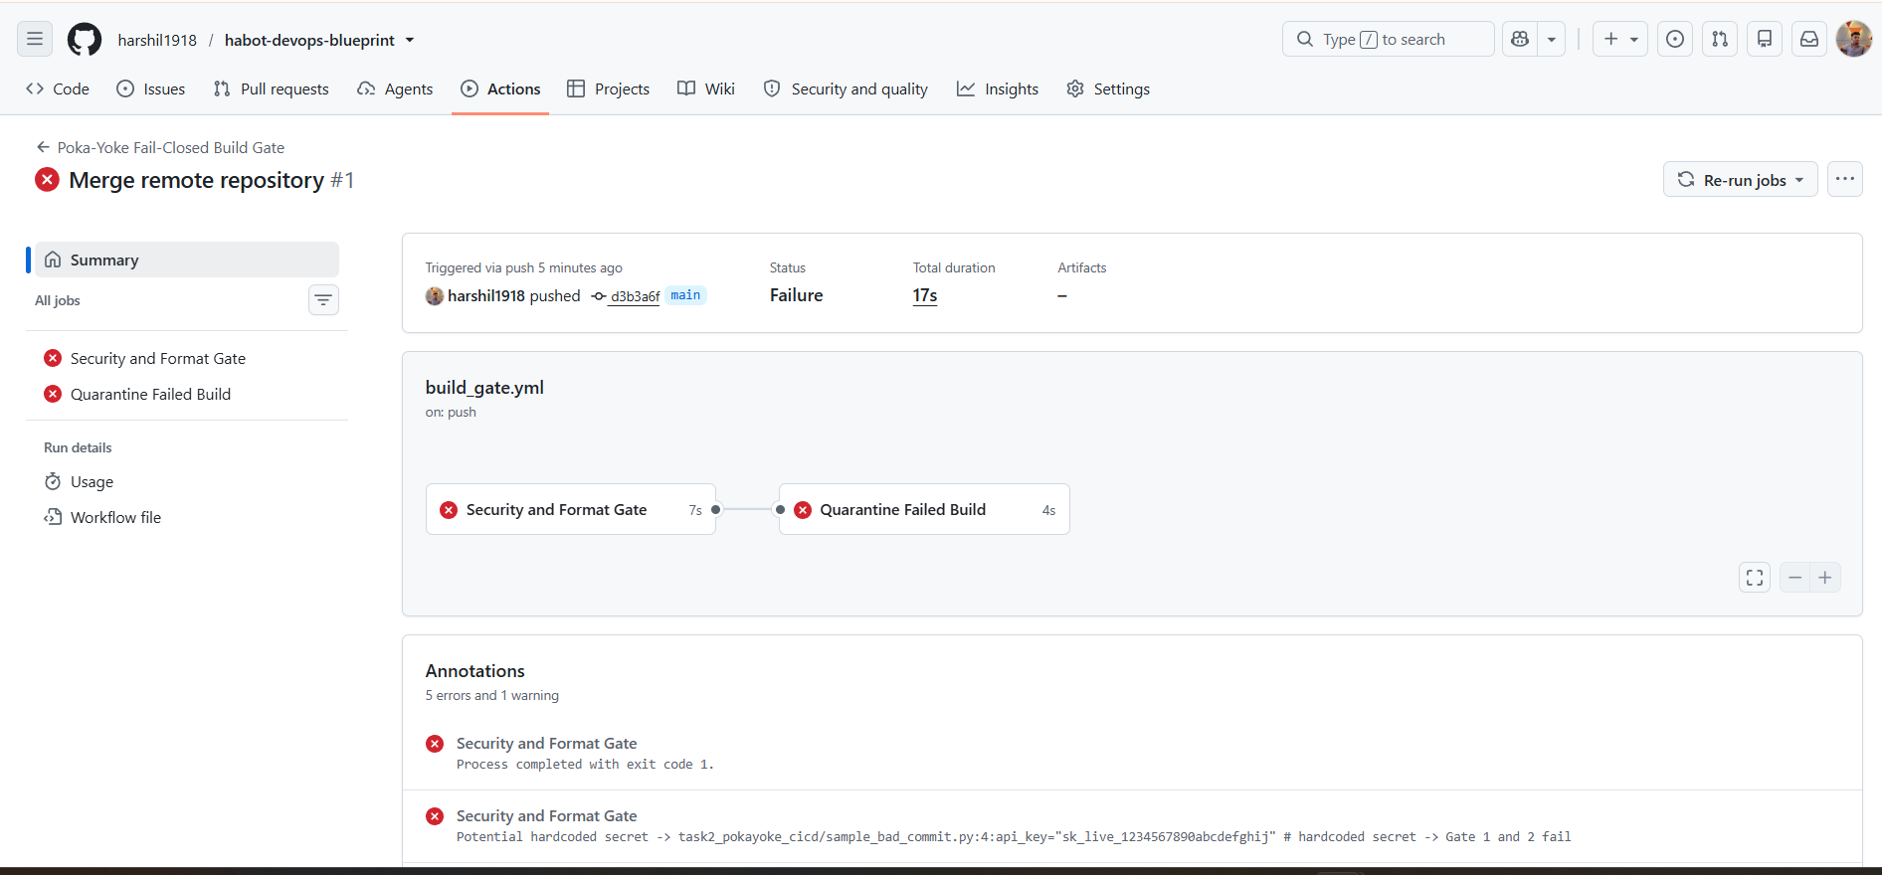
Task 2 · Live Fail-Closed Demonstration
Pushing sample_bad_commit.py must turn the pipeline red.
What the screenshot proves
1 · The bad commit was detected automatically.
2 · The job exited non-zero and stopped.
3 · Deployment never started.
4 · The quarantine step logged the commit and author.
Terminal proof from scan_secrets.sh is included as a backup in the repository.
Notes:
Screen-share the actual red run here. Have the terminal output ready as a fallback.

Slide 10
Task 3 · Schema Mapping
One row per field: source, type, validation limit, and destination.
JSON field | Serializer field | Exact limit | BigQuery column
student_id | RegexField | STU-YYYY-NNNNN pattern | student_id (STRING)
age | IntegerField | Between 4 and 18 | age (INTEGER)
guardian_email | EmailField | Valid email, max 254 chars | guardian_email (STRING)
hours_requested_per_week | IntegerField | Between 1 and 40 | hours_requested_per_week (INTEGER)
region_owner_group | RegexField | region-xx pattern | region_owner_group (STRING)
The full mapping and the DCYN rule library ship as docs/schema_mapping.xlsx with Wrap Text enabled and full forms only.
Notes:
Point to the spreadsheet deliverable. Note wrap text and no abbreviations, per the brief.

Slide 11
Task 3 · Serializer Enforcement
Validation happens at the boundary, before storage or streaming.
Exact limits, zero judgement
Defence in depth
Every field declares a precise constraint: regular-expression patterns, minimum and maximum values, closed choice sets, and a mandatory consent check. A non-conforming payload is rejected with a specific error.
The Django model repeats the same limits as database check constraints, so the rule holds even if a record is created outside the serializer path.
student_id must match STU-YYYY-NNNNN exactly, or the request is refused.
age and hours are bounded integers; guardian_email must be a valid address.
This directly prevents the schema mismatch that broke downstream analytics.
Notes:
Tie back to incident failure 2: the serializer is what stops schema drift at the door.

Slide 12
Task 3 · DCYN Yes/No Library
Deterministic rules replace human judgement in onboarding.
is_age_eligible
Age between 4 and 18
is_consent_present
Consent signature is non-empty
has_existing_support_plan
Support-plan flag is True
is_guardian_contactable
Guardian email is well formed
are_hours_within_policy
Weekly hours between 1 and 40
is_region_assigned
Region group is set
AUTO_APPROVABLE = Yes only when every rule returns Yes. No human tie-breaker required.
Notes:
Each rule is a pure function; same input always gives same Yes/No. That is the Poka-Yoke.

Slide 13
Data Pipeline Integrity: No Loss
Validated records reach BigQuery with their types intact.
Only serializer-validated records are published to Pub/Sub, so malformed data never enters the stream.
Pub/Sub message attributes carry student_identifier and region_owner_group for routing and Row-Level Security.
The BigQuery table schema is fixed in Terraform, so the streaming sink and the source stay aligned.
Table and dataset expiry plus versioning give a recoverable trail without unbounded storage growth.
Result
The exact class of failure from the incident, a schema mismatch reaching analytics, becomes impossible because alignment is enforced in code, not maintained by hand.
Notes:
Summarise how the three tasks jointly guarantee end-to-end integrity.

Slide 14
Alignment with HabotConnect
Values and Leadership Principles
[ FILL FROM THE TWO PDFs HR SENT ]
Replace with 3 to 4 of HabotConnect's actual Values and Leadership Principles, and one line each on how this project demonstrates it. For example:
· Mistake-proofing (Poka-Yoke) → the fail-closed gate blocks bad commits automatically.
· Accountability / Quiet Management → every file is documented and reproducible without supervision.
· Data integrity → encryption, Least Privilege, and schema enforcement throughout.
Notes:
MANDATORY: replace this with the real Values and Leadership Principles from the PDFs before submitting.

Slide 15
Blueprint Delivered
Task 1 · Terraform provisions D0 and D1 securely with IAM Conditions, Row-Level Security, and customer-managed encryption.
Task 2 · A fail-closed GitHub Actions gate detects secrets and format errors, then quarantines the commit.
Task 3 · A Django serializer with exact limits and a deterministic DCYN Yes/No library remove human judgement.
Repository: habot-devops-blueprint · [YOUR GITHUB REPO LINK]
Harshil Parmar · harshilparmar1907@gmail,com| +91 9824624715
Thank you. I welcome your questions.
Notes:
Close confidently, invite questions, and be ready to screen-share the code and the red pipeline run.

