Slide 1
Scene Classification using Deep Learning
Name – Harshil Parmar
Student id - 1210216

Slide 2
Project Summary
• Objective: Classify scenes using deep learning.
• Dataset: Places365 (top 50 classes, 50,000 samples).
• Approach: Fine-tuned ResNet-50 on filtered data using PyTorch.

Slide 3
Key Findings
• Achieved ~88% validation accuracy using just 50,000 samples.
• Applied advanced data augmentation, label smoothing, and dropout.
• Grad-CAM helped visualize model attention effectively.

Slide 4
Evaluation Highlights
• Metrics: Accuracy, Precision, Recall, F1-score, AUC-ROC.
• Visuals: Confusion Matrix, ROC Curve, Grad-CAM heatmaps.
• Early stopping and learning rate scheduling improved performance.

Slide 5


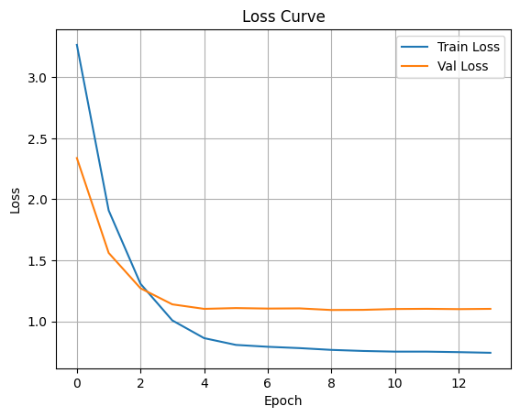
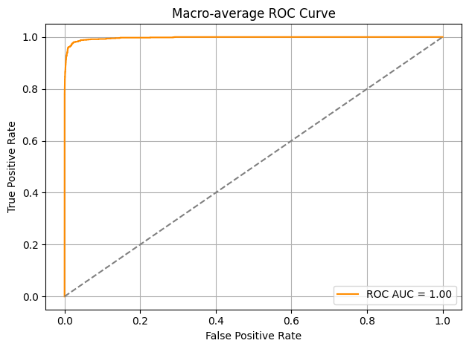



Evaluation Visualization

Slide 6
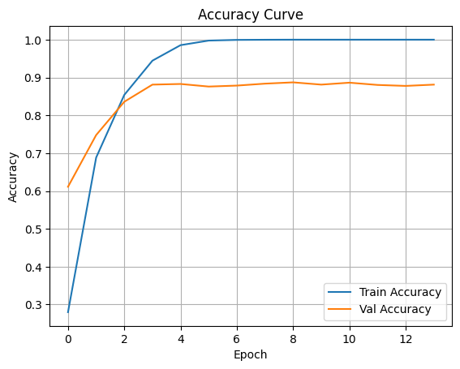
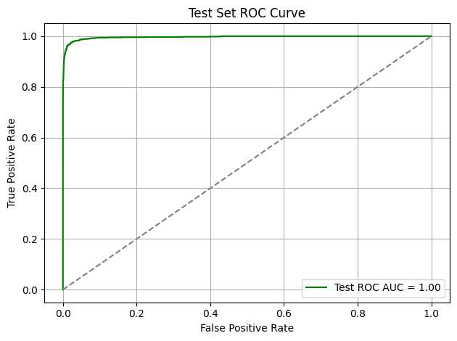
Evaluation Visualization

Slide 7
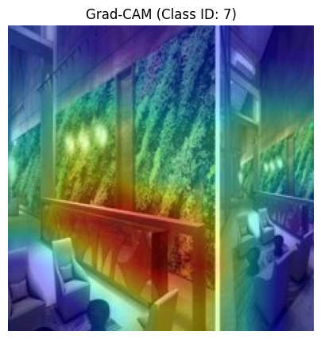
Evaluation Visualization

Slide 8
Experiences Gained
• Implemented full model lifecycle using PyTorch.
• Learned hyperparameter tuning, AMP (mixed precision), and evaluation.
• Built modular, interpretable, and reproducible pipeline.

Slide 9
Challenges Faced
• Limited data caused class imbalance and lower generalization.
• High memory usage in Google Colab during augmentation.
• Difficulty in interpreting misclassified visually similar scenes.

Slide 10
Lessons Learned
• Importance of data quality over quantity.
• Visual interpretability (Grad-CAM) enhances trust in AI.
• Continuous tuning and analysis drive performance improvements.

Slide 11
Future Improvements
• Use larger or full Places365 training set.
• Test with Vision Transformers or EfficientNet.
• Integrate SHAP/LIME for more transparency.
• Apply Optuna for automated hyperparameter optimization.

Slide 12
Thank You
Prepared by: Harshil Parmar
Course: Deep Learning with Pytorch

