Slide 1
Scene Classification using Deep Learning
Name – Harshil Parmar
Student id - 1210216

Slide 2
Data Representation
Places365 is a large-scale scene-centric image dataset developed by MIT for training and evaluating deep learning models on scene classification, not object detection. Unlike ImageNet (which focuses on objects), this focuses on the context or environment of a place (e.g., kitchen, stadium, forest).
Dataset size – 1.8 million images
Places365-Standard
~1.8 million training images across 365 scene categories

Slide 3
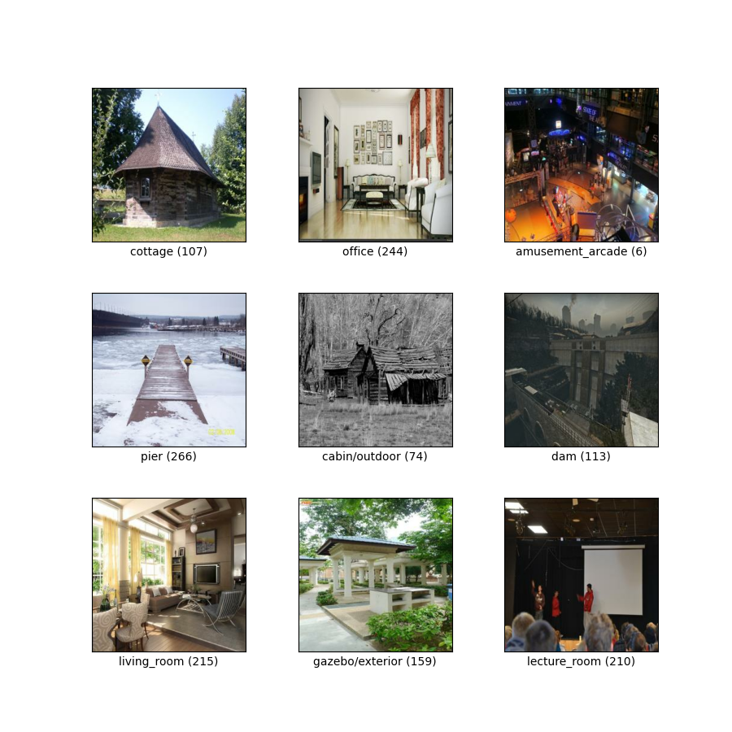
Sample Images

Slide 4
Configuration
img_size = 224
subset_size = 50000
num_top_classes = 50
batch_size = 32
epochs = 50
learning_rate = 1e-4
label_smoothing = 0.1
patience = 5

Slide 5
Model Architecture
Model used – Restnet-50
Activation: Softmax
Loss Function – CrossEntrophyLoss with lablel_smothing = 0.1
Optimizer – AdamW
Scheduler: ReduceLROnPlateau (monitors validation loss)

Slide 6
Project Summary
• Objective: Classify scenes using deep learning.
• Dataset: Places365 (top 50 classes, 50,000 samples).
• Approach: Fine-tuned ResNet-50 on filtered data using PyTorch.

Slide 7
Key Findings
• Achieved ~84% validation accuracy using just 50,000 samples.
• Applied advanced data augmentation, label smoothing, and dropout.
• Grad-CAM helped visualize model attention effectively.

Slide 8
Evaluation Highlights
• Metrics: Accuracy, Precision, Recall, F1-score, AUC-ROC.
• Visuals: Confusion Matrix, ROC Curve, Grad-CAM heatmaps.
• Early stopping and learning rate scheduling improved performance.

Slide 9
Results
Train accuracy - 100 %
Validation accuracy – 89 %
Test AUC ROC – 0.97
Observation – Good Generlization and no overfitting

Slide 10


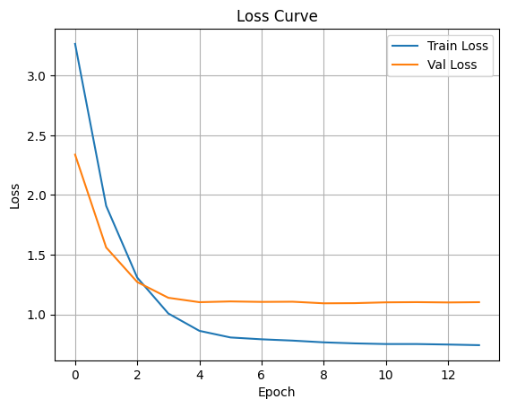
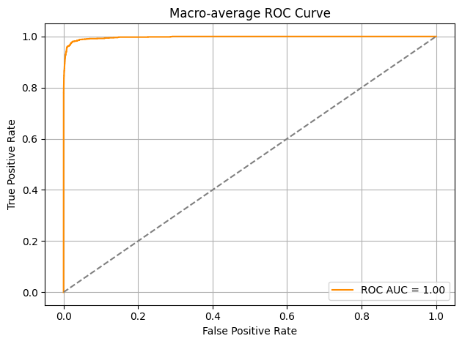



Evaluation Visualization

Slide 11
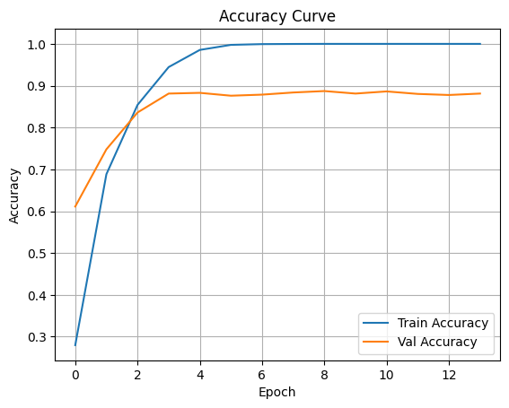
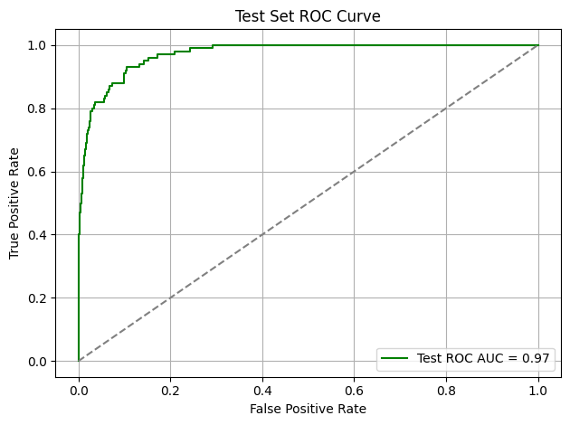
Evaluation Visualization

Slide 12
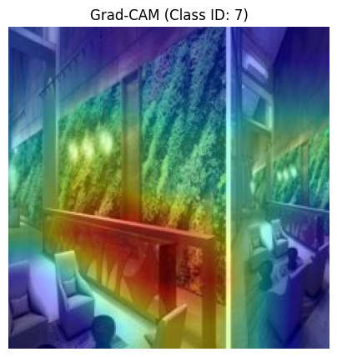
Evaluation Visualization

Slide 13
Experiences Gained
• Implemented full model lifecycle using PyTorch.
• Learned hyperparameter tuning, AMP (mixed precision), and evaluation.
• Built modular, interpretable, and reproducible pipeline.

Slide 14
Challenges Faced
• Limited data caused class imbalance and lower generalization.
• High memory usage in Google Colab during augmentation.
• Difficulty in interpreting misclassified visually similar scenes.

Slide 15
Lessons Learned
• Importance of data quality over quantity.
• Visual interpretability (Grad-CAM) enhances trust in AI.
• Continuous tuning and analysis drive performance improvements.

Slide 16
Future Improvements
• Use larger or full Places365 training set.
• Test with Vision Transformers or EfficientNet.
• Integrate SHAP/LIME for more transparency.
• Apply Optuna for automated hyperparameter optimization.

Slide 17
References
Places365 Dataset Paper Zhou, B., Lapedriza, A., Khosla, A., Oliva, A., & Torralba, A. (2017). Places: A 10 million Image Database for Scene Recognition. [IEEE Transactions on Pattern Analysis and Machine Intelligence (TPAMI)] Link to paper
ResNet Paper (Original) He, K., Zhang, X., Ren, S., & Sun, J. (2016). Deep Residual Learning for Image Recognition. [CVPR 2016] Link to paper
MIT Places365 Official Website http://places2.csail.mit.edu/
PyTorch Official Documentation https://pytorch.org/docs/stable/index.html
TIMM (PyTorch Image Models) Library Wightman, R. (2020). GitHub - timm
Transfer Learning for Scene Classification with ResNet
Official ResNet-50 and ResNet-101 pretrained on Places365 from MIT and TIMM.
Fine-tuning techniques based on pretrained weights.

Slide 18
Thank You
Prepared by: Harshil Parmar
Course: Deep Learning with Pytorch

