Slide 1
⚡ IBM BOB AI HACKATHON 2026 // TRACK: AI // NERC-CIP & IEEE-1547 GROUNDED
GRIDGUARD AI
Power Outage Prediction & Grid Equipment Failure Advisor
Transforming electric utility operations from reactive catastrophe response into proactive, automated resilience by fusing multi-modal sensor telemetry, spatial weather forecasts, and historical failure records with IBM Bob and watsonx.ai.
PROJECT TEAM: GridGuard AI
• Harshil Thakkar (Lead) — Full-Stack & System Architect
• Priyal Rathod — AI/ML Risk Modeling & Physics Engine
• Rutvik Jasani — Backend & SCADA Telemetry Gateway
• Hetavi Suhagiya — Frontend UI & Data Visualization
CORE TECHNOLOGIES
• IBM Bob CLI & Model Context Protocol (MCP)
• IBM watsonx.ai (Granite / Llama-3 Foundation Models)
• Python FastAPI, NumPy, IEEE C57 / IEC 60076 Standards
• React 18, TypeScript, Recharts, SCADA HUD Console

Slide 2
PROBLEM STATEMENT // THE RELIABILITY CRISIS
Aging Power Grids Are Blind to Compounding Weather Failures
Traditional calendar maintenance leaves multi-million-dollar transformers vulnerable to unpredicted catastrophic breakdowns.
SCADA GRID DISPATCHERS
• Overwhelmed by 500+ alarms/hr during storms
• Current SCADA systems only alert AFTER equipment trips
• Zero forward visibility into 12-72h degradation curves
• Forced to make high-stress decisions without physics root-cause explanations
FIELD CREW DIRECTORS
• Reliant on calendar schedules (every 12-24 mos)
• Internal insulation decay escalates between visits
• Emergency crews dispatched into impassable flooded roads after failure occurs
• High overtime costs and spare-parts logistics chaos
CITIZENS & CRITICAL ASSETS
• Blackouts sever power to hospitals, water pumps, and telecommunications
• Protracted outages lasting days to weeks
• Severe economic devastation to regional industry
• Public Utility Commission regulatory penalties
$1M - $2.5M
PER HOUR COST
Direct financial cost of major substation blackout in industrial corridors.
4 - 18 MONTHS
REPLACEMENT LEAD TIME
Global procurement delay to engineer & deliver a Large Power Transformer.
70% BUDGET
REACTIVE DRAIN
Utility maintenance expenditure consumed by emergency spot repairs.
500+ ALARMS
ALARM FLOOD / HR
Nuisance false-positive alarm triggers disorienting control room operators.

Slide 3
SOLUTION OVERVIEW // PHYSICS-GROUNDED INTELLIGENCE
GridGuard AI: Closed-Loop Predictive Grid Resilience
Synthesizing IoT telemetry, weather forecasts, and historical logs into automated crew pre-positioning before outages strike.
WHAT WE BUILT
GridGuard AI transforms electric utility operations from reactive catastrophe response into proactive, automated resilience.
• Physics-Informed Anomaly Engine: Evaluates equipment health against IEEE C57.104 and IEC 60076 standards.
• Dynamic Weather Risk Multiplier: Correlates incoming atmospheric heatwaves and convective storm vectors with live thermal thresholds.
• Downstream Criticality Prioritization: Ranks substations by customer impact and hospital/infrastructure dependence.
• Automated Crew Staging: Pre-positions field repair fleets with specific replacement hardware prior to storm landfall.
01 // MULTI-MODAL DATA FUSION
Ingests 4 IoT telemetry streams (Temperature, Vibration, Partial Discharge, DGA Oil Quality) + forward spatial weather models + historical maintenance dossiers.
02 // PHYSICS-GROUNDED FAILURE MODEL
Computes composite risk: 0.35 * Sensor + 0.30 * Weather + 0.20 * History + 0.15 * Age. Estimates remaining safe operating hours before thermal/dielectric runaway.
03 // GRID IMPACT SEVERITY RANKING
Scales failure probability by downstream customer density and hospital/critical node weighting: Severity = Probability * Grid Impact * Weather Factor.
04 // PRESCRIPTIVE MAINTENANCE & CREW STAGING
Generates concrete engineering work orders (DGA degassing, bushing replacement) and automatically stages emergency strike teams in advance.

Slide 4
TECHNICAL ARCHITECTURE // MICROSERVICES TOPOLOGY
High-Throughput, Resilient Multi-Tier Infrastructure
Stateless analytical microservices coupled with sub-second SCADA HUD telemetry rendering.
TIER 1: INGESTION
Data Fusion Engine
data_fusion.py
• Real-time IoT sensor bus parser
• 48h spatial weather API vectorizer
• Historical MTBF incident cross-ref
• Multi-source feature harmonization
TIER 2: AI ANALYTICS
FastAPI AI Engine
Port 8001 / REST
• IEEE C57 & IEC 60076 thresholding
• Vectorized multi-factor risk scoring
• Downstream severity ranking
• Sub-50ms inference latency
TIER 3: PERSISTENCE
Backend API Gateway
Port 5000 / REST
• Node.js Express 4 REST routing
• PostgreSQL & TimescaleDB hypertables
• Resilient offline fallback mock engine
• NERC-CIP audit trail buffering
TIER 4: SCADA CONSOLE
React 18 + Vite HUD
Port 3000 / Web
• 60 FPS HTML5 canvas electric arcs
• Multi-sensor Recharts trend lines
• 12 substation geospatial grid map
• Level 1/2/3 clearance studio
KEY ARCHITECTURAL HIGHLIGHTS
⚡ Zero-Downtime Evaluation: Built-in resilient fallback engine ensures full 12-substation interactivity even if local PostgreSQL is offline.
🔒 NERC-CIP Compliance: Role-based operational clearance (L1 Monitor, L2 Dispatch, L3 Chief), simulated hardware 2FA, and out-of-band OTP recovery.
🚀 Cloud Ready: Stateless microservices architecture deployable onto IBM Cloud Code Engine or Red Hat OpenShift with horizontal auto-scaling.

Slide 5
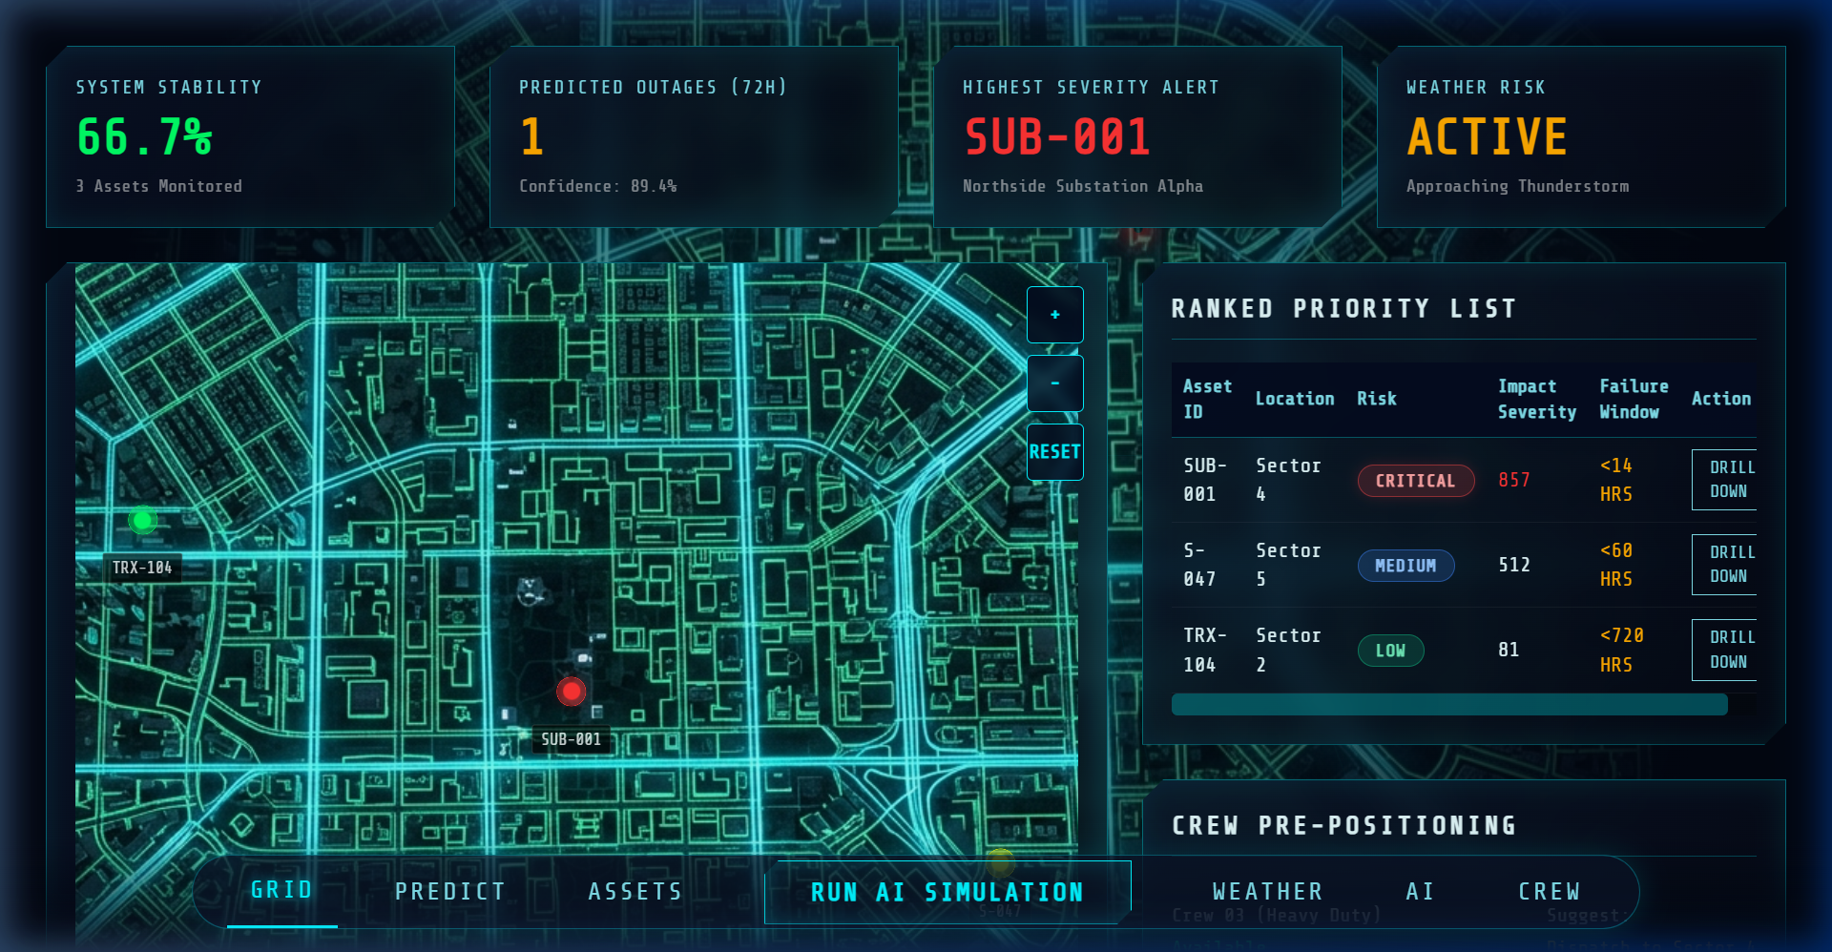
PRODUCT SHOWCASE // LIVE SCADA CONTROL CONSOLE
Operational Command Center & Asset Diagnostics
Real-time visibility across 12 high-voltage transmission nodes with interactive telemetry and crew dispatch.
COMMON GRID DASHBOARD
12 High-Voltage Nodes
Geospatial SCADA map color-coded by real-time risk severity. Criticality table automatically sorts substations by failure probability and downline customer impact.
ASSET DIGITAL TWIN & TRENDS
Multi-Sensor Recharts
Small-multiple time-series plots for Top-Oil Temperature, Vibration, Partial Discharge, and DGA Oil Quality. Pinpoints critical failure window (< 14 hours).
OPERATOR PROFILE & ENCLAVE
Clearance Studio (L1 / L2 / L3)
Role switcher for live hackathon demos. Rotates security keys, verifies out-of-band email OTP reset codes, and records an immutable NERC-CIP audit trail.

Slide 6
COGNITIVE ARCHITECTURE // IBM ECOSYSTEM
Where and How IBM Bob & watsonx Are Integrated
Combining IBM Bob conversational orchestration with watsonx.ai foundation models via Model Context Protocol.
IBM BOB CLI & AGENT
Conversational SCADA Advisor
Acts as the 24/7 intelligent control room co-pilot. Grid dispatchers interrogate complex anomalies using natural language queries ('Why is Substation Alpha at critical risk?') and receive instant, context-aware engineering diagnoses.
MODEL CONTEXT PROTOCOL (MCP)
Standardized SCADA Tool Bridge
Connects IBM Bob directly to live GridGuard backend REST endpoints. Exposes real-time tools to fetch asset telemetry, query weather risk multipliers, compute IEEE failure probabilities, and trigger emergency crew dispatch.
WATSONX.AI FOUNDATION MODELS
Enterprise Playbook Generation
Leverages IBM Granite and Llama-3 models to synthesize multi-sensor telemetry into structured, IEEE-compliant mitigation playbooks, load-shedding schedules, and regulatory NERC-CIP incident reports.
IBM CLOUD CODE ENGINE
Serverless Elastic Scaling
Runs containerized AI inference microservices on managed serverless infrastructure. Auto-scales computing instances instantaneously when severe weather systems compound grid-wide sensor ingestion loads.
[DISPATCHER PROMPT] ➔ [IBM BOB AGENT] ➔ [MCP TOOL CALL] ➔ [SCADA TELEMETRY + WATSONX.AI] ➔ [ACTIONABLE MITIGATION PLAYBOOK]

Slide 7
STRATEGIC VALUE // COMMERCIAL VISION
Projected Business Impact & Beyond the Hackathon
Delivering massive operational savings and a clear trajectory toward production utility deployment.
42% REDUCTION
UNPLANNED OUTAGE DURATION
Compresses utility SAIDI/SAIFI outage indices via predictive strike crew staging.
$85M / YEAR
REGIONAL COST AVOIDANCE
Savings for a standard 2M-meter utility by eliminating catastrophic transformer replacements.
12,000+ HOURS
FIELD LABOR OPTIMIZATION
Eliminates wasteful calendar-based manual inspections with continuous condition monitoring.
PHASE 1 (Q3-Q4 2026)
Physical SCADA & Hardware Integration
• Connect to physical substation RTUs via DNP3 & IEC 61850 protocols.
• Deploy edge inference gateways onto substation control house hardware.
• Ingest live optical fiber partial discharge & continuous online DGA monitors.
PHASE 2 (Q1-Q2 2027)
Autonomous Drone & Robotics Dispatch
• Automated drone inspection launch triggers for thermal infrared substation scans.
• Real-time road flood & downed-tree satellite routing for pre-positioned fleets.
• Closed-loop automated breaker tripping recommendations.
PHASE 3 (2027+)
Regional RTO Federated Intelligence
• Multi-utility threat intelligence sharing across ISO / RTO interconnections.
• Cross-border cascading blackout mitigation with watsonx distributed models.
• Commercial SaaS deployment across North American & European utilities.

Slide 8
SUBMISSION SUMMARY // TEAM GRIDGUARD AI
Engineering the Future of Resilient Energy Grids
A complete, production-grade AI platform built for the IBM Bob AI Hackathon.
Harshil Thakkar
TEAM LEAD & FULL-STACK ARCHITECT
d25dit083@charusat.edu.in
• Overall platform architecture
• React SCADA HUD & canvas
• FastApi / Express integration
• End-to-end evaluation pipeline
Hetavi Suhagiya
AI/ML RISK ENGINEER
24dce119@charusat.edu.in
• IEEE C57 / IEC 60076 scoring
• Multi-modal data fusion pipeline
• Weather compounding model
• Time-to-failure forecasting
Priyal Rathod
BACKEND & SCADA GATEWAY
24dce048@charusat.edu.in
• Node.js REST API gateway
• PostgreSQL / TimescaleDB schema
• Resilient fallback engine
• NERC-CIP audit logging
Rutvik Jasani
FRONTEND & DATA VIZ
24dce140@charusat.edu.in
• Recharts sensor telemetry
• Geospatial substation map
• Operator clearance studio
• UI design tokens & accessibility
⚡ SUBMISSION ARTIFACTS & LINKS
• Source Code: github.com/harshil5506/bob-ai-hackathon-GridGaurdAI
• Comprehensive Documentation: docs/problem-statement.md | docs/solution-overview.md | docs/architecture.md | docs/setup-guide.md
• Live SCADA Console: http://localhost:3000 (Pre-loaded 1-Click Chief Controller Login)
• Mission: Protecting the critical electric power that powers modern civilization.

