Slide 1
CHAROTAR UNIVERSITY OF SCIENCE & TECHNOLOGY (CHARUSAT)
FACULTY OF TECHNOLOGY & ENGINEERING
DEVANG PATEL INSTITUTE OF ADVANCE TECHNOLOGY & RESEARCH (DEPSTAR)
Department of Computer Engineering
SUMMER INTERNSHIP-II [CE446]
Summer Internship Project
AegisSOC: AI-Assisted SOC Triage Platform
Name of Student & Id:
Harshil Patel — 23DCE081
Internal Guide: Dr. Parth Goel
External Guide: Nikunj Bhavsar
Human Resource Executive, Digiesale

Slide 2
AegisSOC — Problem Statement
• Security Operations Center(SOC) analysts face alert fatigue from high false-positive rates across fragmented tools.
• Events stay siloed across endpoint, network, identity, cloud, and email sources — context is lost.
• Manual correlation slows investigation; attack narratives are hard to reconstruct quickly.
• Disruptive response actions risk business impact without clear human approval and audit trails.
• AegisSOC addresses this with graph-aware correlation, explainable detection, and LLM-assisted (not LLM-driven) triage.

Slide 3
Project Scope and Features
Core Features
Out of Scope / Limits
Future Work
• JWT analyst console (alerts, cases, investigation).
• Ingest → normalize → enrich → graph → detect → case → triage → response pipeline.
• Temporal entity graph + attack-path visualization.
• Sigma-like rules, correlation, graph risk scoring.
• Human-in-the-loop approvals with audit logging.
• Docker Compose + sync-mode demo scenarios.
• Not a full commercial SIEM replacement.
• Live VirusTotal/OpenCTI are optional stubs by default.
• Graph ML is lightweight (numpy).
• Tenant isolation is logical (tenant_id), not physical.
• Multi-broker Redpanda + autoscaling.
• Neo4j cluster / AuraDB replicas.
• Live threat-intel feeds with caching.
• Heterogeneous risk scoring.
• mTLS + per-source API keys at ingestion.

Slide 4
Technology Stack and Tools
1
Backend
Python 3.11, FastAPI
2
Frontend
React, TypeScript, Vite, Cytoscape.js
3
Data stores
PostgreSQL, Neo4j, Redis, OpenSearch
4
Streaming
Redpanda (Kafka-compatible)
5
Auth & Ops
JWT RBAC, Docker Compose, Prometheus
6
Other tools
Git/GitHub, VS Code, evaluation scripts

Slide 5
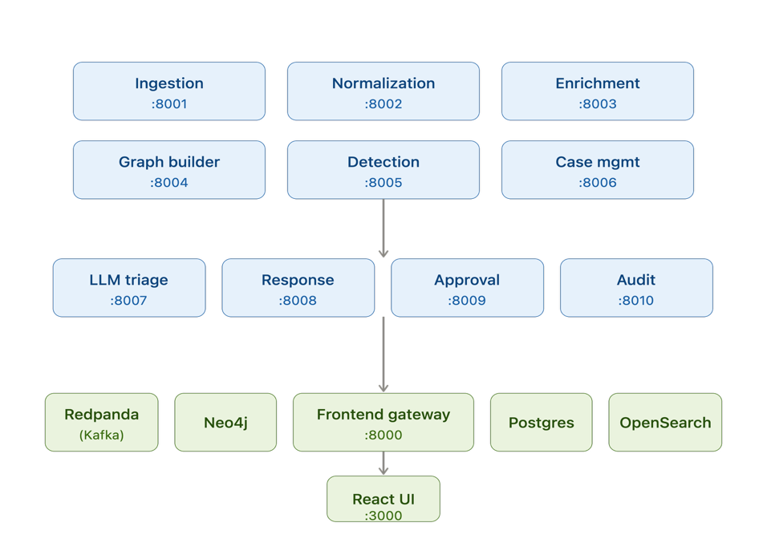
Implementation Architecture
• Event-driven microservices over Kafka/Redpanda topics.
• CanonicalEvent schema unifies Sysmon, Zeek, EDR, AD, CloudTrail, K8s, email.
• Graph builder upserts entities/edges in-memory sync store.
• Detection → case clustering → LLM triage with citation grounding.
• Frontend gateway exposes a unified JWT API to the React console.
• Disruptive actions require senior/analyst approval

Slide 6
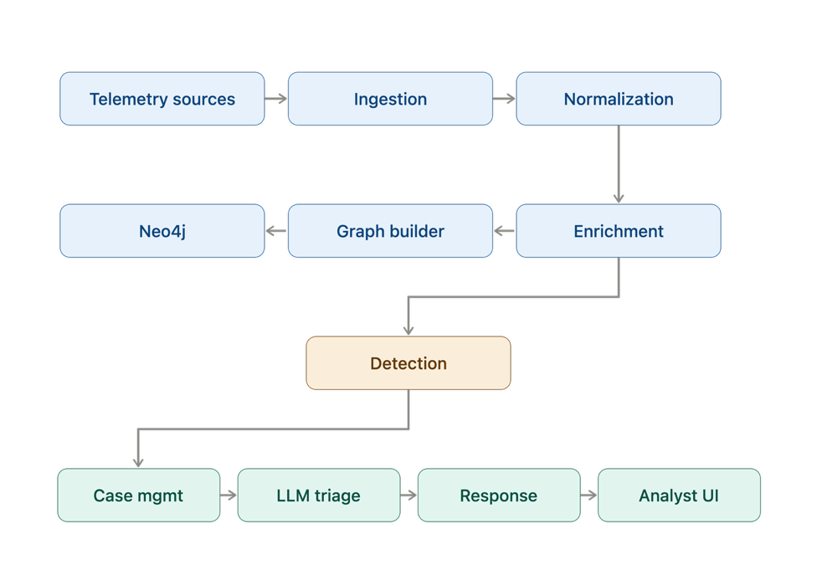
Flow Chart — End-to-End Pipeline
Fig. 5.1 Data Flow

Slide 7
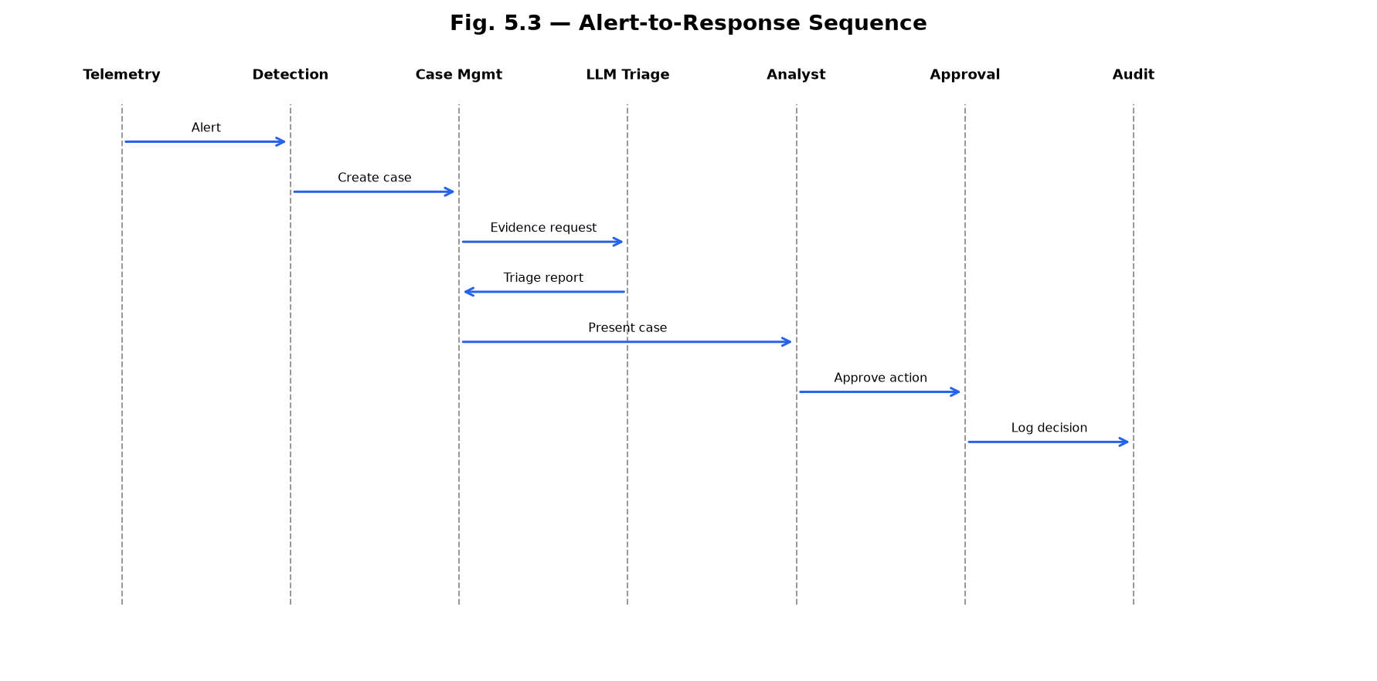
Alert-to-Response Sequence
Fig. 5.3 Sequence

Slide 8
Major Functionalities, Limitations & Outcome
Major Functionalities
Limitations
Outcome
• Multi-source ingest + scenario replay.
• Temporal graph & attack-path analysis.
• Explainable detection & case clustering.
• Grounded LLM triage + ATT&CK mapping.
• Approval workflow with full audit trail.
• Lightweight graph scorer.
• External intel connectors mostly stubbed.
• Heuristic prompt-injection filters.
• Logical multi-tenant scoping only.
• 11 services + React console in Docker.
• Demo scenarios: ransomware, FP, graph memory.
• Detection stays deterministic; LLM assists.
• Human-approved response with evidence.

Slide 9
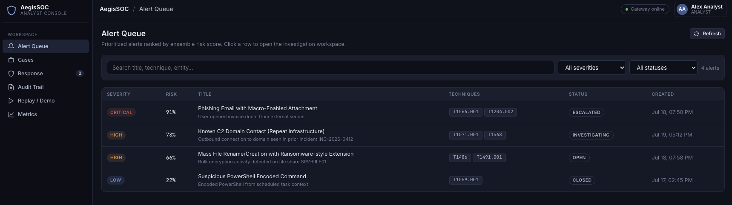
Screenshots — Alert Queue
Alert Queue

Slide 10
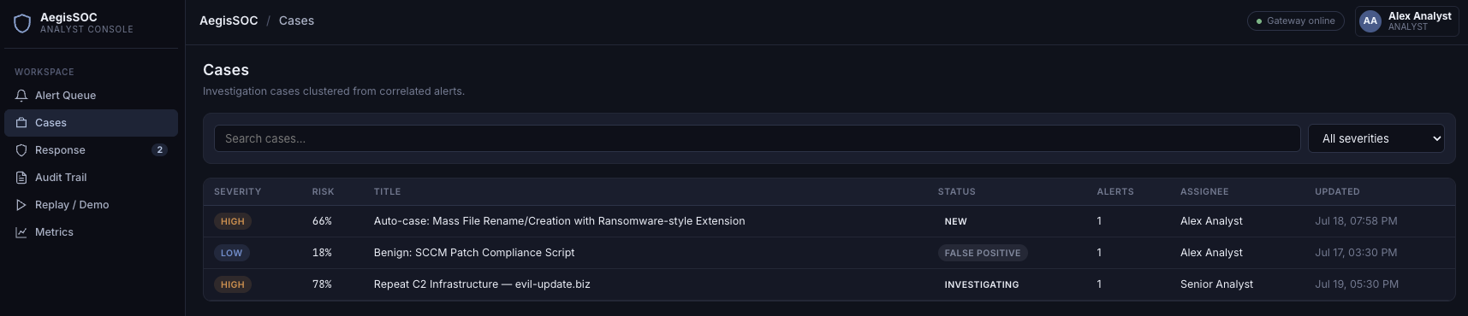
Screenshots — Cases Management
Cases View

Slide 11
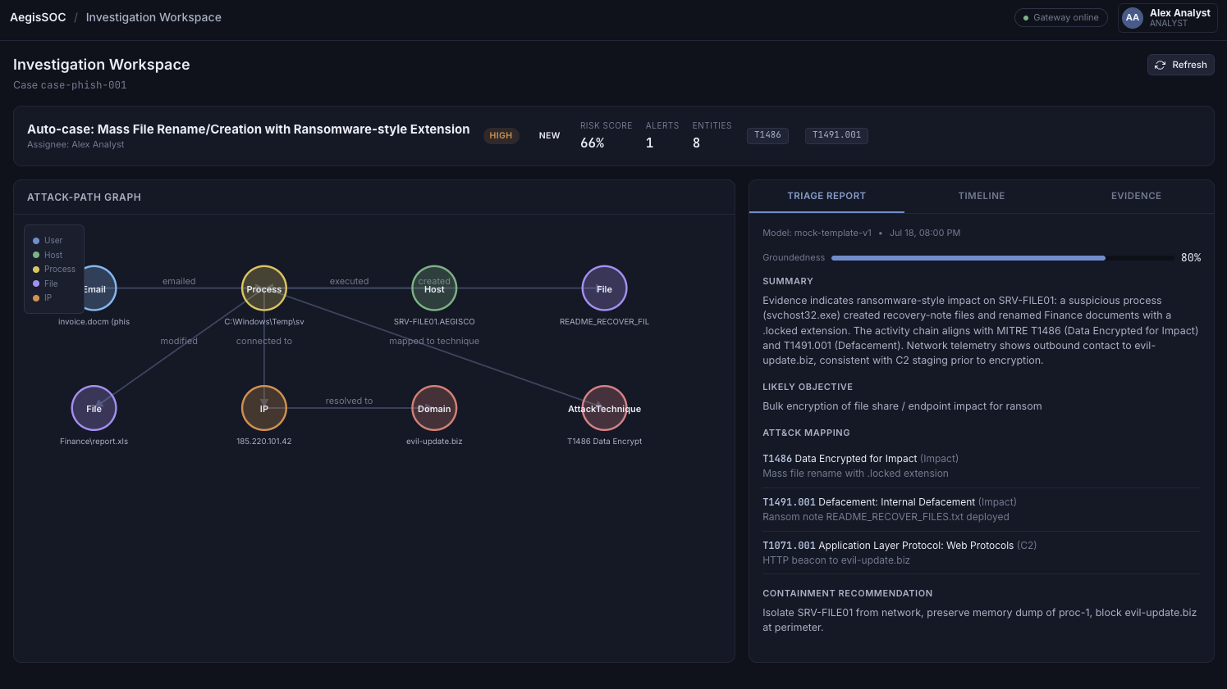
Screenshots — Investigation Workspace
Attack-Path Graph

Slide 12
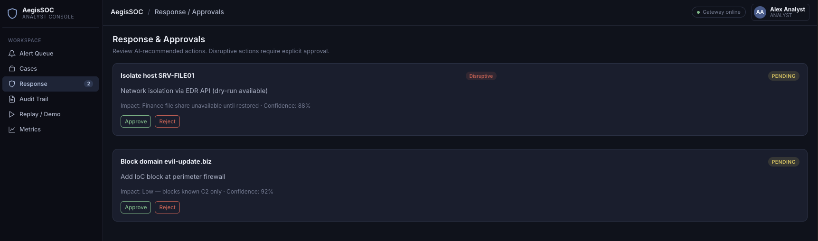
Screenshots — Response & Approvals
Response Panel

Slide 13
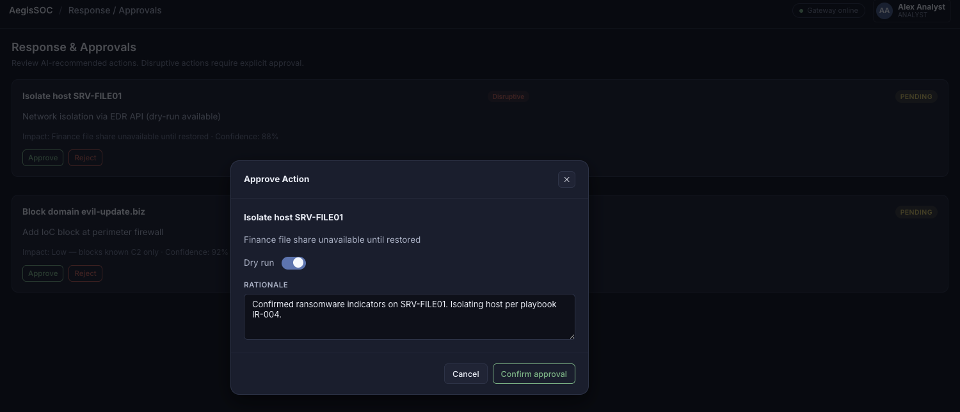
Screenshots — Approval Modal
Human Approval

Slide 14
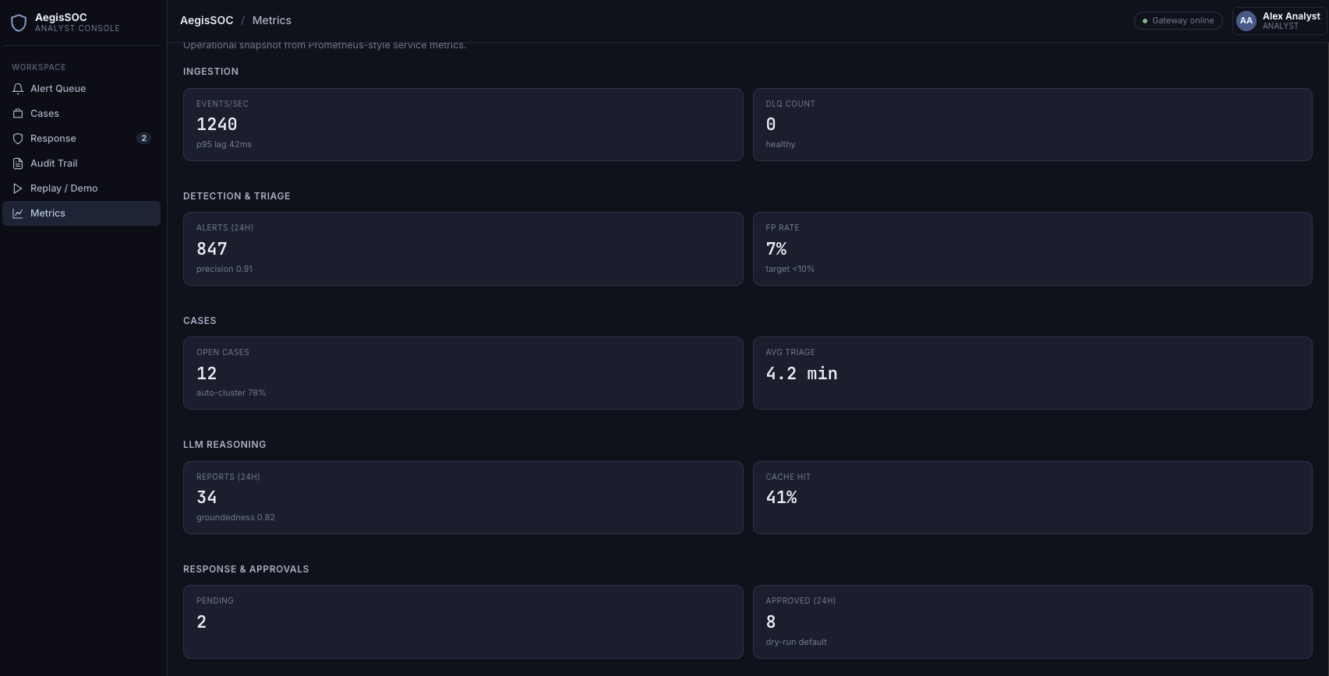
Screenshots — Metrics Dashboard
Ops Metrics

Slide 15
References and Resources
1
MITRE ATT&CK Framework
attack.mitre.org
2
Sigma Rule Format
SigmaHQ / GitHub
3
FastAPI Documentation
fastapi.tiangolo.com
4
Neo4j Graph Database
neo4j.com/docs
5
Apache Kafka / Redpanda
Streaming backbone
6
React + Docker Docs
UI & deployment

Slide 16
Thank You !!!

