Slide 1
CHAROTAR UNIVERSITY OF SCIENCE & TECHNOLOGY (CHARUSAT)
FACULTY OF TECHNOLOGY & ENGINEERING
DEVANG PATEL INSTITUTE OF ADVANCE TECHNOLOGY & RESEARCH (DEPSTAR)
Department of Computer Engineering
MINI-PROJECT – I [CE-270]
Word Counter
Name of Student: Suggested By: Ms. Kinjal Gandhi
Harnish Patel – 23DCE080
Harshil Patel – 23DCE081
Monal Patel – 23DCE087

Slide 2
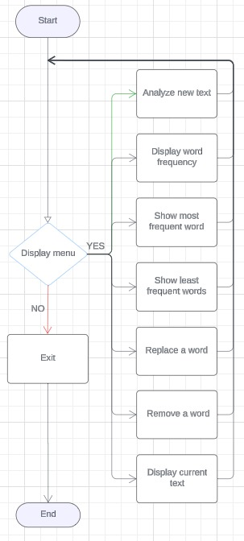
-> The Word Counter designed to analyze a given piece of text by breaking it down into individual words. It includes features like calculating word frequencies , identifying the most & least frequent words , replacing or removing specific words and maintaining total word count. ->It leverages data structures like arrays and HashMap to store & count words, & applies regular expressions for text cleaning & manipulation. The Stream API is used for sorting & filtering word frequencies, while control structures (loops, switch-case) handle user input and processing . The program also includes basic input/output handling & exception handling for robust interaction.
MINI-PROJECT DESCRIPTION :
CHAROTAR UNIVERSITY OF SCIENCE & TECHNOLOGY (CHARUSAT)
FACULTY OF TECHNOLOGY & ENGINEERING
DEVANG PATEL INSTITUTE OF ADVANCE TECHNOLOGY & RESEARCH (DEPSTAR)

Slide 3
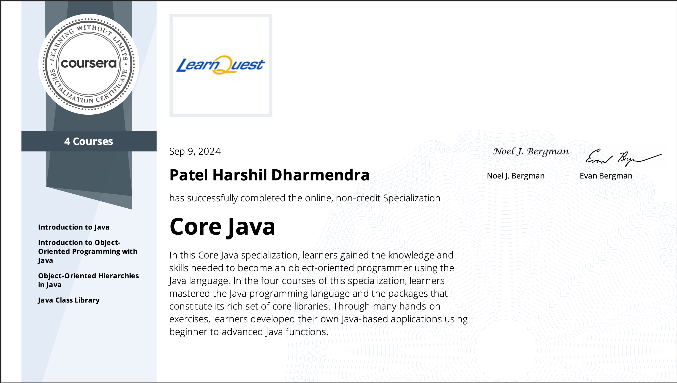
CHAROTAR UNIVERSITY OF SCIENCE & TECHNOLOGY (CHARUSAT)
FACULTY OF TECHNOLOGY & ENGINEERING
DEVANG PATEL INSTITUTE OF ADVANCE TECHNOLOGY & RESEARCH (DEPSTAR)

Slide 4
CHAROTAR UNIVERSITY OF SCIENCE & TECHNOLOGY (CHARUSAT)
FACULTY OF TECHNOLOGY & ENGINEERING
DEVANG PATEL INSTITUTE OF ADVANCE TECHNOLOGY & RESEARCH (DEPSTAR)
Course Content
Basic Java syntax using Java data types
Arrays
Java Operators
Objects and classes
Java Access Modifiers
Constructor Methods
The String Class
JAR Files and Namespaces (Packages)
StringBuffer and StringBuilder
Inheritance
Polymorphism
Class Hierarchies
Overloading and Overriding.
Abstract Classes
Interfaces
Generics
Generic Methods
Collections
Collections Framework
Exception Handling
File I/O
Javadocs
Enums
Annotations

Slide 5
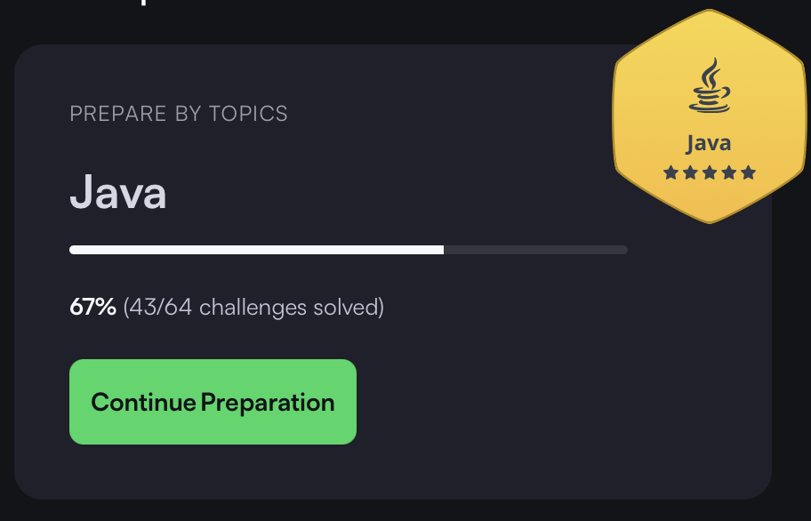
Hacker Rank Progress :
CHAROTAR UNIVERSITY OF SCIENCE & TECHNOLOGY (CHARUSAT)
FACULTY OF TECHNOLOGY & ENGINEERING
DEVANG PATEL INSTITUTE OF ADVANCE TECHNOLOGY & RESEARCH (DEPSTAR)

