Slide 1
Pose Estimation in Surveillance Video
 | Presented by:
 | Jeet Jivrajani (201501039)
 | Priya Mehta (201501085)
 | Harshil Shah (201501097)
 | Vishwa Saparia (201501118)
 | Hiren Galiyawala (1849004)

Slide 2
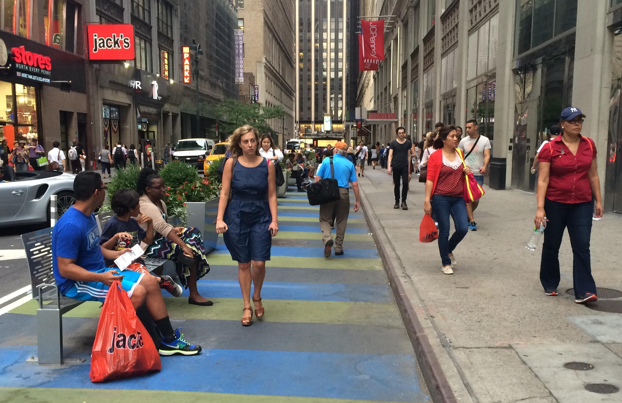
Problem statement
Human pose estimation from surveillance video.
Up-right,
front pose
Up-right,
back pose
Sitting,
side pose
https://nyc.streetsblog.org/2015/09/01/wider-32nd-street-sidewalk-could-be-erased-to-bring-back-loading-zones/

Slide 3
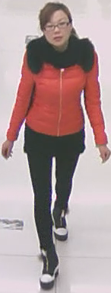
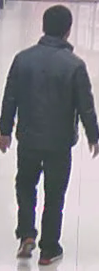
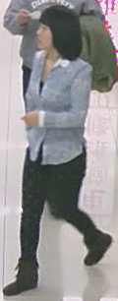
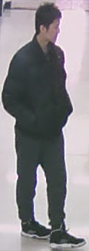
RAP Dataset [1]
A Richly Annotated Dataset for Pedestrian Attribute Recognition
Pedestrian images | 41,585
Resolution | from 36 x 92 to 344 x 554
Cameras | 26
Attributes | 69
Pose | 4
Face Back
Face Left
Face Right
Face Front
[1] Li D, Zhang Z, Chen X, Ling H, Huang K. A richly annotated dataset for pedestrian attribute recognition. arXiv preprint arXiv:1603.07054. 2016 Mar 23.

Slide 4
Using face detection
Technique | Accuracy
 | Face front | Face left | Face right
Haar cascade | × | × | ×
LBP | × | × | ×
HoG | × | × | ×
dlib | 5 % | 6 % | 5 %
Face recognition API | 29 % | 3 % | 1 %

Slide 5
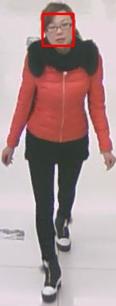

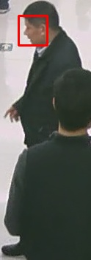
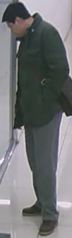
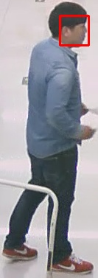
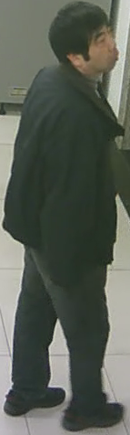
Results (dlib)

Slide 6
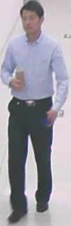
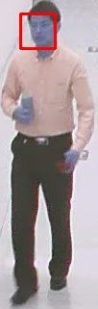
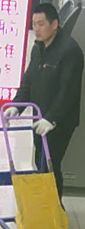
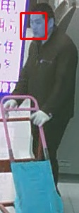
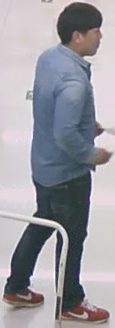
Comparative Results

Slide 7
CNN Implementation details
Pretrained model | Weights of AlexNet [3] pretrained on ImageNet [2]
Fine-tuning | Layers - fc8, fc7, fc6
Images | Training set – 38,000
 | Validation set – 2,000
 | Testing set – 1,585
No. of Classes | 4 (face front, face back, face left, face right)
Learning rate | 0.001
Epochs | 30
Batch size | 64
Dropout rate | 0.30
Validation accuracy | 79.08 %
[2] J. Deng, W. Dong, R. Socher, L. Li, Kai Li and Li FeiFei, "ImageNet: A large-scale hierarchical image database," 2009 IEEE Conference on Computer Vision and Pattern Recognition, Miami, FL, 2009, pp. 248-255.
[3] A. Krizhevsky, I. Sutskever, G. E. Hinton. “ImageNet Classification with Deep Convolutional Neural Networks”, in 25th International Conference on Neural Information Processing Systems 2012 (pp. 1097 – 1105)

Slide 8
Results
Class | No. of images classified correctly | Total images | Accuracy
Face Front | 671 | 696 | 96.41 %
Face Back | 662 | 670 | 98.81 %
Face Left | 15 | 61 | 24.59 %
Face Right | 71 | 158 | 44.94 %
Total | 1419 | 1585 | 89.52 %

Slide 9
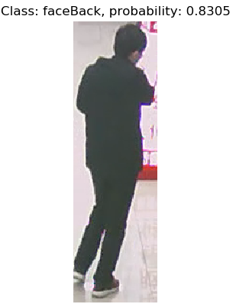
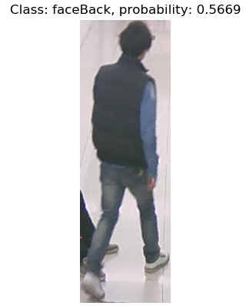
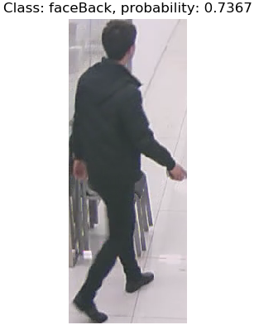
Results

Slide 10
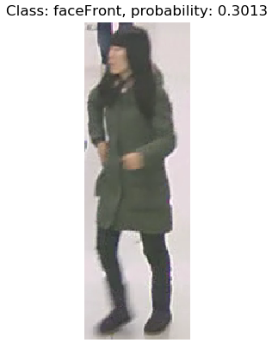
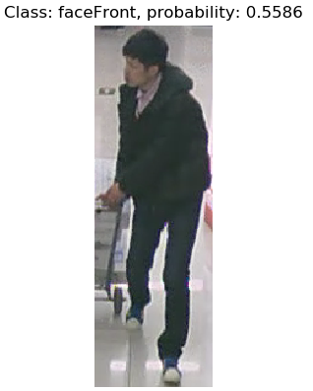
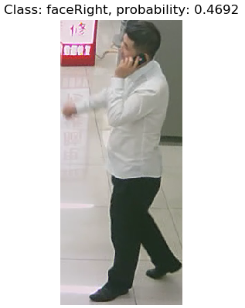
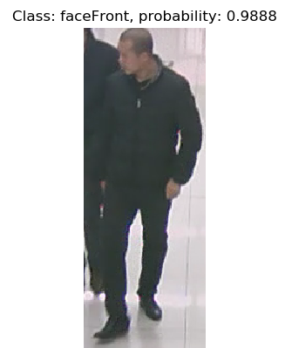
Results

Slide 11
Future work
Detection of standing and sitting pose using the angles formed by the lines between the keypoints.
Improving the model for the side pose.

Slide 12
Work distribution
Mask R-CNN | Jeet, Priya, Hiren
Semi / weak supervision | Harshil, Vishwa, Hiren
Documentation (Report + Presentation) | Harshil, Vishwa, Jeet, Priya, Hiren

Slide 13
REFERENCES
[1] Li D, Zhang Z, Chen X, Ling H, Huang K. A richly annotated dataset for pedestrian attribute recognition. arXiv preprint arXiv:1603.07054. 2016 Mar 23.
[2] J. Deng, W. Dong, R. Socher, L. Li, Kai Li and Li FeiFei, "ImageNet: A large-scale hierarchical image database," 2009 IEEE Conference on Computer Vision and Pattern Recognition, Miami, FL, 2009, pp. 248-255.
[3] A. Krizhevsky, I. Sutskever, G. E. Hinton. “ImageNet Classification with Deep Convolutional Neural Networks”, in 25th International Conference on Neural Information Processing Systems 2012 (pp. 1097 – 1105)
[4] K. He, G. Gkioxari, P. Dollár, and R. Girshick. Mask RCNN. In IEEE International Conference on Computer Vision (ICCV), 2017, Oct 22, pp. 2980 – 2988.
[5] Girdhar R, Gkioxari G, Torresani L, Paluri M, Tran D. Detect-and-Track: Efficient Pose Estimation in Videos. InProceedings of the IEEE Conference on Computer Vision and Pattern Recognition 2018 (pp. 350-359).
[6] Güler RA, Neverova N, Kokkinos I. Densepose: Dense human pose estimation in the wild. arXiv preprint arXiv:1802.00434. 2018 Feb 1.
[7] Ukita N, Uematsu Y. Semi-and weakly-supervised human pose estimation. Computer Vision and Image Understanding. 2018 May 1;170:67-78.
[8] Yu K, Leng B, Zhang Z, Li D, Huang K. Weakly-supervised learning of mid-level features for pedestrian attribute recognition and localization. arXiv preprint arXiv:1611.05603. 2016 Nov 17.

Slide 14
Thank You

