Slide 1

AT & LOFT - Desktop
Drop 6- Customer service
Screen resolution – 1680px x 1050px
1st Aug

Slide 2
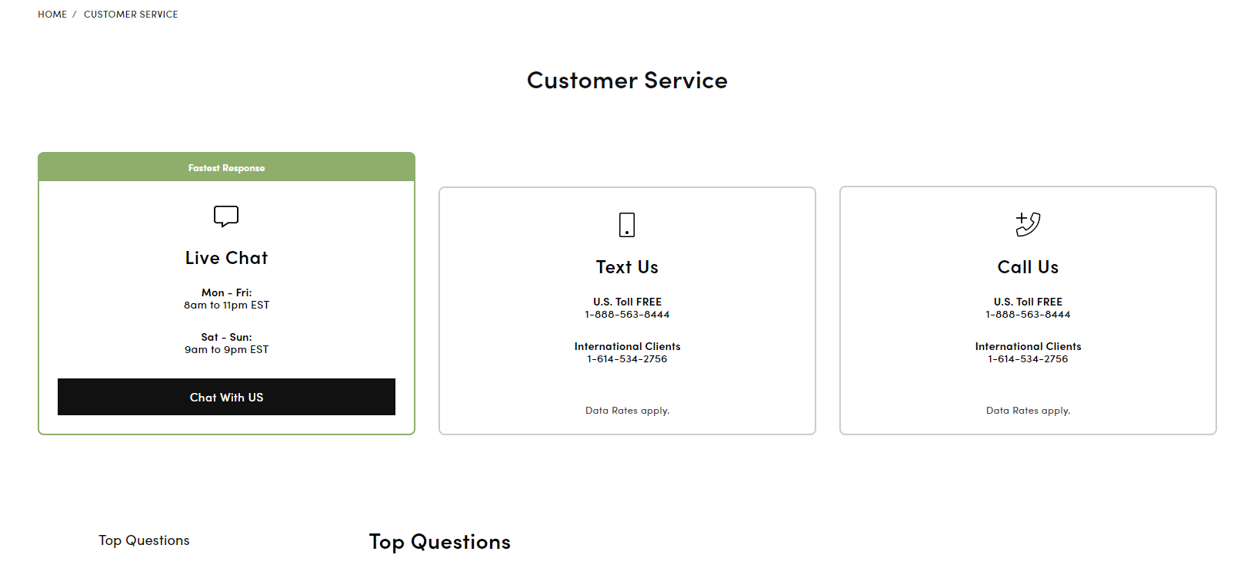
Customer service
S.N | Issues
1 | Please check breadcrumb spacing for all the as per figma design
2 | Padding should be 11px 0 12px 0
3 | Left and Right side of padding of box will be 10px instead of 15px
4 | .inner-box padding-top should be 40px instead of 32px because right now it is not align with green box
5 | Please check the spacing of icon from top for all three boxes
6 | Font color should be #111111
7 | Button font size should be 1rem and line-height should be 16px.
8 | Font color should be #111111 and line height should be 13px
1
2
3
4
5
6
7
8

