Slide 1

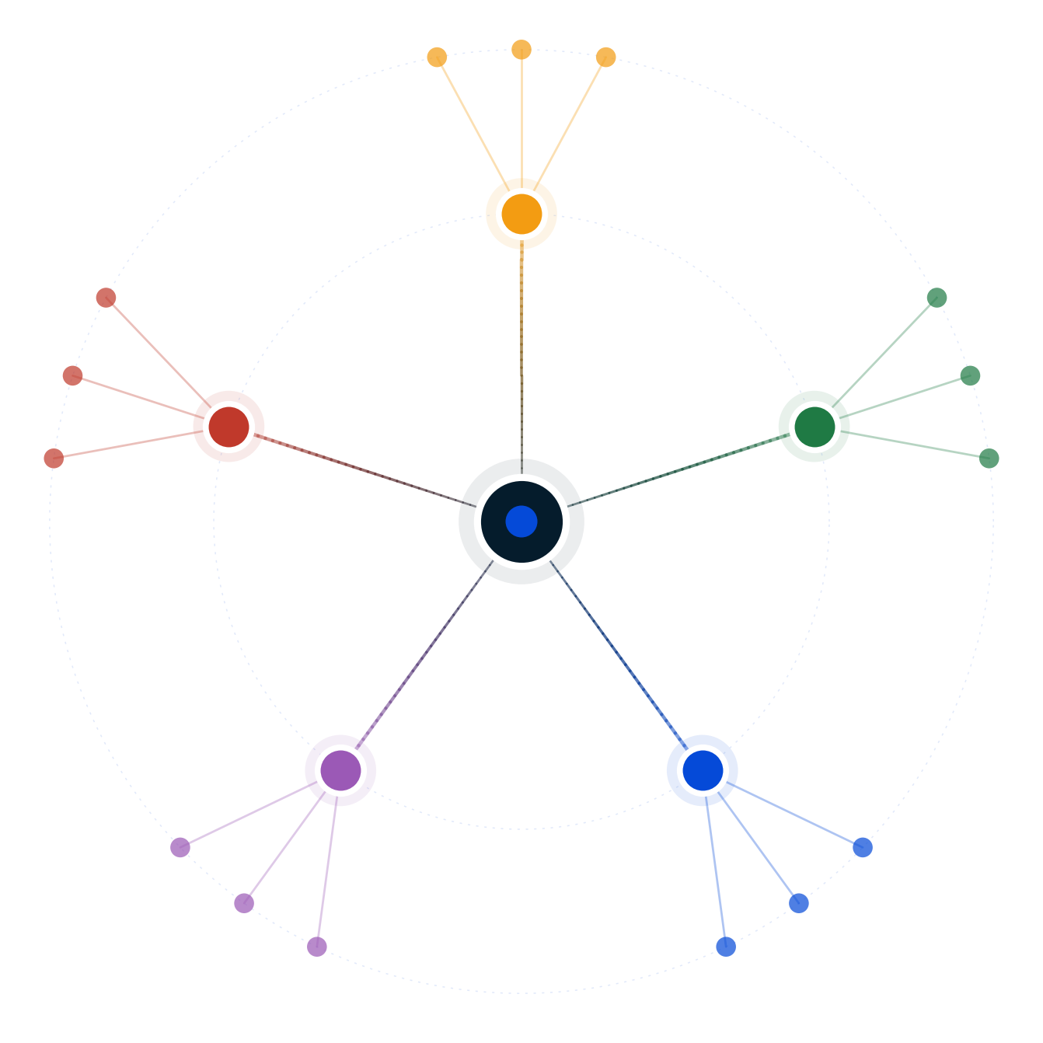
Autodecision
Should Razorpay build a company brain for SMEs?
Decision Brief — possibility map and recommendation
April 2026
GENERATED BY AUTODECISION — possibility map with synthesized recommendation, not a single-shot answer

Slide 2
Table of contents
Section
Slides
Recommendation
3
How we explored this decision
4 – 7
What the council found
8 – 13
Path forward
14 – 15
Appendix — Sources
16
Autodecision 2

Slide 3
1/ RECOMMENDATION
Don't build the maximalist company brain — ship a focused agent-native financial layer with three pillars
Ship Books + Compliance + Ops + payments-adjacent agents directly. Acquire a books player (ProfitBooks/Vyapar at ₹400-700 cr) for GL depth. Build a Razorpay-CA platform that turns Tally's deepest moat into Razorpay's distribution lever. Defer CRM and growth/marketing to post-IPO Phase 2. Public framing: "agent-native financial layer" — not "company brain."
CONFIDENCE
DEPENDS ON
MONITOR
MEDIUM-HIGH — cross-persona breakthrough convergence on H6 · sensitivity-robust where H1 broad-build is fragile · ICAI CA-Act ceiling validates CA-augmenter framing
Scope discipline holds publicly through IPO window · CAs adopt Razorpay-CA portal at scale · Books-player acquisition target available · ICAI CA-Act monopoly persists · AA-FIU eligibility creates structural moat
Zoho Pay attach rate inside Zoho Books base · Pilot/Digits India localization moves · CA-portal pilot conversion (target 50+ SMEs/CA) · IPO sentiment on Indian fintech · Agent error rate on production GST filings
PRE-MORTEM
DEEPEST DISAGREEMENT
REVIEW TRIGGER
Scope creep back to broad H1 (P=0.40) · CA-channel pilot fails to deliver 50+ SMEs/CA · Books acquisition target unavailable or overpriced · Agent error in public-name SME triggers ICAI hard guidance · Vembu ideological underpricing collapses payments take-rate
Knowledge-graph moat: data (Optimist) or workflow + AA-FIU regulatory rail (Pessimist)? Iter-2 resolved toward Pessimist using AA framework + DPDP portability evidence — moat is workflow plus regulatory eligibility, not data exclusivity.
Full review at 6 months post-launch (Oct 2026, pre-IPO). Early triggers: Zoho ships agentic Books v1 · Pilot localizes for India · IPO pricing slips below $4.5B · Visible agent error reaches mainstream press · Tally launches CA-loyalty program
Source: Decision Brief (full mode, 2 iterations, H6 4-5/5 council convergence, 16 adversarial scenarios) · [G3], [G6], [G13], [C1:regulator], [C6:synthesis]
Autodecision 3

Slide 4
PART 2
How we explored this decision
A 5-persona council, 6 competing hypotheses, two iterations to convergence, and 16 adversarial stress scenarios — what survived?
Autodecision 4

Slide 5
2.1/ HOW WE ANALYZED
The analysis explored 6 hypotheses across 2 iterations of a 5-persona council, stress-tested by 16 adversarial scenarios
▪ 5 personas spawned as separate subagents — Optimist, Pessimist, Competitor (anchored on Zoho), Regulator, Customer — each with independent context
▪ Iteration 1 surfaced 5 hypotheses spanning success (H1), execution failure (H2), competitive response (H3), technology paradigm break (H4), and platform-not-apps alternative (H5)
▪ Iteration 2 ran in light mode, resolved 3 contradictions identified by the Convergence Judge using empirical Zoho 2025 evidence, and added H6 (hybrid focused path) synthesized from 4 cross-persona breakthroughs
▪ Convergence reached at iteration 2: primary signals pass; assumption stability 100%; effective delta of 4 well below the 50 hard cap; 1 residual contradiction (scope-discipline fragility) at threshold
▪ Adversary phase generated 16 stress scenarios — 5 worst cases, 6 black swans, 5 irrational actors — plus a 12-assumption sensitivity tornado
▪ Real-time anchor: Razorpay has already shipped the agentic AI layer (RAY Agentic-AI Toolkit at FTX'25 [G6]) — the live question was depth, not whether to start
Source: Decision Brief — Convergence Log + Adversarial Scenarios
Autodecision 5

Slide 6
2.2/ HYPOTHESES
Six hypotheses surfaced; only H6 (focused hybrid) survived adversarial pressure and sensitivity analysis
#
Hypothesis
Status
Key assumptions
1
Razorpay ships full company brain; durable lock-in via payments first-touch + India localization + agent-native depth
Fragile · ~0.30 weighted
Razorpay can execute full stack · agent-native premium real · india-localization holds
2
Broad build fragments execution; gross margins compress; IPO multiple re-rates downward
~55% if H1 attempted
Engineering capacity constrained · accounting depth underestimated · capex dilutes margin
3
Zoho's payments cross-sell outpaces Razorpay's accounting extension; first-touch erodes; take-rate compresses
Partially confirmed [G13]
Zoho payments attach aggressive · first-touch erodes · CA recommends Zoho
4
Agent-native is paradigm break; Razorpay captures post-2026 SME cohort by default
Bounded · 9-12mo window
Agent-native truly different · legacy SaaS cannot retrofit · ICAI monopoly holds
5
Build platform + partner with Zoho/Tally/ClearTax for apps
Structurally unavailable · 5/5
Partners willing to integrate (5/5 council disagrees) · knowledge graph is real moat
6
Focused agent-native financial layer + acquire books + CA-channel platform + AA-FIU rail
Leading · 4-5/5 convergence
Scope can be disciplined · CAs will switch · acquisition available · ICAI monopoly holds
Source: Decision Brief — Hypotheses Explored
Autodecision 6

Slide 7
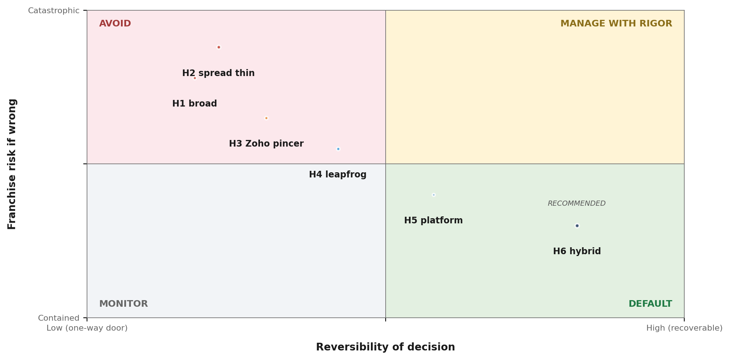
2.3/ STRATEGIC POSITIONING
Plotted on reversibility × franchise risk, H6 sits in the recoverable / contained quadrant; H1 sits where most plausible scenarios kill it
READ
▪ H1 broad —
▪ H2 spread thin —
▪ H3 Zoho pincer —
▪ H4 leapfrog —
▪ H5 platform —
▪ H6 hybrid —
Source: Decision Brief — Hypotheses + Adversarial Scenarios
Autodecision 7

Slide 8
PART 3
What the council found
Five independent persona analyses, anonymized peer review, adversarial pressure, sensitivity sweep — where did insights stabilize, and where did they fracture?
Autodecision 8

Slide 9
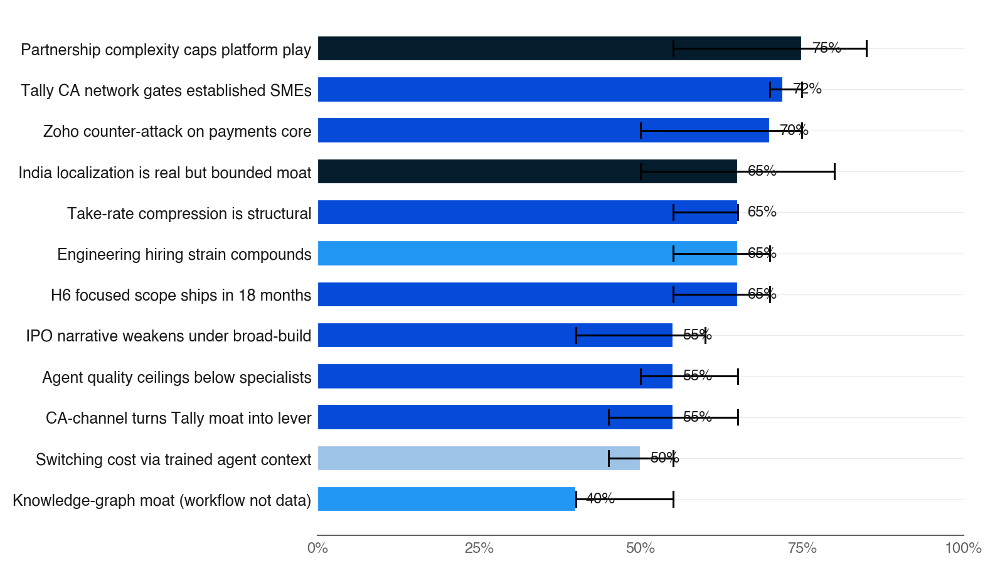
3.1/ EFFECTS MAP
The strongest signals: pure platform play is structurally unavailable; CA network gates established-SME migrations
Source: Decision Brief — Effects Map (High-Confidence Effects)
Autodecision 9

Slide 10
3.2/ COUNCIL DYNAMICS
The deepest disagreement — is the moat data or workflow? — was the iteration 2 productive contradiction resolved
STRONGEST: Regulator
WEAKEST: Optimist
▪ Best groundedness with [G#] tags throughout · explicit contrarian "what if regulation never materializes" branches per hypothesis
▪ Three genuinely novel specialist insights other personas could not produce: AA framework as UX wedge · ICAI CA-Act monopoly as both ceiling AND distribution insight · Zoho's FIU blind-spot
▪ Single most decision-relevant analysis in the council — the ICAI insight is load-bearing for the recommendation in two distinct ways
▪ Clean numerical scaffolding (NRR, ARPU, IPO-multiple math) but anchored on US analogues (Toast/Veeva) without testing Indian SME WTP
▪ Lowest "when I am wrong" rigor across contrarian questions · probability calibration weakest in the council
▪ Highest contribution was creative alternatives (CA-as-partner, open-source agent layer, hybrid platform-plus-thin-apps) — not probability accuracy
Source: Decision Brief — Council Dynamics + Minority-View Winners. Cross-persona breakthrough convergence on H6: 4 alt-prefixed insights from 4 different personas converged on the same path — narrow scope (Pessimist), acquire books (Optimist+Pessimist+Competitor), CA-as-distribution (Customer+Optimist+Pessimist), AA-FIU rail (Regulator).
Autodecision 10

Slide 11
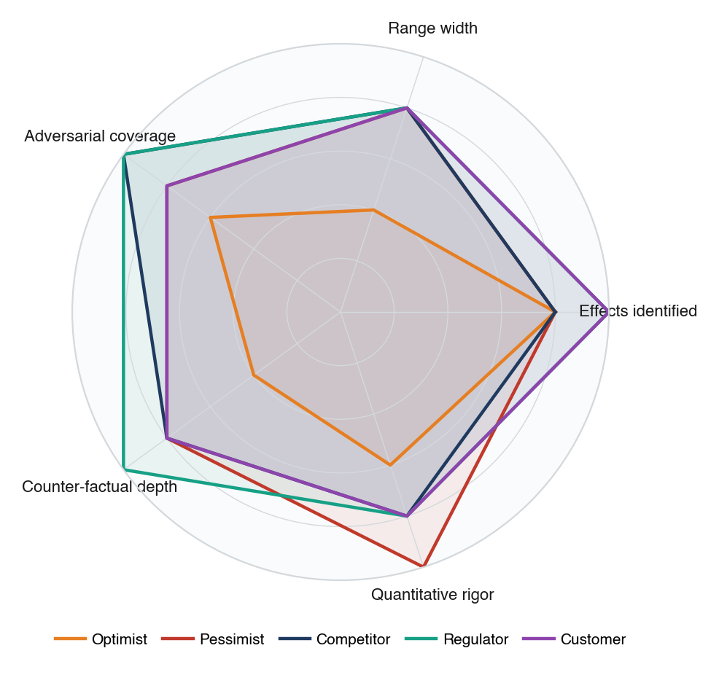
3.3/ COUNCIL DEPTH
Regulator scored highest on adversarial coverage and counter-factual depth; Optimist's narrow ranges drove its #5 peer rank
Source: Decision Brief — Council Dynamics narrative (canonical for radar synthesis per phase protocol)
Autodecision 11

Slide 12
3.4/ ADVERSARIAL PRESSURE
16 adversarial scenarios — most push toward broad-build failure; H6 focused path neutralizes 4 of 5 worst cases
WORST CASES
BLACK SWANS
IRRATIONAL ACTORS
▪ Compound Zoho pincer (P=0.25): take-rate compresses 25 bps + accounting GL ships 9mo late at 70% Tally parity → IPO clears at $3.5-4.5B vs $5-6B target [G3]
▪ Agent trust break in public-name SME (P=0.20): viral founder thread + ICAI position paper → 15-25% pilot SMEs revert; CA channel slams shut
▪ IPO window slams shut (P=0.20): macro/election shock forces scope cut mid-build; brain devolves to accounting + cashflow only
▪ Anthropic disintermediates agent layer (P=0.15): Claude for Business with native MCP connectors makes RAY a thin wrapper [G6]
▪ H5 partnership collapse if pivoted there (P=0.30 conditional): Zoho refuses, Tally extracts 60%+ economics, partner reach 10-15%
▪ Indian IPO market freeze 9-15mo (P=0.10): macro/SEBI cooling-off; emergency private round at down-valuation
▪ Foundation-model capability shift (P=0.10): GPT-5/Claude Opus 5 absorb GST/ITR knowledge → Pilot/Digits India in 6-9mo
▪ Key-person event during IPO (P=0.05): Mathur or Kumar departure; multiple compresses 20-30%
▪ Zoho breaks 25-yr acquisition celibacy (P=0.10): buys Khatabook/ClearTax for ₹2,000-4,000 cr — closes Razorpay greenfield
▪ Major SME data breach (P=0.08): multi-domain DPDP incident, IPO delay 6-12mo [G19]
▪ Microsoft India SMB priority (P=0.07): Copilot + Dynamics 365 + Azure GST localization commoditizes agent layer
▪ Vembu/Zoho ideological war (P=0.30): zero-MDR Zoho Pay for 24mo at ₹400-600 cr loss to deny IPO momentum [G13]
▪ ICAI tightens AI-attest (P=0.25): mandates CA pre-approval per agent journal entry — lands on competitors more if H6 chosen
▪ Top 5-10 RazorpayX logos publicly defect (P=0.20): founder-Twitter contagion poisons design-partner cohort [G4]
▪ RBI/CCI scrutinize super-app concentration (P=0.20): data-portability remedies, partner-neutrality slow graph moat
▪ Anthropic prioritizes US enterprise (P=0.15): SDK rate-limits or 3-5x price hike with 90-day notice during IPO window
Source: Decision Brief — Adversarial Scenarios
Autodecision 12

Slide 13
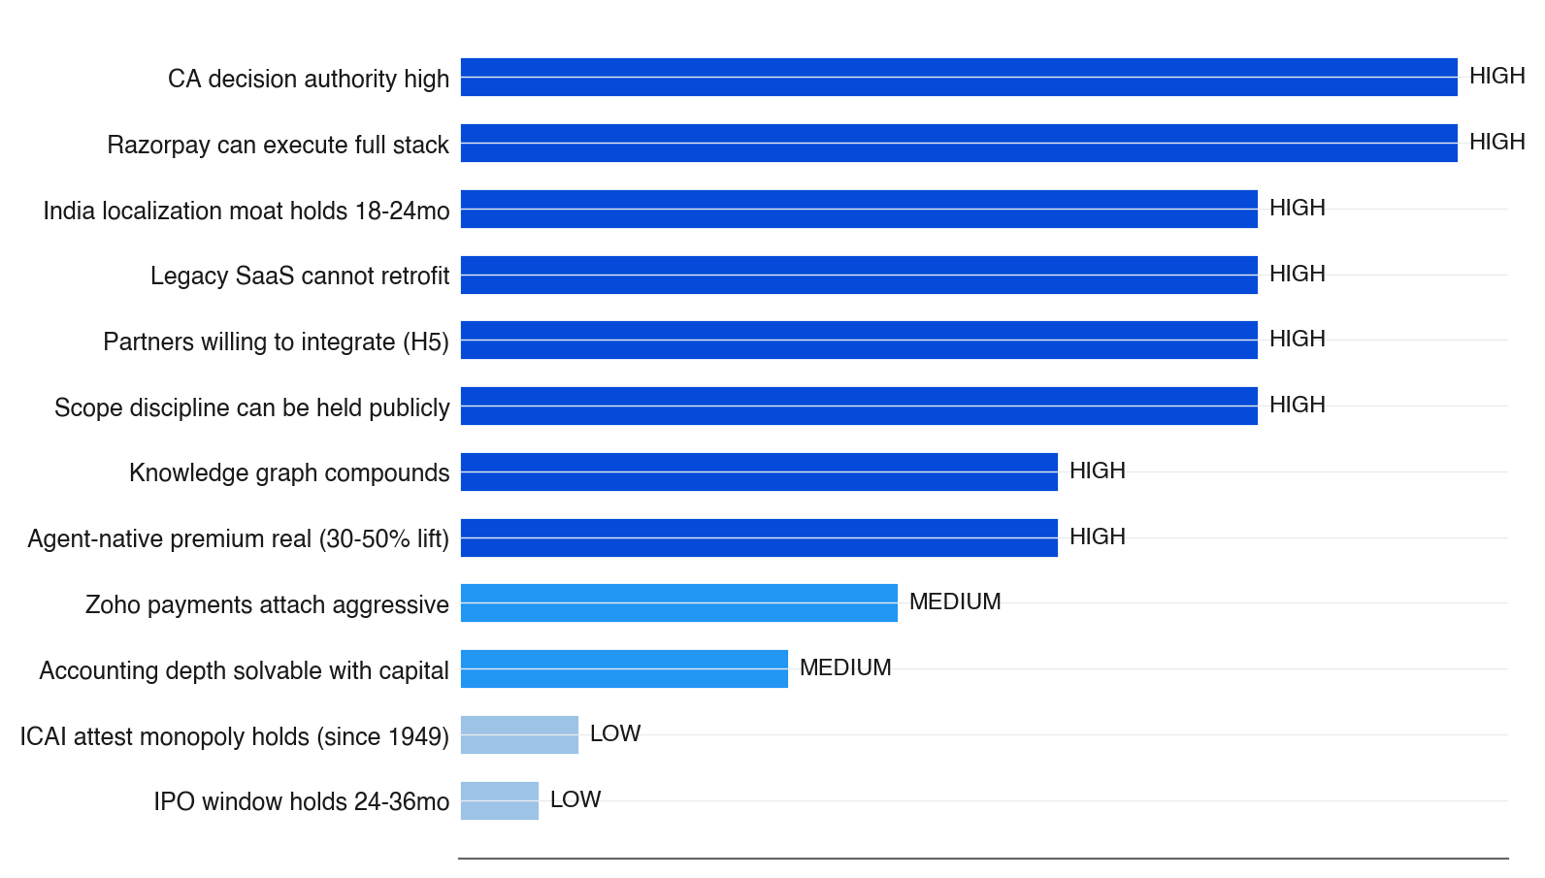
3.5/ SENSITIVITY
Five FRAGILE assumptions are load-bearing — if any one fails, broad H1 becomes indefensible
Source: Decision Brief — Key Assumptions + sensitivity analysis
Autodecision 13

Slide 14
PART 4
Path forward
If H6 hybrid is the right path, what does the 30-month execution sequence look like — and where are the kill criteria?
Autodecision 14

Slide 15
4.1/ ROADMAP
The recommendation maps to a six-checkpoint roadmap with explicit kill criteria at each stage
When
Action
Depends on
Decision point
Kill criteria
0-1 mo
Lock public framing as "agent-native financial layer." Brief PR/IR/board on scope discipline narrative
Internal alignment on narrowed scope
Decide whether to proceed at all
Board insists on "company brain" framing → abandon H6
0-3 mo
M&A diligence on ProfitBooks/Vyapar. CA-portal product spec; recruit 3-5 design-partner CAs. Lock top-5K merchants to 3-yr contracts
Acquisition targets available; CAs willing
LOI within 3 months OR pivot to organic
No LOI by month 3 + no design CAs → narrow to compliance + cashflow
3-6 mo
Close acquisition. Integrate onto RAY agent layer. Launch CA-portal closed beta with 50-100 CAs. Public-beta announcement
Acquisition closes; CA pilot 30+ SMEs/CA
Beta SLO + ≥50% CA retention at 90 days
Retention <30%, error rate >2%, slip >2mo → pause launch
6-12 mo
Scale CA portal to 1-3K CAs. Financial-layer GA. Begin AA-FIU monetization conversations with frenemy partners
Beta validated; IPO process on track
IPO RHP filing milestone (month 9-10)
IPO sentiment turns to Zoho-comp multiple → defer GA, hold burn
12-18 mo
IPO listing (target month 12-15). Phase 2 go/no-go on CRM/growth using IPO proceeds based on Phase 1 attach + competitive position
IPO completes; Phase 1 NRR ≥120% bundled
IPO listing + Phase 2 go/no-go
Phase 1 NRR <100% or IPO multiple <6x → hold Phase 2
18-30 mo
Selective Phase 2 expansion if validated. Continue CA growth to 10K+. Defend payments core via long-term contracts + embedded fintech
Phase 1 metrics held; capital deployed
24-month strategic review
Phase 2 underperforms specialists at month 24 → do not invest further
Source: Decision Brief — Appendix A: Decision Timeline
Autodecision 15

Slide 16
APPENDIX SOURCES
Every numeric claim in this deck traces to a tagged ground source, document extraction, or council estimate
Tag
Type
Claim
Source
[G1]
Ground
Razorpay FY25 revenue ₹3,783 cr (~$455M), up 65% YoY — gateway, POS, RazorpayX, loyalty, intl
medianama Oct 2025
[G2]
Ground
Razorpay's stated strategy is already "financial OS for businesses"
medianama
[G3]
Ground
IPO confidentially filed at ~$5-6B (down from $7.5B 2021); ~₹4,500 cr target raise late 2026
Paypers, BusinessToday Apr 2026
[G4]
Ground
RazorpayX 50K+ customers, 70% of Indian unicorns, $30B annualized TPV, 85% YoY
Business Standard
[G6]
Ground
RAY Agentic-AI Toolkit launched Feb 2025 on Anthropic Claude Agent SDK
yourstory, The Paypers
[G11]
Ground
Tally dominates Indian SME accounting via 25-yr CA-network entrenchment; ~380K CAs
onlinenifm
[G12]
Ground
Zoho finance suite grew 50% YoY in India; India is Zoho Books #1 geo (40.5%)
Outlook Business, 6sense
[G13]
Ground
Zoho launched Zoho Payments + Zoho Pay UPI in 2025 — direct cross-sell threat to Razorpay payments
Outlook Business
[G15]
Ground
Pilot announced first fully autonomous AI Accountant in Feb 2026
aimultiple
[G18]
Ground
AA framework: 126 FIs live, 2.61B accounts, consent-based per-fetch
financialservices.gov.in
[G19]
Ground
DPDP Act in force 2025; consent withdrawal, 30-day DSAR, breach notification
DPDP rules 2025
[G21]
Ground
Horizontal SaaS rarely exceeds 20% share; vertical leaders 40%+ — winner-takes-most
Tidemark VSKP
[D2]
Document
Customer churn: Razorpay → Zoho Books → Zoho CRM → Zoho Payments (n=1 founder)
razorpay-super-app-context.md
[C1:regulator]
Council
ICAI CA-Act monopoly limits agent autonomy AND creates CA-channel-as-distribution opportunity
iter-1 Regulator
[C6:synthesis]
Council
H6 hybrid path emerges from cross-persona breakthrough convergence in iteration 2
iter-2 synthesis
Source: Decision Brief — Sources table
Autodecision 16

