Slide 1
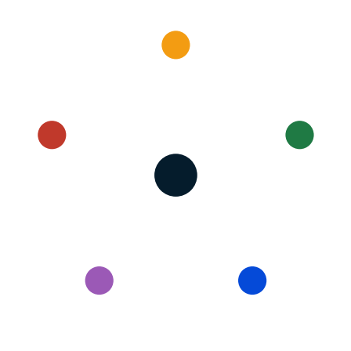
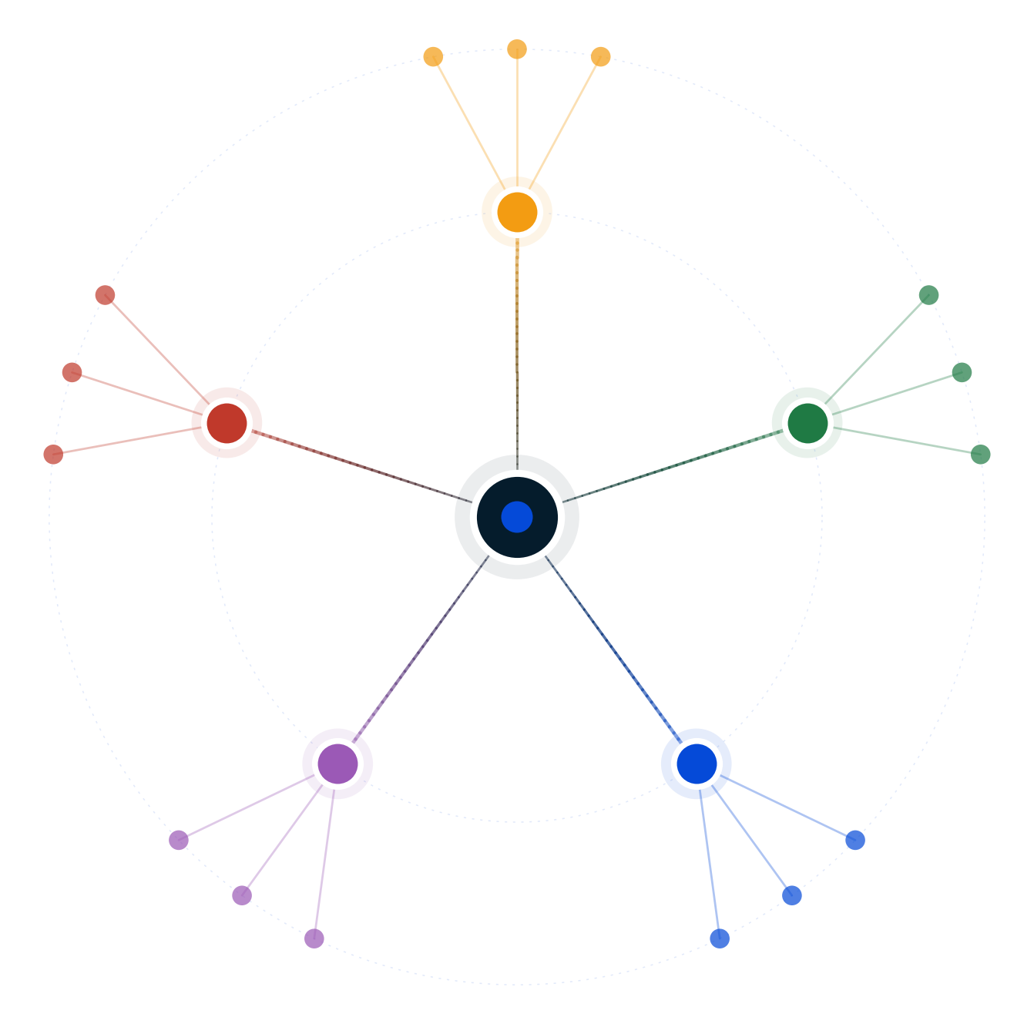
Autodecision
Should Adobe deprecate Photoshop's UI within 3 years?
Decision Brief — possibility map and recommendation
April 2026
GENERATED BY AUTODECISION — possibility map with synthesized recommendation, not a single-shot answer

Slide 2
Table of contents
Section
Slides
Recommendation
3
How we explored this decision
4 – 7
What the council found
8 – 13
Path forward
14 – 15
Appendix — Sources
16
Autodecision 2

Slide 3
1/ RECOMMENDATION
The aggressive deprecation path survives <15% of plausible scenarios; ship a segmented dual-SKU instead
Do NOT deprecate the Photoshop UI. Ship Photoshop Pro (UI + 10-year LTS) alongside Photoshop Agentic (Firefly AI Assistant native), with binding public reversal triggers.
CONFIDENCE
DEPENDS ON
MONITOR
HIGH on do-not-deprecate · MEDIUM-HIGH on segmented+LTS structure · MEDIUM on board willingness to publish reversal triggers
Board willing to publish binding reversal triggers · LTS commitment credible to pros · Segments are separable · Adobe execution amortizes dual-SKU R&D
Firefly AI Assistant beta NPS · Acrobat UI backlash trajectory · OpenAI/Anthropic creative product launches · Figma post-IPO M&A · Enterprise ELA renewal cohort
PRE-MORTEM
DEEPEST DISAGREEMENT
REVIEW TRIGGER
h6 without binding triggers (P=0.30) · Foundation model plateau (P=0.25) · Pro community rejects LTS as marketing-only (P=0.20) · Internal resourcing split degrades both SKUs (P=0.55)
Optimist: 55% first-mover platform lock compounds. Pessimist: 75% reversal-impossible franchise damage. Disagreement IS the data.
Firefly AI Assistant beta NPS <40 · OpenAI/Anthropic ships native creative · Adobe board refuses public reversal triggers · Q2 FY26 Digital Media growth <10%
Source: Decision Brief (full mode, 2 iterations, council 5/5 endorsement on h6) · [G15], [C3:council], [C4:pessimist], [C17:council]
Autodecision 3

Slide 4
PART 2
How we explored this decision
A 5-persona council, 6 competing hypotheses, two iterations to convergence, and 12 adversarial stress scenarios — what survived?
Autodecision 4

Slide 5
2.1/ HOW WE ANALYZED
The analysis explored 6 hypotheses across 2 iterations of a 5-persona council, stress-tested by 12 adversarial scenarios
▪ 5 personas spawned as separate subagents — Optimist, Pessimist, Competitor, Regulator, Customer — each with independent context
▪ 6 hypotheses generated, ranging from aggressive deprecation (h1) to additive Adobe-actual strategy (h3) to the synthesis winner (h6 segmented dual-SKU + LTS + binding reversal triggers)
▪ 2 iterations — convergence reached at iteration 2 with 78% assumption stability, 1 productive contradiction remaining
▪ Adversary phase generated 12 stress scenarios across worst-cases, black swans, and irrational actors
▪ Sensitivity analysis on 10 key assumptions — 3 high-sensitivity, 5 medium, 2 low
▪ Real-time anchor: Adobe announced Firefly AI Assistant as additive on April 15, 2026 [G15] — three days before this analysis. The announced strategy is h3, the recommendation upgrades to h6.
Source: Decision Brief Convergence Log; engine-protocol.md
Autodecision 5

Slide 6
2.2/ HYPOTHESES
Six hypotheses surfaced; only h6 survived 5/5 council endorsement and adversarial stress
#
Hypothesis
Status
Key assumptions
1
Aggressive deprecation wins (3-year UI sunset)
Conditional · joint P 12-20%
Agentic is terminal paradigm · 36-month parity · Foundation labs enter creative
2
User revolt destroys franchise
Risk path of h1
Muscle-memory switching cost real · Narrative damage sticky · Enterprise procurement revolts
3
Hybrid additive dominates (Adobe's actual April 2026 strategy [G15])
Strongly supported
Both modes coexist · Market rewards additive · AI Assistant quality holds
4
Competitive window closes by 2028
Conditional on foundation lab entry
Foundation labs enter creative · Category narrative matters · Translates to valuation
5
Segmentation is the right structure
Conditional on segment separability
Segments separable · Dual tier doesn't confuse · Pricing power preserved
6
Segmented + 10yr LTS + binding reversal triggers
Leading · 5/5 council
Dual SKU separable · LTS credible · Reversal triggers enforceable
Source: Decision Brief — Hypotheses Explored
Autodecision 6

Slide 7
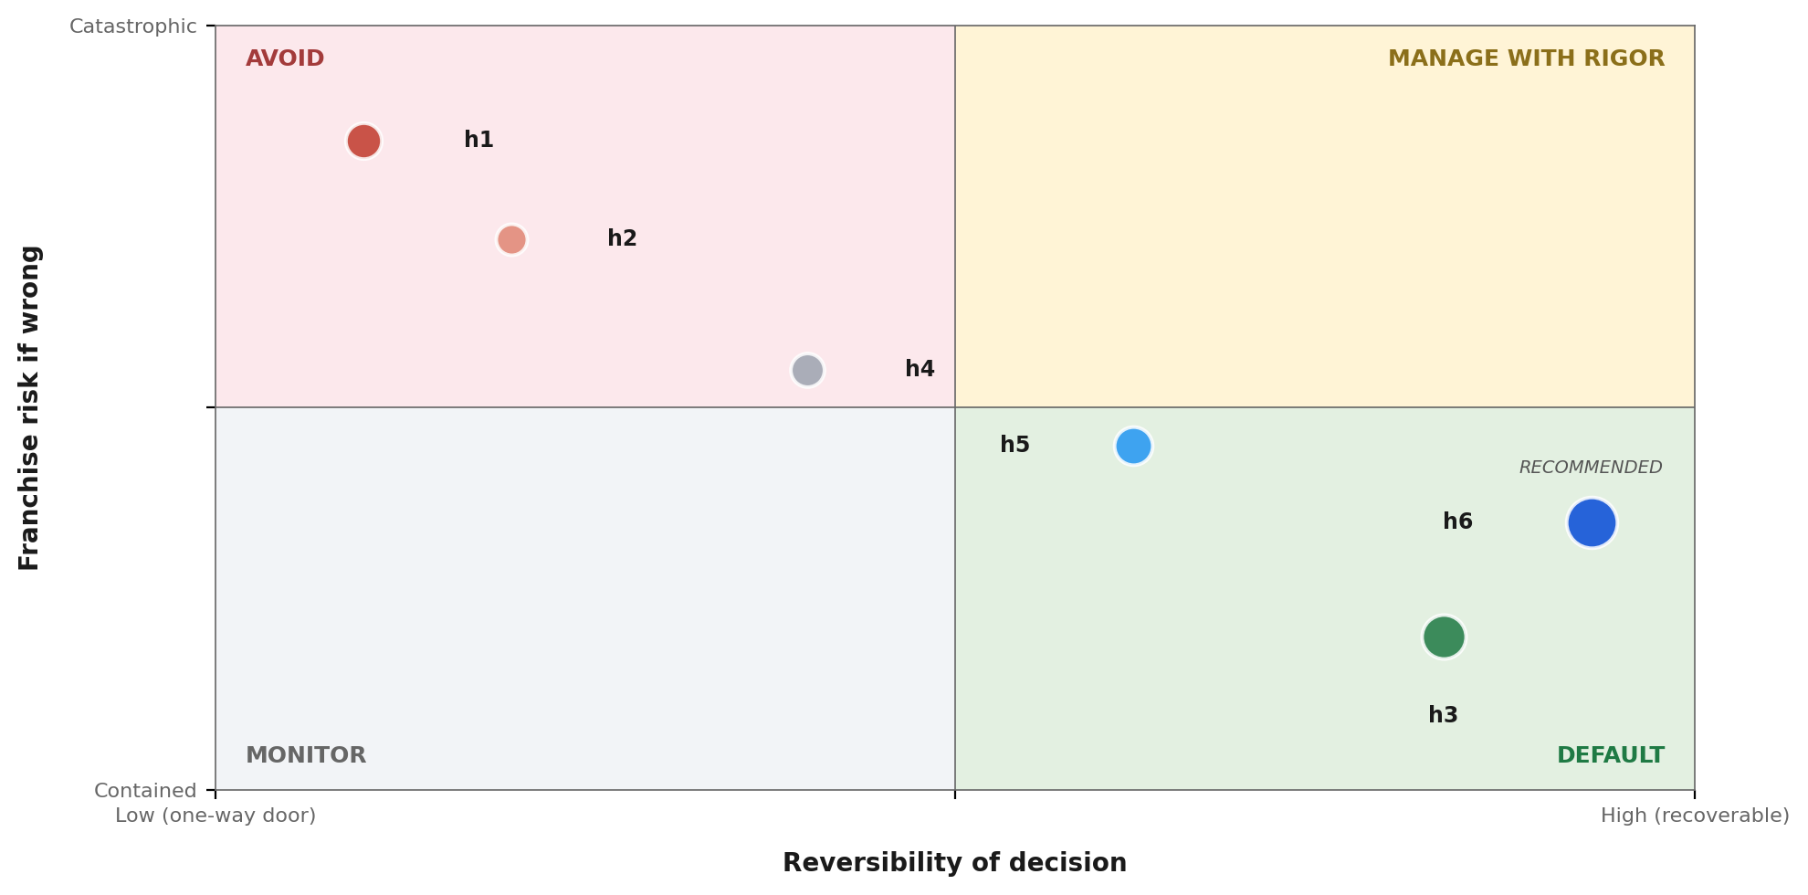
2.3/ STRATEGIC POSITIONING
Plotted on reversibility × franchise risk, h6 sits in the manageable quadrant; h1 sits where every adversarial scenario amplifies
READ
▪ h1 — Aggressive deprecation — irreversible, catastrophic if wrong (joint P 12-20%)
▪ h2 — User revolt — risk path of h1, same quadrant
▪ h4 — Window-closes — conditional, indeterminate position
▪ h5 — Segmentation — direction right, structure incomplete
▪ h3 — Hybrid additive — Adobe's actual April 2026 strategy [G15]
▪ h6 — Segmented + LTS + binding reversal triggers — captures growth while preserving optionality
Source: Synthesis from Decision Brief — bubble size = council_agreement × probability of dominance
Autodecision 7

Slide 8
PART 3
What the council found
Where the personas converged, where they diverged, and what the disagreement itself reveals about the decision.
Autodecision 8

Slide 9
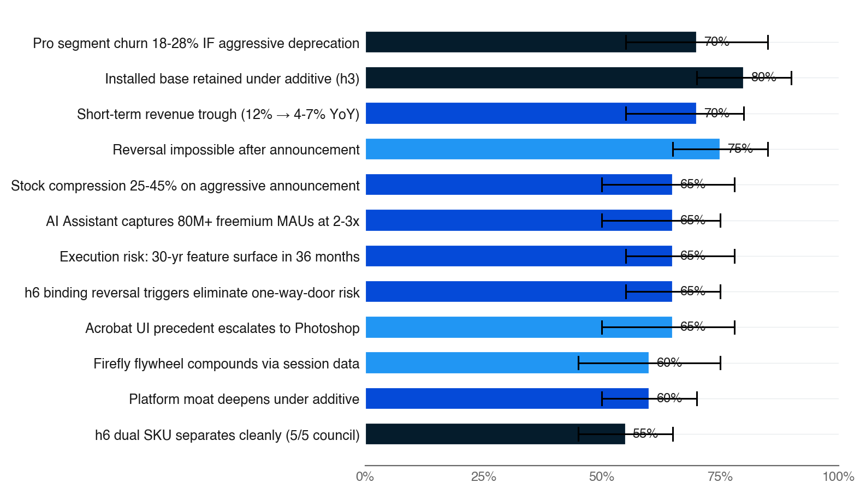
3.1/ EFFECTS MAP
The strongest signals point to franchise risk under aggressive paths and quiet compounding under additive
▪ Top 12 effects ranked by council_agreement × probability
▪ Bar color = council agreement (navy = 5/5, fading to pale = 1/5)
▪ Black bracket = persona disagreement range — width is the uncertainty signal
▪ Two of the three highest-agreement effects (5/5) are downside under aggressive paths
▪ h6 effects (last row) emerge in iteration 2 with full council endorsement
Source: Decision Brief — Effects Map (top 15 by council_agreement × probability) · [C7:council], [C10:council], [C16:council]
Autodecision 9

Slide 10
3.2/ COUNCIL DYNAMICS
The deepest disagreement — competitive urgency vs franchise preservation — IS the data
STRONGEST: REGULATOR (#1 PEER RANK)
DEEPEST DIVIDE: URGENCY VS PRESERVATION
▪ Won on structural depth — EU AI Act obligations, Firefly training-data suit risk, fiduciary / Delaware business judgment rule, ADA Section 508 implications of chat-only UI
▪ Surfaced TWO of the alternatives that synthesized into h6: dual-SKU LTS + binding reversal triggers
▪ Identified h6 as protected under business judgment rule — reversibility insulates the board even if strategy fails
▪ Compliance moat (AI Act + copyright + enterprise DPA) buys 18-24 months regardless of UI strategy
▪ Optimist + Competitor: narrow window, first-mover lock compounds (P=0.55 [C2:optimist])
▪ Pessimist + Regulator + Customer: catastrophic franchise downside under forced transition (P=0.75 [C4:pessimist] reversal impossible)
▪ Disagreement range on foundation_labs_enter_creative: 0.30-0.70 [C3:council] — the disagreement IS the data
▪ Optimist was weakest (#5 peer rank) — joint-probability inflation flagged by 4/4 reviewers
▪ BLIND SPOT caught: 4/5 personas missed agentic inference COGS — ~10-50× per session, material at 41M subs
Source: Decision Brief — Council Dynamics · [C2:optimist], [C2:pessimist], [C3:council]
Autodecision 10

Slide 11
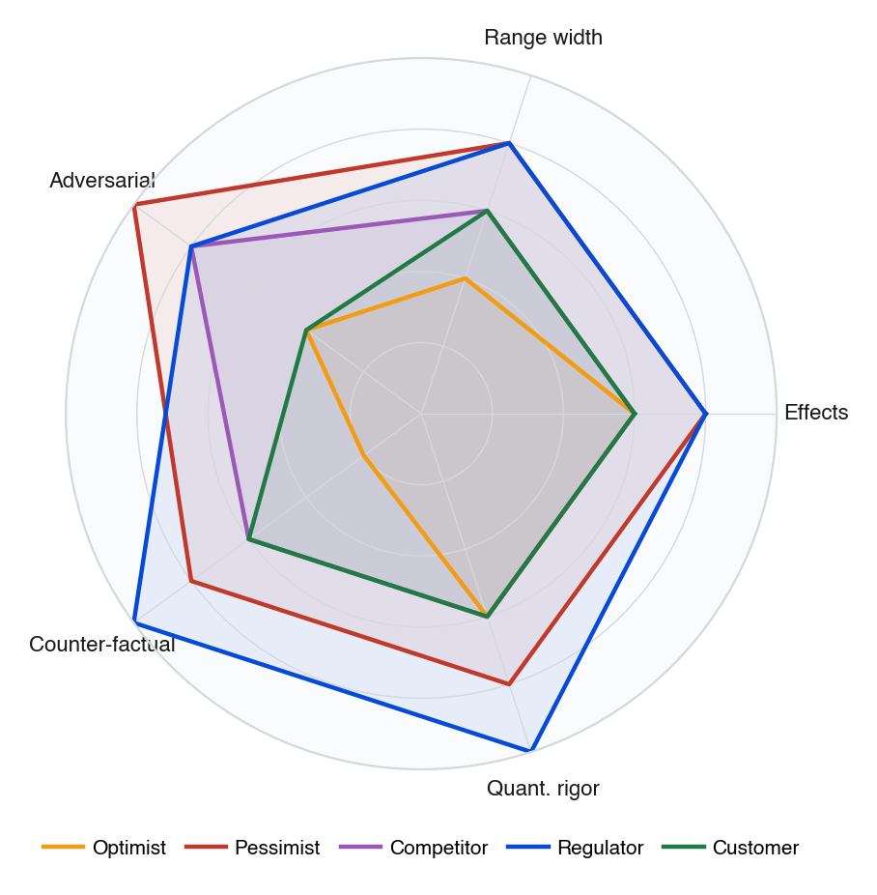
3.3/ COUNCIL DEPTH
Regulator scored highest on structural depth and counter-factual rigor; Optimist's narrow ranges drove its #5 peer rank
▪ Each persona scored 1-5 across five rigor dimensions, derived from peer-review and critique outputs
▪ Regulator's structural depth surfaced both alternatives that synthesized into h6 — dual-SKU LTS and binding reversal triggers
▪ Optimist's narrow range and weak counter-factual depth flagged in 4/4 reviews — joint-probability inflation pattern
▪ Pessimist + Regulator together cover the full adversarial surface; their alignment on irreversibility risk drove the h6 design
▪ Customer's lower adversarial coverage is structural — the role focuses on adoption value, not threats
Source: Synthesized from Decision Brief — Council Dynamics + Critique outputs
Autodecision 11

Slide 12
3.4/ ADVERSARIAL PRESSURE
Twelve adversarial scenarios — eight push toward kill-aggressive or segmented; only h6's reversal triggers neutralize all of them
WORST CASES
BLACK SWANS
IRRATIONAL ACTORS
▪ Foundation model capabilities plateau by 2027 (P=0.25)
▪ Pro community organizes mass migration via plugin APIs (P=0.20)
▪ EU AI Act enforcement hits Firefly mid-transition (P=0.20)
▪ Senior ML talent departs during stock-compression trough (P=0.30)
▪ Apple ships Vision Pro agentic Final Cut + Photos Dec 2027 (P=0.15)
▪ Figma acquires Runway or Midjourney with post-IPO war chest (P=0.15)
▪ CEO Narayen retires mid-transition; successor reverses (P=0.10)
▪ China bans Creative Cloud during trade escalation; $2-3B revenue (P=0.10)
▪ F500 flagship client publicly abandons Adobe; narrative contagion (P=0.15)
▪ Viral 'Adobe killed Photoshop' video from top creator (P=0.20)
▪ Activist investor takes 5% stake demanding reversal during trough (P=0.15)
▪ Board member leaks internal concerns; stock further compresses (P=0.08)
Source: Decision Brief — Adversarial Scenarios · [C23:adversary] through [C35:adversary]
Autodecision 12

Slide 13
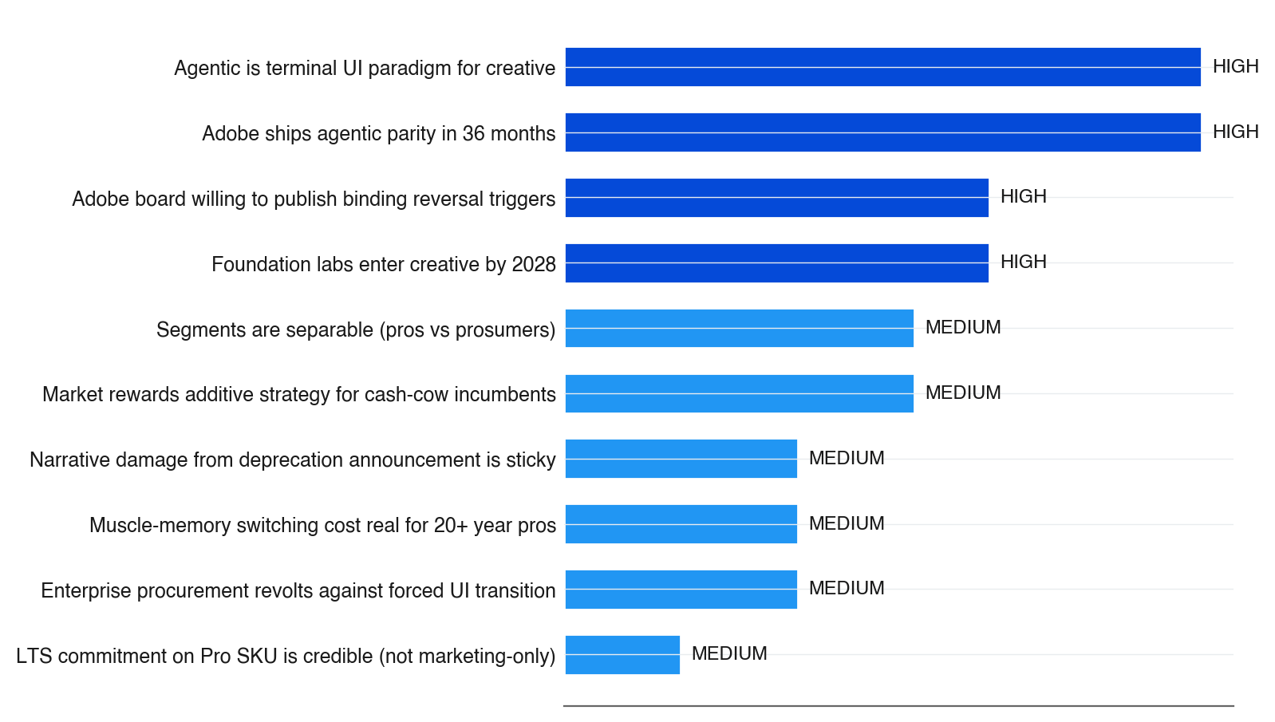
3.5/ SENSITIVITY
Three high-sensitivity assumptions are load-bearing — if any one fails, aggressive deprecation becomes indefensible
▪ Bar length = sensitivity weight × number of effects impacted
▪ Dark-blue bar = HIGH sensitivity, lighter = MEDIUM
▪ All four HIGH-sensitivity assumptions are external — Adobe controls none directly
▪ h6's binding reversal triggers convert assumption-failure from catastrophic to recoverable
▪ If 36-month parity slips (>60% probability per [C1:council]), aggressive deprecation guarantees the partial-agentic awkward state — exactly what h6 is structured to prevent
Source: Decision Brief — Key Assumptions · sensitivity per effects-impacted × HIGH/MEDIUM/LOW weight
Autodecision 13

Slide 14
PART 4
Path forward
Six checkpoints with binding reversal triggers — every gate has a kill criterion before the next commitment.
Autodecision 14

Slide 15
4.1/ ROADMAP
The recommendation maps to a six-checkpoint roadmap with clear kill criteria at each stage
Every checkpoint has a binding reversal trigger; failure at any gate triggers either reversal or extension of LTS
When
Action
Decision point
Kill criteria
Q2 FY26
Firefly AI Assistant beta launches
Beta NPS ≥ 50 from pros
Beta NPS < 30 → reassess
Q3 FY26
Publish Pro LTS commitment + Agentic SKU roadmap
Public commitment with binding reversal triggers
Board refuses to publish → fall back to pure h3
Q4 FY26
Firefly AI Assistant GA across CC apps
GA launches on schedule
Ship slip > 2 quarters → narrative damage risk
FY27
Agentic SKU builds; Pro SKU continues UI investment
Agentic ARPU $15-20/mo; Pro maintained
Pro churn > 5% OR Agentic ARPU < $10 → reversal
FY28
Foundation lab entry decision point
OpenAI/Anthropic creative products shipped or not
Foundation lab dominant category → accelerate
FY29
3-year review point (original deprecation date)
Reaffirm LTS; evaluate market shift
Pro churn > 8% → reversal; <3% + strong agentic → continue
Source: Decision Brief — Appendix A: Decision Timeline · binding reversal triggers per [C17:council]
Autodecision 15

Slide 16
APPENDIX SOURCES
Selected sources
Tags appear inline throughout the deck — [G#] = ground data, [C#:persona] = council finding, [C#:adversary] = adversarial scenario
Tag
Type
Claim
Source
G2
Ground
Creative Cloud: 41M paid subs YE 2025; 80M+ freemium MAUs
prodesigntools.com, qz.com
G3
Ground
Adobe Acrobat UI redesign backlash sustained and unresolved
acrobat.uservoice.com
G15
Ground
Firefly AI Assistant announced April 15 2026 (additive, not replacement)
blog.adobe.com, news.adobe.com
G17
Ground
Firefly AI Assistant supports third-party models (Anthropic Claude)
appleinsider.com
C3
Council
Foundation labs enter creative by 2028 P=0.5 joint
iter-1 council
C4
Council
Reversal impossible P=0.75 after announcement
iter-1 pessimist
C7
Council
Pro churn spike P=0.70 with 18-28% magnitude
iter-1 council
C10
Council
Installed base retained under additive P=0.80
iter-1 council
C17
Council
Binding reversal triggers at 8% pro churn
iter-2 council
C23
Adversary
Foundation model plateau P=0.25 (worst case)
iter-1 adversary
C32
Adversary
F500 flagship client abandons Adobe P=0.15 (irrational actor)
iter-1 adversary
Source: Decision Brief — Sources (full list in companion brief markdown)
Autodecision 16

