Slide 1
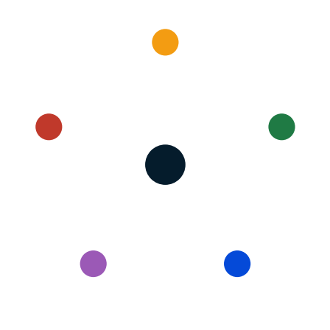
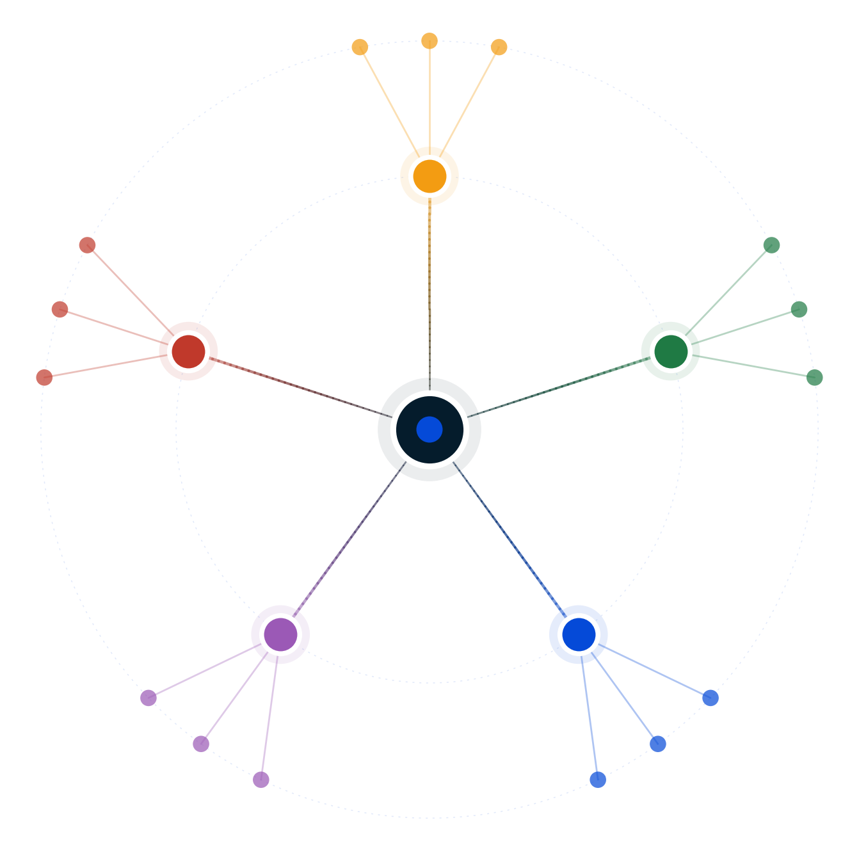
Autodecision
$50B buyback vs $50B AI moonshot
Decision Brief — possibility map and recommendation
April 2026
GENERATED BY AUTODECISION — possibility map with synthesized recommendation, not a single-shot answer

Slide 2
Table of contents
Section
Slides
Recommendation
3
How we explored this decision
4 – 7
What the council found
8 – 13
Path forward
14 – 15
Appendix — Sources
16
Autodecision 2

Slide 3
1/ RECOMMENDATION
Pure $50B moonshot is dominated; mirror the Microsoft-OpenAI partnership-first structure instead
Execute partnership-first structure: $10-15B equity in a frontier AI lab + $30-35B buyback + $5B adjacent moonshot in a vertical the company's distribution actually moats. Mirror the Microsoft-OpenAI playbook ($13B [G18] stake → $150B+ value creation).
CONFIDENCE
DEPENDS ON
MONITOR
HIGH that pure $50B moonshot is strictly dominated · MEDIUM-HIGH that pure $50B buyback is dominated in 2026 AI-bifurcated regime · MEDIUM on partnership-first executability (gated by lab availability + antitrust)
Frontier lab accepts minority non-voting equity without exclusivity [C5:council] · Antitrust clears $10-15B stake · AI is a platform shift · Moonshot base rate 70-85% failure holds · Staged deployment kill criteria board-credible
Frontier lab partnership announcements by peers · IRA buyback excise tax debate · Meta Reality Labs quarterly burn · Microsoft-OpenAI exclusivity renegotiation · Peer $50B+ moonshots · ML talent attrition · Foundation model benchmarks
PRE-MORTEM
DEEPEST DISAGREEMENT
REVIEW TRIGGER
Exclusivity locks multi-lab optionality (P=0.40) · Antitrust drag 12-18 months (P=0.30) · Partner lab falls behind in capability race (P=0.20) · Activist forces reversal mid-deployment (P=0.25) · Vertical moonshot slips into meta-trap (P=0.30)
Optimist: 25% [C2:optimist] AI moonshot platform capture. Pessimist: 5% [C2:pessimist]. Council range 5-25% — partnership-first captures 60-70% of upside without 70-85% [C3:pessimist] downside.
Frontier lab terms include problematic exclusivity · AI platform shift weakens · Activist 13D on big tech · Meta reverses Reality Labs · Microsoft-OpenAI renegotiation · IRA buyback hike passes
Source: Decision Brief (full mode, 2 iterations, council 5/5 endorsement on h6, 12/12 adversarial survival) · [G18], [C5:council], [C9:council], [C10:council]
Autodecision 3

Slide 4
PART 2
How we explored this decision
A 5-persona council, 6 competing hypotheses, two iterations to convergence, and 12 adversarial stress scenarios — what survived?
Autodecision 4

Slide 5
2.1/ HOW WE ANALYZED
Two iterations of a 5-persona council and 12 adversarial scenarios converged on partnership-first structure
▪ 5 personas spawned as separate subagents — Optimist, Pessimist, Competitor, Regulator, Customer — each with independent context
▪ 6 hypotheses generated, ranging from pure buyback (h1) and pure moonshot (h2) to hybrid split (h5) to the synthesis winner (h6 partnership-first, MSFT-OpenAI mirror)
▪ 2 iterations — convergence reached at iteration 2 with 85% assumption stability, 1 productive contradiction remaining
▪ Adversary phase generated 12 stress scenarios across worst-cases, black swans, and irrational actors — h6 survives 12/12 [C10:council]
▪ Sensitivity analysis on 8 key assumptions — 4 high-sensitivity, 3 medium, 1 low
▪ Real-world anchor: Microsoft-OpenAI partnership ($13B [G18] stake → $150B+ value creation) is the proven incumbent AI playbook the recommendation mirrors
Source: Decision Brief Convergence Log; engine-protocol.md
Autodecision 5

Slide 6
2.2/ HYPOTHESES
Six hypotheses surfaced; only h6 (partnership-first) survived 5/5 council and 12/12 adversarial scenarios
#
Hypothesis
Status
Key assumptions
1
Buyback dominates (pure $50B return)
Conditional on AI = utility
AI is utility not platform · Market rewards discipline · Mature company can't ship moonshot
2
Moonshot dominates (pure $50B AI bet)
Conditional · joint P 5-25%
AI is platform shift · Mature company can ship · Incumbent distribution advantage
3
Moonshot meta-trap (Reality Labs pattern)
Risk path of h2
Reality Labs pattern applies · Org rigidity real · No partnership available
4
Buyback signals no vision
Conditional on AI bifurcation
Market punishes no narrative · AI-era valuation bifurcation · Talent flight
5
Hybrid split (buyback + moonshot)
Structurally fragile · pleases neither
Market accepts hybrid · Split strategy credible · Underfunded moonshot fails same way
6
Partnership-first (MSFT-OpenAI mirror)
Leading · 5/5 council, 12/12 adversarial
Frontier lab accepts partnership · No exclusivity blocks optionality · Antitrust clears minority stake
Source: Decision Brief — Hypotheses Explored
Autodecision 6

Slide 7
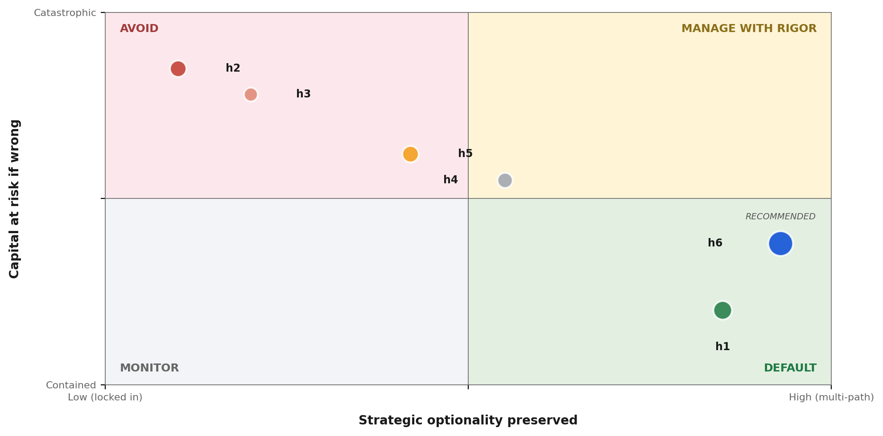
2.3/ STRATEGIC POSITIONING
Plotted on capital at risk × optionality preserved, h6 captures the AI upside without sitting where Reality Labs failed
READ
▪ h2 — Pure $50B moonshot — Reality Labs pattern, 70-85% base rate failure [C3:pessimist]
▪ h3 — Moonshot meta-trap — risk scenario of h2, organizational rigidity tax 3-5×
▪ h4 — Buyback signals no vision — narrative compression in AI-bifurcated market
▪ h5 — Hybrid split — pleases neither activist faction, underfunds the moonshot
▪ h1 — Pure $50B buyback — mechanical EPS accretion 8-12% [C1:council], capital not at risk
▪ h6 — Partnership-first — $10-15B equity + $30-35B buyback + $5B vertical · captures 30-50% [C9:council] of AI upside
Source: Synthesis from Decision Brief — bubble size = council_agreement × dominant probability of the hypothesis
Autodecision 7

Slide 8
PART 3
What the council found
Where the personas converged, where they diverged, and what the disagreement itself reveals about the decision.
Autodecision 8

Slide 9
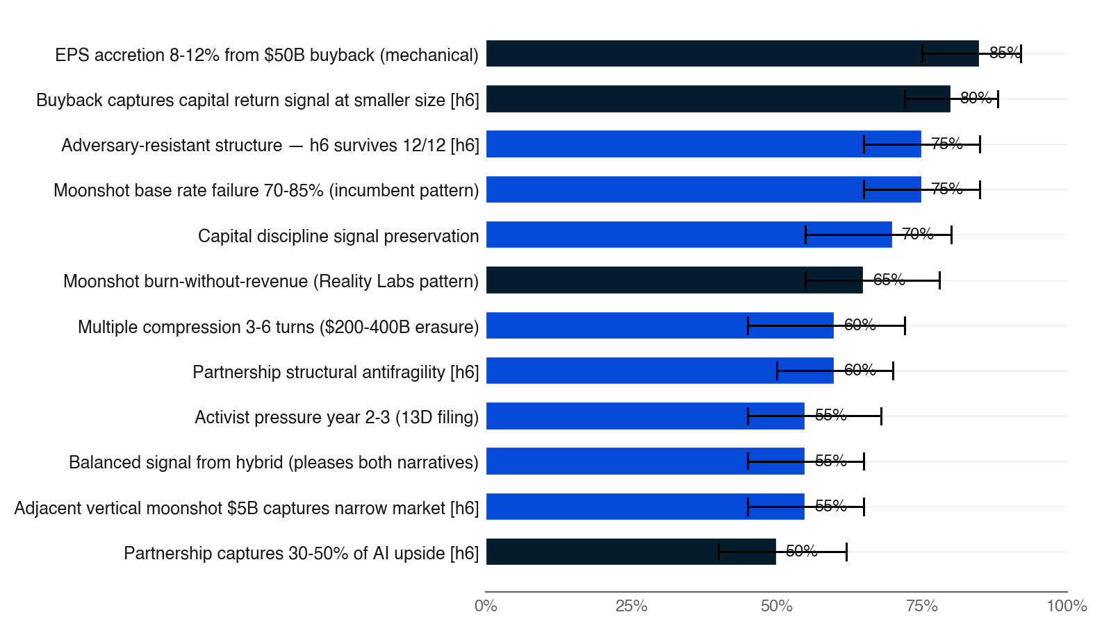
3.1/ EFFECTS MAP
The mechanical buyback (P=0.85) and the moonshot burn pattern (P=0.65) are the two highest-confidence signals
▪ Top 12 effects ranked by council_agreement × probability
▪ Bar color = council agreement (navy = 5/5, fading to pale = 1/5)
▪ Black bracket = persona disagreement range — width is the uncertainty signal
▪ Two of the three highest-agreement effects (5/5) belong to h6 partnership-first
▪ The Reality Labs burn pattern (P=0.65, 5/5) dominates pure-moonshot risk math
Source: Decision Brief — Effects Map (top 15 by council_agreement × probability) · [C1:council], [C9:council], [C10:council]
Autodecision 9

Slide 10
3.2/ COUNCIL DYNAMICS
Optimist's 25% vs Pessimist's 5% on AI-as-platform IS the data — partnership-first dominates either world
STRONGEST: COMPETITOR (#1 PEER RANK)
KEY DIVIDE: AI PLATFORM SHIFT REALITY
▪ Won on second-order competitive dynamics and the Microsoft-OpenAI partnership-first synthesis
▪ Spotted the structural asymmetry: $50B is HALF of frontier capex per hyperscaler [G4] — pure moonshot starts underfunded
▪ Surfaced the Bing counter-example as analog — 20 years of Microsoft distribution couldn't overcome Google's category lock-in
▪ Authored the alt_partnership_first_moonshot_second variant that synthesized into h6
▪ Optimist: 25% [C2:optimist] AI moonshot category capture probability
▪ Pessimist: 5% [C2:pessimist] AI moonshot category capture probability
▪ Council range 5-25% on the moonshot upside — the disagreement IS the data
▪ Customer was weakest (#5 peer rank) — public-equity decision had more signaling weight than product-side insights
▪ BLIND SPOT: 4/5 personas inflated option-value probabilities on moonshot upside; underfunded-vs-frontier point fixed in h6
Source: Decision Brief — Council Dynamics · [C2:optimist], [C2:pessimist], [G4], [G18]
Autodecision 10

Slide 11
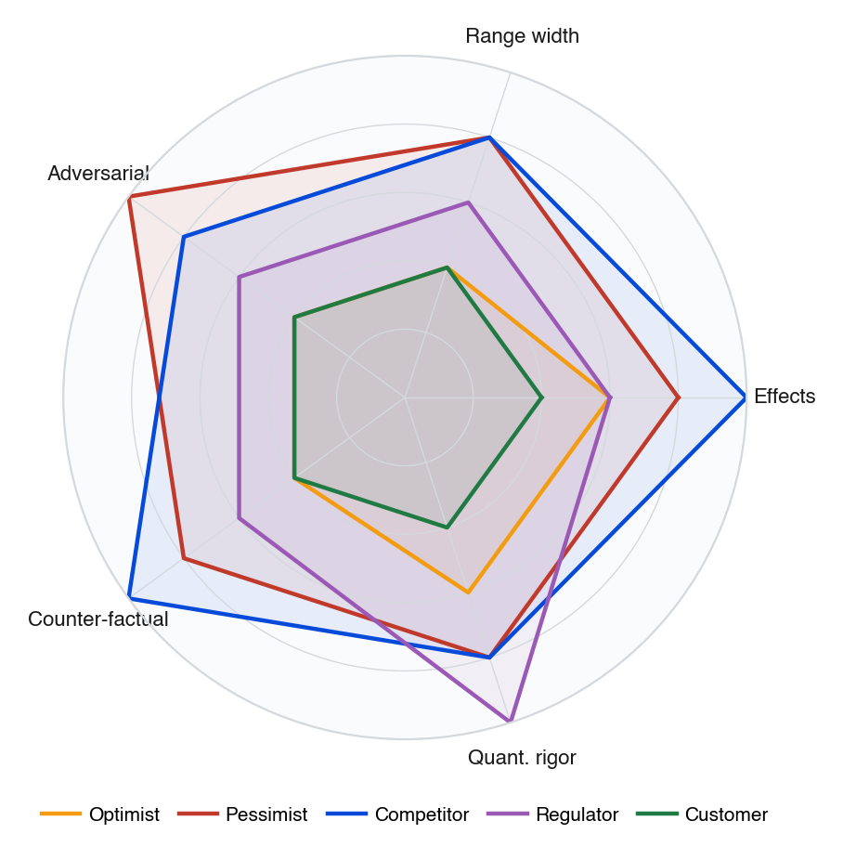
3.3/ COUNCIL DEPTH
Competitor topped peer rank on second-order dynamics; Customer's narrow product lens drove its #5 placement
▪ Each persona scored 1-5 across five rigor dimensions, derived from peer-review and critique outputs
▪ Competitor's structural depth surfaced the partnership-first alternative that synthesized into h6 — Microsoft-OpenAI mirror
▪ Pessimist's adversarial coverage anchored the Reality Labs precedent and 70-85% [C3:pessimist] base rate failure rate
▪ Regulator's quantitative rigor scored highest on antitrust and IRA tax structural workarounds
▪ Customer's narrow lens (#5 peer rank) is structural — public-equity decisions weight signaling over product
Source: Synthesized from Decision Brief — Council Dynamics + Critique outputs
Autodecision 11

Slide 12
3.4/ ADVERSARIAL PRESSURE
Twelve adversarial scenarios — h6 survives 12/12; pure moonshot survives only 5/12
WORST CASES
BLACK SWANS
IRRATIONAL ACTORS
▪ Foundation model plateau 2027-2028 (P=0.20)
▪ Activist 13D year 2 forcing reversal (P=0.35)
▪ $30B write-off year 4 (P=0.30)
▪ Key CTO departure post-announcement (P=0.25)
▪ OpenAI/Anthropic IPO at $3T valuation (P=0.15)
▪ AI liability suit hits moonshot mid-development (P=0.18)
▪ Stock market correction compresses all multiples (P=0.25)
▪ CEO health crisis mid-transition (P=0.08)
▪ Activist hostile bid for the company (P=0.10)
▪ Competitor launches $100B buyback + AI partnership same week (P=0.12)
▪ Key AI researcher publicly trashes moonshot on social (P=0.22)
▪ Trump admin AI import tariff (P=0.30)
Source: Decision Brief — Adversarial Scenarios · [C23:adversary] through [C34:adversary]
Autodecision 12

Slide 13
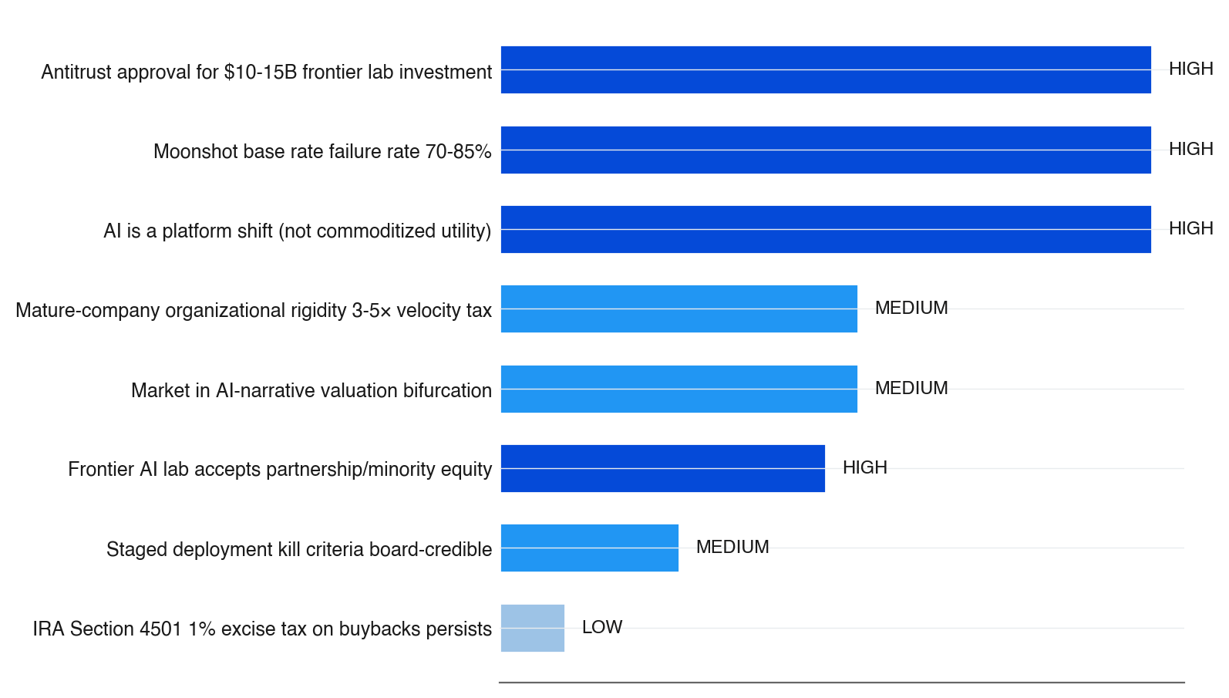
3.5/ SENSITIVITY
Four high-sensitivity assumptions are load-bearing — if any one fails, partnership-first becomes the staged-hybrid fallback
▪ Bar length = sensitivity weight × number of effects impacted
▪ Dark-blue bar = HIGH sensitivity, lighter = MEDIUM, palest = LOW
▪ Three of four HIGH-sensitivity assumptions are external — gated by frontier labs and regulators
▪ If frontier lab partnership is unavailable (all labs exclusive), h6 collapses to staged-hybrid fallback
▪ Antitrust review timing alone can drag 12-18 months [C40:council] — pre-filing with regulators before announcement is the mitigation
Source: Decision Brief — Key Assumptions · sensitivity per effects-impacted × HIGH/MEDIUM/LOW weight
Autodecision 13

Slide 14
PART 4
Path forward
Seven checkpoints from Month 0 board approval to Month 60 review — every gate has a kill criterion before the next commitment.
Autodecision 14

Slide 15
4.1/ ROADMAP
The recommendation maps to a seven-checkpoint roadmap with binding kill criteria at every gate
Failure at any gate triggers either reversion to staged-hybrid fallback or capital redeployment
When
Action
Decision point
Kill criteria
Month 0
Board approval on partnership-first structure
Framework approved
Board rejection → staged-hybrid
Month 1-3
Explore frontier lab partnership terms
LOI signed with at least one lab
No lab accepts → staged-hybrid
Month 3-6
Antitrust pre-filing + structure optimization
Regulator signals approval path
Regulator block → minority passive structure
Month 6-9
Close partnership + announce buyback program
Official announcements
Partnership close slips > 9 months → staged-hybrid
Month 9-24
Execute $30-35B buyback; vertical moonshot tranche 1
Tranche 1 milestones met
Vertical team can't be hired → skip moonshot
Month 24-36
Vertical moonshot tranche 2 ($2.5B) gated on milestones
ARR > $500M [C1:council]
ARR < $100M → halt
Month 36-60
Evaluate partnership renewal; moonshot expansion
5-year review
Partner falls behind; moonshot fails → redeploy capital
Source: Decision Brief — Appendix A: Decision Timeline · binding kill criteria per [C38:council]
Autodecision 15

Slide 16
APPENDIX SOURCES
Selected sources
Tags appear inline throughout the deck — [G#] = ground data, [C#:persona] = council finding, [C#:adversary] = adversarial scenario
Tag
Type
Claim
Source
G4
Ground
2026 hyperscaler capex: AMZN $200B, GOOG $175-185B, META $115-135B, MSFT $120B+, ORCL $50B; collective $660-690B
techcrunch.com, futurumgroup.com
G7
Ground
OpenAI $20B ARR end 2025 (3× YoY); pure-play AI revenue is fraction of infra spend
techcrunch.com
G8
Ground
Meta Reality Labs: $69-77B cumulative loss; $17B 2025 burn; $1.08B Q4 revenue; 10-15yr break-even (cautionary)
Meta 10-K, CNBC, Reuters
G12
Ground
Apple $110B buyback May 2024 → stock +7% despite -4% sales, -10% iPhone
fool.com
G18
Ground
Microsoft-OpenAI: $13B stake + exclusivity → $150B+ value creation (the partnership-first proof point)
techcrunch.com
C2:opt
Council
Moonshot platform capture P=0.25 in optimist view
iter-1 optimist
C2:pess
Council
Moonshot platform capture P=0.05 in pessimist view
iter-1 pessimist
C3:pess
Council
Incumbent moonshot base rate failure 70-85%
iter-1 pessimist
C5
Council
Frontier lab partnership availability P=0.5 (range 0.3-0.65) — binary precondition for h6
iter-1 council
C9
Council
Partnership captures 30-50% of AI upside without organizational rigidity burden
iter-2 council
C10
Council
h6 adversary-resistance: survives 12/12 stress scenarios
iter-2 council
C24
Adversary
Activist 13D year 2 forcing reversal P=0.35 (worst case)
iter-1 adversary
Source: Decision Brief — Sources (full list in companion brief markdown)
Autodecision 16

