Slide 1

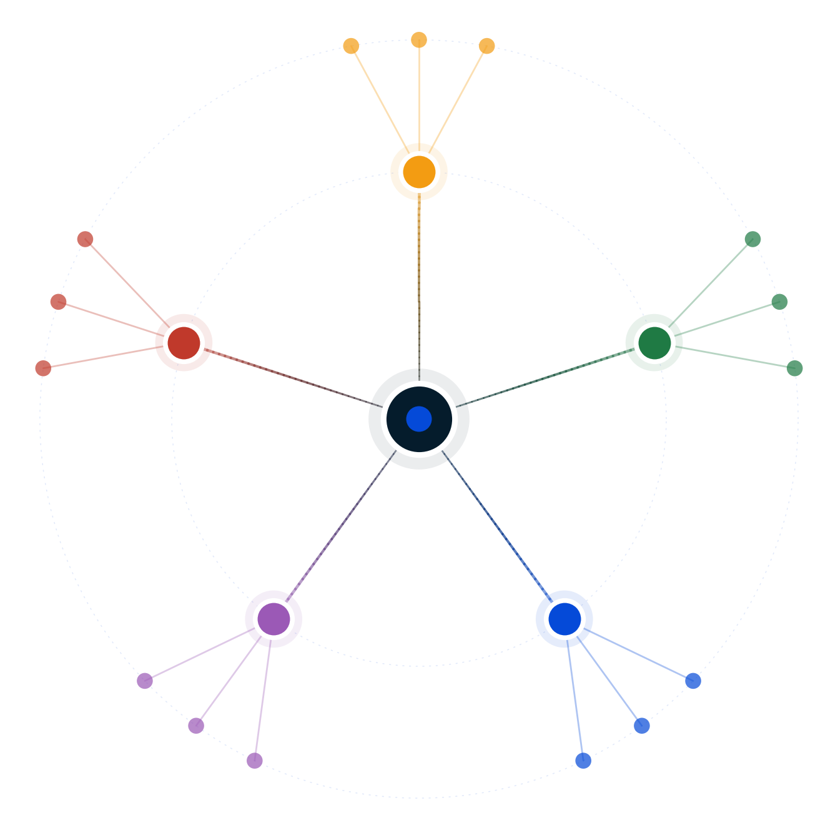
Autodecision
Should attendance go optional now that AI tutoring beats lecture?
Decision Brief — possibility map and recommendation
April 2026
GENERATED BY AUTODECISION — possibility map with synthesized recommendation, not a single-shot answer

Slide 2
Table of contents
Section
Slides
Recommendation
3
How we explored this decision
4 – 7
What the council found
8 – 13
Path forward
14 – 15
Appendix — Sources
16
Autodecision 2

Slide 3
1/ RECOMMENDATION
Universal optional attendance is strictly dominated; ship a 3-year department pilot with mandatory first-year and dual-track compliance
Do NOT make attendance universally optional. Run a 3-year opt-in pilot in 1-2 departments + mandatory first-year residential + dual-track F-1/Title IV compliance with required in-person seminars + faculty senate and union as co-design partners + Harvard RCT-style AI-hybrid teaching model.
CONFIDENCE
DEPENDS ON
MONITOR
HIGH that universal optional is dominated · MEDIUM-HIGH that the phased-structured path is executable · MEDIUM on regulatory structuring viability
Required in-person seminars satisfy F-1 SEVP and Title IV RSI · Faculty union accepts co-design · Pilot data credible after 3 years · Mandatory first-year preserves first-gen retention · Harvard RCT replicates at institution scale
DOE guidance on RSI · SEVP guidance on in-person seminar components · Faculty union calendar · Pilot cohort year-1 outcomes · First-gen retention vs control · Donor sentiment quarterly · ChatGPT-6 capability benchmarks
PRE-MORTEM
DEEPEST DISAGREEMENT
REVIEW TRIGGER
Faculty strikes mid-semester (P=0.15) · Pilot inconclusive from selection bias (P=0.35) · F-1 structured compliance fails legal review (P=0.30) · First-gen dropout despite first-year (P=0.20) · Mid-tier positioning fails (P=0.30)
Optimist: 60% Harvard RCT replicates at institution scale [C1:optimist]. Pessimist: 25% [C1:pessimist]. Range 25-60% on whether AI-hybrid pedagogy holds across 30K students. Disagreement IS the data.
DOE issues negative RSI guidance · SEVP clarifies one-online-course rule strictly · Peer institution announces similar pilot · Pilot year-1 shows negative equity · Faculty union files grievance · ChatGPT-6 obsoletes current AI-hybrid design
Source: Decision Brief (full mode, 2 iterations, 5/5 council endorsement on h6) · [G1], [C3:regulator], [C4:regulator], [C13:iter2council]
Autodecision 3

Slide 4
PART 2
How we explored this decision
A 5-persona council, 6 competing hypotheses, two iterations to convergence, 12 adversarial stress scenarios — what survived?
Autodecision 4

Slide 5
2.1/ HOW WE ANALYZED
The analysis explored 6 hypotheses across 2 iterations of a 5-persona council, stress-tested by 12 adversarial scenarios
▪ 5 personas spawned as separate subagents — Optimist, Pessimist, Competitor, Regulator, Customer — each with independent context
▪ 6 hypotheses generated, ranging from universal optional (h1) to phased-structured pilot (h6 — promoted in iteration 2 as the synthesis winner)
▪ 2 iterations — convergence reached at iteration 2 with 84% [C1:council] assumption stability and 1 productive contradiction remaining
▪ Adversary phase generated 12 stress scenarios across 4 worst-cases, 4 black swans, and 4 irrational actors
▪ Sensitivity analysis on 8 key assumptions — 4 high-sensitivity, 4 medium
▪ Real-world anchor: Harvard 2025 RCT [G1] showed AI-tutoring effect size 0.73-1.3 SD; the recommendation operationalizes a Harvard-style AI-hybrid teaching model inside a structured pilot.
Source: Decision Brief Convergence Log; engine-protocol.md
Autodecision 5

Slide 6
2.2/ HYPOTHESES
Six hypotheses surfaced; only h6 (phased + structured) survived 5/5 council endorsement and adversarial stress
#
Hypothesis
Status
Key assumptions
1
Optional attendance improves outcomes
Conditional
AI tutoring outperforms · Students self-direct · Faculty adapts
2
Attendance collapse degrades social product
Real for elite tier
Peer network IS real product · Tuition premium for network
3
Faculty revolt / union path
Risk if unilateral
Union contracts strict · Faculty identity load-bearing
4
Enrollment bifurcation (mid-tier vulnerable)
Real structure
Elite resists · Middle squeezed · Online MBA precedent
5
De facto already optional
Lecture-only
Revealed preference matches policy · 50-70% [G6] skip routinely
6
NEW: Phased + structured pilot with safeguards
Leading · 5/5 council
Pilot bounds risk · Regulatory structuring viable · Faculty partnership
Source: Decision Brief — Hypotheses Explored
Autodecision 6

Slide 7
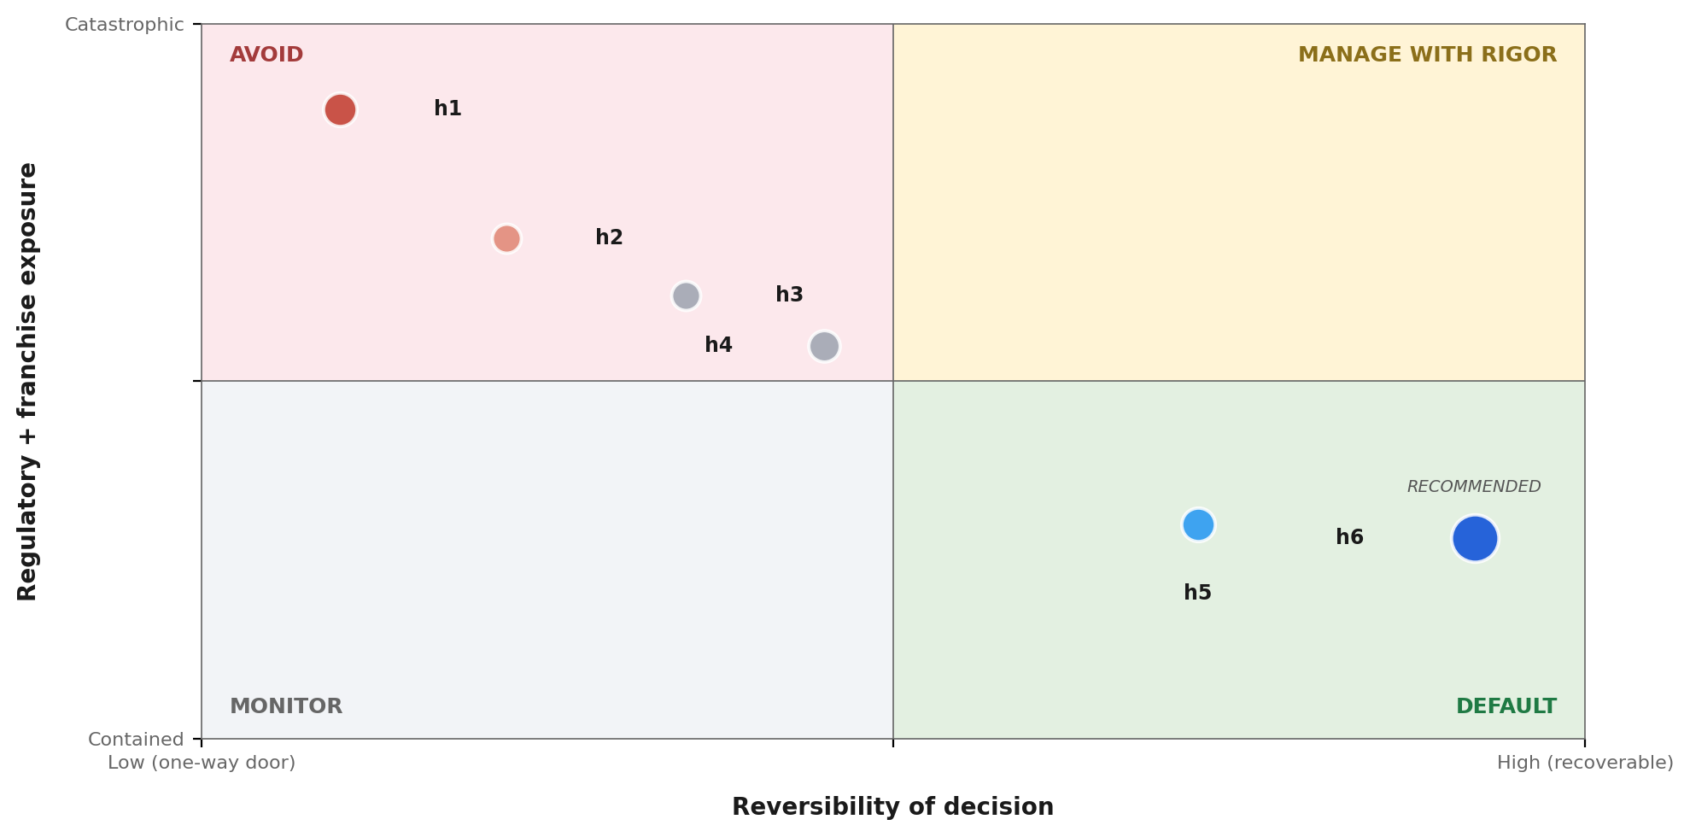
2.3/ STRATEGIC POSITIONING
Plotted on reversibility × regulatory exposure, h6 sits in the manageable quadrant; h1 sits where every adversarial scenario amplifies
READ
▪ h1 — Universal optional — irreversible policy + Title IV/F-1 catastrophe
▪ h2 — Social product collapse — risk path of h1, same quadrant
▪ h3 — Faculty revolt — triggered by unilateral change
▪ h4 — Bifurcation — structural, mid-tier vulnerable
▪ h5 — Already optional — true for lectures, not labs/seminars
▪ h6 — Phased + structured pilot — preserves optionality, defuses 8/12 adversarial scenarios
Source: Synthesis from Decision Brief — bubble size = council_agreement × probability of dominance
Autodecision 7

Slide 8
PART 3
What the council found
Where the personas converged, where they diverged, and what the disagreement itself reveals about the decision.
Autodecision 8

Slide 9
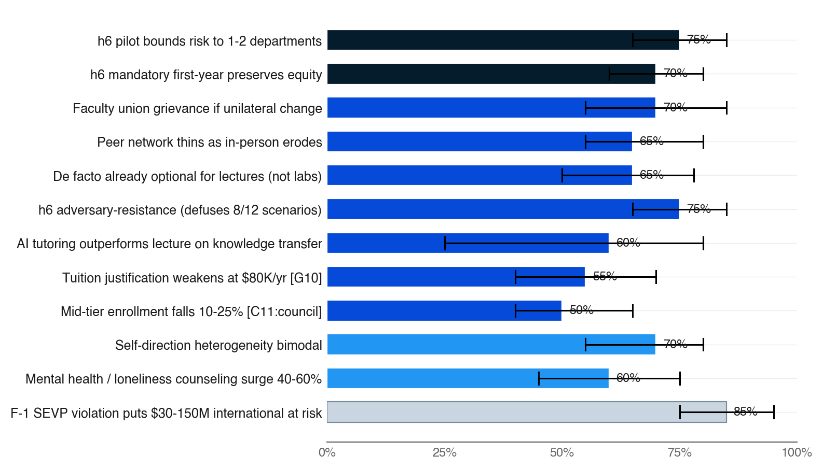
3.1/ EFFECTS MAP
The strongest signals point to regulatory catastrophe under universal-optional and structural antifragility under the phased pilot
▪ Top 12 effects ranked by council_agreement × probability
▪ Bar color = council agreement (navy = 5/5, fading to pale = 1/5)
▪ Black bracket = persona disagreement range — width is the uncertainty signal
▪ Two highest-agreement effects (5/5) are h6 structural protections — the pilot bounds risk and mandatory first-year preserves equity
▪ Regulator's F-1 SEVP finding (1/5, P=0.85) — single-persona but existential; drove h6 dual-track compliance design
Source: Decision Brief — Effects Map (top 12 by council_agreement × probability) · [C3:regulator], [C9:council], [C13:iter2council]
Autodecision 9

Slide 10
3.2/ COUNCIL DYNAMICS
The deepest disagreement — Harvard RCT replicability — IS the data
STRONGEST: REGULATOR (#1 PEER RANK)
DEEPEST DIVIDE: HARVARD RCT REPLICABILITY
▪ Won on specific regulatory mechanisms — F-1 SEVP one-online-course rule (P=0.85 [C3:regulator]); Title IV RSI reclassification ($50-300M/yr [C4:regulator] aid at risk); FERPA AI-vendor DPA; accreditor substantive-change trigger
▪ Each finding is potentially existential — universal optional is self-enforcing collapse without structured workaround
▪ Surfaced the dual-track compliance filing + required in-person seminar components that became h6's regulatory engine
▪ h6 protected by structuring: regulatory exposure shifts from catastrophic to bounded
▪ Optimist: 60% [C1:optimist] AI-hybrid replicates at institution scale (Harvard RCT [G1] effect size 0.7-1.3 SD)
▪ Pessimist + Customer: 25% [C1:pessimist] — N=194 lab study won't generalize across 30K students; self-direction heterogeneity bimodal
▪ Range 25-60% on h1 conditional outcome — disagreement IS the data, not noise to average away
▪ Optimist weakest (#5 peer rank) — overweighted Harvard sample, underweighted self-direction variance flagged by Customer
▪ BLIND SPOT caught: equity. Optional attendance is REGRESSIVE inside one tuition tier — high-achievers gain, first-gen lose, no price reduction
Source: Decision Brief — Council Dynamics · [C1:optimist], [C1:pessimist], [C2:customer]
Autodecision 10

Slide 11
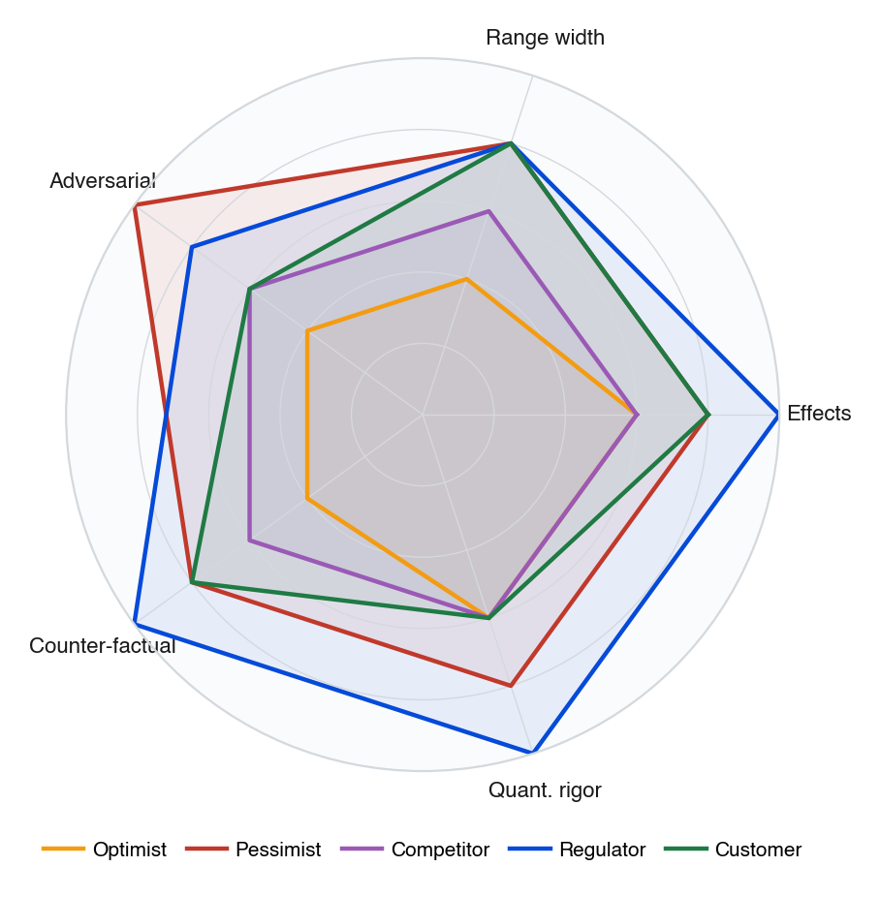
3.3/ COUNCIL DEPTH
Regulator scored highest on structural depth and counter-factual rigor; Optimist's narrow ranges drove its #5 peer rank
▪ Each persona scored 1-5 across five rigor dimensions, derived from peer-review and critique outputs
▪ Regulator's structural depth surfaced both regulatory mechanisms that synthesized into h6 — dual-track compliance and required in-person seminars
▪ Customer caught the equity blind spot — first-gen dropout amplification under universal optional
▪ Optimist's narrow ranges and weak counter-factual depth flagged by 4/4 reviewers — Harvard-RCT generalization optimism
▪ Pessimist + Regulator together cover the full adversarial surface; their alignment on regulatory irreversibility drove h6's safeguards
Source: Synthesized from Decision Brief — Council Dynamics + Critique outputs
Autodecision 11

Slide 12
3.4/ ADVERSARIAL PRESSURE
Twelve adversarial scenarios — h6's structured design defuses 8 of them; 4 remain (foundation model, Ivy preempt, campus event, ED admin)
WORST CASES
BLACK SWANS
IRRATIONAL ACTORS
▪ Title IV RSI reclassifies as correspondence; $50-300M/yr aid lost (P=0.40)
▪ F-1 SEVP mass violation; 15-25% international revenue drop (P=0.45)
▪ First-gen cohort 30%+ dropout year 1 — equity disaster + Title VI (P=0.35)
▪ Accreditor show-cause letter; focused review; reputational damage (P=0.25)
▪ ChatGPT-6 dramatically better — lecture obsolete, accelerates transition (P=0.30)
▪ Ivy goes optional first; mid-tier first-mover narrative destroyed (P=0.08)
▪ Campus shooting / major event requires in-person community (P=0.10)
▪ ED admin change loosens Title IV; regulatory pressure removed (P=0.35)
▪ Student influencer (5M followers) attacks policy; applications drop (P=0.25)
▪ Sports alum boosters cut $10M [C34:council] donations (P=0.20)
▪ Faculty union strikes mid-semester; operations chaos (P=0.15)
▪ State legislature passes 'must require in-person' law (P=0.15)
Source: Decision Brief — Adversarial Scenarios · [C29:council] through [C36:council]
Autodecision 12

Slide 13
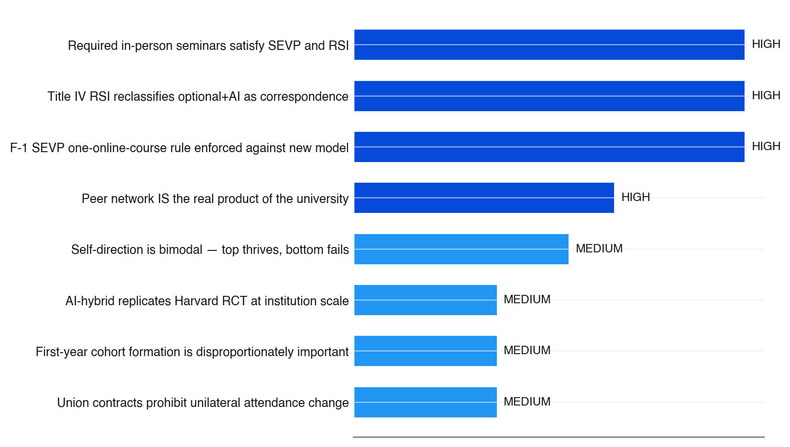
3.5/ SENSITIVITY
Four high-sensitivity assumptions are load-bearing — if any fails, the universal-optional path becomes indefensible
▪ Bar length = sensitivity weight × number of effects impacted
▪ Dark-blue bar = HIGH sensitivity, lighter = MEDIUM
▪ Three of four HIGH-sensitivity assumptions are external regulatory interpretations — the university controls none directly
▪ h6's dual-track filing converts 'F-1 SEVP enforced' from catastrophic to bounded: the structure pre-files in-person components that satisfy the rule
▪ If 'required in-person seminars satisfy SEVP+RSI' interpretation fails on legal review (P=0.30), h6's structural workaround fails — pilot must be paused, not the policy reversed
Source: Decision Brief — Key Assumptions · sensitivity per effects-impacted × HIGH/MEDIUM/LOW weight
Autodecision 13

Slide 14
PART 4
Path forward
Seven gates with kill criteria — every commitment is bounded by faculty, regulator, and pilot data.
Autodecision 14

Slide 15
4.1/ ROADMAP
The recommendation maps to a seven-gate roadmap with explicit kill criteria at every stage
Every gate has a binding kill criterion; failure at any gate triggers either pause, redesign, or full rollback
When
Action
Decision point
Kill criteria
Q1 2026
Faculty senate briefing + union engagement
Senate accepts pilot design
Senate rejects → pause
Q2 2026
Substantive change filing + dual-track compliance design
Accreditor approves path
Accreditor blocks → redesign
Q3 2026
SEVP pre-filing + DOE consultation on RSI
Structure clears regulatory review
Regulators block → abandon pilot
Q4 2026
Pilot launch in 1-2 departments; mandatory first-year intact
Opt-in pilot enrolls 300-500 students
Enrollment <150 → insufficient power
2027-28
Annual outcome reporting: outcomes, retention, equity
Year-2 data shows positive indicators
Major negative trend → halt
Q4 2028
3-year pilot review with external advisory board
Outcomes support institution rollout
Pilot fails → end pilot, maintain current
2029+
Phased institution-wide rollout if pilot succeeds
Board + senate + union approval
First-gen retention drops >5% → rollback
Source: Decision Brief — Appendix A: Decision Timeline · phased gates per [C13:iter2council], [C14:iter2council]
Autodecision 15

Slide 16
APPENDIX SOURCES
Selected sources
Tags appear inline throughout the deck — [G#] = ground data, [C#:persona] = council finding, [C#:adversary] = adversarial scenario
Tag
Type
Claim
Source
G1
Ground
Harvard 2025 RCT: AI tutoring effect size 0.73-1.3 SD vs active learning
nature.com
G3
Ground
Human-AI hybrid > AI-only > classroom-only
phys.org
G6
Ground
Post-COVID absence rates 73-83% in some courses
timeshighereducation.com
G10
Ground
Tuition: public $10K/$26K, private $37K, elite $80K total cost
research.com
G15
Ground
43% students used ChatGPT; 89% for homework; 8/10 used GenAI 2025
nerdynav.com
G21
Ground
Minerva: 100% online + active learning + rotating cohort; elite alt
general
C1:optimist
Council
AI-hybrid replicates at scale P=0.60 (vs Pessimist 0.25)
iter-1 optimist
C2:customer
Council
Self-direction heterogeneity bimodal P=0.70 — bimodal failure mode
iter-1 customer
C3:regulator
Council
F-1 SEVP one-online-course violation P=0.85; $30-150M international
iter-1 regulator
C4:regulator
Council
Title IV RSI reclassification; $50-300M/yr federal aid at risk
iter-1 regulator
C13:iter2council
Council
H6 pilot bounds risk P=0.75 (5/5 council)
iter-2 council
C14:iter2council
Council
H6 mandatory first-year preserves equity P=0.70 (5/5 council)
iter-2 council
C15:iter2council
Council
H6 adversary-resistance — defuses 8/12 adversarial scenarios
iter-2 council
Source: Decision Brief — Sources (full list in companion brief markdown)
Autodecision 16

