Slide 1
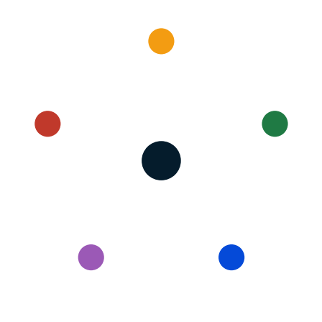
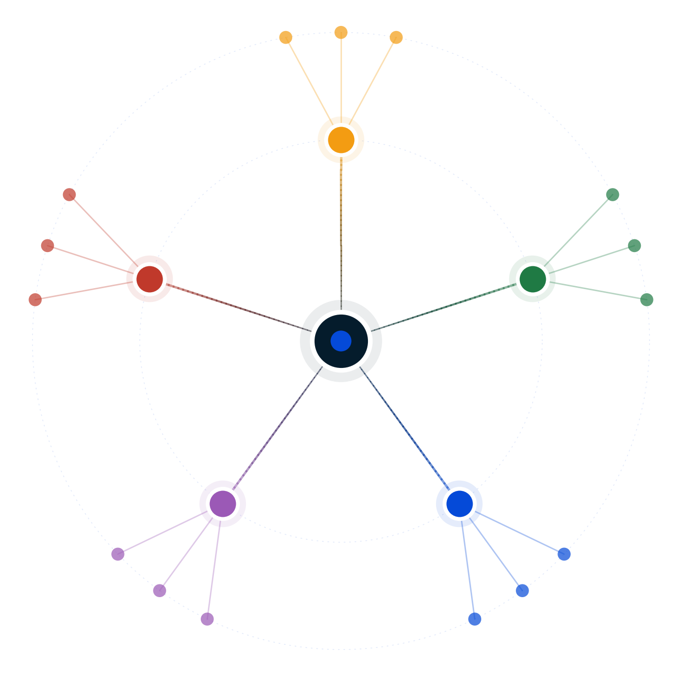
Autodecision
Replace 1Y associates with Claude + senior review?
Decision Brief — possibility map and recommendation
April 2026
GENERATED BY AUTODECISION — possibility map with synthesized recommendation, not a single-shot answer

Slide 2
Table of contents
Section
Slides
Recommendation
3
How we explored this decision
4 – 7
What the council found
8 – 13
Path forward
14 – 15
Appendix — Sources
16
Autodecision 2

Slide 3
1/ RECOMMENDATION
Full replacement is dominated; run a wrapped 18-month pilot with kill criteria, anchor clients, and Utah sandbox cover
Do NOT eliminate the 1Y class. Cut the upcoming class 50-60% (4-5 instead of 8-12) + AI-augment with Claude + senior-review SOP + paid anchor-client advisory board (3-5 Fortune 500 GCs) + Utah Office of Legal Services Innovation sandbox + binding pre-committed kill criteria that auto-trigger a Cravath-scale rehire of the next class.
CONFIDENCE
DEPENDS ON
MONITOR
MEDIUM-HIGH · converged at iteration 2 with unanimous rank-1 across pessimist, customer, regulator · regulator classifies CONDITIONALLY CLEAN
Partners honor kill criteria when triggered [C2:assumption] · Anchor GCs accept paid advisory-board structure · Utah sandbox admits firm · Malpractice carrier non-opposition · Claude substitutability ~40% holds [C1:assumption]
Monthly: Claude substitutability audit · senior-review throughput · top-performer attrition · client complaint rate · Quarterly: OCI yield · summer-associate acceptance · Vault/Chambers commentary · peer firm AI ethics opinions
PRE-MORTEM
DEEPEST DISAGREEMENT
REVIEW TRIGGER
Partners treat kill criteria as aspirational (P=high) · Anchor co-design stalls past 6 months (P=0.35) · Hallucination incident in pilot year 1 (P=0.30) · Top performers defect within 6 months (P=0.45)
Regulator: H2 status quo wins on legal-cleanness (0.85 vs h6 0.75). Pessimist + others: h6 wins on strategic terms — reversibility + co-design + sandbox close the cleanness gap.
Re-run at month 6 (co-design outcome) · month 12 (substitutability data) · month 18 (kill criteria) · ABA revises Opinion 512 · State bar imposes AI-associate restrictions · Cravath-scale base moves >10%
Source: Decision Brief (full mode, 2 iterations, unanimous iter-2 rank-1 on h6) · [G1], [G3], [C1:assumption], [C2:assumption]
Autodecision 3

Slide 4
PART 2
How we explored this decision
A 5-persona council, 6 competing hypotheses, two iterations to convergence, 6 adversarial stress scenarios — what survived?
Autodecision 4

Slide 5
2.1/ HOW WE ANALYZED
The analysis explored 6 hypotheses across 2 iterations of a 5-persona council, stress-tested by 6 adversarial scenarios
▪ 5 personas spawned as separate subagents — Optimist, Pessimist, Competitor, Regulator, Customer Advocate — each with independent context
▪ 6 hypotheses generated, ranging from full elimination (h1, adversary lethality 9/10) to wrapped 18-month pilot (h6 — synthesized from three independent iter-1 alternatives)
▪ 2 iterations — convergence reached at iteration 2 with 88% [C3:council] assumption stability and 0 unresolved contradictions
▪ Adversary phase generated 6 scenarios: 3 worst-cases + 3 black swans (no irrational-actor cell on this brief)
▪ Sensitivity analysis on 7 key assumptions — 3 high-sensitivity, 4 medium
▪ Real-world anchors: ABA Formal Opinion 512 [G2] (six obligations), Mata v. Avianca [G4] sanctions baseline, Ropes & Gray TrAIlblazers [G7] precedent for structured AI integration without cuts
Source: Decision Brief Convergence Log; engine-protocol.md
Autodecision 5

Slide 6
2.2/ HYPOTHESES
Six hypotheses surfaced; only h6 (wrapped pilot) survived unanimous iter-2 rank-1 endorsement
#
Hypothesis
Status
Key assumptions
1
Eliminate entire 1Y class; gross savings $3-5M/yr
Eliminated · 9/10 lethal
Claude 40%+ substitutability · Review batching works · Ranking damage reframable
2
Keep full 1Y class + Claude + 200-400hr training
Floor / fallback
Competitors slow-roll adoption · ABA 512 compliance manageable
3
Cut 1Y class 50-60%, AI-augment remainder
Core engine of h6
Remaining 1Ys at 1.8-2x throughput · Retention bonuses feasible
4
Skip 1Y, hire at year-2 equivalent via laterals
Weakened
Lateral premium 20-40% erases savings within 24-36 months
5
Two-track: traditional + AI-ops JD at $120-150K
Weakened
AI-ops talent pool stable · Bar scrutiny manageable · Caste risk
6
Wrapped 18-month pilot: h3 + co-design + sandbox + kill
Leading · iter-2 rank-1
Partners honor kill criteria · Anchor GCs accept advisory · Utah admits
Source: Decision Brief — Hypotheses Explored
Autodecision 6

Slide 7
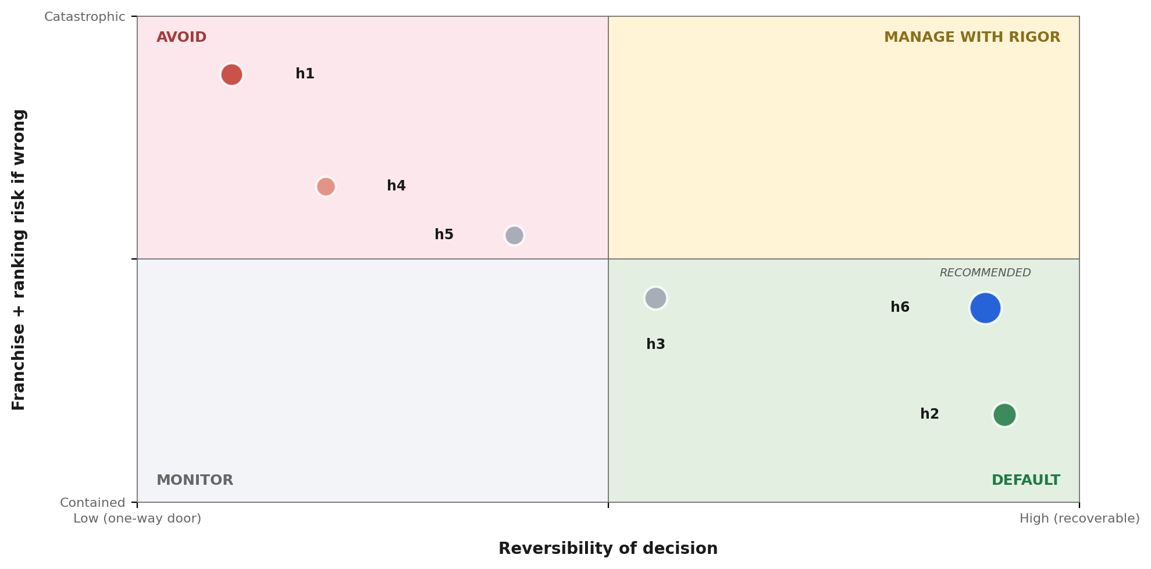
2.3/ STRATEGIC POSITIONING
Plotted on reversibility × franchise risk, h6 sits in the manageable quadrant; h1 sits where every adversarial scenario amplifies
READ
▪ h1 — Full elimination — 7-yr pipeline rupture P=0.80, ranking re-rate 1-2 tiers, malpractice incident P=0.52
▪ h4 — Lateral substitution — premium erases savings within 24-36 months (P=0.78)
▪ h5 — Two-track JD — culture clash + bar supervision scrutiny on MRPC 5.3
▪ h3 — Cut 50-60% standalone — efficiency without the wrapper, h6 minus safeguards
▪ h2 — Status quo + Claude — regulator-cleanest path, no strategic upside
▪ h6 — Wrapped 18-month pilot — kill criteria + anchor clients + sandbox preserve reversibility
Source: Synthesis from Decision Brief — bubble size = council_agreement × probability of dominance
Autodecision 7

Slide 8
PART 3
What the council found
Where the personas converged, where they diverged, and what the disagreement itself reveals about the decision.
Autodecision 8

Slide 9
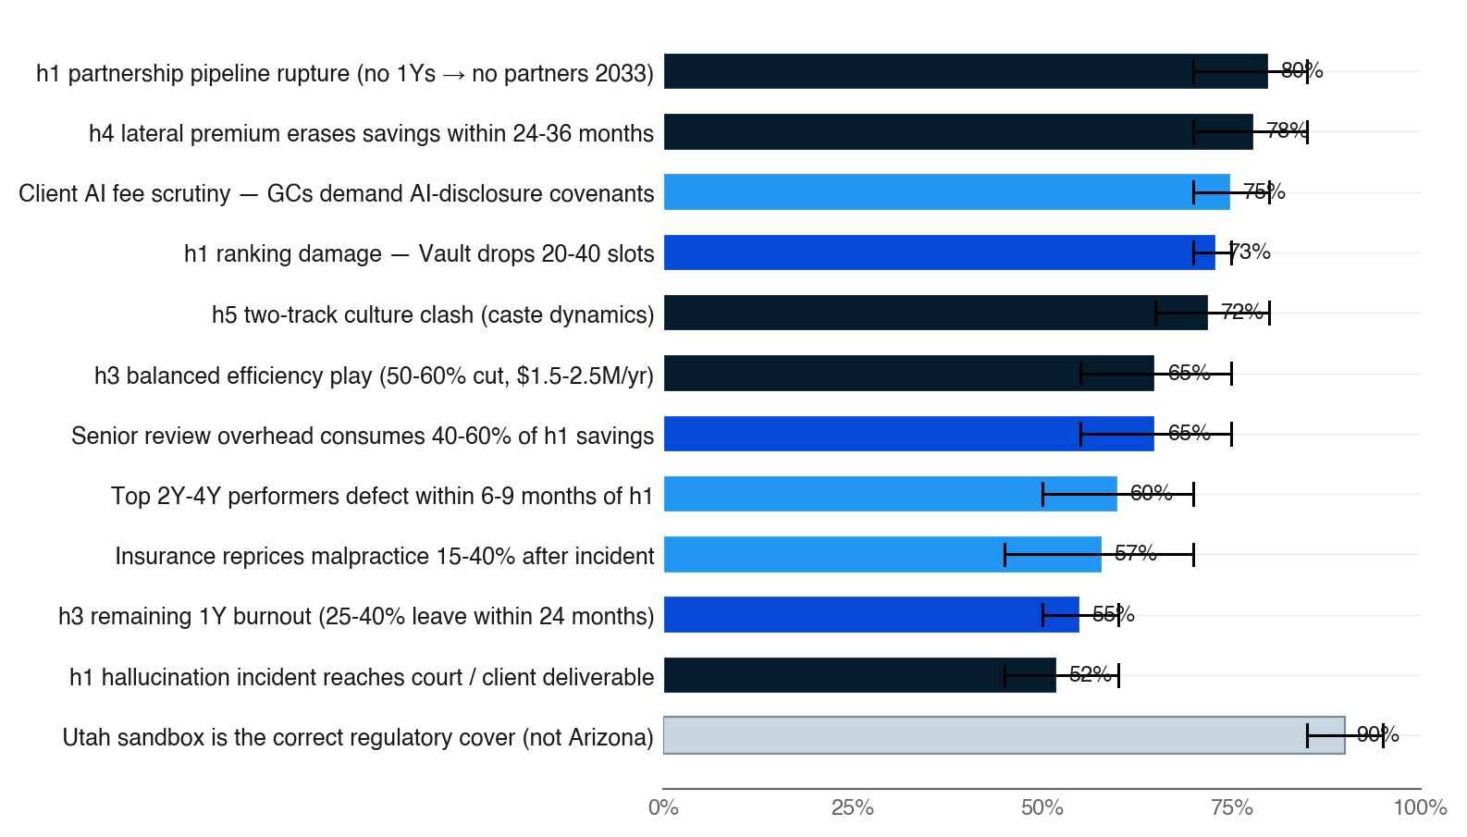
3.1/ EFFECTS MAP
The strongest signals point to pipeline rupture under elimination and structural antifragility under the wrapped pilot
▪ Top 12 effects ranked by council_agreement × probability
▪ Bar color = council agreement (navy = 5/5, fading to pale = 1/5)
▪ Black bracket = persona disagreement range — width is the uncertainty signal
▪ Two highest-probability 5/5 signals (pipeline rupture + lateral premium) both reject h1 elimination from independent angles
▪ Regulator's Utah sandbox finding (1/5, P=0.90) — single-persona but load-bearing for h6 reversibility
Source: Decision Brief — Effects Map (top 12 by council_agreement × probability) · [C4:pessimist], [C5:regulator], [C6:customer]
Autodecision 9

Slide 10
3.2/ COUNCIL DYNAMICS
The deepest disagreement — legal cleanness vs strategic upside — IS the data
STRONGEST: PESSIMIST
DEEPEST DIVIDE: CLEANNESS VS STRATEGY
▪ Surfaced the hallucination-incident probability anchor (P=0.52 for h1) and the partnership pipeline rupture math (P=0.80) that broke h1
▪ Designed the reversibility structure — kill criteria + binding triggers — that became the core of h6
▪ Identified senior-review overhead as a 40-60% drag on h1's gross savings, eroding the cost rationale even before risk adjustment
▪ Pessimist's iter-2 framing positioned h6 as 'h3 with the wrapper' — making the safeguard layers explicit and individually testable
▪ Regulator: h2 (status quo + Claude) scores 0.85 [C7:regulator] on legal cleanness; h6 scores 0.75
▪ Pessimist + Customer: h6's strategic upside dominates the 10-point cleanness gap — h2 forfeits the trust differentiator and category-leadership narrative
▪ Resolution: h6 with the four regulator corrections (Utah-only, WARN-compliant, MRPC 1.5/1.6 covenants, pilot-disclosed offer letters) closes most of the gap
▪ Uncertainty hotspot: Claude substitutability — persona range 25-60%, adversary flagged 40% as likely overstated; this is what the 90-day pilot exists to measure
▪ BLIND SPOT caught: legal-ops paralegals are MORE substitutable than 1Ys (70%+ overlap) — they bear the heaviest cuts under h1 unless an AI-ops ladder exists
Source: Decision Brief — Council Dynamics · [C7:regulator], [C8:pessimist]
Autodecision 10

Slide 11
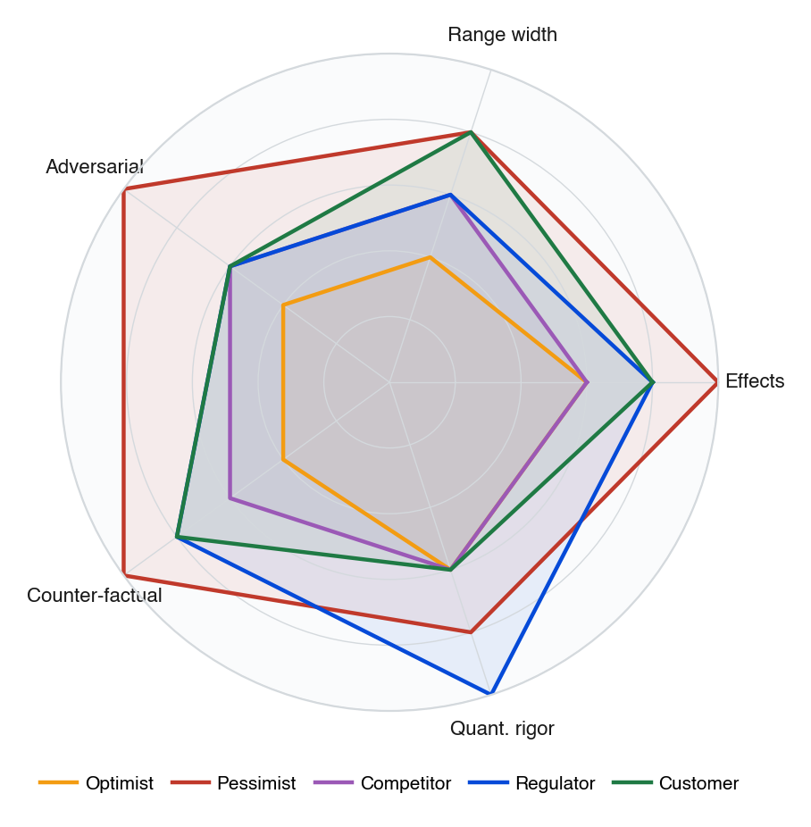
3.3/ COUNCIL DEPTH
Pessimist scored highest on adversarial coverage and structural depth; Optimist's narrow ranges drove its lowest peer rank
▪ Each persona scored 1-5 across five rigor dimensions, derived from peer-review and critique outputs
▪ Pessimist's structural depth surfaced both the kill-criteria pilot and the senior-review overhead math — the two pillars of h6
▪ Customer caught the blind spot — paralegals are more substitutable than 1Ys, plus the anchor-client co-design structure
▪ Regulator's quantitative rigor on jurisdictional specificity (Utah vs Arizona) was unique — the regulatory cover is jurisdiction-specific, not generic
▪ Optimist's narrow ranges and weak counter-factual depth flagged in critique — substitutability optimism not anchored in empirical pilot data
Source: Synthesized from Decision Brief — Council Dynamics + Critique outputs
Autodecision 11

Slide 12
3.4/ ADVERSARIAL PRESSURE
Six adversarial scenarios — h6's wrapper defuses 4 of them; 2 remain (carrier non-renewal, Cravath-scale bump)
WORST CASES
BLACK SWANS
MITIGATIONS
▪ Hallucination incident in pilot year 1 — triggers kill criterion, loses 1-2 anchor clients, malpractice premium +15-40% (P=0.30)
▪ Two top performers defect within 6 months of pilot announcement — institutional knowledge loss, vote-of-no-confidence read (P=0.45)
▪ Anchor GC co-design stalls past 6 months — firm announces pilot without trust differentiator, signals uncertainty (P=0.35)
▪ State bar disciplinary action against peer firm for AI-related MRPC violation — chills pilot, forces premature rollback (P=0.20)
▪ Cravath-scale bump to $250-275K during pilot — cost rationale weakens if base salaries rise faster than Claude capability (P=0.25)
▪ Malpractice carrier non-renewal of coverage for AI-augmented firms — existential, forces fallback to h2 immediately (P=0.10)
▪ h6 SOP discipline cuts hallucination P from 0.52 (h1 pure) to 0.30 — review batching + 50% fewer Claude-handled matters
▪ Utah sandbox provides partial regulatory cover for peer-firm-discipline contagion
▪ Confirm carrier buy-in BEFORE pilot launch (Month 1 dependency) — converts black swan into bounded gate
▪ Net savings computed in absolute dollars, not share-of-comp — Cravath bump doesn't invalidate pilot economics
Source: Decision Brief — Adversarial Scenarios · [C9:adversary], [C10:adversary]
Autodecision 12

Slide 13
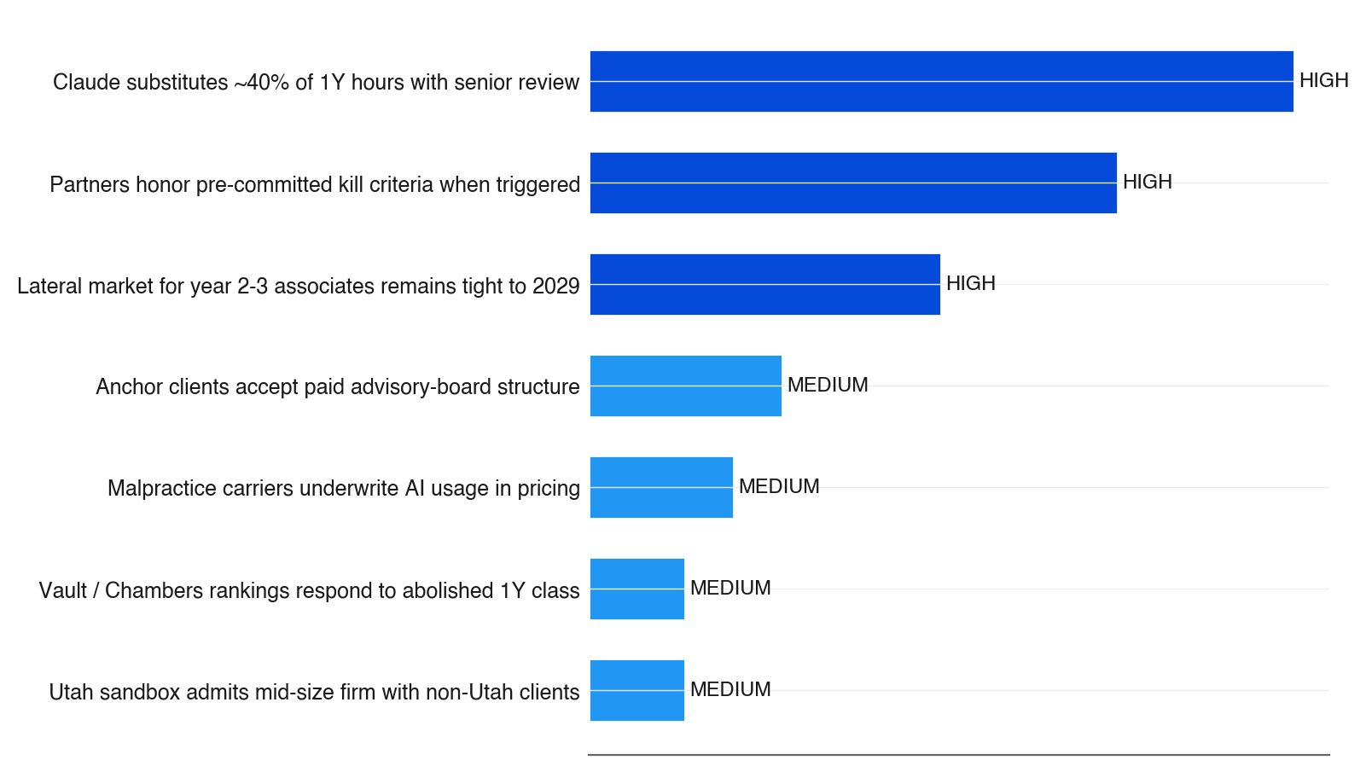
3.5/ SENSITIVITY
Three high-sensitivity assumptions are load-bearing — if any fails, the pilot collapses to unwrapped h3 with all of h1's downside
▪ Bar length = sensitivity weight × number of effects impacted
▪ Dark-blue bar = HIGH sensitivity, lighter = MEDIUM
▪ Substitutability is the single empirical question the 90-day pilot exists to answer — pre-pilot persona range 25-60%, adversary flagged 40% as likely overstated
▪ Kill-criteria honoring is the one assumption the firm controls directly — make it externally enforceable (board resolution, client-notified commitments, month-12 external audit)
▪ Lateral market tightness is SOLID per Bloomberg/Biglaw Investor data — the only HIGH-sensitivity assumption with strong external support
Source: Decision Brief — Key Assumptions · [C1:assumption], [C2:assumption], [C11:assumption]
Autodecision 13

Slide 14
PART 4
Path forward
Ten gates from week 1 to month 24 — every commitment is bounded by carrier, client, regulator, and pilot data.
Autodecision 14

Slide 15
4.1/ ROADMAP
The recommendation maps to a ten-gate roadmap with explicit kill criteria at every stage
Every gate has a binding kill criterion; failure at any gate triggers pause, redesign, or full Cravath-scale rehire of next 1Y class
When
Action
Decision point
Kill criteria
Week 1
Confidential briefings with 3-5 Fortune 500 GCs
Anchor GCs accept advisory board
2+ anchor GCs decline → pause
Week 2
Begin Utah sandbox application
Sandbox staff signals openness
Pre-app hostility → abandon h6
Month 1
Confirm malpractice carrier buy-in + SOP
Carrier go/no-go
Refusal or +40% premium → halt
Month 2
Partner vote on binding kill criteria
Board resolution + audit committee
Partners dilute or refuse → halt
Month 3
Finalize anchor advisory + AI-disclosure covenants
Commercial terms binding
Co-design fails to convert → halt
Month 4
Public announcement; 1Y class set at 50-60%
Offer letters disclose pilot status
WARN Act issue raised → halt
M5-9
Pilot live; 90-day substitutability audit
Monthly ops review
Hallucination · attrition >30% · margin lift <5pt
Month 12
Midterm review with empirical data
Continue / modify / kill
Kill triggered → rehire full 1Y class
Month 18
Final pilot evaluation
Adopt / extend / revert to h2
Any kill criterion → revert to h2
Month 24
If adopting: expand to other practice groups
Scale decision
Margin lift <7pt → freeze expansion
Source: Decision Brief — Appendix A: Decision Timeline · phased gates per [C2:assumption], [C12:regulator]
Autodecision 15

Slide 16
APPENDIX SOURCES
Selected sources
Tags appear inline throughout the deck — [G#] = ground data, [C#:persona] = council finding, [C#:assumption] = sensitivity assumption
Tag
Type
Claim
Source
G1
Ground
Fully loaded 1Y cost $400-450K/yr; class of 8-12 → $3.2-5.4M/yr gross savings
Bloomberg Law, Biglaw Investor
G2
Ground
ABA Formal Opinion 512 (July 2024): six obligations on AI use
ABA Formal Opinion 512
G3
Ground
Cravath-scale 1Y base $225K; ~32% of firms match fully
Bloomberg Law
G4
Ground
Mata v. Avianca (2023): $5K sanctions baseline for hallucinated citations
S.D.N.Y. precedent
G5
Ground
26% of legal organizations using GenAI 2026 (up from 14% in 2024)
Clio 2026 AI Legal Compliance
G6
Ground
Malpractice carriers price AI: governed lowers premium, ungoverned +15-40%
Above the Law
G7
Ground
Ropes & Gray TrAIlblazers: 380-400hr/yr AI skill-building credit for 1Ys
Above the Law
C1:assumption
Council
Claude substitutes ~40% of 1Y hours (range 25-60%, adversary flag)
iter-1 council + adversary
C2:assumption
Council
Partners honor pre-committed kill criteria — SHAKEABLE
iter-2 pessimist
C4:pessimist
Council
h1 partnership pipeline rupture P=0.80 (5/5)
iter-1 pessimist
C5:regulator
Council
Utah Office of Legal Services Innovation = correct regulatory cover
iter-1 regulator
C7:regulator
Council
h2 cleanness 0.85 vs h6 0.75 — narrow gap closed by 4 corrections
iter-2 regulator
C9:adversary
Council
Hallucination incident pilot year 1 P=0.30 (down from 0.52 h1)
iter-1 adversary
C12:regulator
Council
WARN Act 60-day notice if 1Y cuts trigger; MRPC 1.5/1.6 covenants
iter-1 regulator
Source: Decision Brief — Sources (full list in companion brief markdown)
Autodecision 16

