Slide 1

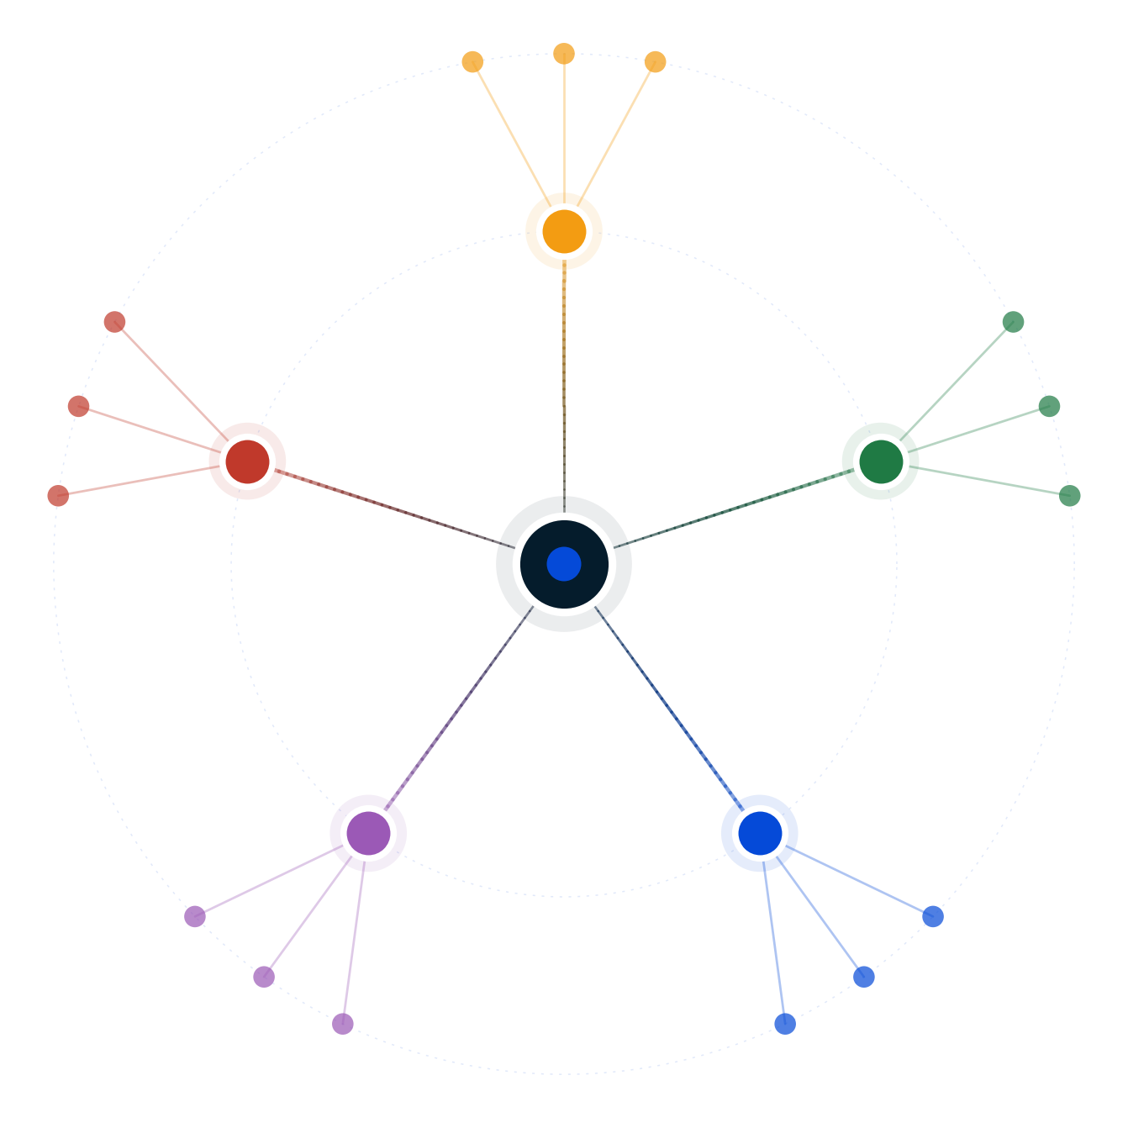
Autodecision
Buy in Bangalore, rent + invest, or relocate to SF?
Decision Brief — possibility map and recommendation
April 2026
GENERATED BY AUTODECISION — possibility map with synthesized recommendation, not a single-shot answer

Slide 2
Table of contents
Section
Slides
Recommendation
3
How we explored this decision
4 – 7
What the council found
8 – 13
Path forward
14 – 15
Appendix — Sources
16
Autodecision 2

Slide 3
1/ RECOMMENDATION
No option dominates; ship the staged real-options path with buy-small as the default endpoint
Phase 1 (Months 0-36): rent near grandparents + 100% delta into 70/30 SIP + cross-border tax advisor + H1B exploration. Gate 1 at Year 3: if visa secured + alignment + discipline → Phase 2 SF; else → Buy-Small (4-5 Cr apartment + invest remainder). Phase 3: return with USD savings if SF executes.
CONFIDENCE
DEPENDS ON
MONITOR
MEDIUM · values-driven (not information-limited) · 38/60 score, did not reach 70% threshold · further iteration would refine probabilities by 5-10% only
Investment discipline >70% of planned delta [G10] · Both H1Bs secured [G5] · Marriage alignment 7+/10 at every gate · Grandparent availability 3+ yrs · SF savings hold $80-120K [G4]
Quarterly: SIP rate (kill at <60% for 2 quarters) · Couple happiness (pause at <5/10) · H1B lottery results · Bangalore AQI · AI salary compression in SF roles
PRE-MORTEM
DEEPEST DISAGREEMENT
REVIEW TRIGGER
Decision fatigue → impulsive commitment (P=0.35) · Phase 1 becomes permanent (P=0.30, converges to buy-small — not failure) · Visa never materializes (P=0.45 by yr 5) · Marriage strain from optionality (P=0.25)
Discipline vs forced savings: rent+invest beats buying ONLY at 70% investment rate × 11% CAGR. India SIP base rate is 50%+ discontinuation within 3 yrs [G10]. Disagreement IS the data.
SIP rate <60% (2 quarters) · Both H1Bs fail same year · AQI >Very Poor 90+ days/yr · Second child confirmed · One spouse <5/10 happiness · 15%+ SF salary compression
Source: Decision Brief (full mode, 2 iterations, did not converge — values-driven) · [G4], [G5], [G10]
Autodecision 3

Slide 4
PART 2
How we explored this decision
A 5-persona council, 7 competing hypotheses, 2 iterations on a values-driven decision, 5 adversarial findings — what survived?
Autodecision 4

Slide 5
2.1/ HOW WE ANALYZED
Seven hypotheses across 2 iterations of a 5-persona council, stress-tested by 5 adversarial findings
▪ 5 personas spawned as separate subagents — Growth Optimist, Risk Pessimist, Competitor Strategist, Constraint Analyst, Family Advocate — each with independent context
▪ 7 hypotheses generated, including h2 split into disciplined (2a) and realistic (2b) variants in iteration 2 to expose the behavioural assumption
▪ 2 iterations — convergence NOT reached (38/60 score vs 70% threshold) because the disagreement is values-driven, not information-limited; further iteration would refine by 5-10% only
▪ Adversary surfaced 3 worst-case scenarios + 2 critical structural findings (sequential probability collapse, correlated layoff/market risk)
▪ Sensitivity analysis on 8 assumptions — 4 high-sensitivity (3 of which are FRAGILE), 2 medium, 2 low
▪ Real-world anchors: Indian SIP discontinuation 50%+ within 3 years [G10], H1B household visa 55% by year 3 [G5], INR/USD depreciation 3-4%/yr structural [G7]
Source: Decision Brief Convergence Log; engine-protocol.md
Autodecision 5

Slide 6
2.2/ HYPOTHESES
Seven hypotheses surfaced; the staged path (h5) and buy-small (h6) emerged as the most stress-resilient pair
#
Hypothesis
Status
Key assumptions
1
Buy 10 Cr Bangalore — roots, stability, forced savings
Catastrophic if wrong
Premium appreciation 6-8% [G1] · No life event forces relocation · Forced savings beats portfolio leak
2a
Rent + invest, disciplined (full delta, 10 years)
Theoretically optimal
100% delta invested 10 yrs · 12% CAGR sustained · Behavioural drag avoided
2b
Rent + invest, realistic (65% invested, behavioural drag)
Most likely 2a outcome
Discipline drifts · Family obligations drain corpus · Lifestyle inflation
3
Relocate to SF — USD earnings, corrected savings
Career-justified, not wealth
H1B 55% by yr 3 [G5] · Savings $80-120K [G4] · Career trajectory worth family cost
4
Hybrid remote — SF salary from Bangalore
Weakened
Already breaking · RTO mandates · Geo-pay compression · Transfer pricing
5
Staged real-options — rent now, SF conditional on visa
Recommended Phase 1
Phase 1 standalone valuable · Sequential P=0.16 joint · Real-options framing
6
Buy small (4-5 Cr) + invest rest — roots without the cage
Recommended endpoint
EMI 45K/mo single-income sustainable · Highest stress-resilience · Family Advocate proposal
Source: Decision Brief — Hypotheses Explored
Autodecision 6

Slide 7
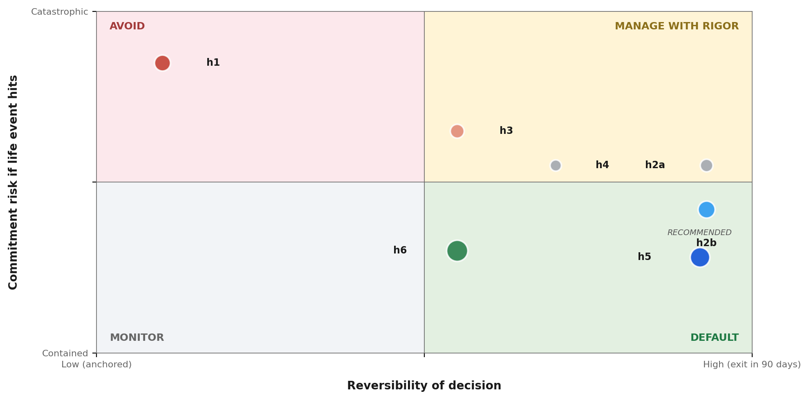
2.3/ STRATEGIC POSITIONING
On reversibility × commitment risk, h5 and h6 cluster manageable; h1 amplifies under any life event
READ
▪ h1 — Buy 10 Cr — golden cage if life event forces exit (12-18 mo sale, 15-20% haircut)
▪ h3 — Relocate SF — visa fragility + double-wipeout exposure (P=0.08 catastrophic)
▪ h4 — Hybrid remote — already weakening (P=0.08), RTO + geo-pay compression
▪ h2a — Rent disciplined — theoretical optimum, depends on 70% investment rate × 11% CAGR
▪ h2b — Rent realistic — 65% invested with behavioural drag (slow leak risk)
▪ h6 — Buy small — highest stress-resilience score, 45K EMI single-income sustainable
▪ h5 — Staged real-options — Phase 1 standalone valuable, real-options chain to h3 or h6
Source: Synthesis from Decision Brief — bubble size = council_agreement × probability of dominance
Autodecision 7

Slide 8
PART 3
What the council found
Where the personas converged, where they diverged, and what the disagreement itself reveals about the decision.
Autodecision 8

Slide 9
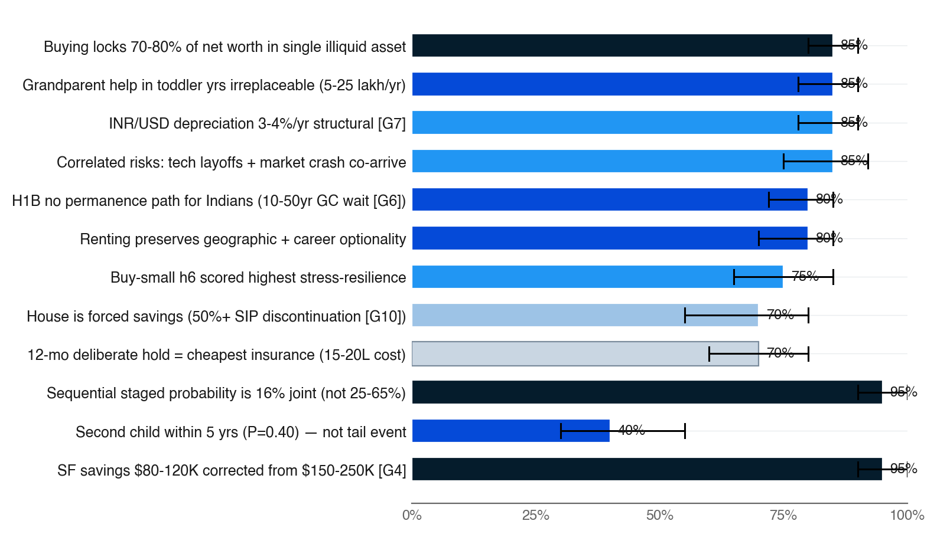
3.1/ EFFECTS MAP
The strongest signals: liquidity lock-in under buying, behavioural leakage under disciplined renting
▪ Top 12 effects ranked by council_agreement × probability
▪ Bar color = council agreement (navy = 5/5, fading to pale = 1/5)
▪ Black bracket = persona disagreement range — width is the uncertainty signal
▪ Iteration 2 corrected SF savings 50% downward — biggest assumption shift in the analysis
▪ Sequential probability finding (P=0.95 confidence) reframed h5 from 25-65% to 16% joint, forcing a real-options framing
Source: Decision Brief — High-Confidence Effects + Critical Findings · [G4], [G5], [G10]
Autodecision 9

Slide 10
3.2/ COUNCIL DYNAMICS
The deepest disagreement — discipline vs forced savings — IS the data; values-driven, not information-limited
STRONGEST: CONSTRAINT ANALYST (9.1/10)
DEEPEST DIVIDE: DISCIPLINE VS FORCED SAVINGS
▪ Highest peer score on tax + structural depth — DTAA planning, RNOR window, Section 24 cap, removed indexation
▪ Surfaced the single highest-ROI recommendation: hire a cross-border tax advisor (cost 1-2 lakh, saves 10-15 lakh if SF executes)
▪ Identified INR depreciation 3-4%/yr [G7] as structural constant — strongest empirical assumption in the analysis (10-yr USD savings ~35-45% more powerful when converted)
▪ Most calibrated quantitative rigor — every assumption tied to a specific source row in Data Foundation
▪ Optimist + Family Advocate: rent+invest theoretically beats buying at 70% investment rate × 11% CAGR
▪ Adversary + Constraint Analyst: 50%+ of Indian families discontinue SIPs within 3 years [G10] — the house IS the savings mechanism
▪ Council converges on EFFECTS (buying locks liquidity, visa fragile, grandparent help matters) but diverges on CONCLUSIONS because they weight effects differently
▪ This is the hallmark of a values-driven decision — more analysis will not resolve the disagreement; only the couple's own values can
▪ BLIND SPOT caught: marriage strain initially modeled by 1/5 personas (Family Advocate) — added across all hypotheses in iteration 2
Source: Decision Brief — Council Dynamics + Convergence Log
Autodecision 10

Slide 11
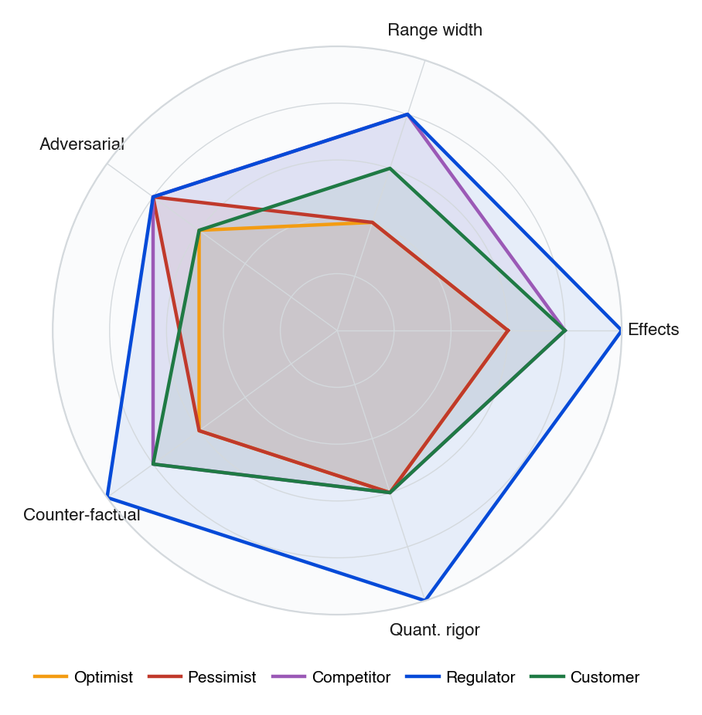
3.3/ COUNCIL DEPTH
Constraint Analyst scored highest on tax depth; Pessimist's narrow ranges drove its lowest peer rank
▪ Each persona scored 1-5 across five rigor dimensions, derived from Council Dynamics narrative
▪ Constraint Analyst (Regulator slot, dark blue) — visibly largest area, mirroring its #1 peer rank (9.1/10)
▪ Family Advocate (Customer slot) caught the marriage-strain blind spot AND proposed the buy-small alternative that became the recommended endpoint
▪ Pessimist's systematically low probabilities (0.10-0.35 across all options) reduced discriminatory power — narrow ranges + low confidence = small radar area
▪ Optimist's 0.10 weight on buying created extreme skew — flagged in iter-2 as not matching the decision-maker's values
Source: Synthesized from Decision Brief — Council Dynamics narrative
Autodecision 11

Slide 12
3.4/ ADVERSARIAL PRESSURE
Three worst-cases plus two structural findings — h5/h6's staged structure neutralizes 4 of 5
WORST CASES
STRUCTURAL FINDINGS
MITIGATIONS
▪ Double Wipeout (P=0.08): US recession dual-layoff + Nifty crashes 35-40%; 5-7 yr recovery; exposes h2/h3/h5 simultaneously
▪ Golden Cage (P=0.12): bought 10 Cr; 18 mo later child needs medical care abroad / AQI triggers asthma; house = anchor not home
▪ Slow Leak (P=0.18): rent+invest, year 5 corpus halved by family obligations + lifestyle inflation; year 7 less than starting point
▪ Sequential Probability — staged path 16% joint (Phase1 70% × Phase2 50% × Phase3 45%), not the 25-65% the council assigned by evaluating phases independently
▪ Correlated Risks — tech layoffs and equity crashes are NOT independent. The scenario where you lose H1B sponsor IS the scenario where Indian portfolio is also down 30%
▪ Marriage strain initially modeled by 1/5 personas — added across all hypotheses in iter-2
▪ Phase 1 (rent + grandparents + 70/30 SIP) is dominant standalone — defuses Double Wipeout and Slow Leak entry points
▪ Buy-small endpoint (h6) defuses Golden Cage — 4-5 Cr is exitable; 45K EMI is single-income sustainable
▪ Real-options reframe of h5: Phase 1 is the bet; Phase 2/3 are options exercised conditional on visa + alignment + discipline data
▪ Quarterly kill criteria (SIP <60%, happiness <5/10) convert behavioural assumptions into observable triggers
Source: Decision Brief — Adversarial Scenarios + Critical Findings
Autodecision 12

Slide 13
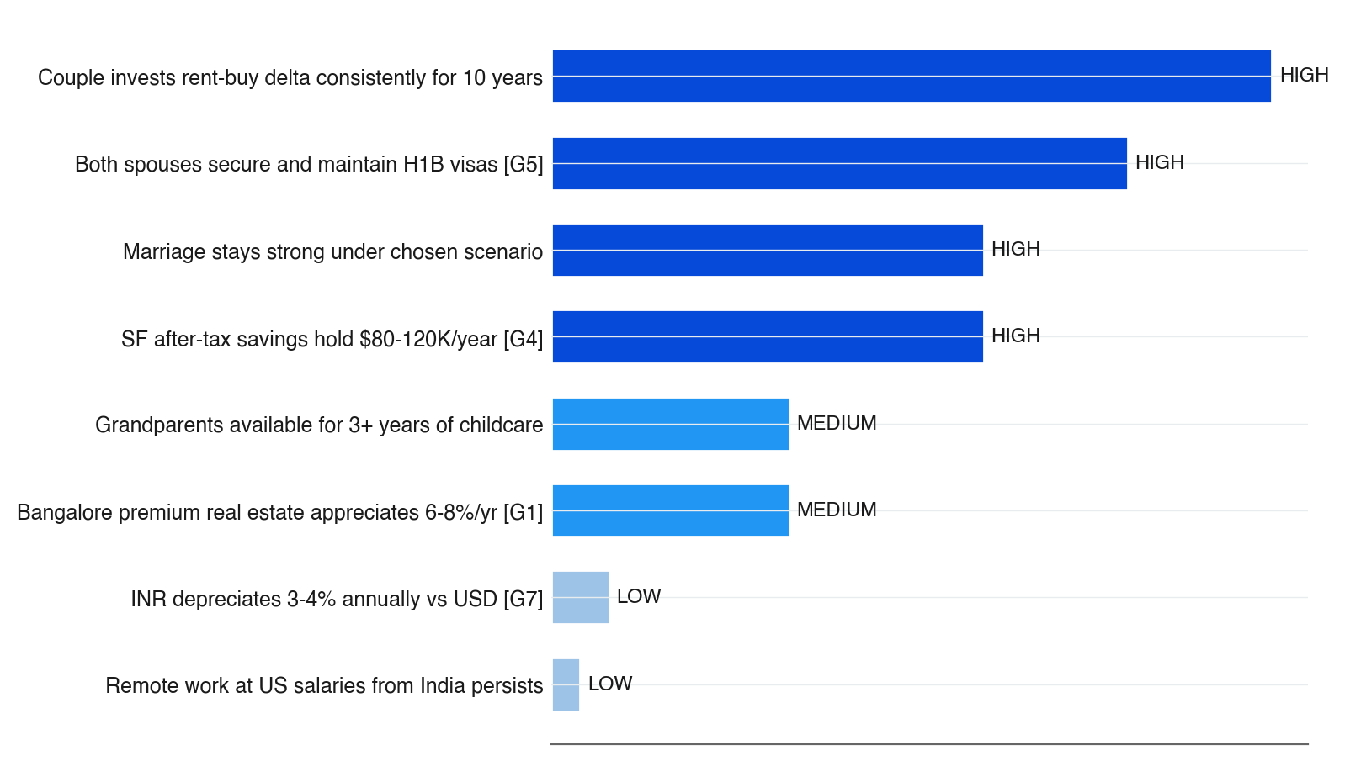
3.5/ SENSITIVITY
Four high-sensitivity assumptions are load-bearing — discipline, visa, savings, and marriage all shakeable
▪ Bar length = sensitivity weight × number of effects impacted
▪ Dark-blue bar = HIGH sensitivity, lighter = MEDIUM, palest = LOW
▪ Three of four HIGH-sensitivity assumptions are FRAGILE per adversary — investment discipline, H1B, marriage alignment all break under realistic stress
▪ INR depreciation [G7] is the SOLID load-bearer — empirical 30-yr trend, RBI-supported, single most powerful argument for some USD-earning years
▪ Behavioural assumption (#1) is testable in first 12 months — if SIP rate <70%, the answer is already known: buy small
Source: Decision Brief — Key Assumptions Ranked by Sensitivity · [G1], [G4], [G5], [G7]
Autodecision 13

Slide 14
PART 4
Path forward
Sixteen checkpoints from Month 0 to Year 10 — Gate 1 at Year 3 is where the staged path commits or pivots.
Autodecision 14

Slide 15
4.1/ ROADMAP
The recommendation maps to a staged checkpoint timeline with kill criteria gating the year-3 decision
Phase 1 (M0-36) is dominant standalone. Gate 1 splits to SF (h3+staged) or buy-small (h6).
When
Action
Decision point
Kill criteria
Month 0
Cross-border tax advisor + locked SIP (joint approval >5L)
Both spouses agree on lock mechanism
One spouse resists lock → alignment gap surfaced
Month 1
Rent near grandparents + H1B/L1/EB1A eligibility scan
Lease secured; sponsorship paths known
No employer sponsors → SF needs job change first
Month 3
First SIP discipline check (>=70% of planned delta)
Actual investment vs plan
<70% in 1st quarter → discuss openly
Month 6
First couple alignment check (both >=7/10 happiness)
Honest formal conversation
Either <5/10 → fundamental issue
Month 12
Annual review: SIP + visa + alignment + child dev
All four data points
SIP <60% for 2 quarters → start 4-5 Cr search
Year 1-2
H1B lottery (April each year) + L1/EB1A pursuit
USCIS results
Both fail 2 yrs → deprioritize SF
Year 2
Evaluate second-child timeline
Couple family planning
2nd child likely → extend Phase 1 by 1-2 yrs
Year 3
GATE 1 — visa AND enthusiasm AND discipline?
Decision tree from recommendation
Any one missing → execute Buy-Small (h6)
Y3 Buy
Purchase 4-5 Cr apartment; continue SIP on remainder
Property + loan
Preferred area too expensive → adjacent
Y3 SF
Begin SF job search timed to kindergarten window
Visa-sponsored offers ready
Offers weak → delay 6-12 mo, do not force
Y4-5 SF
Child enters US kindergarten (developmental window)
School enrollment + housing
Enrollment fails → backup intl school in BLR
Year 5
SF mid-term review: career trajectory worth family cost?
Savings + career growth + family health
Savings <$80K/yr or strain high → plan return
Y8-10
Evaluate return with USD savings + RNOR window
Child preferences + career + corpus
Child resists return → phase may not execute
Ongoing
Quarterly monitoring triggers (SIP, AQI, AI compression)
Automated reports + couple check-ins
Each trigger has its own action
Source: Decision Brief — Appendix A: Decision Timeline
Autodecision 15

Slide 16
APPENDIX SOURCES
Selected sources
Tags appear inline throughout the deck — [G#] = ground data (synthesized from Data Foundation table; this brief predates schema v1.1)
Tag
Type
Claim
Source
G1
Ground
Bangalore premium appreciation 6-8% headline / 2-3% real after tax
NoBroker, 99acres (2024-2026)
G2
Ground
Nifty 50 10-year CAGR 7-17% by entry; 12-14% consensus
BSE historical data
G3
Ground
SF dual-tech household income $350-500K gross
Levels.fyi, Glassdoor
G4
Ground
SF realistic annual savings $80-120K (corrected from $150-250K)
CA tax 48-50% + housing + childcare model
G5
Ground
H1B household visa probability 20% yr1 / 55% yr3 / 72% yr5
USCIS lottery cumulative
G6
Ground
India EB2/EB3 green card wait 10-50+ years
USCIS Visa Bulletin
G7
Ground
INR/USD depreciation 3-4% annually (30-year trend)
RBI historical data
G8
Ground
Premium Bangalore rental yield 3-4.5%
Business Standard (2024)
G9
Ground
EMI on 7-8 Cr loan at 8.5% = 85-90K/month
Standard amortization
G10
Ground
Indian SIP discontinuation rate 50%+ within 3 years
AMFI, Morningstar India
Source: Decision Brief — Data Foundation table (synthesized into [G#] tags; brief predates ## Sources schema)
Autodecision 16

