Slide 1


Autodecision
Should I drop B2B SaaS pricing by 10%?
Quick Decision Brief — single-pass analysis, no council
April 2026
GENERATED BY AUTODECISION — possibility map with synthesized recommendation, not a single-shot answer

Slide 2
Table of contents
Section
Slides
Recommendation
3
How we explored this decision
4 – 6
What the analysis found
7
Appendix — Sources
8
Autodecision 2

Slide 3
1/ RECOMMENDATION
Do not implement a blanket 10% cut; restructure to hybrid pricing or test segmented promo instead
DO NOT cut blanket pricing 10%. Cut is too small to move enterprise (inelastic), too large to ignore in margin (3-7 pts compression), and 60%+ likely to be matched by competitors within 90 days. Instead: (a) segmented SMB-only promotional tier, (b) usage-based or hybrid component giving lower entry without permanent anchor reset, or (c) time-limited 10% discount for annual commitments to test elasticity first.
CONFIDENCE
DEPENDS ON
MONITOR
LOW-MEDIUM · single pass, no adversarial pressure · run /autodecision for full council + iteration on a high-stakes pricing call
Price elasticity in target segment >1 [G1] · Competitors don't match within 90 days [G3] · Cut applies uniformly · Sales team doesn't stack additional discounts · Existing customers don't discover and demand parity
ARPU on new deals · Existing customer renewal demands · SMB vs enterprise acquisition split · Competitor pricing pages · Sales discount stacking · Gross margin trend
PRE-MORTEM
DOMINANT RISK
BETTER ALTERNATIVE
Competitor matches within 90 days (P=0.60) · Sales team uses cut as crutch (P=0.50) · Existing customers demand renegotiation (P=0.70) · Margin compresses 3-7 points (P=0.85)
Enterprise inelasticity — 3x less price-sensitive than SMB [G1]. A 10% cut lands in the dead zone: too small to change vendor selection, large enough to compress margins materially.
Hybrid / usage-based pricing — Chargebee data [G6] shows 38% higher revenue growth premium · 43% of SaaS already hybrid · Gartner predicts 70% prefer usage by 2026 [G7]
Source: Quick Decision Brief (single-pass) · [G1], [G3], [G6], [G7]
Autodecision 3

Slide 4
PART 2
How we explored this decision
Quick-mode single-pass against grounded data — what did the analysis surface?
Autodecision 4

Slide 5
2.1/ HOW WE ANALYZED
Quick-mode single-pass analysis with 4 hypotheses, 12 effects, 5 sensitivity assumptions
▪ Mode: Quick (single-pass, no council, no iteration, no adversarial pressure) — fast sanity check before a real decision, not a final answer
▪ 4 hypotheses generated — including the 'restructure pricing instead of cut' alternative that scored highest
▪ 12 effects mapped (7 first-order + 5 second-order) with probability + timeframe per effect
▪ 5 key assumptions ranked by sensitivity — 2 HIGH, 2 MEDIUM, 1 LOW
▪ Real-world anchors: enterprise B2B price elasticity 3x lower than SMB [G1], competitor match rate 60%+ [G3], hybrid pricing 38% revenue premium [G6]
▪ Confidence is bounded LOW-MEDIUM by design — for high-stakes pricing changes, run /autodecision for full council + iteration
Source: Quick Decision Brief — Effects + Key Assumptions
Autodecision 5

Slide 6
2.2/ HYPOTHESES
Four hypotheses; only 'restructure to hybrid' survives the basic stress-test
#
Hypothesis
Status
Why
1
10% cut drives enough volume to offset revenue loss
Unlikely
Enterprise inelastic; only plausible in SMB segment
2
10% cut triggers competitor matching; net-zero benefit
Likely
60%+ match rate per [G3]; erodes market margins
3
10% cut is too small to matter (dead zone)
Likely
Doesn't shift vendor selection; does compress margins
4
Restructure pricing model (hybrid/usage-based) instead
Recommended
Hybrid models +38% revenue growth [G6]; addresses growth without permanent cut
Source: Quick Decision Brief — Hypotheses
Autodecision 6

Slide 7
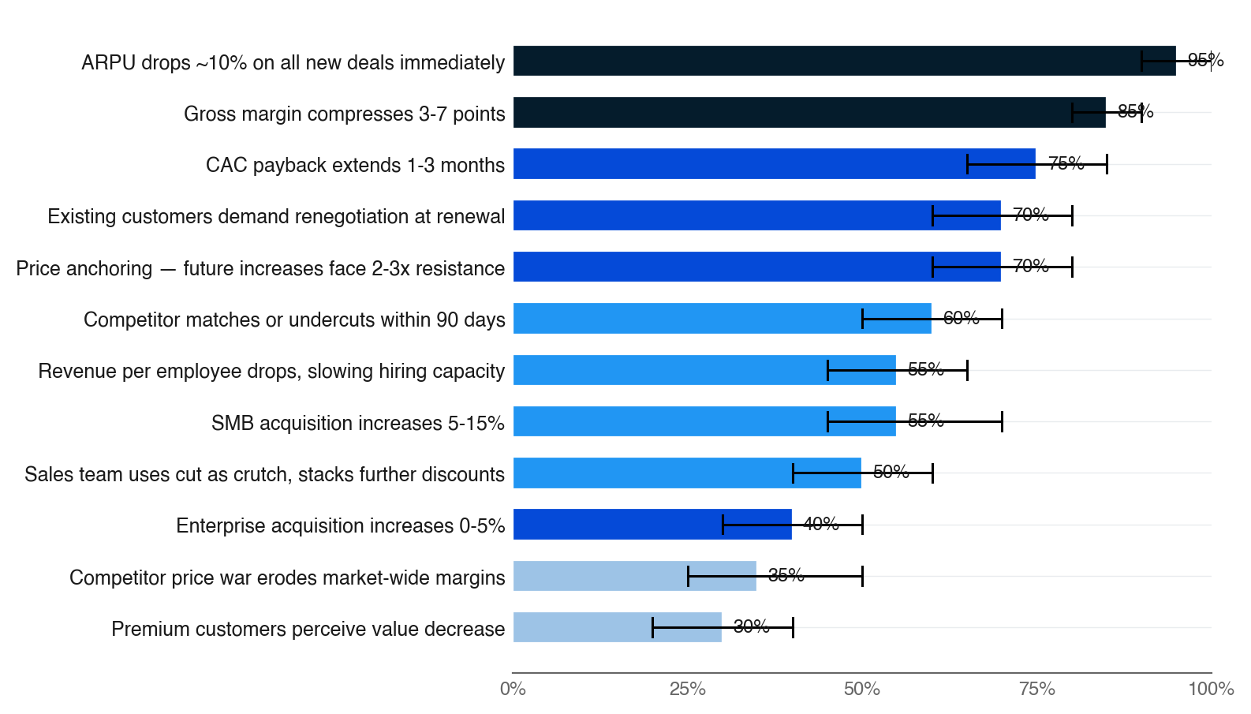
3.1/ EFFECTS MAP
Strongest signals: ARPU drop is certain; volume lift is segment-specific; competitor match is likely
▪ Top 12 effects ranked by probability × council-style agreement (single-pass: agreement is heuristic)
▪ Bar color = agreement weight (navy = strong evidence, fading to pale = single-source)
▪ Black bracket = uncertainty range — wider bars mean less confidence
▪ Three highest-P effects (ARPU drop, margin compression, CAC extension) are the cost side — all near-certain
▪ Volume lift effects (SMB +5-15%, enterprise +0-5%) skew low — the cut is too small to move the needle
Source: Quick Decision Brief — Effects (first + second order) · [G1], [G3], [G6]
Autodecision 7

Slide 8
APPENDIX SOURCES
Selected sources
Tags appear inline throughout the deck — [G#] = ground data (synthesized from Data Foundation table; quick-mode briefs predate ## Sources schema)
Tag
Type
Claim
Source
G1
Ground
Enterprise vs SMB price elasticity gap — up to 3x less sensitive in enterprise
Monetizely B2B SaaS elasticity research
G2
Ground
Cross-segment elasticity variation — 2-4x across B2B SaaS segments
Monetizely measurement guide
G3
Ground
Competitor price-matching rate — 60%+ of businesses respond to competitor price moves
Maxio, Cobloom SaaS pricing research
G4
Ground
High-ARPU churn advantage — customers >$250/mo have lowest churn rates
Vitally, Churnfree benchmarks
G5
Ground
Value-based pricing premium — outperforms cost-plus and competitor-based by 30-40%
Cobloom, Dock pricing strategy research
G6
Ground
Hybrid pricing revenue lift — 38% higher revenue growth vs single-model
Chargebee State of Subscriptions 2025
G7
Ground
Usage-based pricing adoption — 43% SaaS hybrid; Gartner predicts 70% prefer usage by 2026
Chargebee, Gartner
Source: Quick Decision Brief — Data Foundation table (synthesized into [G#] tags)
Autodecision 8

