Slide 1

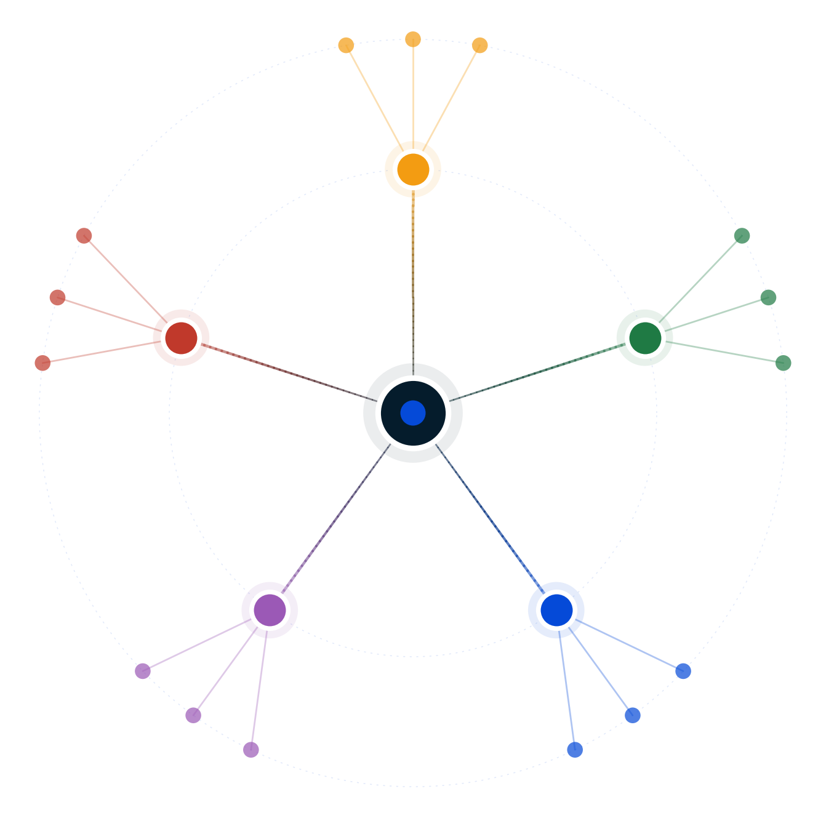
Autodecision
Should I drop B2B SaaS pricing by 30%?
Quick Decision Brief — single-pass analysis, no council
April 2026
GENERATED BY AUTODECISION — possibility map with synthesized recommendation, not a single-shot answer

Slide 2
Table of contents
Section
Slides
Recommendation
3
How we explored this decision
4 – 6
What the analysis found
7
Appendix — Sources
8
Autodecision 2

Slide 3
1/ RECOMMENDATION
Do not implement a blanket 30% cut; the math is brutally unfavorable in a market raising prices 8-25%
DO NOT cut blanket pricing 30%. You need 43% volume lift to break even (B2B sales cycles make this near-impossible in 12 months) [G1] · LTV drops 30%+ [G2] · 2026 market is RAISING prices 8-25% [G3] — your cut reads as desperation. Existing customers (P=0.80) demand retroactive pricing, anchor permanently resets (P=0.80). Instead: (a) lower-cost SMB-only entry tier, (b) 90-day competitive win-back with time-limited discount that doesn't reset anchor, or (c) invest the 10-20pt margin into sales / PLG / channel partnerships.
CONFIDENCE
DEPENDS ON
MONITOR
LOW-MEDIUM · single pass, no adversarial pressure · run /autodecision for full council on a high-stakes pricing call of this magnitude
43% volume lift achievable in 12 months [G1] · Brand survives 30% cut in 8-25% raising market [G3] · Existing customers don't demand retroactive pricing · Competitors don't escalate to price war · LTV holds despite 30% ARPU reduction
ARPU on new deals · Existing customer renewal renegotiation rate · Competitor pricing pages and announcements · Enterprise vs SMB acquisition mix · Net revenue retention · Fundraising market reception
PRE-MORTEM
DOMINANT RISK
BETTER ALTERNATIVE
43% volume lift fails in 12 months (P=0.75) · Margin compresses 10-20 points (P=0.90) · Existing customers demand retroactive pricing (P=0.80) · LTV drops 30%+ (P=0.80) · Price anchor permanently resets (P=0.80)
No B2B SaaS precedent of a large price reduction succeeding [G9]. Industry playbook is raise / restructure / tier — never cut. A 30% cut against an 8-25% raising market signals distress to enterprise buyers AND investors.
Restructure to hybrid / usage-based — Chargebee data [G6] shows 38% higher revenue growth premium · Captures price-sensitive demand without permanent anchor reset · Already proven across 43% of SaaS
Source: Quick Decision Brief (single-pass) · [G1], [G2], [G3], [G6], [G9]
Autodecision 3

Slide 4
PART 2
How we explored this decision
Quick-mode single-pass against grounded data — what did the analysis surface?
Autodecision 4

Slide 5
2.1/ HOW WE ANALYZED
Quick-mode single-pass with 5 hypotheses, 15 effects, 6 sensitivity assumptions — all 3 HIGH are FRAGILE
▪ Mode: Quick (single-pass, no council, no iteration, no adversarial pressure) — fast sanity check before a real decision, not a final answer
▪ 5 hypotheses generated — including 'restructure to hybrid' which scored highest, and 'cut works IF paired with model restructure' which is the only narrow-win condition
▪ 15 effects mapped (8 first-order + 7 second-order) with probability + timeframe per effect
▪ 6 key assumptions ranked by sensitivity — 3 HIGH (all FRAGILE per single-pass adversary), 2 MEDIUM, 1 LOW
▪ Real-world anchors: 43% volume needed to break even at 30% cut [G1] · LTV drops 30%+ on discounting research [G2] · 2026 market raising 8-25% [G3] · No B2B SaaS precedent of large reduction succeeding [G9]
▪ Confidence is bounded LOW-MEDIUM by design — 30% is a major pricing change; do not act on this alone, run /autodecision for full council + iteration
Source: Quick Decision Brief — Effects + Key Assumptions
Autodecision 5

Slide 6
2.2/ HYPOTHESES
Five hypotheses; only restructure-to-hybrid avoids permanent anchor reset
#
Hypothesis
Status
Why
1
30% cut drives 43%+ volume increase
Extremely unlikely
B2B sales cycles 3-9 months · 43% lift in <12mo near-impossible
2
30% cut wins deals but destroys margins
Pyrrhic victory
CAC payback 18-24mo · LTV -30%+ · multiples compress
3
30% cut signals desperation
Likely
Cutting in 8-25% raising market reads as distress to buyers + investors
4
30% cut works IF paired with model restructure
Narrow win condition
Only if entry tier in land-and-expand, not a cut to existing price
5
Restructure to hybrid / usage-based instead
Recommended
+38% revenue growth premium [G6] · captures demand without anchor reset
Source: Quick Decision Brief — Hypotheses
Autodecision 6

Slide 7
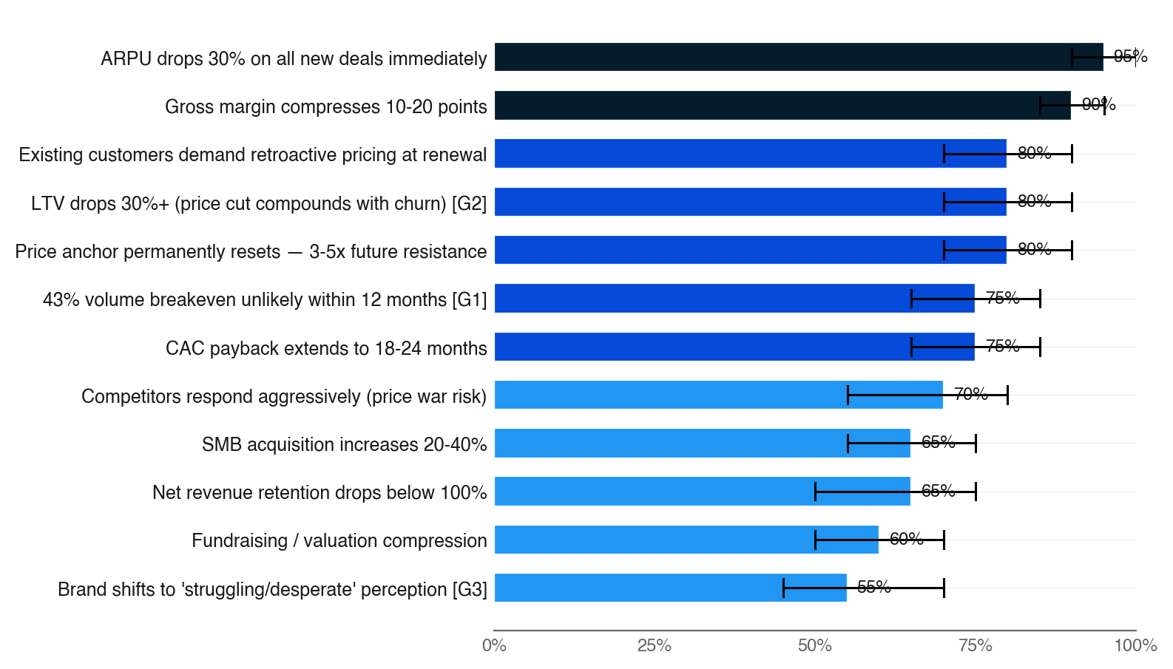
3.1/ EFFECTS MAP
Strongest signals: ARPU collapse, margin compression, anchor reset — all near-certain
▪ Top 12 effects ranked by probability × agreement (single-pass: agreement is heuristic)
▪ Bar color = agreement weight (navy = strong evidence, fading to pale = single-source)
▪ Black bracket = uncertainty range
▪ Five effects at P>=0.80 — the cost side is near-certain, the upside (volume lift) is materially less certain
▪ Anchor reset (P=0.80) is the long-term scar — future increases face 3-5x resistance regardless of how the 30% cut performs short-term
Source: Quick Decision Brief — Effects (first + second order) · [G1], [G2], [G3]
Autodecision 7

Slide 8
APPENDIX SOURCES
Selected sources
Tags appear inline throughout the deck — [G#] = ground data (synthesized from Data Foundation table; quick-mode briefs predate ## Sources schema)
Tag
Type
Claim
Source
G1
Ground
Breakeven volume increase needed at 30% cut — 43% more customers (1/0.7)
Basic math
G2
Ground
LTV impact of SaaS discounting — lowers LTV by over 30%
SBI State of B2B SaaS Pricing 2024, T2D3
G3
Ground
Industry price direction 2026 — average 8-12% increases; aggressive movers 15-25%
Visdum, Ibbaka 2026 predictions
G4
Ground
Churn spike from pricing changes — 10-15% without legacy customer protection
Ibbaka, Visdum research
G5
Ground
Enterprise vs SMB price sensitivity — enterprise 3x less price-sensitive
Monetizely elasticity research
G6
Ground
Hybrid pricing revenue premium — 38% higher revenue growth vs single-model
Chargebee State of Subscriptions 2025
G7
Ground
B2B SaaS market 2026 — mid-cap stocks lost 30%+ in Feb 2026 SaaSpocalypse
Financial media
G8
Ground
Churn revenue impact — all-time high, 30% above COVID boom peak
SaaStr, industry benchmarks
G9
Ground
No B2B SaaS precedent of a large price reduction succeeding — playbook is raise/restructure/tier
Monetizely, Cobloom, multiple sources
Source: Quick Decision Brief — Data Foundation table (synthesized into [G#] tags)
Autodecision 8

