Slide 1
Laravel Certificate Course
NAME : HARSHIL PARMAR
ENROLL NO : 23000009
SYBCA-B-Batch
CMP304

Slide 2
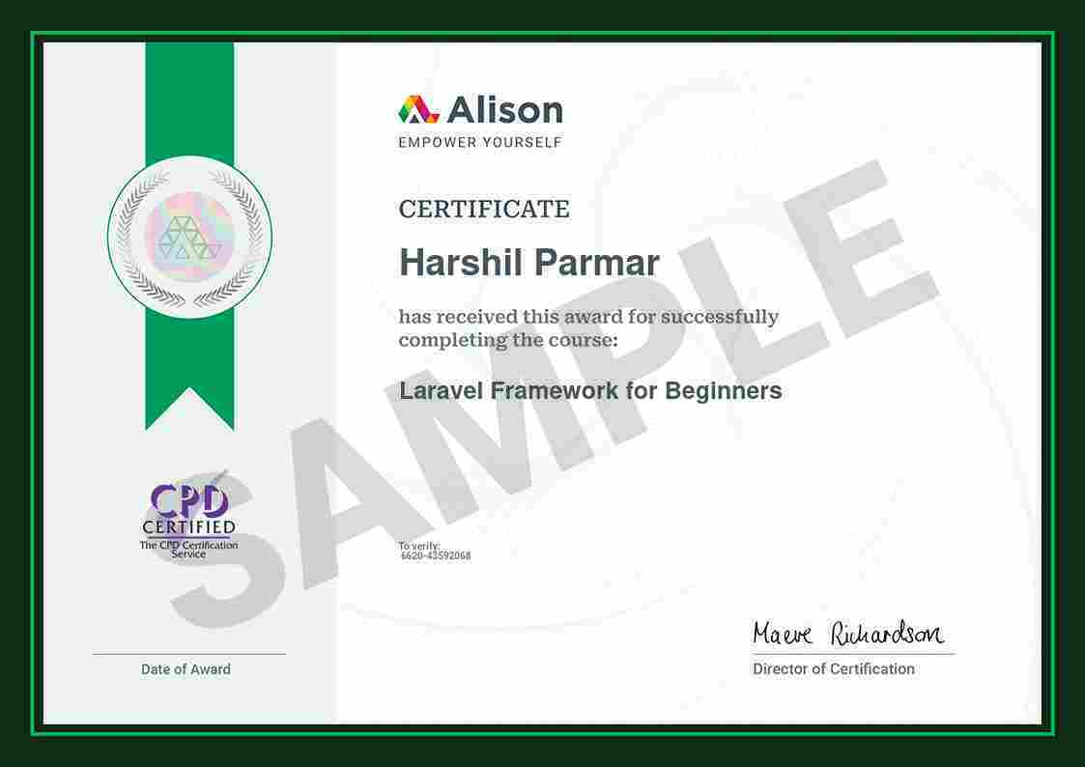

Slide 3
01
Introduction to the Course
content
02
Purpose of Laravel
03
Advantages Over Plain PHP
04
Importance of MVC in Laravel
05
Examples of MVC in Laravel
06
Conclusion

Slide 4
Introduction to the Course
01
/

Slide 5
Course Objectives
Framework Capabilities
This section covers the fundamental capabilities of Laravel, outlining what developers can achieve using the framework.
MVC Concept
Understanding the MVC (Model-View-Controller) architecture is essential for efficient Laravel development.
Web Application Initialization
Learn how to set up and initialize a new web application using Laravel.

Slide 6


Basics of Laravel Framework
1
Framework Basics
A brief introduction to Laravel's core concepts, helping developers grasp its foundational elements.
2
Developing Applications
An overview of the steps involved in creating a basic web application with Laravel.

Slide 7
Purpose of Laravel
02
/

Slide 8
Streamlining Development
Elegant Syntax
Pre-built Components
Laravel focuses on providing an elegant and expressive syntax that simplifies coding processes and reduces complexity.
The framework's pre-built libraries and tools help developers minimize repetitive tasks while fostering innovation.

Slide 9

Developer Empowerment
Ready-made Functionalities
Efficiency in Development
Key features like routing and authentication enable developers to focus more on unique application aspects, enhancing productivity.
Laravel's design fosters a more efficient approach to developing sophisticated web applications.

Slide 10
Advantages Over Plain PHP
03
/

Slide 11
Scalability and Maintainability
MVC Architecture
Clear Code Structure
The MVC architectural pattern promotes code organization, aiding in both scalability and maintainability.
Keeping modules distinct makes applications easier to understand, maintain, and grow over time.

Slide 12
Extensive Ecosystem
1
Laravel Packages
Laravel's ecosystem includes a variety of packages that compute solutions for a myriad of development needs.
2
Developer Community
A vibrant community and abundant resources ensure support and guidance for developers at all levels.

Slide 13
Importance of MVC in Laravel
04
/

Slide 14
Separation of Concerns
Code Organization
Readability and Maintainability
The MVC pattern promotes a distinct separation of concerns, enhancing overall code organization.
This separation improves both the readability of the code and its maintainability over time.

Slide 15
Code Reusability
Individual Component Development
Testing Support
Each part of MVC can be developed independently, reducing duplication and improving efficiency.
Independent testing of Models, Views, and Controllers ensures that each component functions correctly.

Slide 16
Examples of MVC in Laravel
05
/

Slide 17


User Module
An example code snippet demonstrates how the User model is represented in Laravel using Eloquent ORM.

Slide 18

View Representation
Blog User Profile
A sample Blade template illustrates how data is presented in the user profile view.

Slide 19
Controller Representation
User Controller Example
The UserController class example showcases how to handle user data retrieval using MVC.

Slide 20
Conclusion
06
/

Slide 21
Course Recap
Key Takeaways
Next Steps
Summarize the important concepts learned throughout the course, reinforcing the value of using Laravel.
Anticipate future learning paths for participants to continue their development journey in Laravel.

