Slide 1


BOB AI HACKATHON 2026 · TRACK: AI
CampusPilot
AI-Powered Student Success Platform
One Dashboard. One AI. Every Student's Success.
Team MindForge — Harshil Parmar · Aarnav Patel · Krishna Gajara · Hevin Jajadiya

Slide 2






The Problem
Students juggle 6+ disconnected platforms daily — Gmail, Classroom, WhatsApp, Calendar, Notes, and Placement Portals — losing hours to coordination instead of learning.
Missed Deadlines
Assignments slip through the cracks
Poor Attendance Tracking
No real-time visibility
Scattered Materials
Notes and resources everywhere
Information Overload
Hard to prioritize what matters
Students spend more time organizing work than learning — reducing productivity and placement readiness.

Slide 3

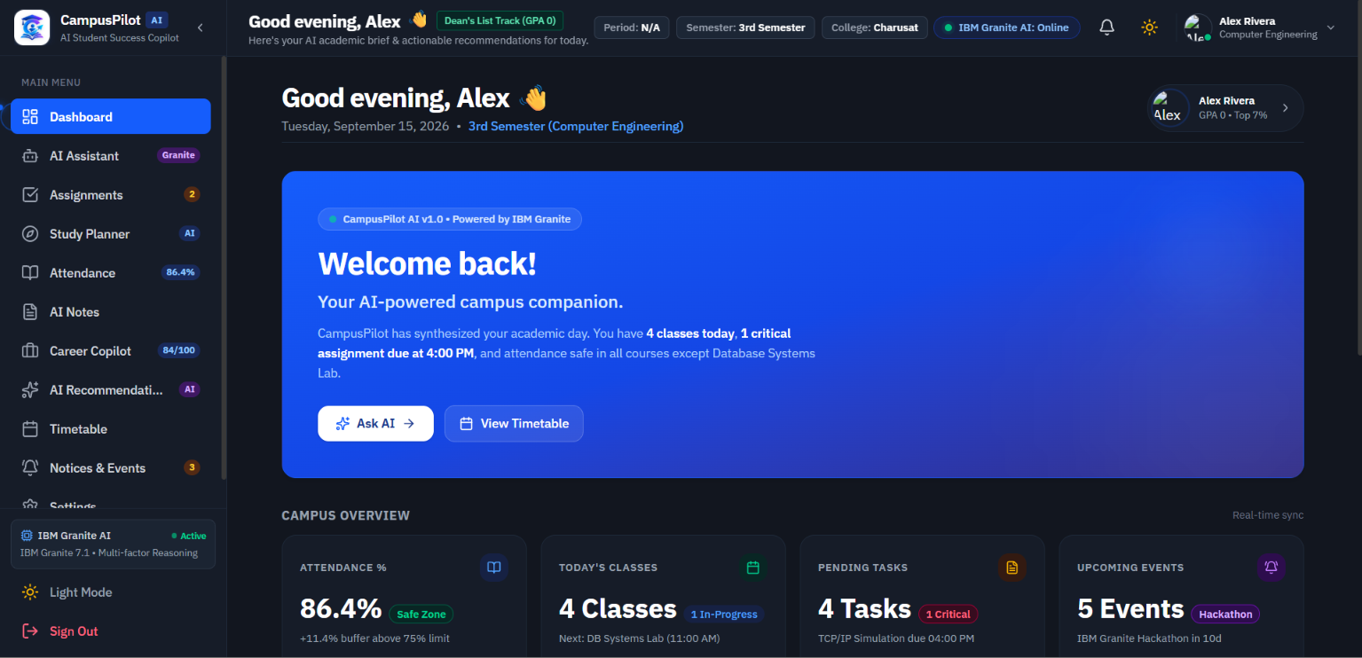







CampusPilot
Your AI Academic & Career Copilot
AI Assistant
Context-aware academic Q&A
Personalized Dashboard
Unified academic overview
Attendance Analytics
Real-time tracking & alerts
Assignment Tracker
AI-prioritized task queue
Smart Timetable
Auto-scheduled study blocks
Smart Notes
AI-summarized lecture notes
Career Copilot
Placement & internship guidance
Smart Notifications
Timely, relevant alerts only
Every recommendation is personalized using authenticated student data — no generic advice.

Slide 4
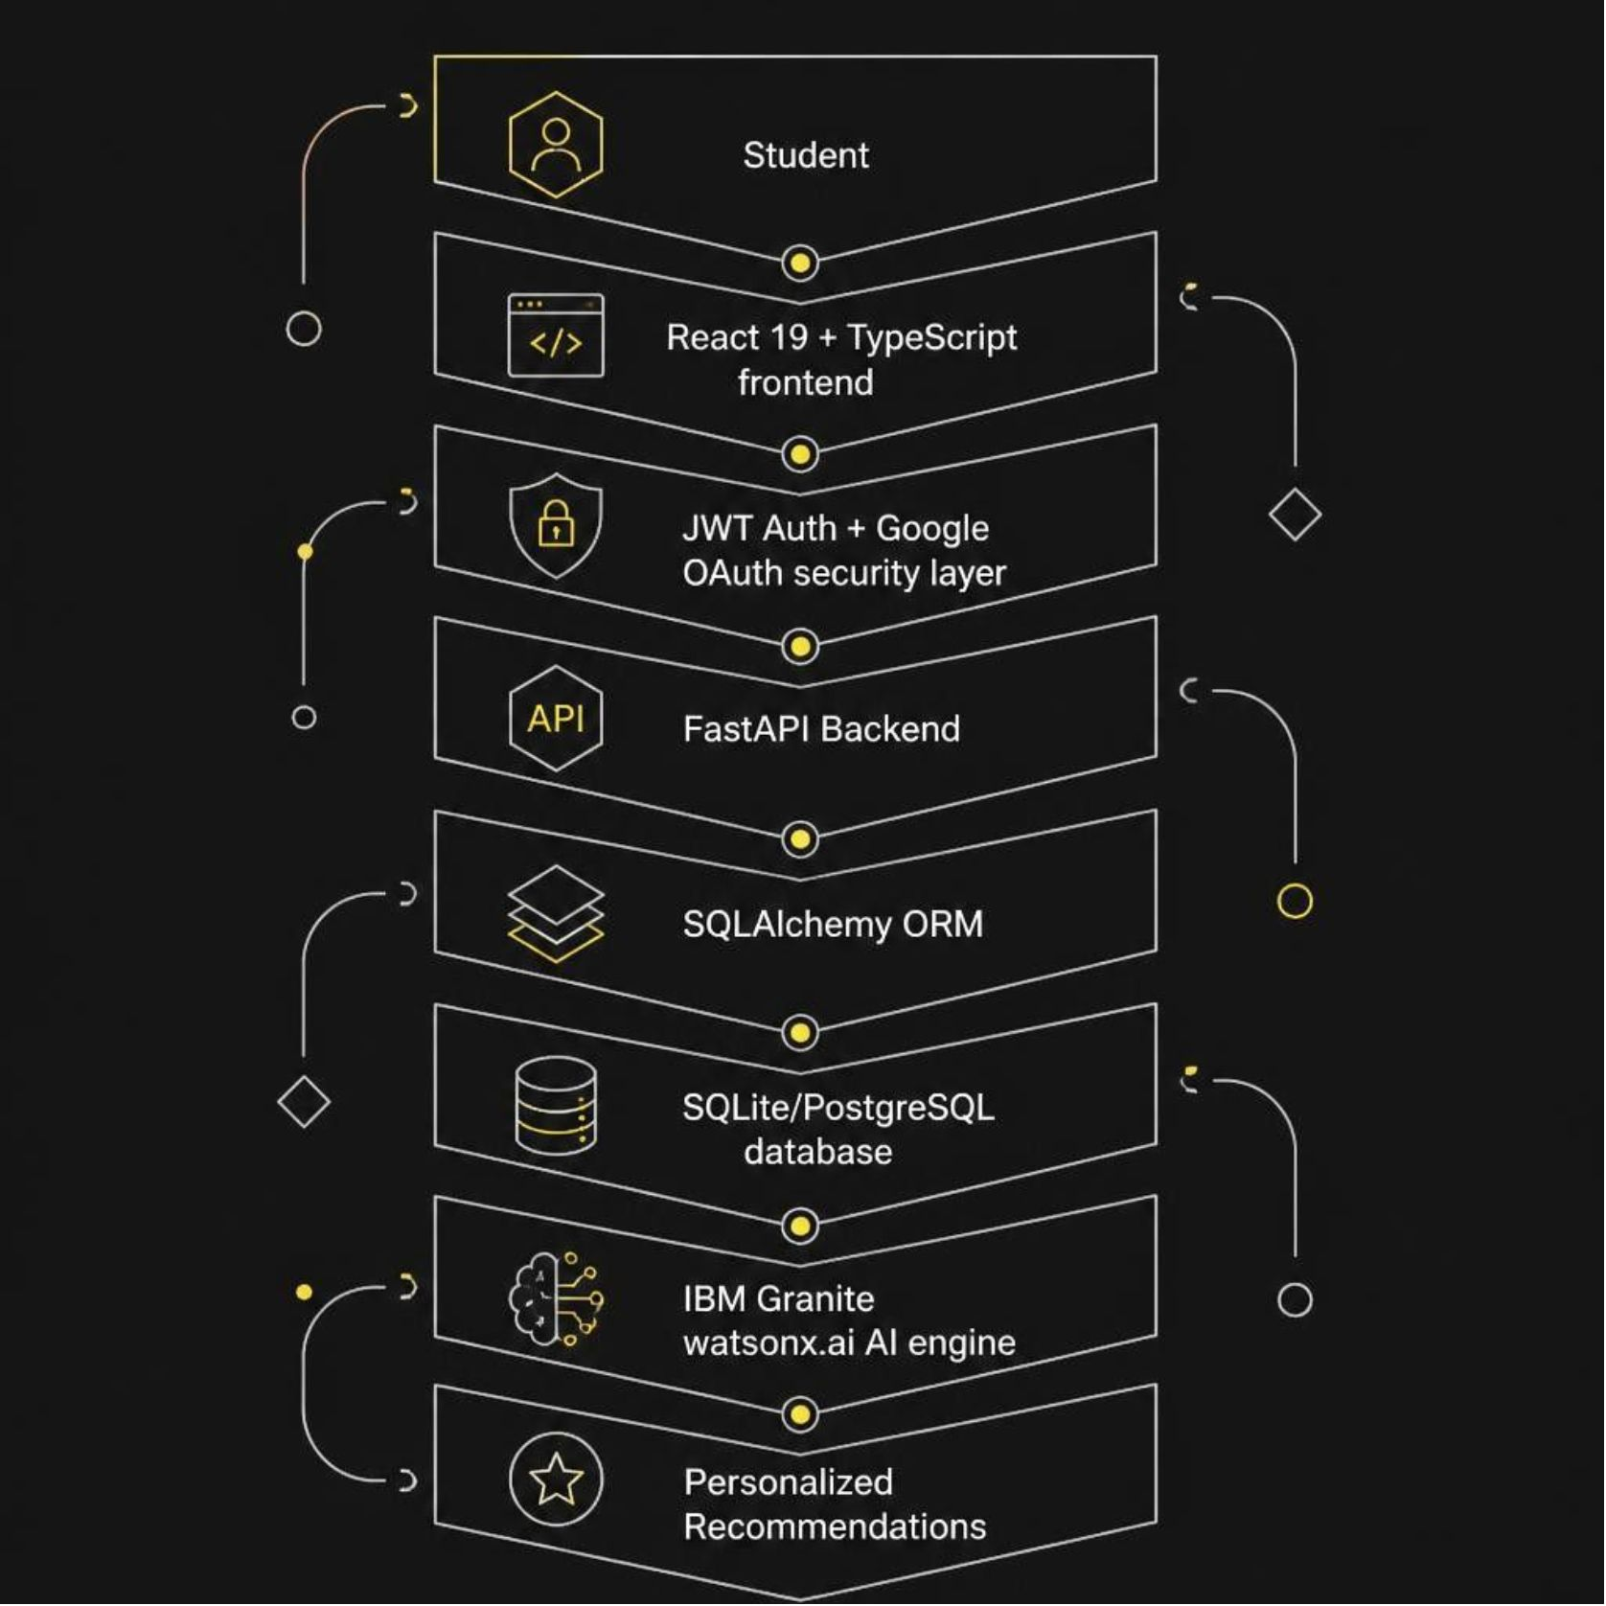


System Architecture
Tech Stack
Frontend
Backend
React 19 · TypeScript · Tailwind CSS · React Query
FastAPI · SQLAlchemy · JWT Auth · Google OAuth
AI Engine
Database
IBM Granite via watsonx.ai — powering all personalized recommendations
SQLite / PostgreSQL with SQLAlchemy ORM

Slide 5

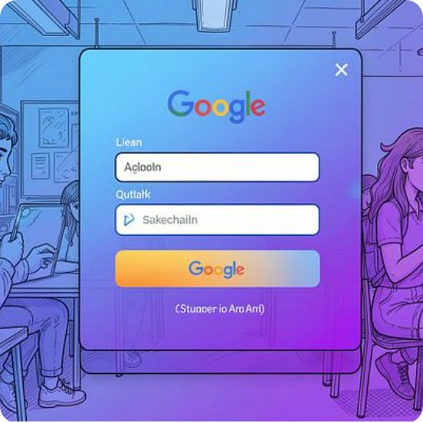
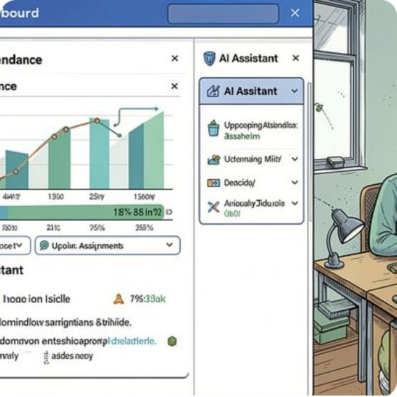
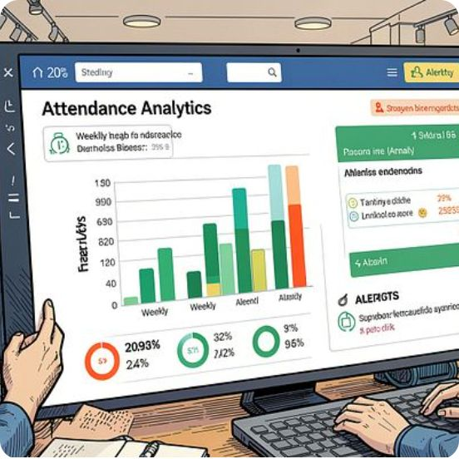
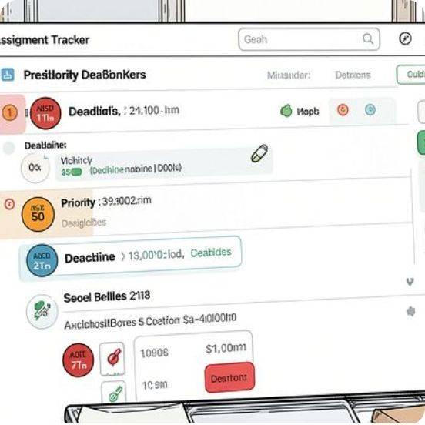
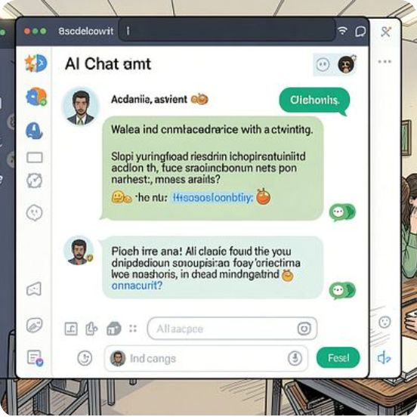
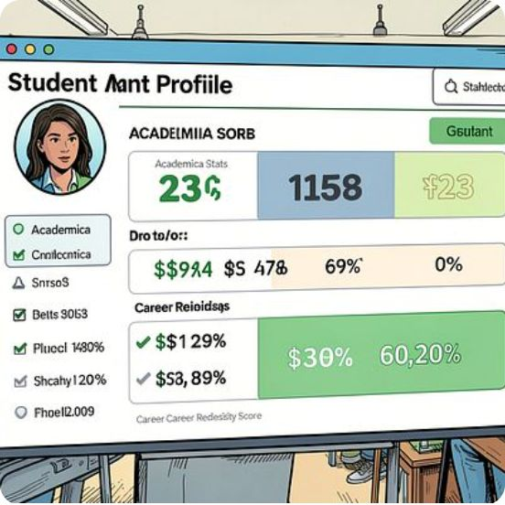
Live Demo
A seamless, secure student journey — from login to AI-powered insights. Every student sees only their own academic data.
Login
Academic Actions
Google OAuth secure access
Attendance, assignments, notes
Dashboard
AI Copilot
Personalized feed overview
Recommendations and career guidance

Slide 6
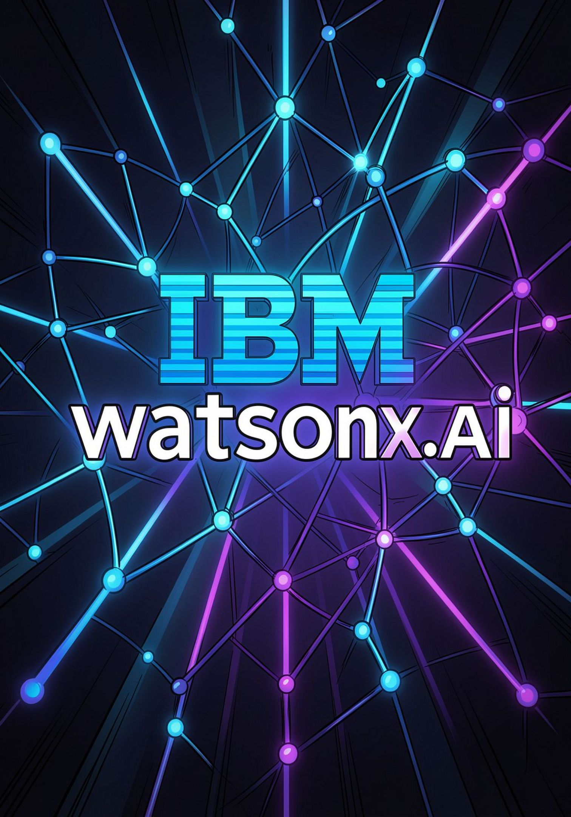





IBM Technologies Used
Powered by IBM Granite on watsonx.ai
Study Planning
Personalized revision schedules
Academic Q&A
Context-aware concept explanations
Assignment Prioritization
Smart task ranking by urgency
Career Guidance
Placement & internship recommendations
Unlike generic chatbots, CampusPilot combines IBM Granite with authenticated student data to deliver context-aware, personalized academic assistance.

Slide 7
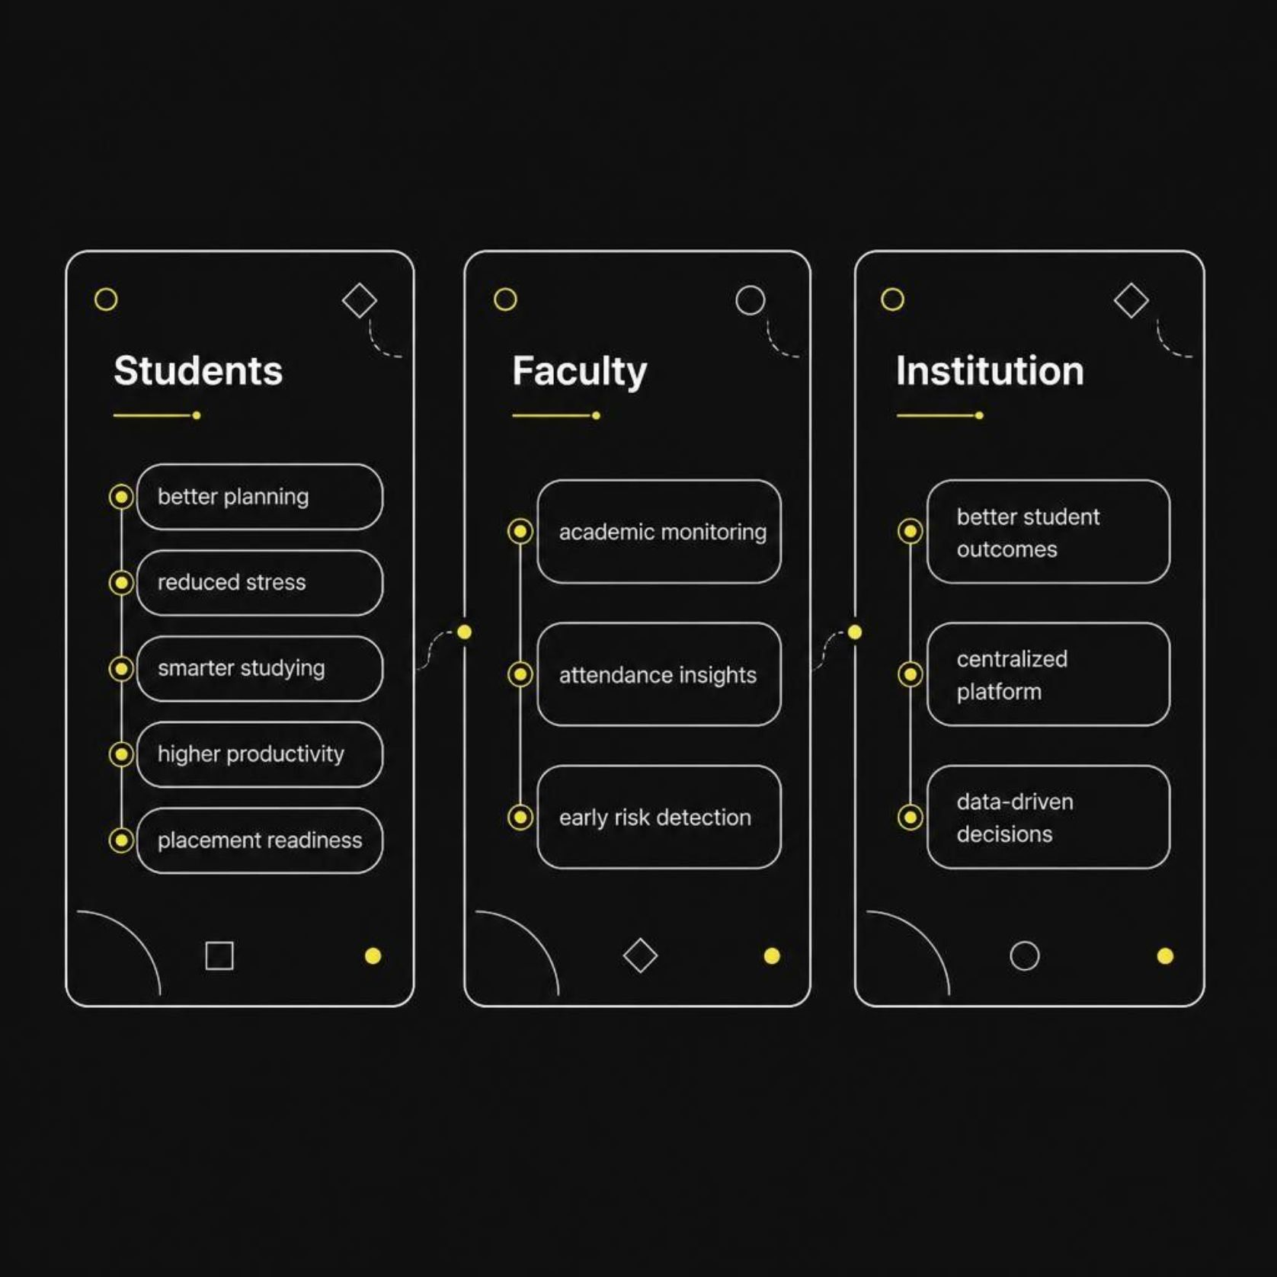




Impact & Future Scope
Who Benefits
CampusPilot creates a virtuous cycle — students study smarter, faculty intervene earlier, institutions make better decisions.
What's Next
Google Classroom & Gmail Integration
ERP Integration
Mobile App
Faculty & Parent Dashboards

Slide 8
Team MindForge
Harshil Parmar
Aarnav Patel
Krishna Gajara
Hevin Jajadiya
Team Lead
Backend · AI Integration · Project Leadership
Backend Engineer
APIs · Database · System Design
Frontend Lead
UI/UX · Dashboard Development · React
QA & DevOps
Testing · Documentation · Deployment
Thank You
Questions? We'd love to walk you through the live demo.
CAMPUSPILOT
BOB AI HACKATHON 2026

